Slide 1

Introduction to 3D Imaging:
Perceiving 3D from 2D Images
How can we derive 3D information from one or more
2D images?
There have been 2 approaches:
1. intrinsic images: a 2D representation that stores some
3D properties of the scene
2. 3D shape from X: methods of inferring 3D depth
information from various sources

Slide 2
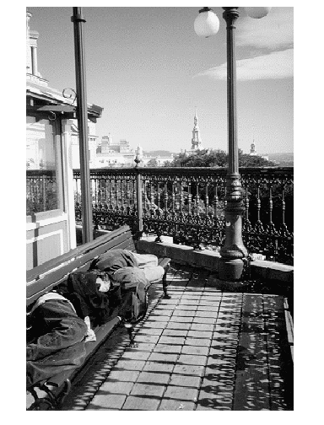
What can you determine about
1. the sizes of objects
2. the distances of objects from the camera?
What knowledge
do you use to
analyze this image?

Slide 3
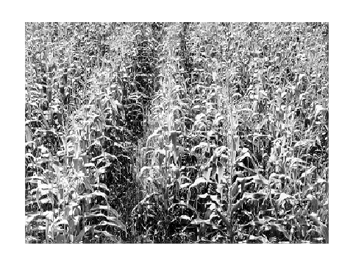
What objects are shown in this image?
How can you estimate distance from the camera?
What feature changes with distance?

Slide 4
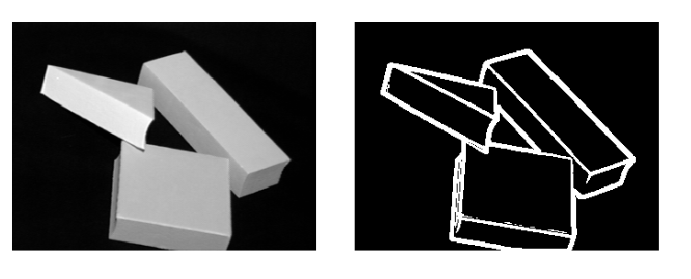
Intrinsic Images: 2.5 D
The idea of intrinsic images is to label features of a
2D image with information that tells us something
about the 3D structure of the scene.
occluding
edge
convex
edge

Slide 5
Contour Labels for Intrinsic Images
convex crease (+)
concave crease (-)
blade (>)
limb (>>)
shadow (S)
illumination boundary (I)
reflectance boundary (M)
+
M
+
+
S
I

Slide 6
Labeling Simple Line Drawings
Huffman and Clowes showed that blocks world drawings
could be labeled (with +, -, >) based on real world constraints.
Labeling a simple blocks world image is a
consistent labeling problem!
Waltz extended the work to cracks and shadows and
developed one of the first discrete relaxation algorithms,
known as Waltz filtering.

Slide 7
Problems with this Approach
Research on how to do these labelings was confined
to perfect blocks world images
There was no way to extend it to real images with
missing segments, broken segments, nonconnected
junctions, etc.
It led some groups down the wrong path for a while.

Slide 8
3D Shape from X
shading
silhouette
texture
stereo
light striping
motion
mainly research
used in practice

Slide 9
Perspective Imaging Model: 1D
real image
point
This is the axis of the
real image plane.
E
xi
f
camera lens
O is the center of projection.
O
image of point
B in front image
D
This is the axis of the front
image plane, which we use.
zc
xf
xi xc
f zc
=
xc
B
3D object
point

Slide 10
Perspective in 2D
(Simplified)
Yc
camera
P´=(xi,yi,f)
Xc
3D object point
yi
P=(xc,yc,zc)
=(xw,yw,zw)
ray
f
F
xi
yc
optical
axis
zw=zc
xi xc
f zc
=
xi = (f/zc)xc
yi = (f/zc)yc
Zc
xc
Here camera coordinates
equal world coordinates.
yi yc
f zc
=

Slide 11
3D from Stereo
3D point
left image
right image
disparity: the difference in image location of the same 3D
point when projected under perspective to two different cameras.
d = xleft - xright

Slide 12
Depth Perception from Stereo
Simple Model: Parallel Optic Axes
image plane
z
Z
camera
L
f
xl
baseline
b
f
camera
R
xr
x-b
X
P=(x,z)
z x
f xl
z x-b
f xr
z y y
f yl yr
y-axis is
perpendicular
to the page.
=
=
=
=

Slide 13
Resultant Depth Calculation
For stereo cameras with parallel optical axes, focal length f,
baseline b, corresponding image points (xl,yl) and (xr,yr)
with disparity d:
z = f*b / (xl - xr) = f*b/d
x = xl*z/f or b + xr*z/f
y = yl*z/f or yr*z/f
This method of
determining depth
from disparity is
called triangulation.

Slide 14
Finding Correspondences
If the correspondence is correct,
triangulation works VERY well.
But correspondence finding is not perfectly solved.
for the general stereo problem.
For some very specific applications, it can be solved
for those specific kind of images, e.g. windshield of
a car.
°
°

Slide 15
3 Main Matching Methods
1. Cross correlation using small windows.
2. Symbolic feature matching, usually using segments/corners.
3. Use the newer interest operators, ie. SIFT.
dense
sparse
sparse

Slide 16
Epipolar Geometry Constraint:
1. Normal Pair of Images
The epipolar plane cuts through the image plane(s)
forming 2 epipolar lines.
P
y1
z1
z2
y2
epipolar
plane
P1
x
P2
C1
b
C2
The match for P1 (or P2) in the other image,
must lie on the same epipolar line.

Slide 17
Epipolar Geometry:
General Case
P
y1
y2
P2
x2
P1
e2
e1
x1
C1
C2

Slide 18
Constraints
1. Epipolar Constraint:
Matching points lie on
corresponding epipolar
lines.
2. Ordering Constraint:
Usually in the same
order across the lines.
P
Q
e2
e1
C1
C2

Slide 19
Structured Light
light stripe
3D data can also be derived using
a single camera
a light source that can produce
stripe(s) on the 3D object
light
source
camera

Slide 20
Structured Light
3D Computation
3D data can also be derived using
a single camera
a light source that can produce
stripe(s) on the 3D object
3D point
(x, y, z)
θ
(0,0,0)
light
source
b
x axis
f
b
[x y z] = --------------- [x´ y´ f]
f cot θ - x´
(x´,y´,f)
3D
image

Slide 21
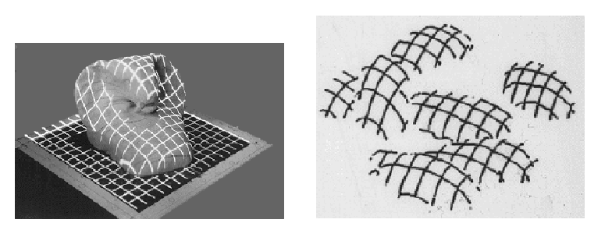
Depth from Multiple Light Stripes
What are these objects?

Slide 22
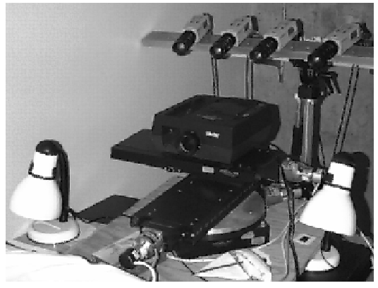
Our (former) System
4-camera light-striping stereo
cameras
projector
rotation
table
3D
object

