Slide 1


NATIONAL RESEARCH UNIVERSITY HIGHER SCHOOL OF ECONOMICS
FEDERAL GRANTS TO REGIONS AS A POLITICAL TOOL IN RUSSIA
Research Proposal
PRESENTED BY
Ekaterina Petrova
ACADEMIC SUPERVISOR:
LANGUAGE SUPERVISOR:
Dmitry Y. Rudenko
Svetlana N. Kucherenko

Slide 2


3 | Background of the Study
4 | Thesis Statement
5 | Literature Review
6 | Methods and Data
7 | Anticipated Results
8 | Summary
10 | References
OUTLINE

Slide 3
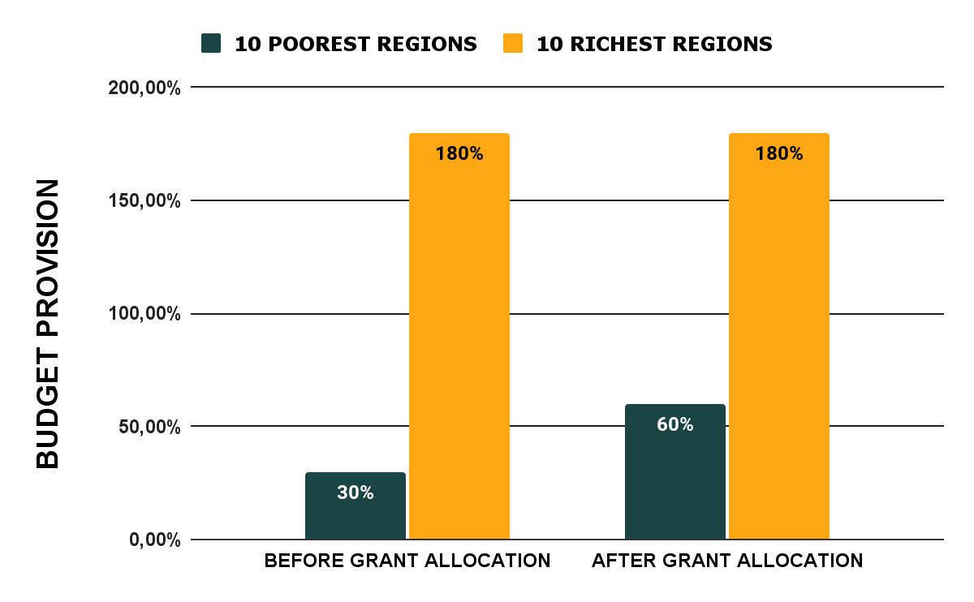
The Difference in Budget Provision of the Most and the Least Provided Regions
Before and After Grant Allocation in 2017
Source: https://budget.gov.ru/%D0%A0%D0%B5%D0%B3%D0%B8%D0%BE%D0%BD%D1%8B/%D0%91%D1%8E%D0%B4%D0%B6%D0%B5%D1%82%D0%BD%D0%B0%D1%8F-%D0%BE%D0%B1%D0%B5%D1%81%D0%BF%D0%B5%D1%87%D0%B5%D0%BD%D0%BD%D0%BE%D1%81%D1%82%D1%8C-%D1%81%D1%83%D0%B1%D1%8A%D0%B5%D0%BA%D1%82%D0%BE%D0%B2-%D0%A0%D0%A4
03

Slide 4
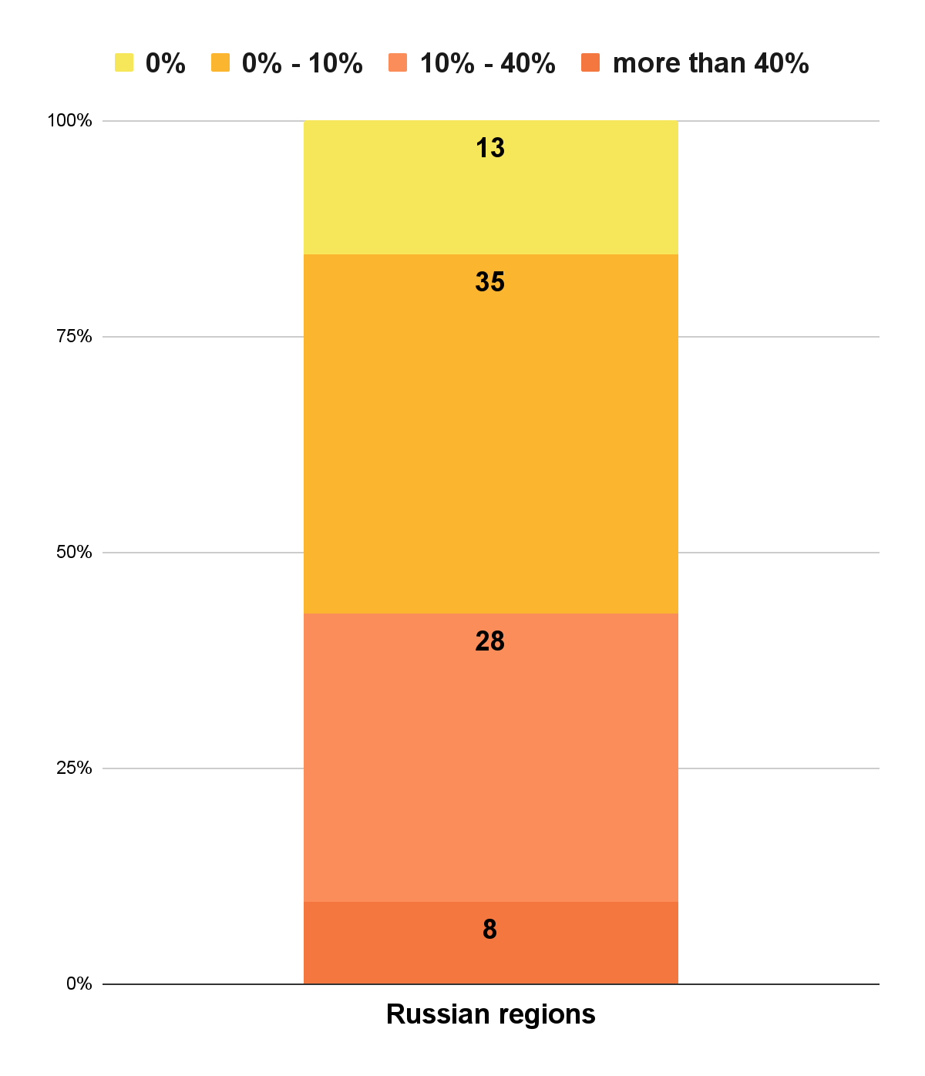
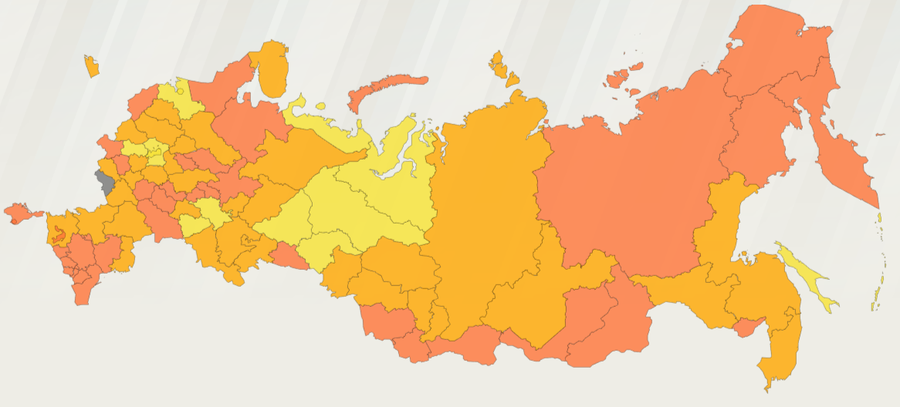
Number of regions with the different shares of a grant in the budget in 2017
The shares of grants in the budgets of the regions on the map
The source: https://budget.gov.ru/%D0%A0%D0%B5%D0%B3%D0%B8%D0%BE%D0%BD%D1%8B/%D0%A3%D1%80%D0%BE%D0%B2%D0%B5%D0%BD%D1%8C-%D0%B4%D0%BE%D1%82%D0%B0%D1%86%D0%B8%D0%BE%D0%BD%D0%BD%D0%BE%D1%81%D1%82%D0%B8-%D1%81%D1%83%D0%B1%D1%8A%D0%B5%D0%BA%D1%82%D0%BE%D0%B2-%D0%A0%D0%A4?regionId=45000000
04

Slide 5
BACKGROUND OF THE STUDY
RUSSIAN GRANT SYSTEM
CHARACTERISTICS:
Only 15% self-sufficient regions
High difference between poor and rich regions
Inefficient tax allocation system
Unproductive incentives
Studies proving political motivation of grants
05

Slide 6
THESIS STATEMENT
Research Question | Do votes for particular parties of subjects in Russia determine federal grants received by them?
Scope of the study | Russian regions in the years 2003-2019
Relevance of the study | a deeper understanding of the true grounds of grant allocation improving the system of a regional budget structuring
06

Slide 7
Grants in Russia
Theoretical Part
Russian Voting
LITERATURE REVIEW
Empirical Part
The Studies of the USA
The Study of Argentina

Slide 8

THEORETICAL PART
Grants in Russia | Russian Voting
The most subsidized subjects are national republics (Ref. 1, 6, 14) Russian violation of the federal principles, long-term budgetary imbalance and dependence of regions (Ref. 7, 10, 13) Geopolitical regional policy in Russian investment decision-making (Ref. 14) Inefficiency of criteria for assessment of a regional needs and the grant amounts (Ref. 8) | Consistently high turnout and the electoral support of national republics for federal incumbents (Ref. 9) Ruralness and dense social networks in ethnic villages for electoral mobilization (Ref. 12)
08

Slide 9
The critique of the existing grant allocation and taxation systems
High dependence of certain regions on a state subsidies
Grants in Russia
CONCLUSIONS
High level of the political resources and partisan loyalty of that regions
Russian Voting

Slide 10
Author, year | Variables | Period
Holcombe, R. G. and Zardkoohi, A. (1981) | senator serving time congressman share membership in the senate | 1 year
Porto and Sanguinetti (2001) | number of deputies membership in the senate | 4 decades
Grossman, P. J. (1994) | state bureaucracy political capital party size union membership | 4 years
Hankins, W. B., Goetzke, F., and Hoover, G. (2019) | Republican share Majority in House/Senate urbanization | 15 years
Christenson, D. P., Kriner, D. L., and Reeves, A. (2017) | Copartisan senators House delegation copartisans Appropriations committee Budget committee | 25 years
EMPIRICAL PART
Control variables used:
poverty level
income pc
rural population
population number
Models used:
linear regression
log-linear regression
10

Slide 11
METHODS AND DATA
METHODS:
log-linear regression,
regional and period fixed effects
DATA:
panel for 4 and 5 periods of the years 2003-2019
for 89 regions
SOURCES:
Federal Treasury,
The CEC of Russia,
Federal State Statistics Service
11

Slide 12
MODEL
AVG_GRANT_it = b0 + b1*PARTY_it + b2*SENATOR_it + b3*RURAL_it + b4*POVERTY_it + b5*INCOME_it
AVG_GRANT_it = b0 + b1*PRESIDENT_it + b2*SENATOR_it + b3*RURAL _it + b4*POVERTY_it + b5*INCOME _it
i - region
t - period
AVG_GRANT | average grants given p.c in 1 period | NUM
PARTY | voting for the main party in The Russian State Duma | NUM
PRESIDENT | voting for the President from the main party | NUM
SENATOR | state’s senator was chosen by the President | 0/1
RURAL | rural population | %
POVERTY | poverty level | %
INCOME | income p.c. | %
12

Slide 13
ANTICIPATED RESULTS
MORE VOTES
MORE GRANTS
Political capital of a region determines its grants received
13

Slide 14
SUMMARY
Grant system with no sustainable economic growth and state dependence of regions
High level of a political capital in subsidized regions
Log-linear regression model on a panel data
Anticipate a positive causal correlation between grant amounts and election results
14

Slide 15
REFERENCES
Aksentiev, A. (2020). Subsidies and their role in modern conditions of economic development. Journal of Economics, Entrepreneurship Law, 10(7):1955 – 1973.
Christenson, D. P., Kriner, D. L., and Reeves, A. (2017). All the president’s senators: Presidential copartisans and the allocation of federal grants. Legislative Studies Quarterly, 42(2):269 – 294.
Grossman, P. J. (1994). A political theory of intergovernmental grants. Public Choice, 78(3):295–303.
Hankins, W. B., Goetzke, F., and Hoover, G. (2019). Partisan Determinants of Federal Highway Grants. Review of Regional Studies, 49(3):389–406. Publisher: Southern Regional Science Association Inc.
Holcombe, R. G. and Zardkoohi, A. (1981). The Determinants of Federal Grants. Southern Economic Journal, 48(2):393–399. Publisher: Southern Economic Association.
Khanova, L. and Khozyainov, D. P. (2020). Improving approaches to equalisation transfer of the russian federation’s subjects. Journal of Economics, Entrepreneurship Law, 23(10 (6)):1823–1844.
Kolodina, Y. A. (2019). The research of regional leveling policies effectiveness in the russian federation. Regional economy and management: electronic scientific journal, (4(60) Art. 6618.).

Slide 16
Mamedov, A., Nazarov, V., and Siluanov, A. (2012). Issues of Interbudgetary Relations in Russia. Research Paper Series, (159P):188–188.
Panov, P. (2019). Ethnic groups’ spatial localization as a voting factor in national republics of the Russian Federation. Perm Federal Research Centre Journal, (2):53–62.
Pinskaya, M. (2009). Implementation of the principle of federalism in the tax system of russia. Finance and Credit, 4(34 (370)):29–32.
Porto, A. and Sanguinetti, P. (2001). Political Determinants of Intergovernmental Grants: Evidence From Argentina. Economics & Politics, 13(3):237. Publisher:Wiley-Blackwell
Shkel, S., Scherbak, A., and Tkacheva, T. (2022). The anatomy of loyalty: Mechanisms for the formation of an electoral super-majority in the ethnic republics of contemporary russia. The Russian Sociological Review, 21(1):38–70.
Suleymanov, M. (2013). Problems and prospects for the formation of an effective model of tax federalism in russia. Finance and Credit, 7(25 (553)):65–71.
Zubarevich, N. V. (2017). Development of the russian space: Barriers and opportunities for regional policy. The world of new economy, 12(2):46–57.
REFERENCES

