Slide 1
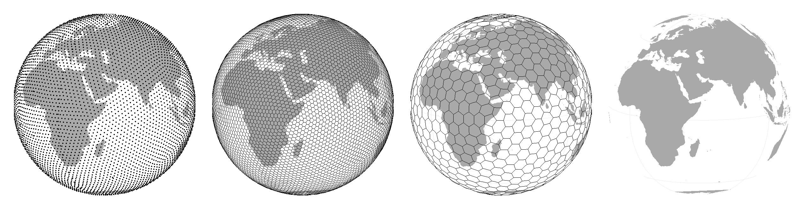
Practical class: Simulating placement of species ranges
Petr Keil

Slide 2
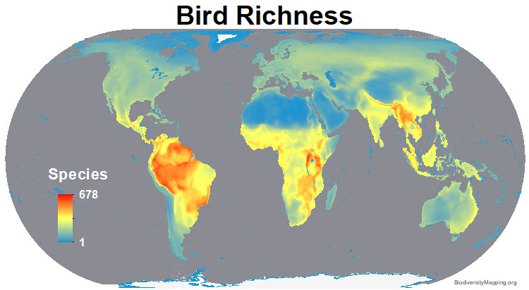
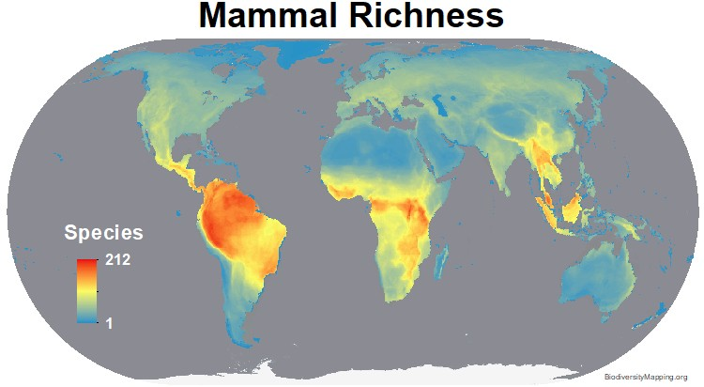
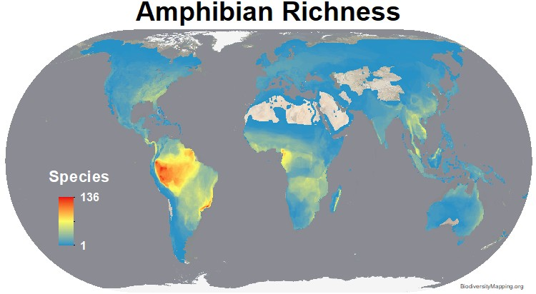
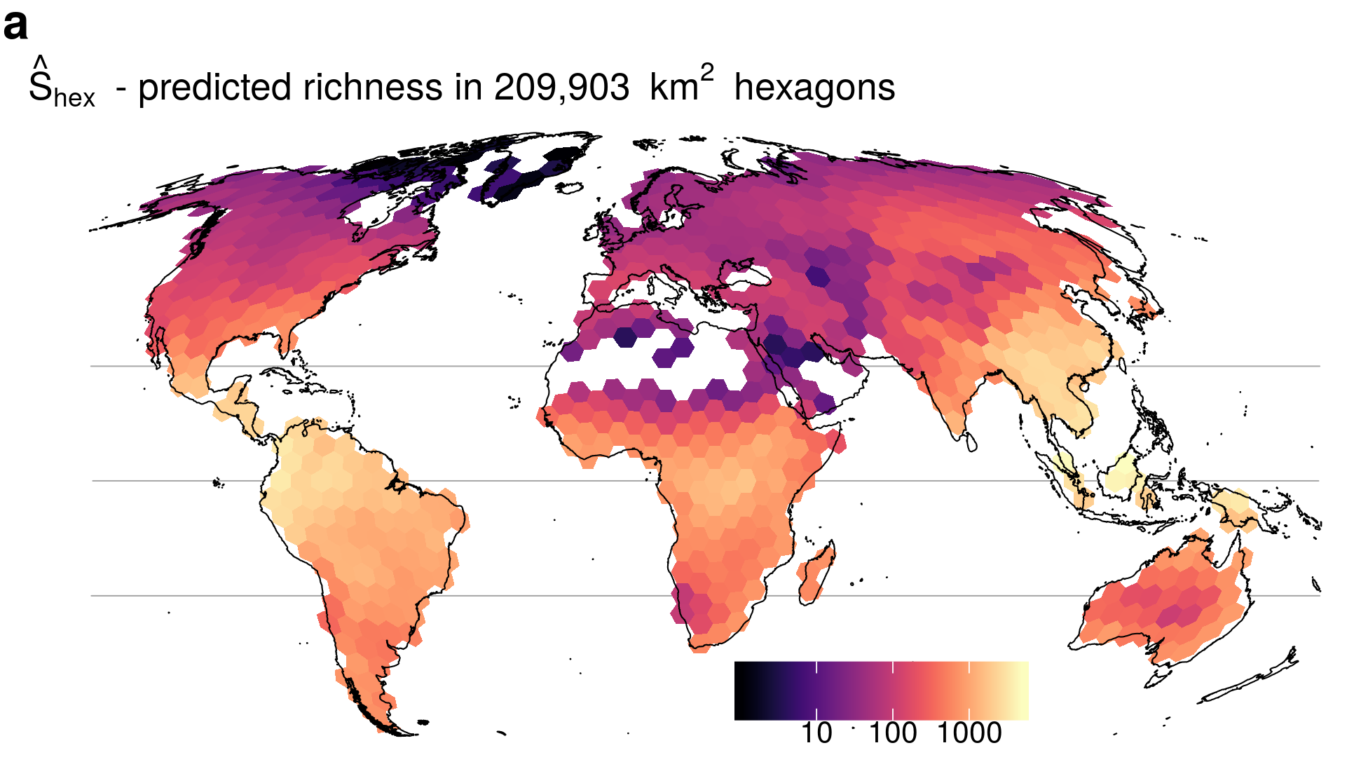
Why do we see latitudinal gradient of species richness?
Tree Richness
BiodiversityMapping.org; Keil & Chase (2019) Nature Communications

Slide 3
Latitudinal gradient
Birds across the New World (grid cells of ~ 611,000 km²)
Storch & Gaston (2004) Basic and Applied Ecology

Slide 4
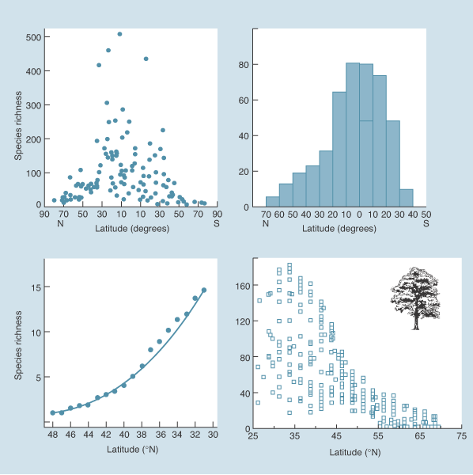
Latitudinal gradient
marine bivalves
butterflies
US lizards
trees
Begon et al. (2004) Ecology (the textbook)

Slide 5
Maybe these patterns will emerge by random placement of geographic ranges
2D Domain
Are we going to see more species in the middle, or around the edges?
Colwell & Lees (2000) Trends in Ecology & Evolution

Slide 6
Maybe these patterns will emerge by random placement of geographic ranges
Are we going to see more species in the middle, or around the edges?
1D Domain
Colwell & Lees (2000) Trends in Ecology & Evolution

Slide 7
Goals of today’s practical class
Implement a simple random range placement model and see if it produces realistic patterns of species richness, e.g. the latitudinal gradient of diversity
Demonstrate the idea of a null model in spatial ecology
Continue practicing simple algorithmic thinking (loops, indices, algorithms)

Slide 8
1D
2D
domain.size
lower.col
upper.col
1
1
1
lower
upper
lower.row
upper.row
domain.size
domain.size

Slide 9
The mid domain effect in two dimensions – the spreading dye model
The best model combines the geometric mid-domain effect with climatic effects, specifically actual evapotranspiration (AET).
Storch et al. (2006) Ecology Letters

