Slide 1
Occupancy, Range size, Prevalence, P

Slide 2
Range size, Occupancy, Prevalence, P
P = 3/64 = 0.05
P = 3/64 = 0.05
1
Occupancy
P = 2/16 = 0.13
P = 3/16 = 0.19
0
1
4
16
Cell area (Grain)
P = 1/4 = 0.25
P = 3/4 = 0.75
Occupancy-area relationship (He & Condit 2007)
Scale-area relationship (Kunin 1998)
Range-area relationship (Harte et al. 2005)
Area-area curve (IUCN 2011)
Scaling pattern of occupancy (Hui et al. 209)

Slide 3
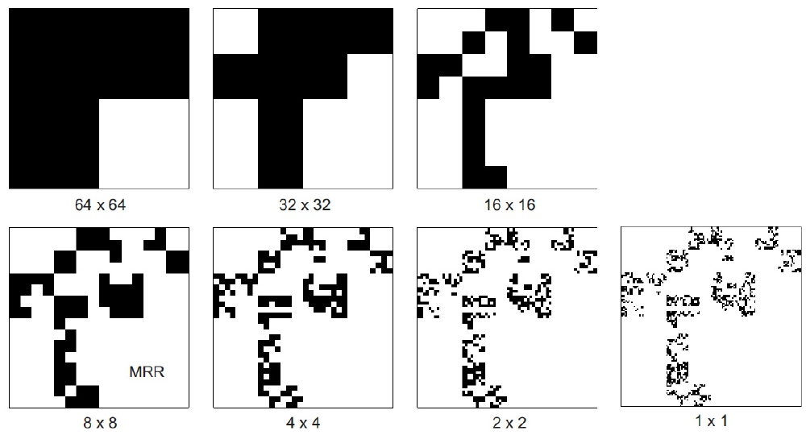
Log Occupancy [km²]
Log Cell area [km²]

Slide 4
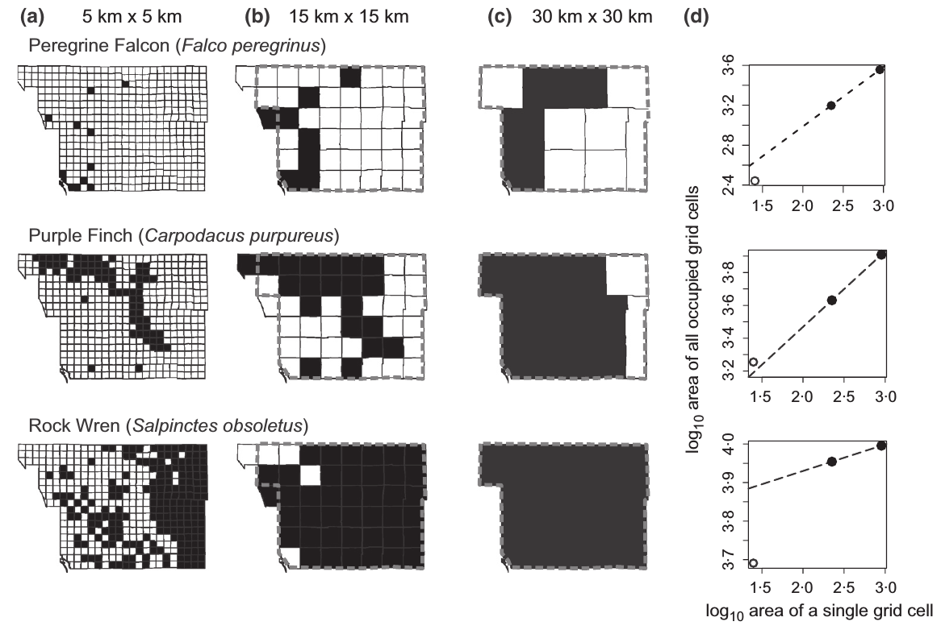
Downscaling species occupancy
Keil et al. 2014 Methods in Ecology & Evolution

Slide 5
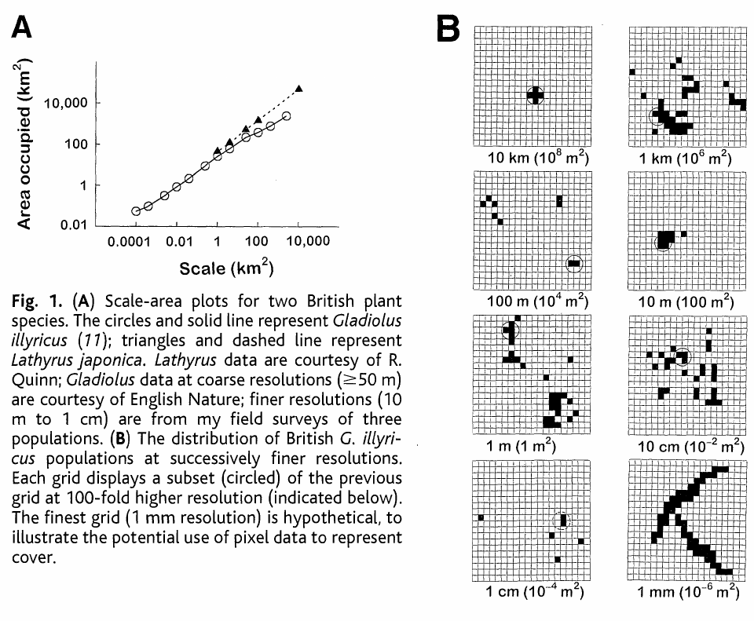
Empirical scaling of species occupancy
Kunin 1998 Science

Slide 6
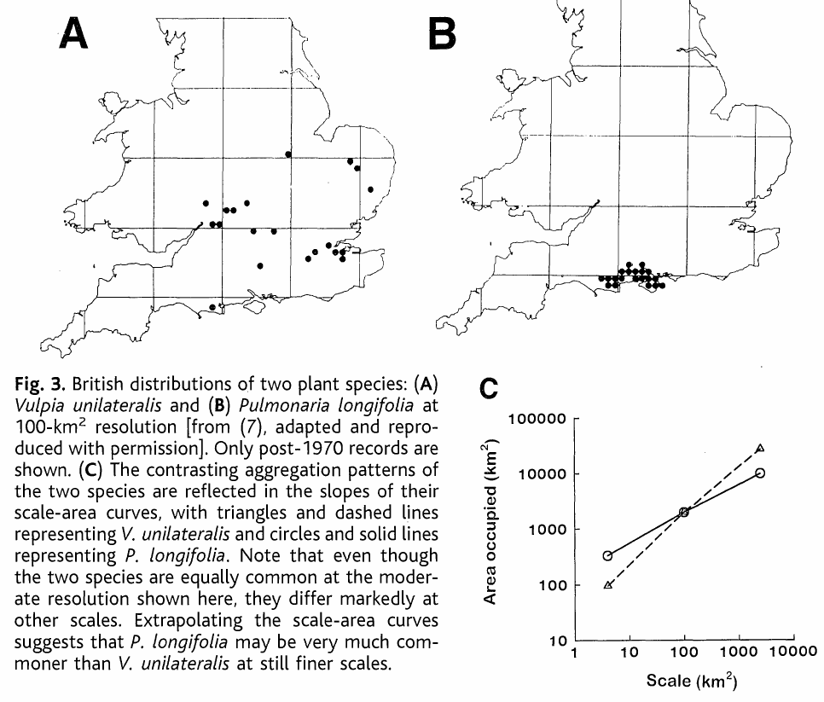
Empirical scaling of species occupancy
Kunin 1998 Science

Slide 7
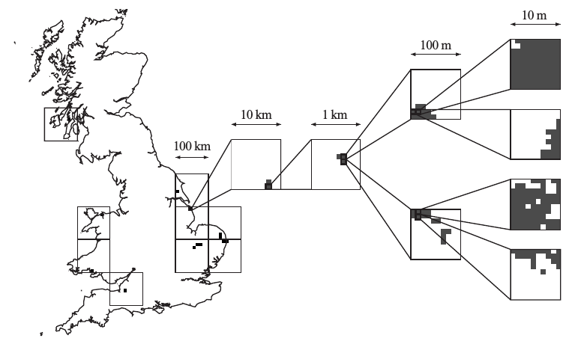
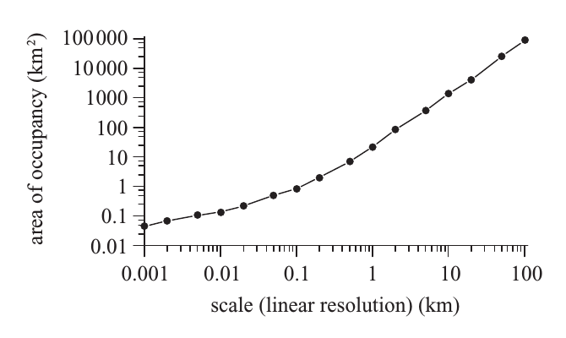
Empirical scaling of species occupancy
Hartley et al. 2004 Proc R Soc B

Slide 8
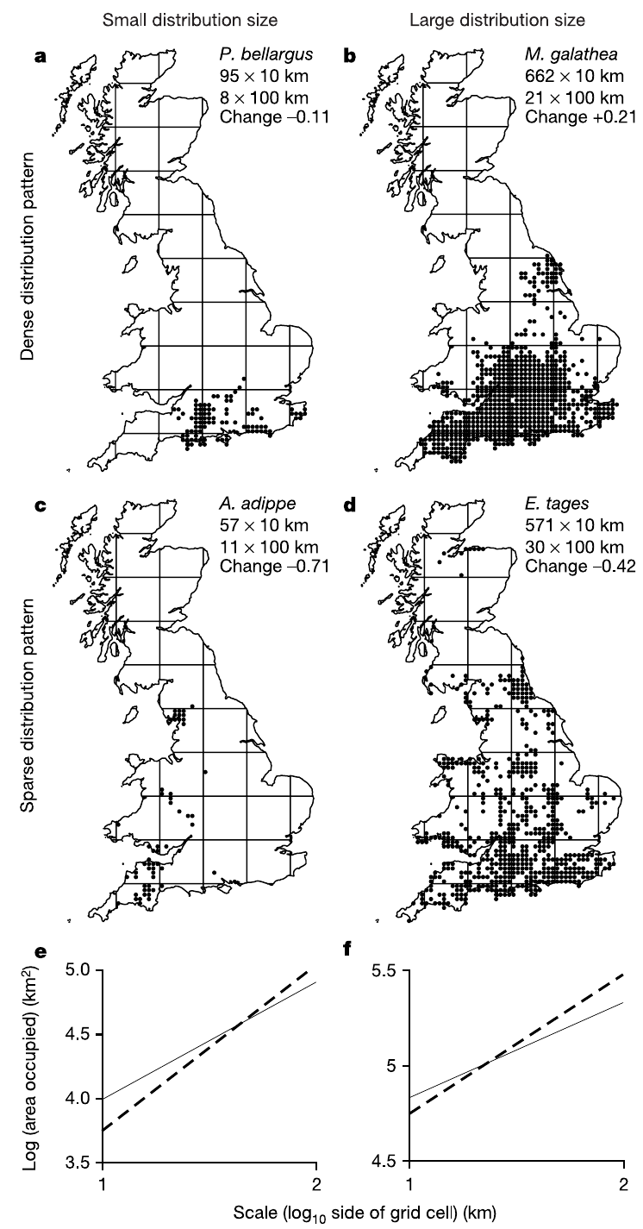
Inferring biodiversity change from static scaling
Wilson et al. 2004 Nature

