Slide 1





PPA – point pattern analysis
Introduction
Michael Kempf - University of Basel, Dep. Env. Sciences
Contact: michael.kempf@unibas.ch
Atrium summerschool - Brno, CZ
September 2024

Slide 2
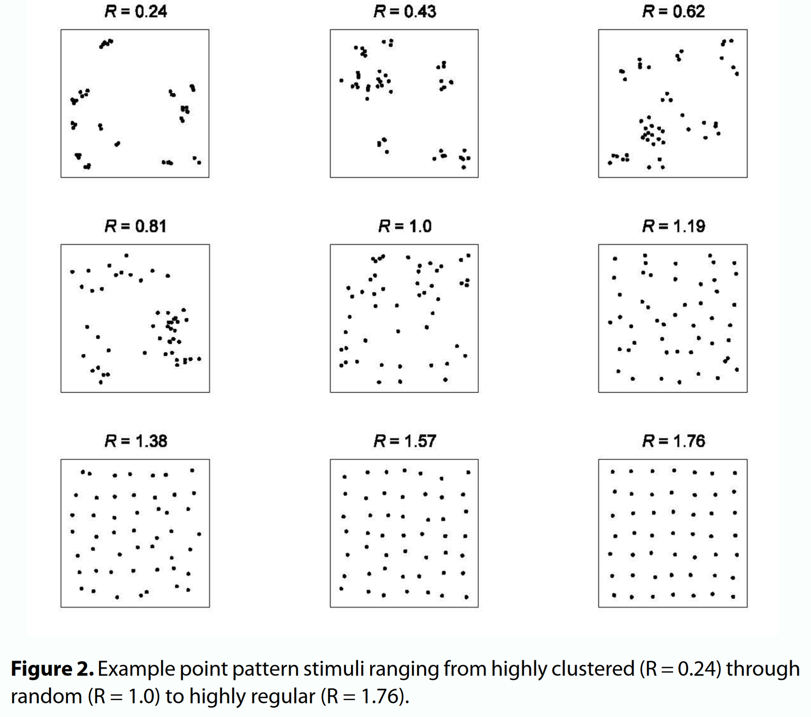
What is PPA?
<- Clustered pattern
PPA examines relationships within point distributions and between point distributions and meaningful secondary response variables
PPA seeks at recognizing patterns and making them comprehensible
<- Random pattern
<- Regular pattern
Dry, Preiss & Wagemans (2012), DOI: 10.7771/1932-6246.1117

Slide 3

PPA is building on models
Models consist of characteristics that are relevant to describe other characteristics
To construct a model, individual characteristics are selected that are either empirically (inductive) or theoretically based (deductive)
Antoine Saint Exupéry after Magritte

Slide 4
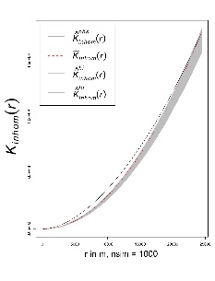
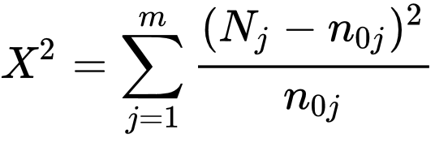

In PPA
Inductive Model -- Deductive Model -- Comparison data
Distribution tests
Chi-squared
CSR
K-Function
Distribution test
KS-Test
Distribution test
VDA-Statistics
$$D_{n,m}= \begin{matrix}sup \\ x\end{matrix} \left| F_{1,n}\left(x\right)− F_{2,m}\left(x\right) \right|$$
$$Â_{12}= ({R_{1}}/ m −{\left(m+1\right)}/ 2) / n$$
A null hypothesis is assumed, which must be tested and, if necessary refuted if necessary
Checks whether 2 samples are drawn from the same distribution
Tests preferences of the samples compared to a covariate
Tests a distribution for
Complete Spatial Randomness

Slide 5
Ripley’s K
Ripley’s K is a method to determine whether a point pattern deviates
from complete spatial randomness (CSR) at a given distance
CSR assumes equal probability of location for all points
CSR assumes that an event in one location does not affect events in other locations
Nearest neighbor does not take into account interaction and complexity of the point pattern!
Here, we focus on interaction using the K-Function

Slide 6
PPA explores CSR
“A first order property of a pattern concerns itself with the variation of the observations’ density across a study area. For example, the distribution of oaks will vary across a landscape based on underlying soil characteristics (resulting in areas having dense clusters of oaks and other areas not).” (https://mgimond.github.io/Spatial/chp11_0.html)
This means that we investigate differences in the density ratio of point distributions in the area
In other words: how does the intensity of our point distribution changes in space (and time)
We refer to this as SECOND ORDER INTENSITY or PROPERTY
Whereas FIRST ORDER PROPERTY includes covariates (e.g., topography)

Slide 7
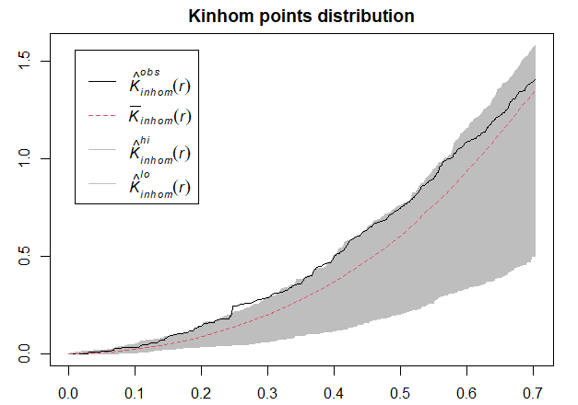
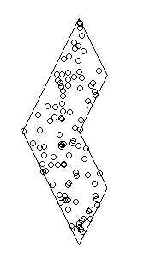
Observing second order properties using Ripley’s K
What does a random distribution look like?
And we can look at the process within the window
We can see that the observed point process
stays (mostly) within the randomization edges
(so-called envelope of a random Poisson Process)

Slide 8
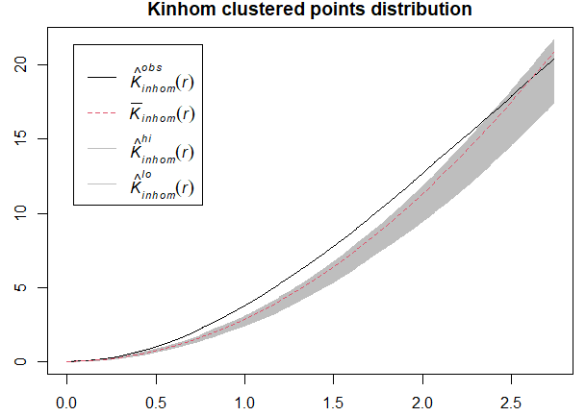
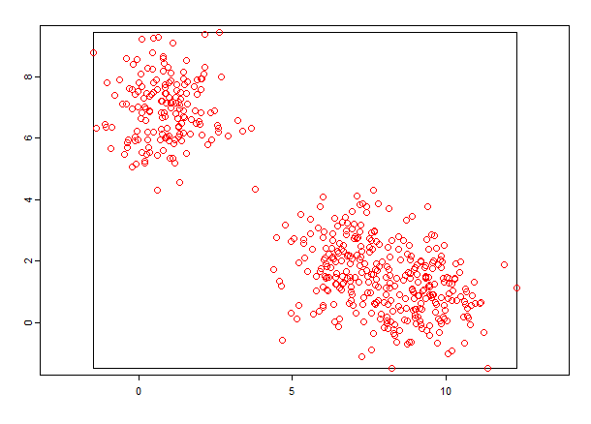
Observing second order properties using Ripley’s K
What does a clustered distribution look like?
And we can look at the process
We can see that the observed point process
lies outside the randomization edges
(so-called envelope of a random Poisson Process)

Slide 9
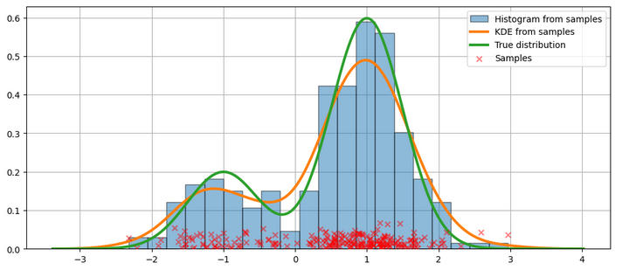
How to estimate density using KDE?
We now have an understanding of whether our data is randomly distributed or not
But we want more! KDE is a statistical technique to generate a smooth continuous distribution between data points that represent the density of the underlying pattern
KDE will produce a surface (raster) that details the estimated distribution of our event point data over space. Each cell within our raster contains a value that is this estimated density at that location
https://www.statsmodels.org/stable/examples/notebooks/generated/kernel_density.html
KDE computes a density for small subsets of our study area - but unlike quadrat analysis, these subsets overlap one another to create a moving sub-region window, defined by a kernel.
However, you will need to consider the bandwidth or diameter of your Kernel (sigma)

Slide 10
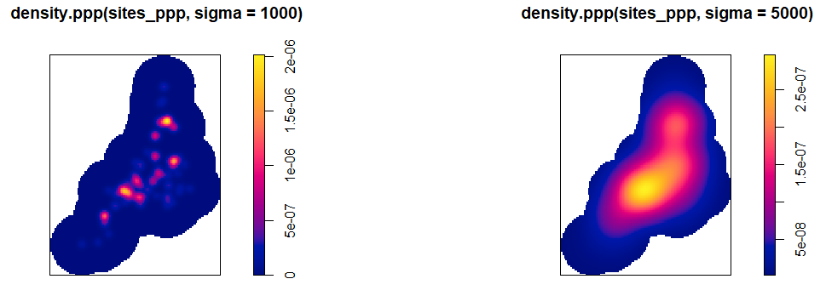
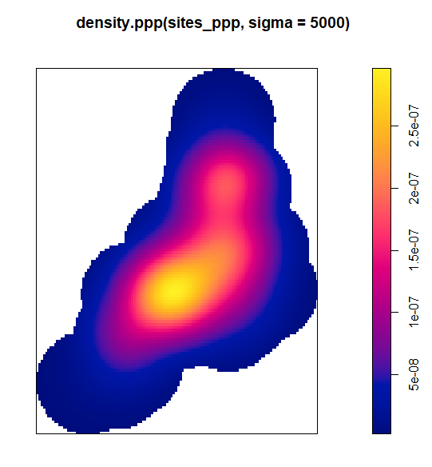
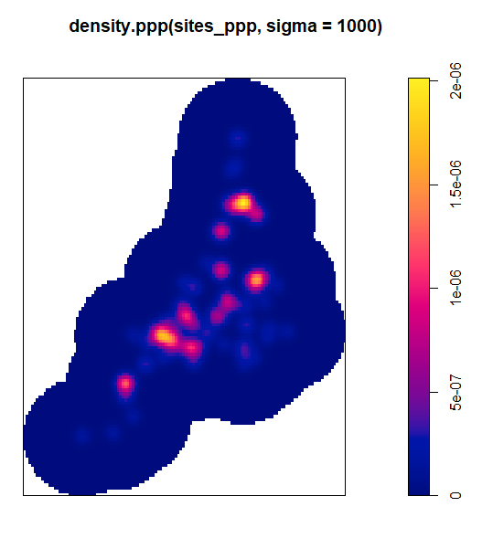
Let’s do a simple KDE!
## simple KDE with bandwidth (sigma) = 1000 m
## the same units as your CRS, in this case (m)
plot(density.ppp(sites_ppp, sigma = 1000))
# adjust the sigma!
plot(density.ppp(sites_ppp, sigma = 5000))
There is considerable difference between both ….
We can see: larger sigma affects the intensity visualization and obfuscates smaller clusters …

Slide 11
What have we seen so far?
We observe a point pattern, which shows considerable clustering processes
in particular areas of the point distribution
We can visualize these clusters using a Kernel Density Estimation (KDE)

Slide 12
What else can we do now?
We want to see if there is a variable that controls these clustering behaviour
That is referred to as FIRST ORDER PROPERTIES of a point pattern

Slide 13
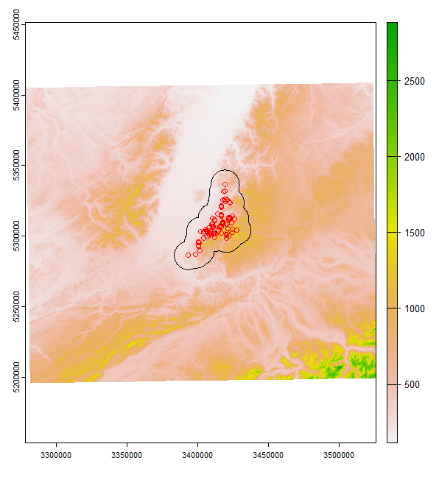
First order properties
We can load sites and plot them on top of a covariate
-> Here, we use a Digital Elevation Model (DEM)

Slide 14
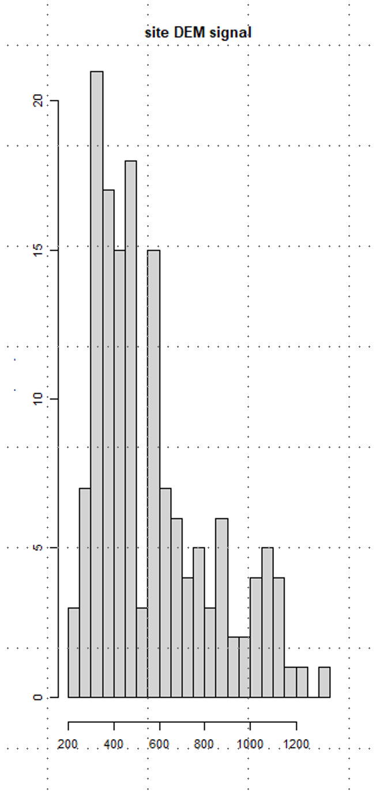
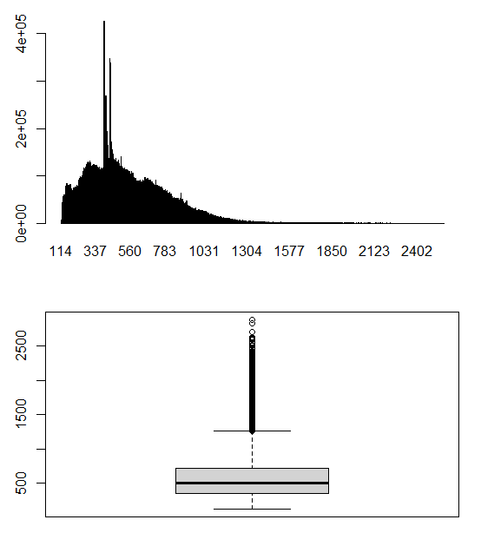
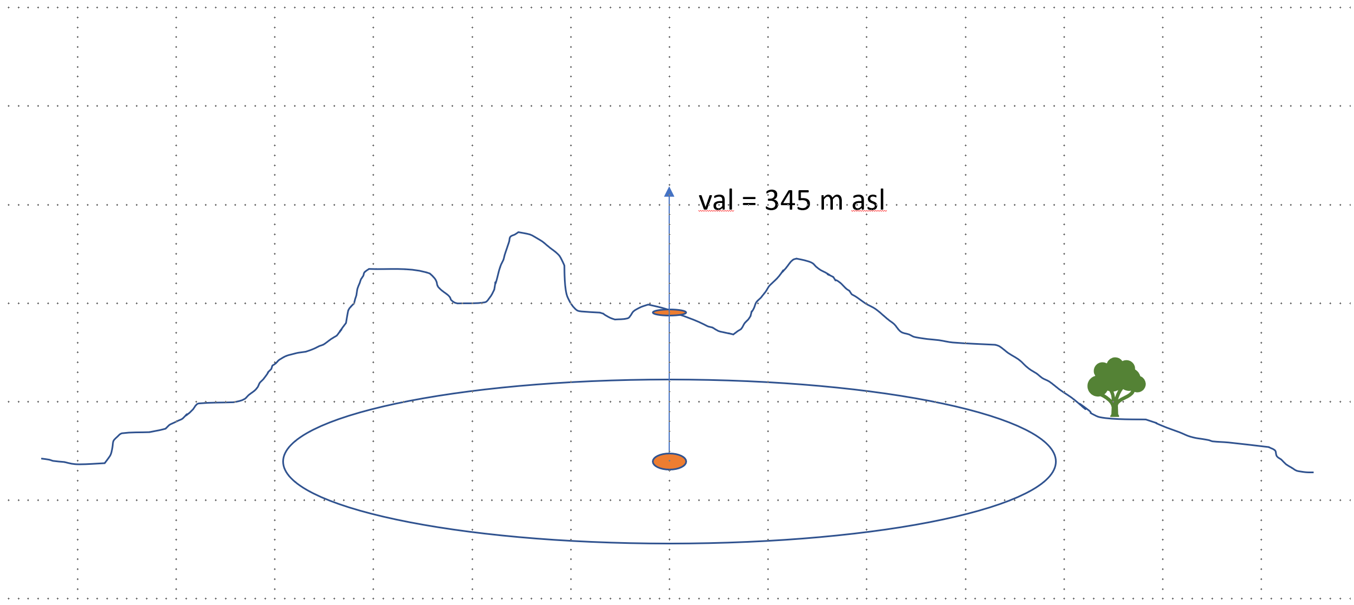
First order properties
> global(dem, c("mean"), na.rm=TRUE)
mean
dem 552.7271
Looking at the data range of the DEM
to observe the values in space
r
And extract the values that are underlying each site …
A first order property of a pattern concerns itself with the variation of the observations’ density across a study area. For example, the distribution of oaks will vary across a landscape based on underlying soil characteristics (resulting in areas having dense clusters of oaks and other areas not
names : range_min, range_max
min values : 113.6515, 113.6515
max values : 2910.7085, 2910.7085

Slide 15
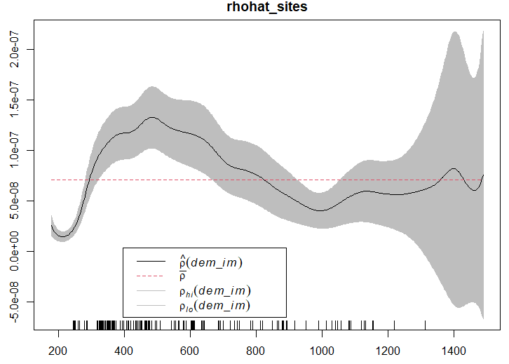
First order properties
To estimate this, we use a function called rhohat
from the spatstat package in R
Which measures the site intensity as a function of the
underlying covariate
r
If there is a high intensity of sites, the tickmarks form a block,
indicating clustering in the range of the respective covariate.
Peaks in the curve indicate high density compared to the
nearest surrounding.
The confidence interval determines the significance of the intensity.
A large envelope points towards lower confidence.
High site intensity and small confidence intervals show high significance
and a strong preference of a particular value range of the covariate.

Slide 16
r
Now lets get it started!

