Slide 1
ACM MULTIMEDIA 2026 · DEMO TRACK
LEX
A Multimodal Neuro-Symbolic System
for Automated Construction Compliance
2,877
1.1M+
89.7%
Regulatory
documents
Knowledge graph
edges
Overall
quality score
Petr Timofeev · Ilya Makarov · ITMO University / AI Talent Hub

Slide 2
PROBLEM & MOTIVATION
LEX · ACM MM 2026
Construction compliance
is broken at scale
$177B
lost annually to design errors worldwide
Engineers spend 50% of their time manually cross-referencing thousands of regulatory clauses
Errors found on construction sites cost 10–50× more to fix than at design stage
Existing LLM-based tools hallucinate citations — a critical failure mode for regulatory work
No system combines norm retrieval with multimodal document auditing over a shared knowledge graph
50%
of engineer time on manual norm lookup
>60 days
average project delay from documentation errors

Slide 3
NOVELTY & DIFFERENTIATION
LEX · ACM MM 2026
What makes LEX different from existing retrieval and compliance systems
Grounding-or-abstain contract
Neuro-symbolic fusion
Unlike plain RAG, the system either retrieves a real clause with full provenance or explicitly abstains. Fabricated citations are architecturally impossible.
Demonstrated via the waterproofing turn-up example: 150mm vs. 200mm threshold in СП 29.13330 §7.2.
Neural retrieval (Qdrant semantic search) feeds a deterministic symbolic graph traversal (Neo4j). The symbolic layer enforces regulatory structure; the neural layer handles semantic variation in natural language queries.
Multimodal Project Documentation auditing
Shared regulatory graph across modes
First system to combine PDF/drawing ingestion (PaddleOCR-VL), LLM extraction, and norm-linked verification in a single pipeline. Handles cross-sections, floor plans, tables, and textual specs within the same regulatory graph.
Both Q&A and auditing modes operate over the same underlying knowledge graph — ensuring consistency between interactive norm lookup and batch document verification.

Slide 4
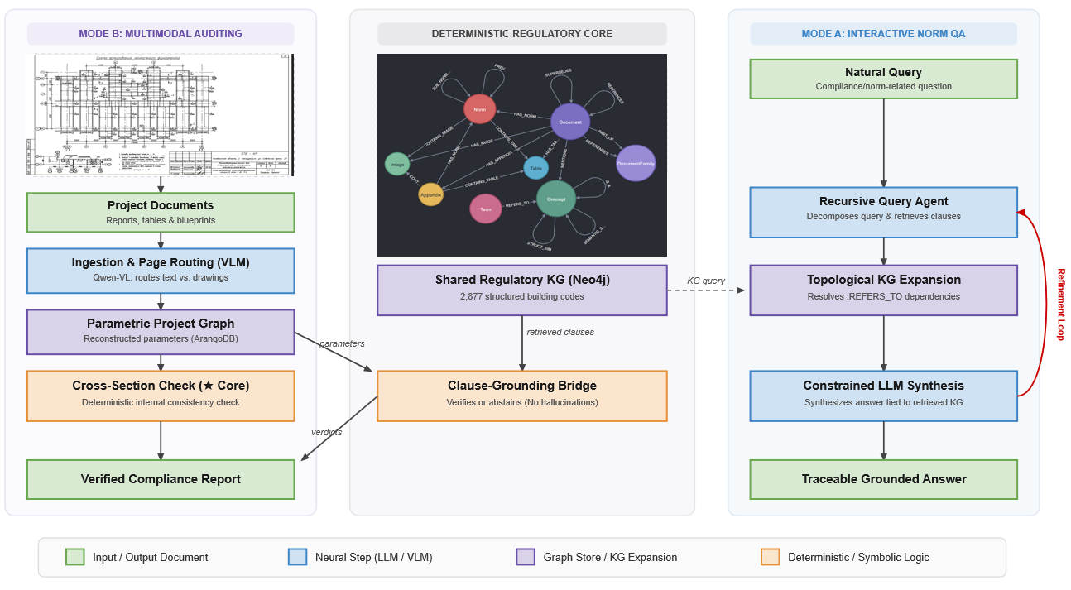
SYSTEM OVERVIEW
LEX · ACM MM 2026
[ Insert architecture figure from paper ]

Slide 5
REGULATORY KNOWLEDGE GRAPH
LEX · ACM MM 2026
Russian construction normative space + Dubai Building Code — multi-lingual corpus
2,877
414K
1.1M
250K+
Documents Russian Building Standards
Graph nodes
Graph edges
Pages indexed
Node taxonomy
Two-graph architecture
Node type | Count for RF | Count for Dubai
Norm clauses | 307,020 | 2,884
Tables | 38,239 | 371
Images / figures | 33,667 | 693
Documents | 13,290 | 189
Terms / concepts | 19,233 | -
Deterministic norm graph (Neo4j) and Project Graph (ArangoDB)
Hierarchy, cross-refs, versioning — precise retrieval
Vector index (Qdrant)
Semantic similarity across 307K clauses
Corpora
RF norms — 2,877 docs (СП · ГОСТ · СНиП)
Dubai Building Code — 1 highly-connected document (UAE)

Slide 6
KEY EXAMPLE: GROUNDING VS. FABRICATION
LEX · ACM MM 2026
Waterproofing turn-up verification — a concrete failure case
Query
LEX Response
Naive LLM (Gemini)
"What is the minimum waterproofing turn-up height at wall junctions ?"
СП 29.13330.2020
§7.2
Generated a citation that appeared valid but did not match any actual document in the corpus.
"For wet rooms (areas with medium to high water exposure), SP 29.13330.2011 requires the installation of a continuous waterproofing membrane (a minimum of two layers for bitumen-based or cementitious waterproofing systems), with a mandatory upturn onto the walls to a height of 200 mm, and the provision of a floor level difference (or threshold) of 15–20 mm."
The threshold value (200mm) was correct — but the source reference was fabricated.
Drawn from project documentation:
Specified value: 150mm
✓ Retrieved — not generated
150mm < 200mm required
→ Non-compliant
Violation detected:
150mm specified, 200mm required
✗ Fabricated citation
— unusable for audit

Slide 7
EVALUATION: QA mode
LEX · ACM MM 2026
Quality Comparison across 10 Complex Adversarial Queries (Weighted Score, 1–10)
Q&A-mode answer quality (LLM-as-judge, 1–10 scale, weighted aggregate)
Model Config | Q1 | Q2 | Q3 | Q4 | Q5 | Q6 | Q7 | Q8 | Q9 | Q10
Zero-Shot General LLM (GPT-5.2) | 7 | 4.1 | 8.1 | 8.7 | 7.5 | 8.4 | 8.1 | 5.4 | 6.2 | 9.4
Naive RAG (E5-Large + Gemini 3 Pro) | 8.3 | 3.3 | 7.8 | 6.7 | 9.0 | 5.0 | 10 | 8.7 | 8.3 | 8.1
Full-Context Injection (Gemini 3 Pro) | 10 | 10 | 8.4 | 9.7 | 10 | 9 | 10 | 10 | 9.3 | 10
LEX (Ours) (Neuro-Symbolic System) | 9.3 | 9.3 | 9.7 | 7.2 | 8.4 | 8.7 | 9.7 | 10 | 9.3 | 8.7
Model | Corr. (0.25) | Cite (0.20) | Safe (0.35) | Eff. (tok) (0.10) | Lat. (s) (0.10) | Aggr. Score
Zero-Shot | 7.5 | 5.7 | 8.6 | 10.0 (~100) | 10.0 (~10s) | 8.03
Naive RAG | 7.7 | 6.4 | 8.4 | 8.5 (~2.6k) | 10.0 (~11s) | 8.00
Full-Context | 9.7 | 9.6 | 9.6 | 1.0 (~170k) | 5.0 (~75s) | 8.31
LEX (Ours) | 8.9 | 8.6 | 9.5 | 7.0 (~5.2k) | 10.0 (~10s) | 8.97
Corpus: 2,877 RF docs (СП · ГОСТ · СНиП) · Pilot: residential complex, Yuzhnoural'sk, Chelyabinsk region (2026) · Detailed in: github.com/petrtym/lexbench

Slide 8
EVALUATION: Audit mode
LEX · ACM MM 2026
Per-Section Graph Breakdown
Section Code | Engineering Domain / Subsection (under PP-87) | Pages | Facts | Decisions | Calculations | Relative Data Density
KR | Structural Solutions (КР) | 117 | 1,012 | 7 | 0 | 100%
IOS-1.2 | Power Supply — Part 2: Internal Electrical Systems | 71 | 483 | 9 | 1 | 48%
AR | Architectural Solutions | 48 | 438 | 0 | 0 | 43%
IOS-3 | Water Disposal / Sewerage & Drainage | 49 | 427 | 2 | 0 | 42
IOS-4.2 | HVAC — Part 2: Heating, Ventilation & Air Conditioning | 63 | 392 | 3 | 4 | 39
IOS-2 | Water Supply (Internal Network) | 44 | 235 | 11 | 3 | 23
IOS-5.2 | Telecom Networks — Part 2: Fire Alarm System | 39 | 234 | 4 | 5 | 23
IOS-5.1 | Telecom Networks — Part 1: Communication & Signaling | 31 | 180 | 2 | 0 | 18
PZU | Site Plan & Land Plot Organization | 27 | 137 | 10 | 9 | 13
IOS-4.1 | HVAC — Part 1: Heating Network & Substation | 27 | 106 | 6 | 5 | 10
PZ | General Explanatory Note | 32 | 67 | 14 | 11 | 6
IOS-1.1 | Power Supply — Part 1: Main Switchgear / Switchbox | 21 | 42 | 4 | 0 | 4
IOS-5.3 | Telecom Networks — Part 3: Elevator Dispatch & Lift Monitoring | 16 | 38 | 4 | 0 | 3
TOTAL | Sum of all 13 Project Sections | 585 | 3,791 | 76 | 38 | Full Project Graph Compiled and checked in 2 hours
Completeness Check (PP-87):
Flagged 3 missing critical sections required for Glavgosexpertiza (GGE) state submission: POS (Construction Organization), OOS (Environmental Protection), and PB (Fire Safety).
Cross-Section Consistency (Triage of 13 Flags):
7 Semantic False Positives (Benign): Filtered out terminology discrepancies regarding Floors vs. Storeys (technical attic counted in PZ but excluded in structural sections).
Confirmed Violations: Isolated critical mismatches, including a Fire-Safety Occupancy Class contradiction (plumbing designed for warehouse use vs. mixed-use residential in PZ) and a Project Code inconsistency on fire-alarm sheets.
Regulatory Match (SP / GOST Verification):
Evaluated 33 engineering parameters:
25 Compliant (OK) | 1 Partial Match | 7 Critical Violations (ERR)
(e.g., insufficient pipe insulation and bathroom waterproofing height).
Calculation Verification:
Checked 38 mathematical expressions: 0 math errors found (all deviations under 2% acceptable rounding limits).
Document Audit (Normcontrol):
Functions as a "document linter" for drafting quality (GOST 2.105 / 21.101).
Flagged 320 total drafting issues (mostly minor formatting errors, unsigned blocks, or missing metadata serving as proxy metrics for pre-submission document hygiene).
Corpus: 2,877 RF docs (СП · ГОСТ · СНиП) · Pilot: residential complex, Yuzhnoural'sk, Chelyabinsk region (2026) · github.com/petrtym/lexbench

Slide 9
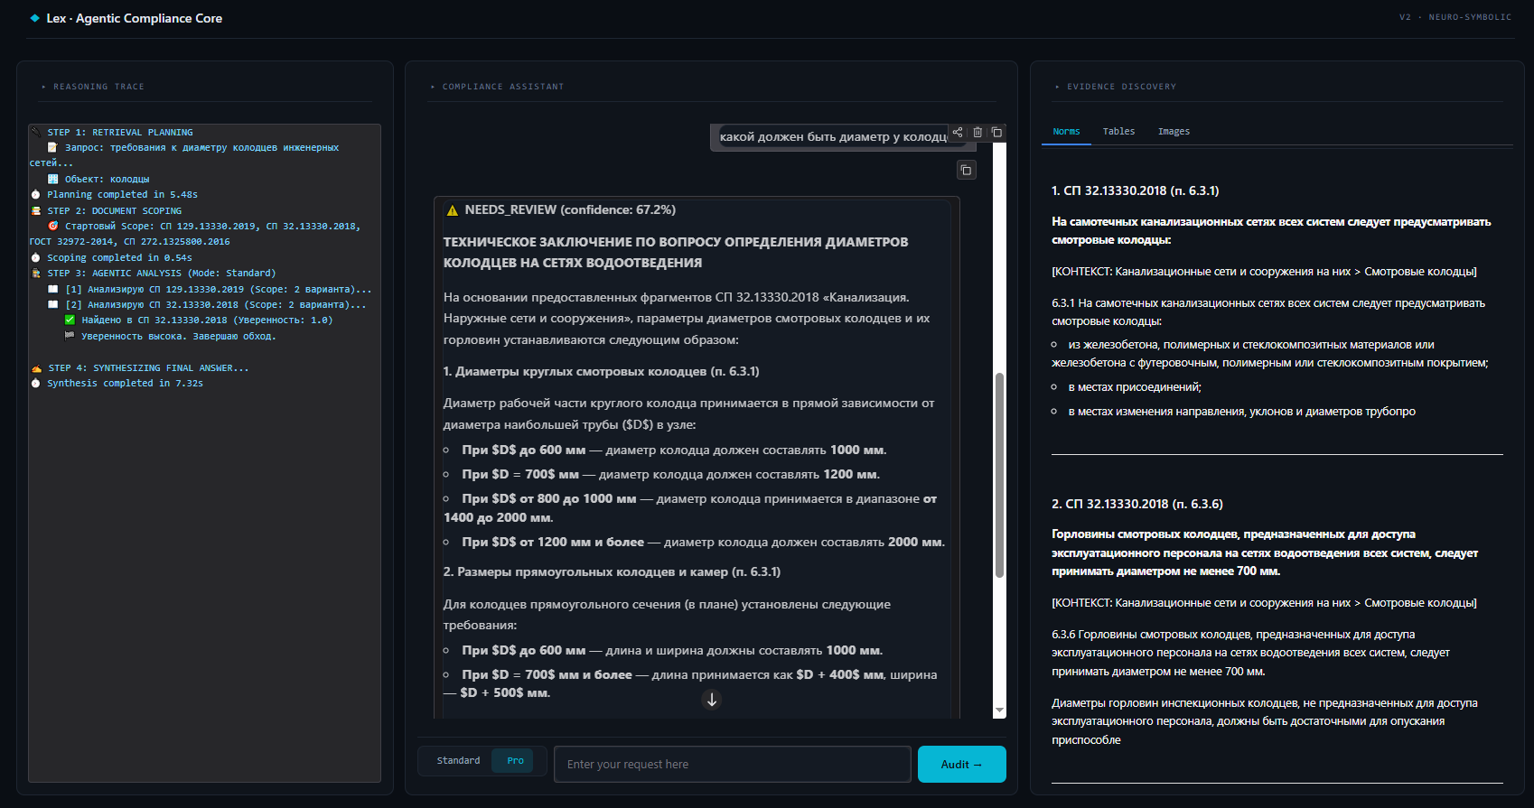
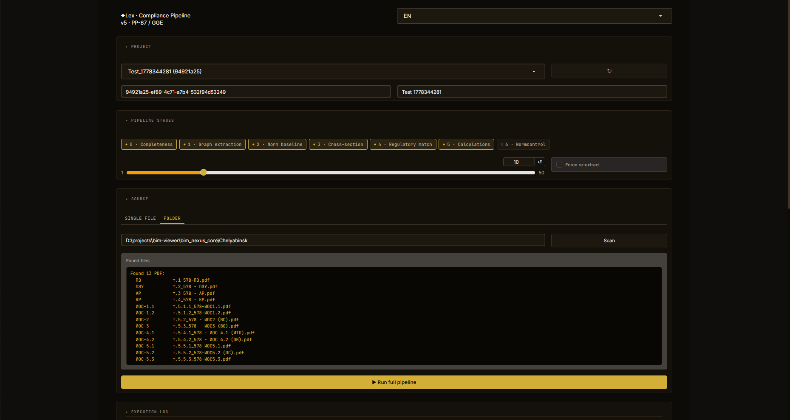
SYSTEM INTERFACES
LEX · ACM MM 2026
Instant Real-Time Check: Upload the pre-packaged multi-section residential document package (МКД) to trigger the compliance pipeline.
Bypassing Latency: Graph extraction is pre-loaded for the demo (but graph dump will be available for checking), allowing you to view cross-section violations and grounded verdicts instantly.
PDFs upload
Violation report + citations
MODE B
Page classification
Graph RAG retrieval
MODE A
Natural language query
Cite clause or abstain
Multi-Jurisdiction Testing: Query the Dubai Building Code (DBC) in English or RF Norms in Russian using natural language.
Self-Verification: Test any custom query yourself to witness the strict "ground-or-abstain" safety contract in real-time.

Slide 10
Impact & Conclusion
Why this matters for the multimedia community
Domain-agnostic architecture
The neuro-symbolic graph + multimodal pipeline is not construction-specific. The same architecture generalises to any regulatory domain with structured corpora — legal, medical, financial.
Benchmark for grounding
LEX provides a concrete, reproducible setting for studying hallucination vs. grounding in retrieval-augmented systems — with verifiable ground truth from official normative documents.
Multimodal document understanding at scale
The building project documentation auditing pipeline advances multimodal PDF understanding: combining OCR, layout analysis, table extraction, and norm linking in a unified, production-tested system.
petrtym@gmail.com · lextech.ceo@gmail.com · Petr Tymofieiev, ITMO University

