Slide 1
GROUP:DATABANG LOST AND FOUND PET SYSTEM
Amani Konduru, Xumin Cai,
Bogun Kim, Hyun Cho, Jeongsu Park

Slide 2
TOPIC: Lost and Found Pet System
User puts Lost/Found_info on the application. (one user could post one Lost/Found or multiples.)
Pet information belongs to Lost/Found_info. (one Pet has one Lost/Found_info record.)
Lost_info and Found_info are two subclasses of the Lost/Found_info.(This is a disjoint function with either lost or found method.)
User who lost pet/pets could pay Reward to single or multiple Users who found their pets.
Pet could transfer to a Shelter after they haven’t been found or claimed.

Slide 3
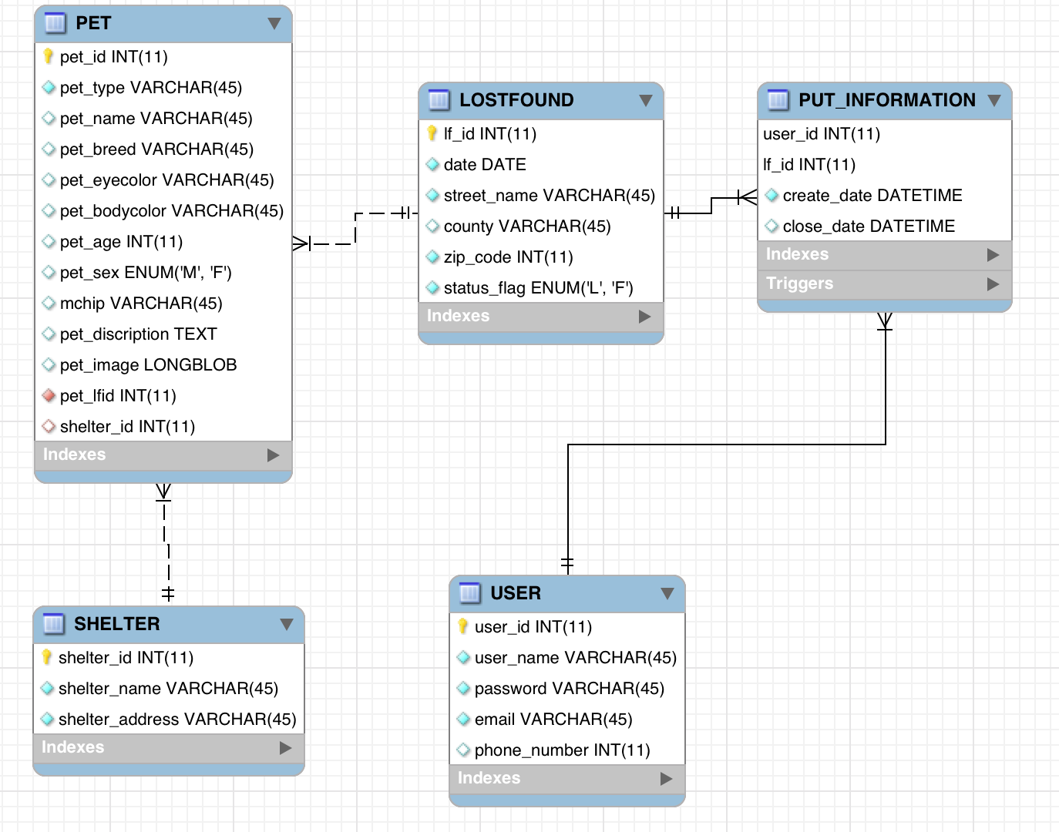
ER Diagram

Slide 4
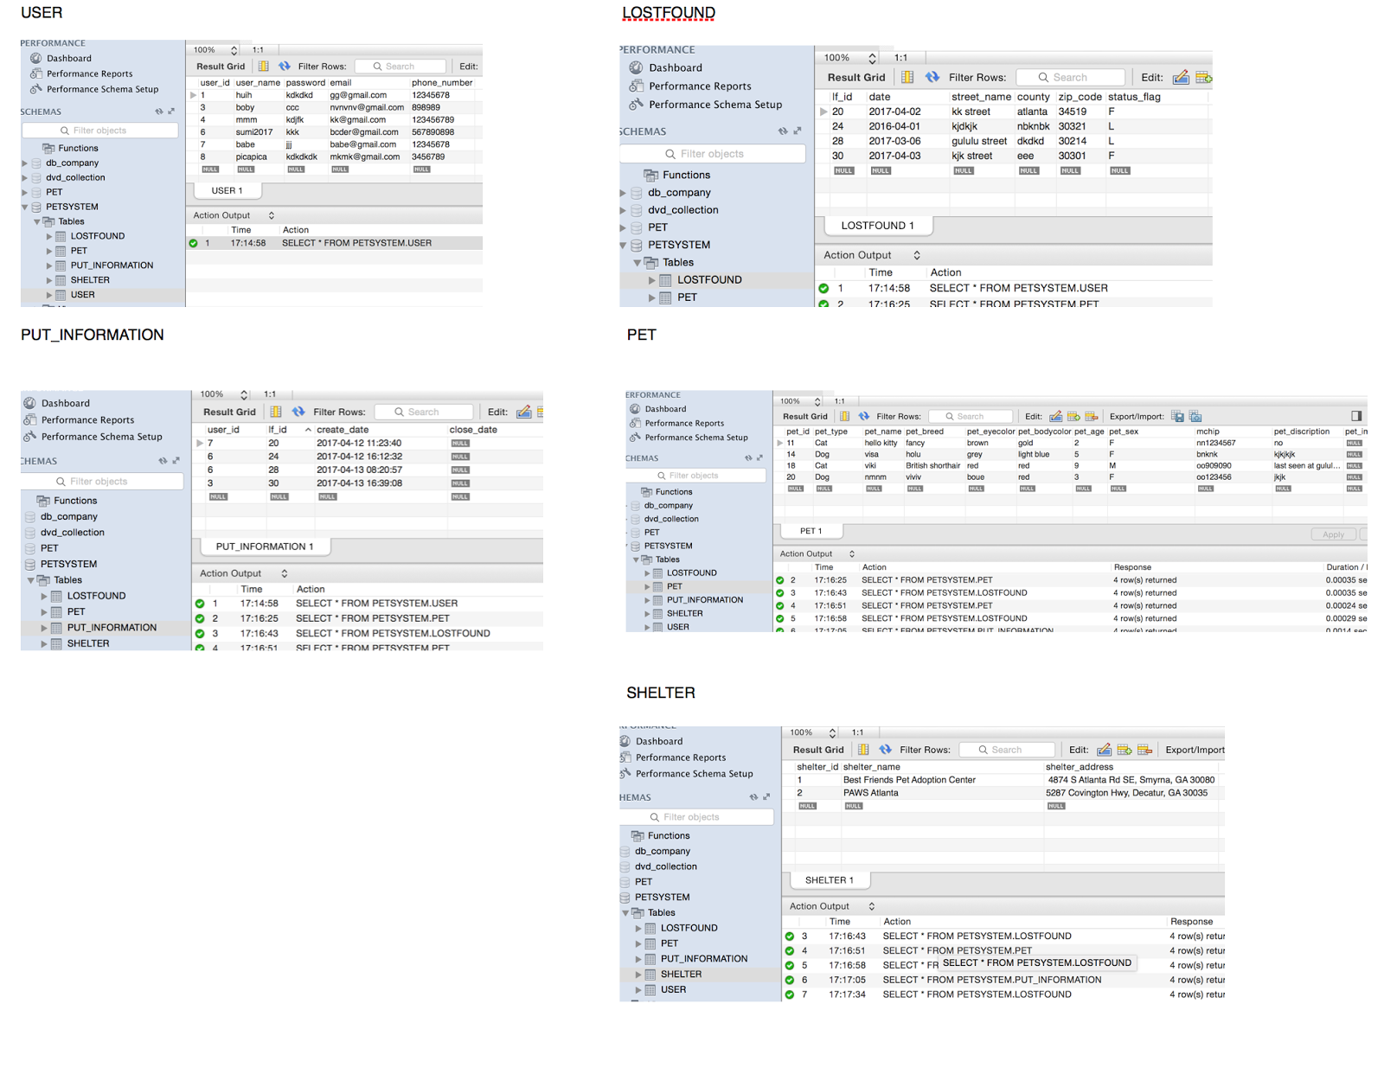
User Table

Slide 5
Lost/Found Table

Slide 6
PUT_information table

Slide 7
Pet Table

Slide 8
Shelter table

Slide 9
Demonstration

Slide 10
Questions?

Slide 11
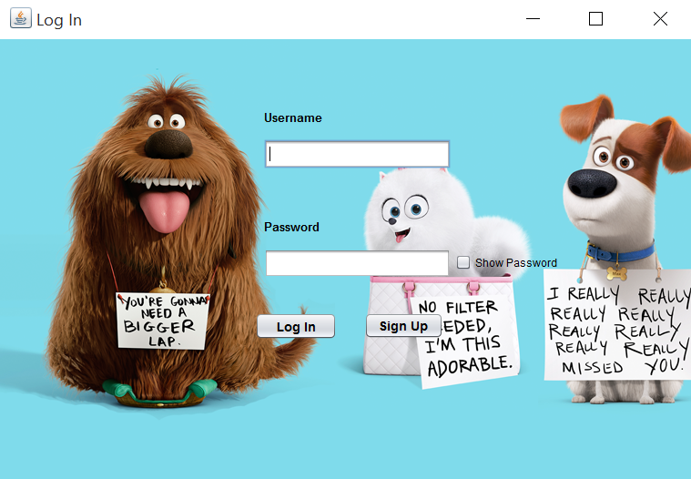
Thank You!

