Slide 1
GROUP:DATABANG LOST AND FOUND PET SYSTEM
Amani Konduru, Xumin Cai,
Bogun Kim, Hyun Cho, Jeongsu Park

Slide 2
Roles
Amani Konduru – Project Manager
Xumin Cai – Java developer
Bogun Kim – Tester
Hyun ChO(Brad) – Database
Jeongsu Park – Database

Slide 3
TOPIC: Lost and Found Pet System
User puts Lost/Found_info on the application. (one user could post one Lost/Found or multiples.)
Pet information belongs to Lost/Found_info. (one Pet has one Lost/Found_info record.)
Lost_info and Found_info are two subclasses of the Lost/Found_info.(This is a disjoint function with either lost or found method.)
Pet could transfer to a Shelter after they haven’t been found or claimed.

Slide 4
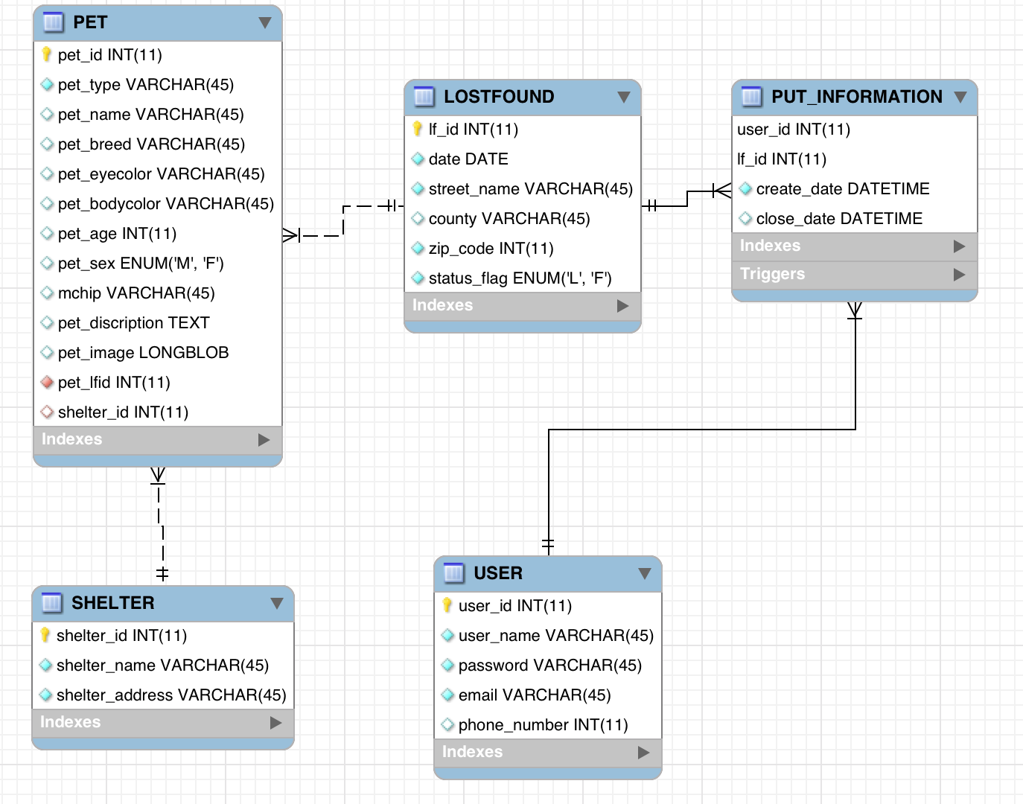
ER Diagram

Slide 5
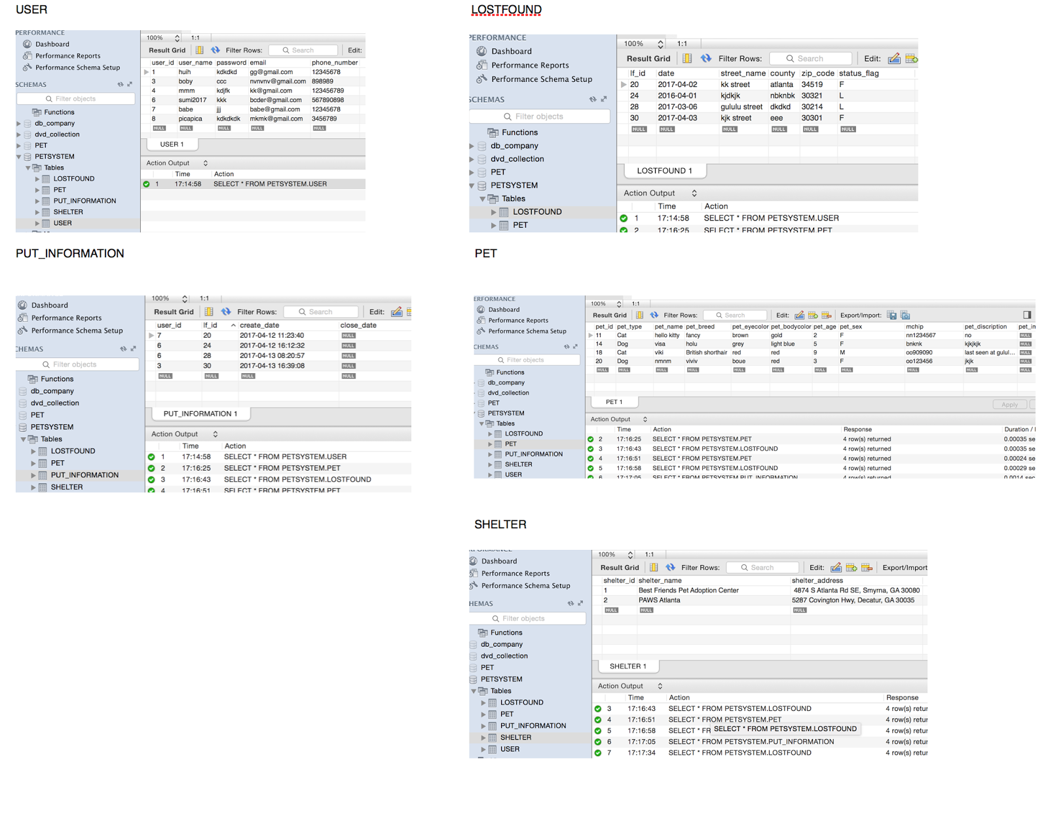
User Table

Slide 6
Lost/Found Table

Slide 7
PUT_information table

Slide 8
Pet Table

Slide 9
Shelter table

Slide 10
Demonstration

Slide 11
Questions?

Slide 12
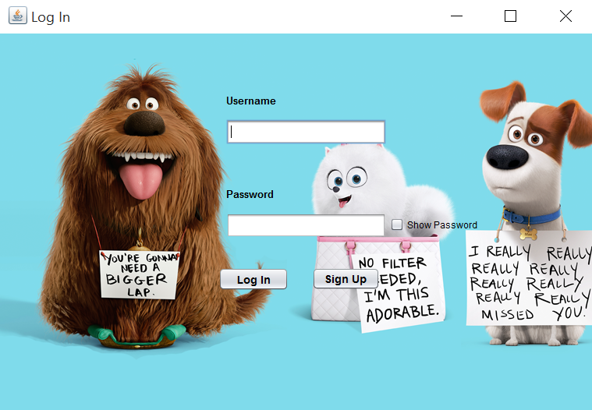
Thank You!

