Slide 1
















SECU-SCAN
Team Adaptive Sync
11:11PM

Slide 2
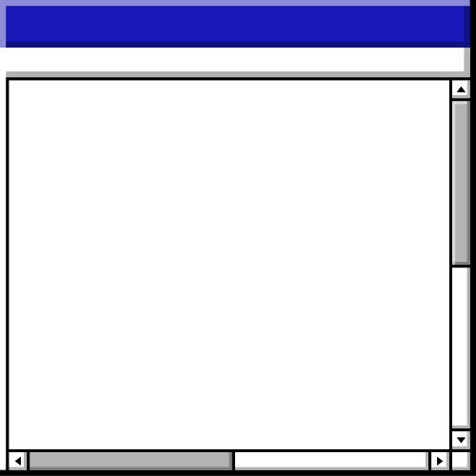

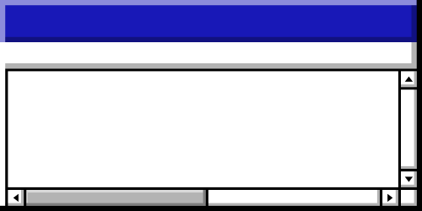


Agenda • Agenda • Agenda • Agenda • Agenda • Agenda • Agenda • Agenda • Agenda • Agenda • Agenda • Agenda • Agenda • Agenda
Topics Covered
What is Secu-Scan
Problem Statement
Agenda
System Architecture
Roles Defined

Slide 3
Agenda • Agenda • Agenda • Agenda • Agenda • Agenda • Agenda • Agenda • Agenda • Agenda • Agenda • Agenda • Agenda • Agenda
Topics Covered
Security Features
User Interface
Agenda
Future Work and Conclusion

Slide 4
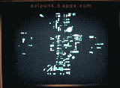
What is Secu-Scan
Project Overview
Objective: To create a secure and intelligent login system for accessing medical imaging data.
Focus: Role-based authentication combined with AI for anomaly detection and SIEM for intrusion detection.
Significance: Enhances data security, proactive threat detection, and user access management.
Back to Agenda Page

Slide 5















Problem Statement • Problem Statement • Problem Statement • Problem Statement • Problem Statement • Problem Statement
Problem Statement
Issue: Growing cyber threats to sensitive medical data necessitate stronger security measures.
Challenge: Balancing accessibility and security while detecting potential intrusions.
Goal: Protect medical imaging information from unauthorized access and identify anomalous behaviors.
Back to Agenda Page
Problem Statement • Problem Statement • Problem Statement • Problem Statement • Problem Statement • Problem Statement

Slide 6




System Architecture
Overview of Architecture:
Database
AI Component
MongoDB for storing user credentials, access logs, and anomaly detection results.
Anomaly detection model integrated for monitoring user behavior.
FRONT END: User interface for login and role selection.
BACK END: Flask application handling authentication and database interactions.
Back to Agenda Page

Slide 7
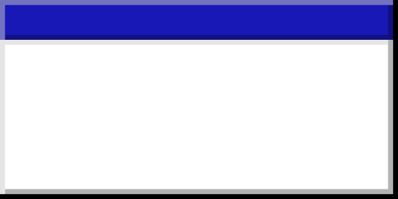


Roles Defined • Roles Defined • Roles Defined • Roles Defined • Roles Defined • Roles Defined • Roles Defined • Roles Defined • Roles Defined • Roles Defined
Patients
Staff
Administrators
Access their personal medical imaging data.
View and manage patient data with additional functionalities.
Full system access for managing user accounts and security settings.
BENEFITS
Tailored access control that enhances security and user experience.
Roles Defined • Roles Defined • Roles Defined • Roles Defined • Roles Defined • Roles Defined • Roles Defined • Roles Defined • Roles Defined • Roles Defined

Slide 8
Security Features • Security Features • Security Features • Security Features • Security Features • Security Features • Security Features
Security Features
Anomaly Detection: Utilizes AI to monitor access patterns and identify suspicious activities in real time.
SIEM Integration: Security Information and Event Management for centralized logging and incident response.
Encryption: Protects sensitive data during transmission and storage.
User Management: Allows role assignment and monitoring of access logs for compliance.
Back to Agenda Page
Security Features • Security Features • Security Features • Security Features • Security Features • Security Features • Security Features

Slide 9
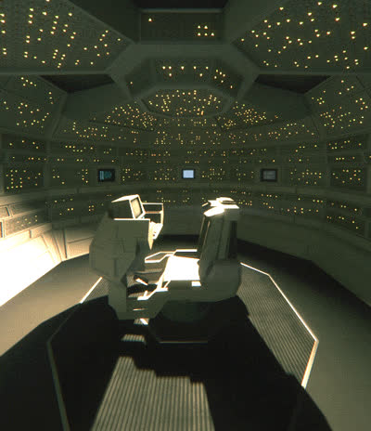
User Interface
Overview of UI:
Login Page: User-friendly design with clear role options.
Role Selection: Simplified navigation for patients, staff, and admins.
Screenshots: Include visuals of the login form, role selection, and user dashboard.
Back to Agenda Page

Slide 10
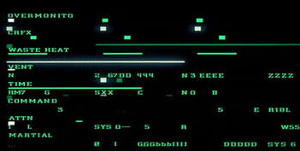
Future Work and Conclusion
Integration of advanced machine learning algorithms for improved anomaly detection.
Expansion of SIEM capabilities for enhanced threat analysis and reporting.
Conclusion: SecuScan effectively addresses the critical need for secure access to medical imaging data while utilizing AI for proactive threat detection and management, ensuring confidentiality and user-specific access.
Back to Agenda Page

Slide 11

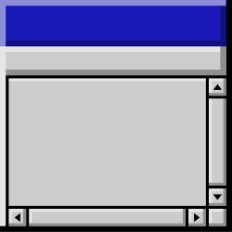
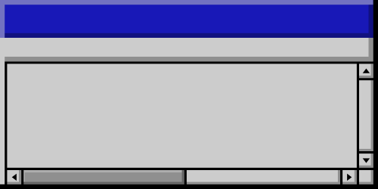
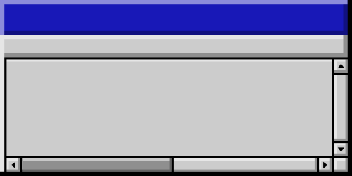

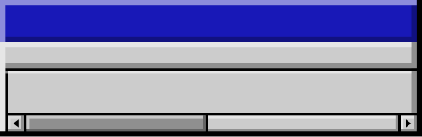
Thank you!

