Slide 1



Slide 2
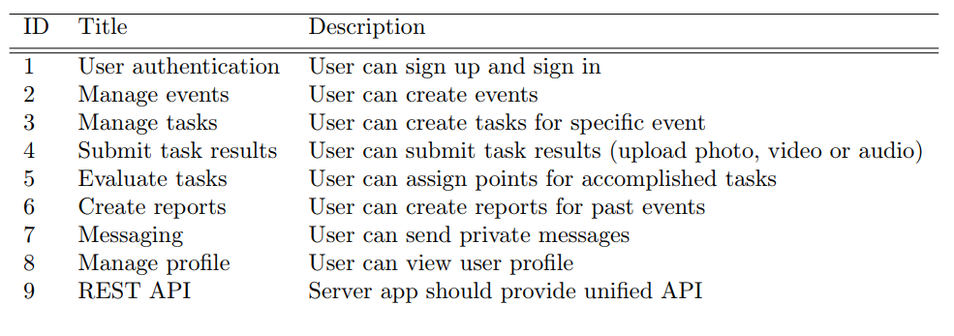
Functional requirements
Notes:
Shrnout, že uživatel se
přihlašuje/registruje
manupuluje s eventama taskama
může posílat zpravy
Měnit profil

Slide 3
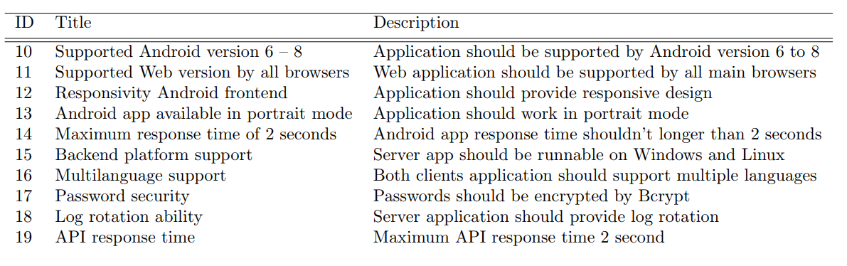
Non-functional requirements
Notes:
Aplikace
Je na android a také na web
reposonsive, multilanguage, secured and fast

Slide 4
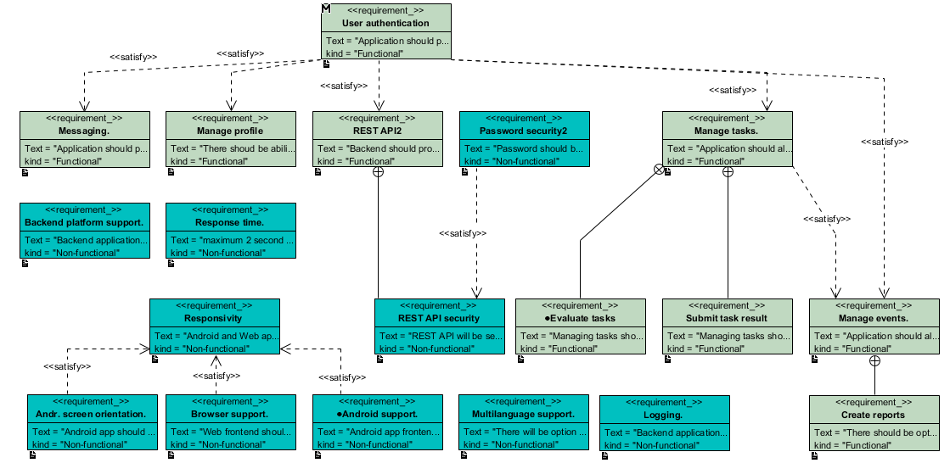
Requirements diagram

Slide 5
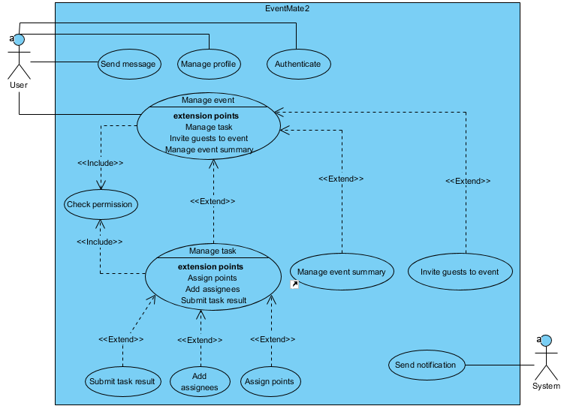
Use case diagram

Slide 6
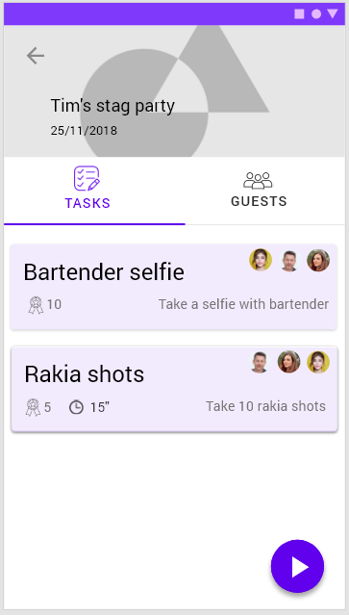
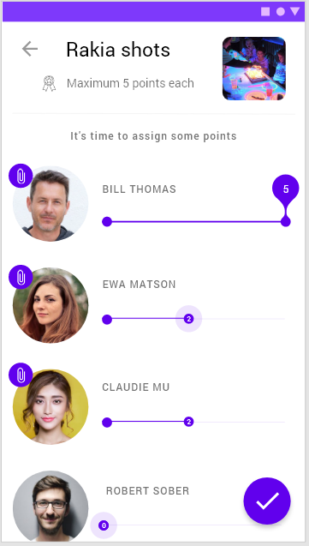

Slide 7
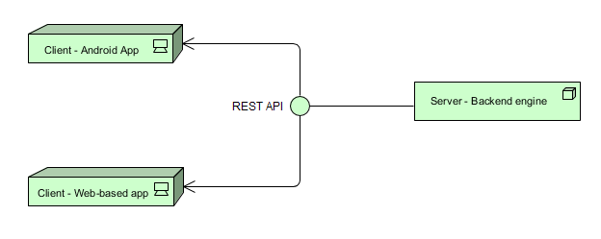
Architectural design
Client server architecture
Data availability for cooperation of many users
More than one type of client (unified API)
Notes:
There are two main reasons why we choosed Client server architecture.
The first one is that we need data to be availible to many users at same time, because users will be editing a reading for example the same event saved on server.
The second is reason that we will have more than one type of client which both will be using the data. So it makes sense to make one unified API on server to serve them all.

Slide 8
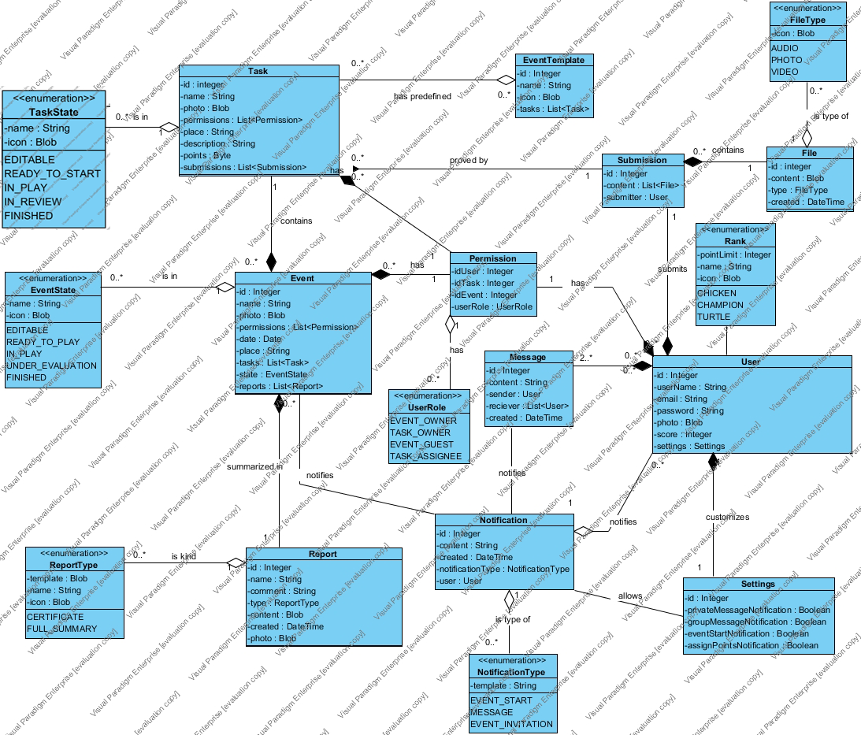

Slide 9
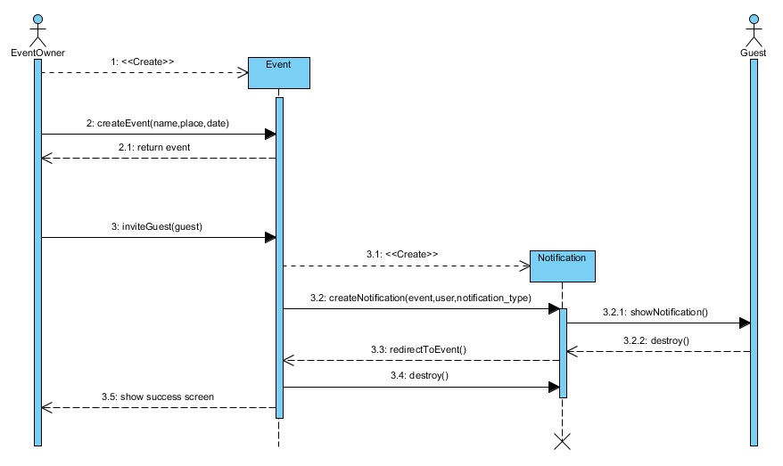
Sequence diagram
Creating event with inviting guests on Android app

