Slide 1
Restaurant Management Application
🍽️
RESTAURANT MANAGER
Django + Python
MySQL (23 Tables)
7 Modules
8 Phases
Django + MySQL | MVT Architecture | Role-Based Access Control

Slide 2
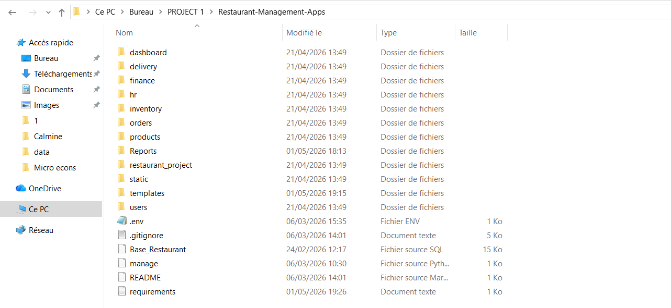
PHASE 1 & 2
Project Setup & Database Models
⚙️ Phase 1: Setup & Configuration
🗄️ Phase 2: Django Models (23 SQL Tables)
Step 1
Install tools: Django, mysqlclient, Pillow, python-decouple
orders/
Client, Table, Reservation, Commande, Ligne_Commande
products/
Produit, Ingredient, Composition_Produit
Step 2
Create the Django project structure with manage.py
inventory/
Stock, Variation_Stock, Approvisionnement, Fournisseur
Step 3
Create 8 Django apps: orders, products, inventory, hr, delivery, finance, dashboard, users
hr/
Employe, Poste, Affectation, Supervision
Step 4
Configure MySQL connection in settings.py
Step 5
Register all apps & import the Base_Restaurant.sql (23 tables)
Step 7
Test connection: python manage.py check

Slide 3
PHASE 3 & 4
Authentication, User Roles & UI Templates
🔐 6 User Roles (Phase 3)
🎨 Phase 4 — Base Template
admin
→ Administrateur
director
→ Directeur
Bootstrap 5 loaded from CDN
base.html with navbar + blocks
head_chef
→ Chef Cuisinier
cook
→ Cuisinier
Child templates use {% extends %}
server
→ Serveur
stock_manager
→ Gestionnaire
Static files (CSS/JS) configured
🔑 Auth Steps (Steps 11–14)
Screenshot: Login page
CustomUser model extends AbstractUser with a role field
AUTH_USER_MODEL = 'users.CustomUser' in settings.py
Built-in LoginView / LogoutView with custom template
@role_required('admin','director') decorator for protected views
Screenshot: Navigation / base template

Slide 4
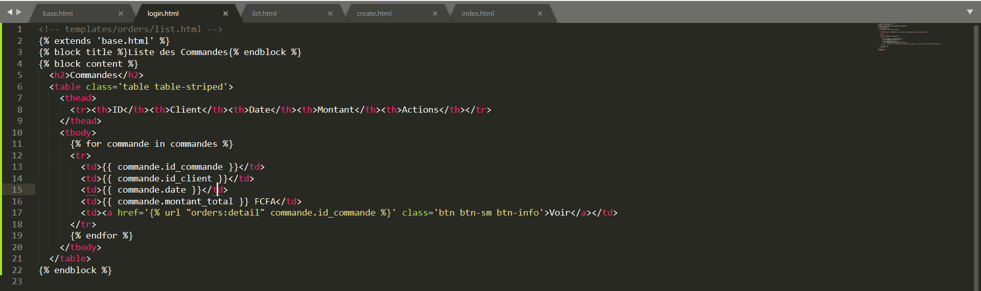
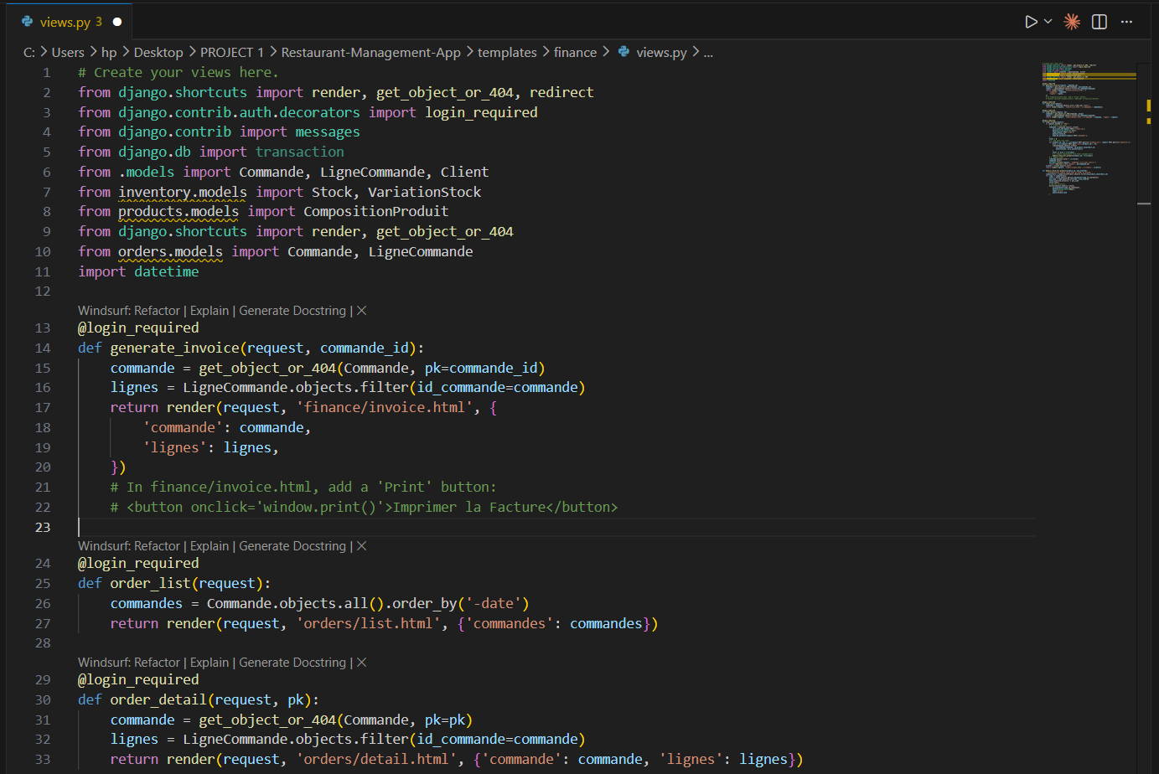
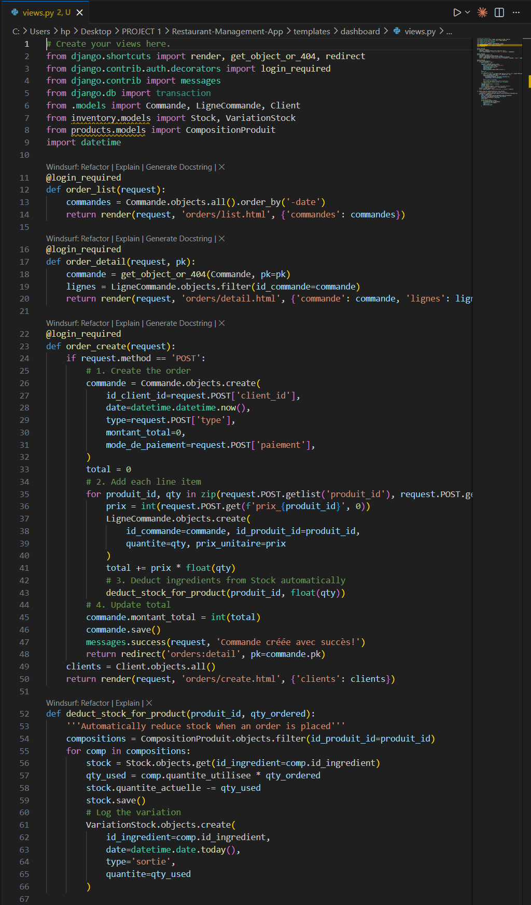
PHASE 5 & 6
Views, Business Logic & Dashboard
📋 CRUD Pattern (Phase 5)
💰
Revenue
📦
Orders
⚠️
Alerts
⭐
Top Items
list
Display all records
[ value ]
[ value ]
[ value ]
[ value ]
detail
Show single record
Screenshot: Order list / create form
create
New entry form
📊 Dashboard Chart (Phase 6)
edit
Update a record
Chart.js via CDN — no install
delete
Remove a record
Last 6 months revenue bar chart
ORM aggregations: Sum, Count, F()
🔄 Auto Stock Deduction
Screenshot: Invoice view
1. Order saved → line items created
📦 7 Modules
2. Ingredients looked up per product
Orders
Products
Inventory
3. Stock quantities auto-reduced
HR
Delivery
Finance
Dashboard
4. Variation_Stock log entry written
Screenshot: Dashboard — KPI + chart

Slide 5
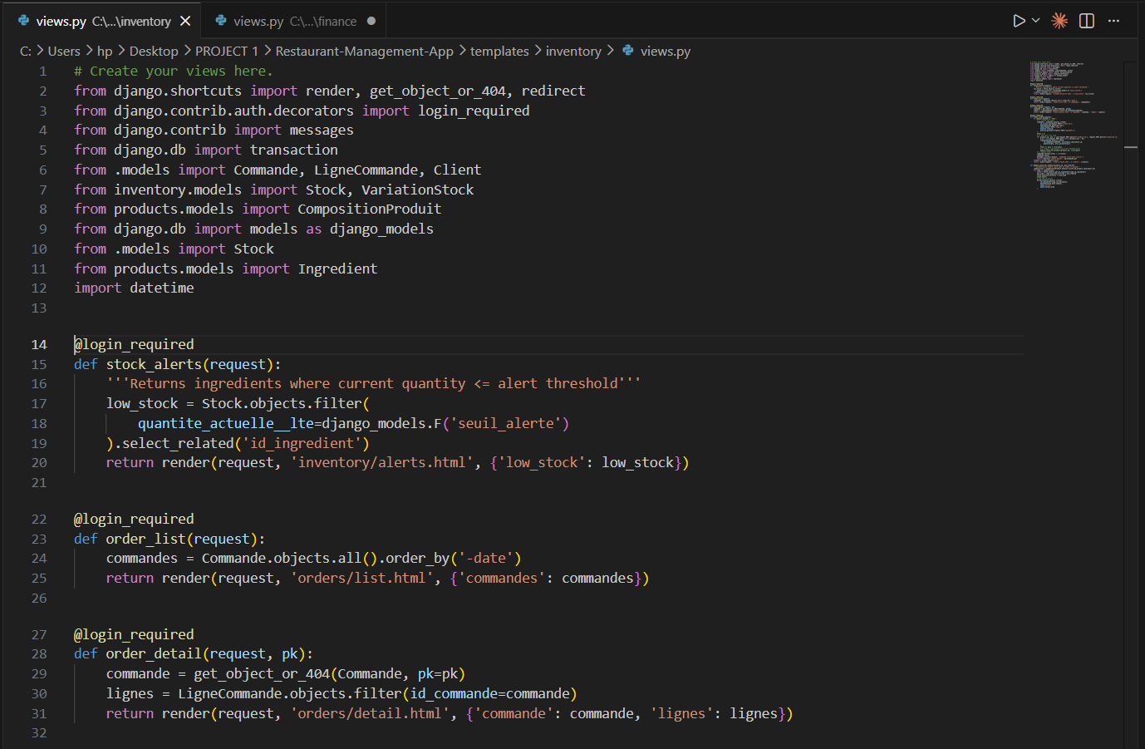
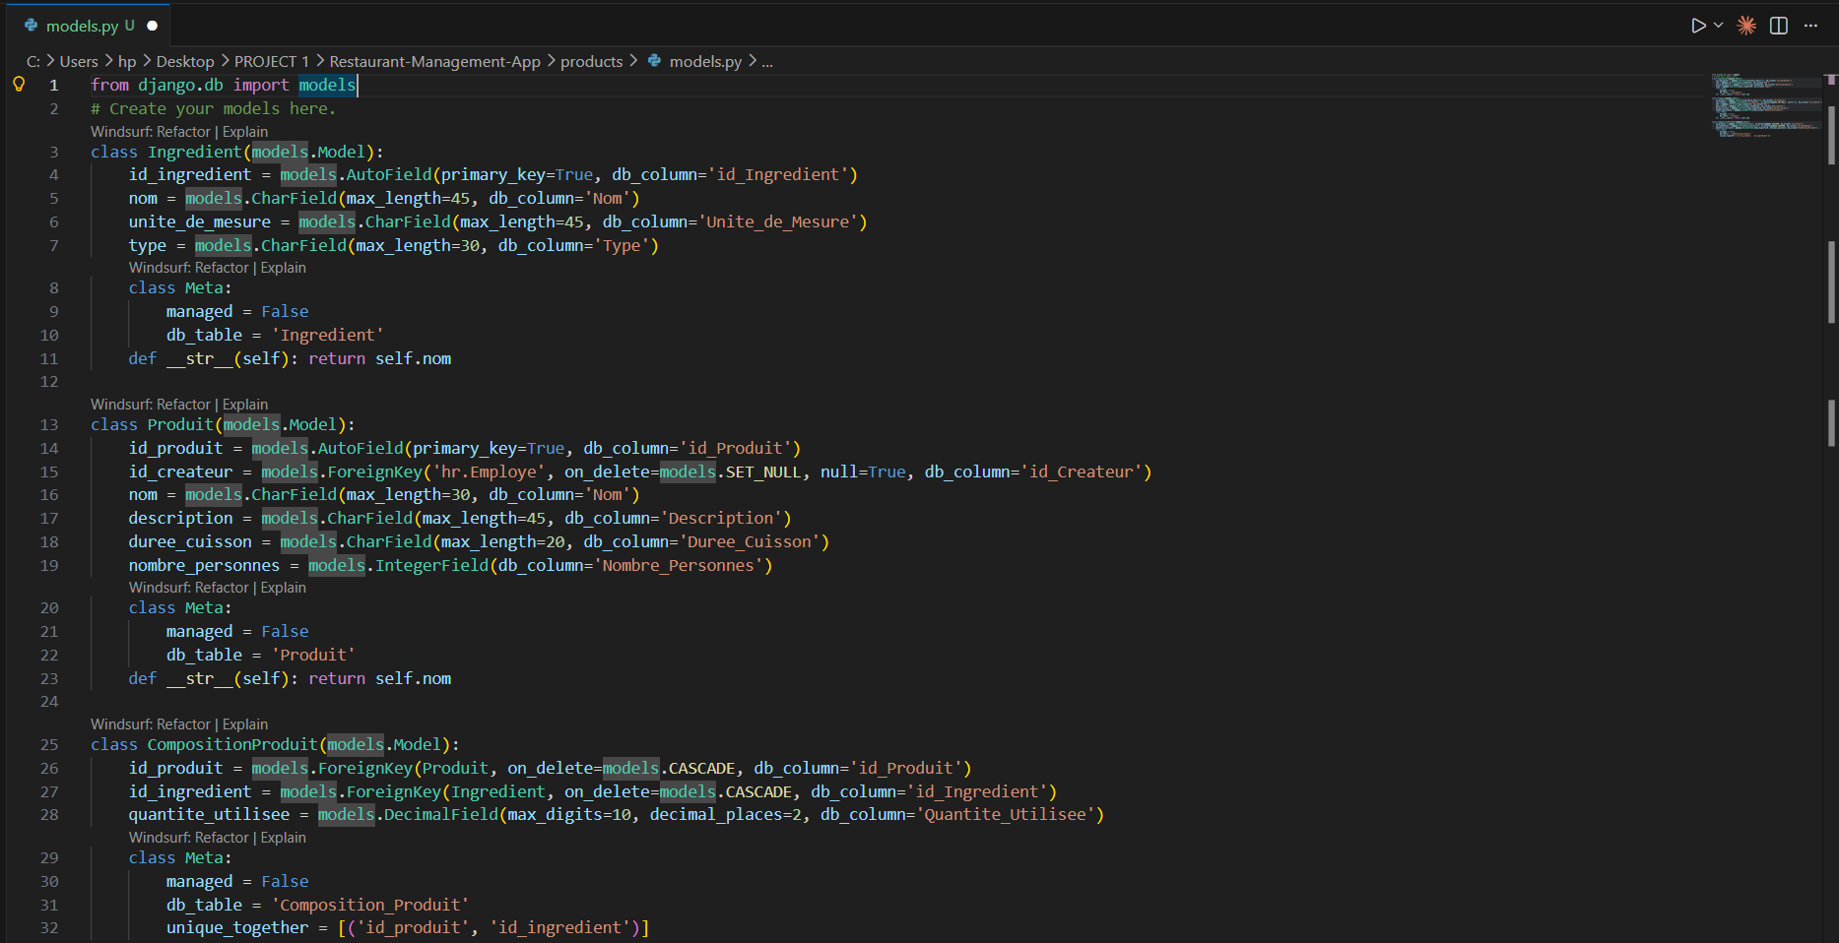
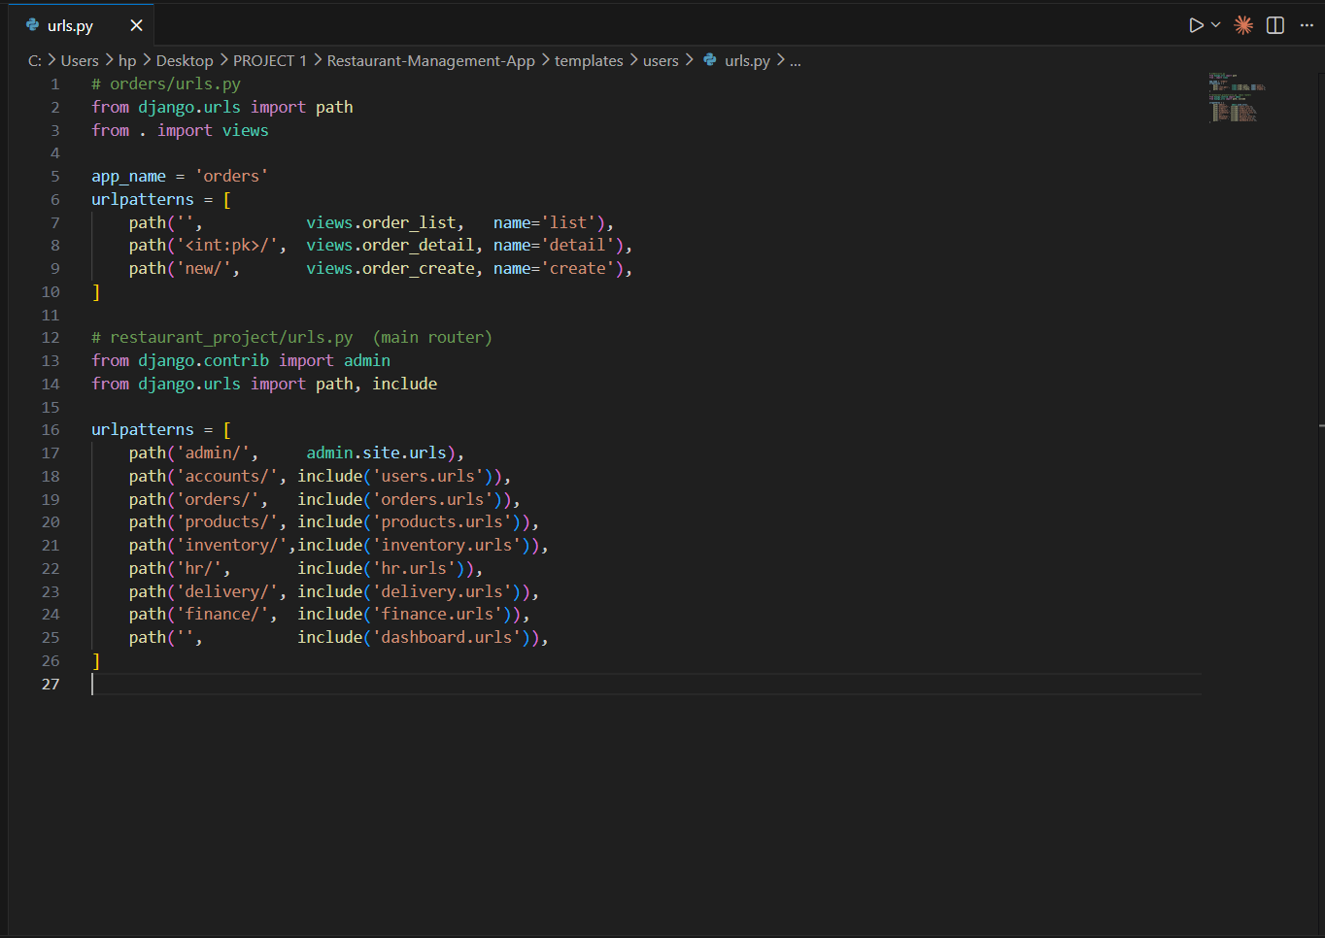
PHASE 7 & 8
Security, Configuration & Submission
🔒 Security Checklist (Phase 7)
📦 Deliverables (Phase 8)
✅
CSRF middleware enabled (CsrfViewMiddleware)
GitHub
Source code + requirements.txt + README
✅
@login_required on all views
SQL
Base_Restaurant.sql in the repo
✅
@role_required for sensitive operations
✅
SESSION_COOKIE_HTTPONLY = True
Report
25–35 pages: architecture + ER + screenshots
✅
No raw SQL — use Django ORM only
Manual
User guide per role (screenshots)
✅
ActionLog model for critical actions
Demo
Live: login → order → stock → dashboard
✅
.env file for secrets (python-decouple)
Screenshot: Admin panel / action logs
Screenshot: Role-restricted view / permission denied
Screenshot: GitHub repo / README

Slide 6
Conclusion
A Complete, Production-Ready Restaurant System
This application brings together 8 development phases into one cohesive platform — covering everything from database design to a role-protected web interface, real-time inventory management, financial reporting, and secure deployment. Built on Django + MySQL with an MVT architecture, it delivers a scalable solution ready for real restaurant operations.
🍽️
🗄️
23 SQL Tables
🔐
6 User Roles
Fully mapped as Django models with managed = False
Role-based access control via custom decorators
REST
MANAGER
📦
7 Functional Modules
🔄
Auto Stock Updates
Orders, Products, Inventory, HR, Delivery, Finance, Dashboard
Ingredients deducted automatically on every order
Django + MySQL
PKFIE, Yaounde
📊
Live Dashboard
🔒
Secure by Design
KPI cards + Chart.js revenue charts from ORM queries
CSRF, HTTPONLY sessions, ORM-only queries, action logs
🚀 Ready to build — follow the 30-step guide and submit via GitHub | Good luck! 🍽️

