Slide 1
Image Denoising using
Ising Model
Noemi Ippolito, Piero Pettenà, Maria Pronestì

Slide 2
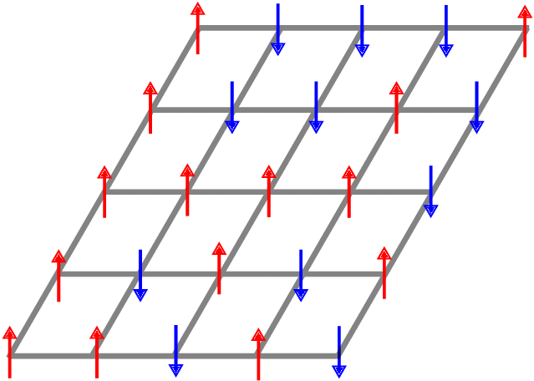
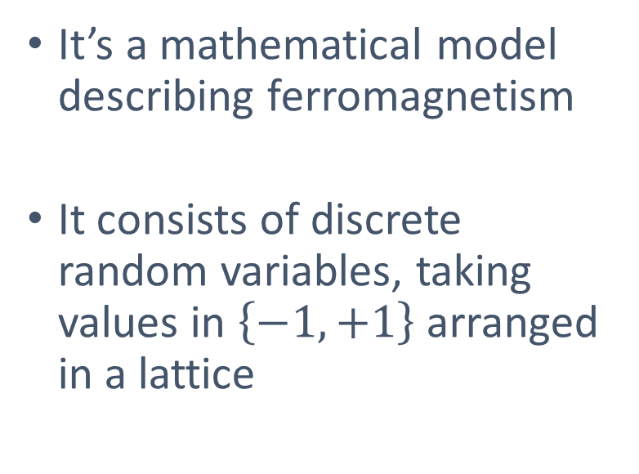
Ising model
It’s a mathematical model describing ferromagnetism
It consists of discrete random variables, taking values in $\left\{−1,+1\right\}$arranged in a lattice

Slide 3
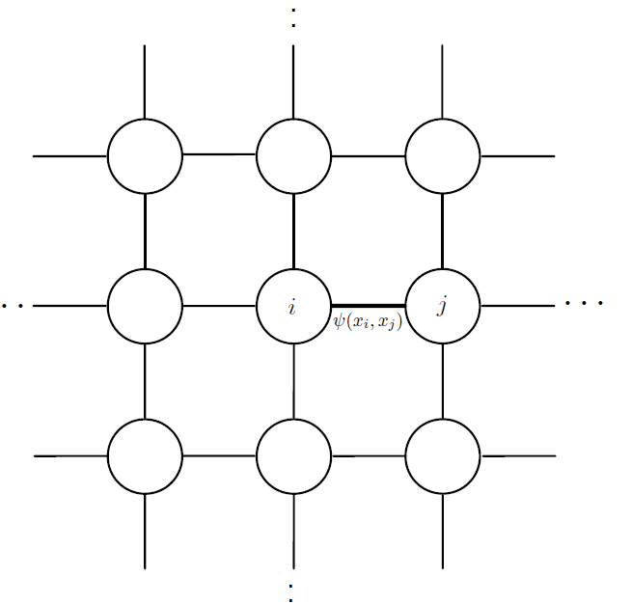
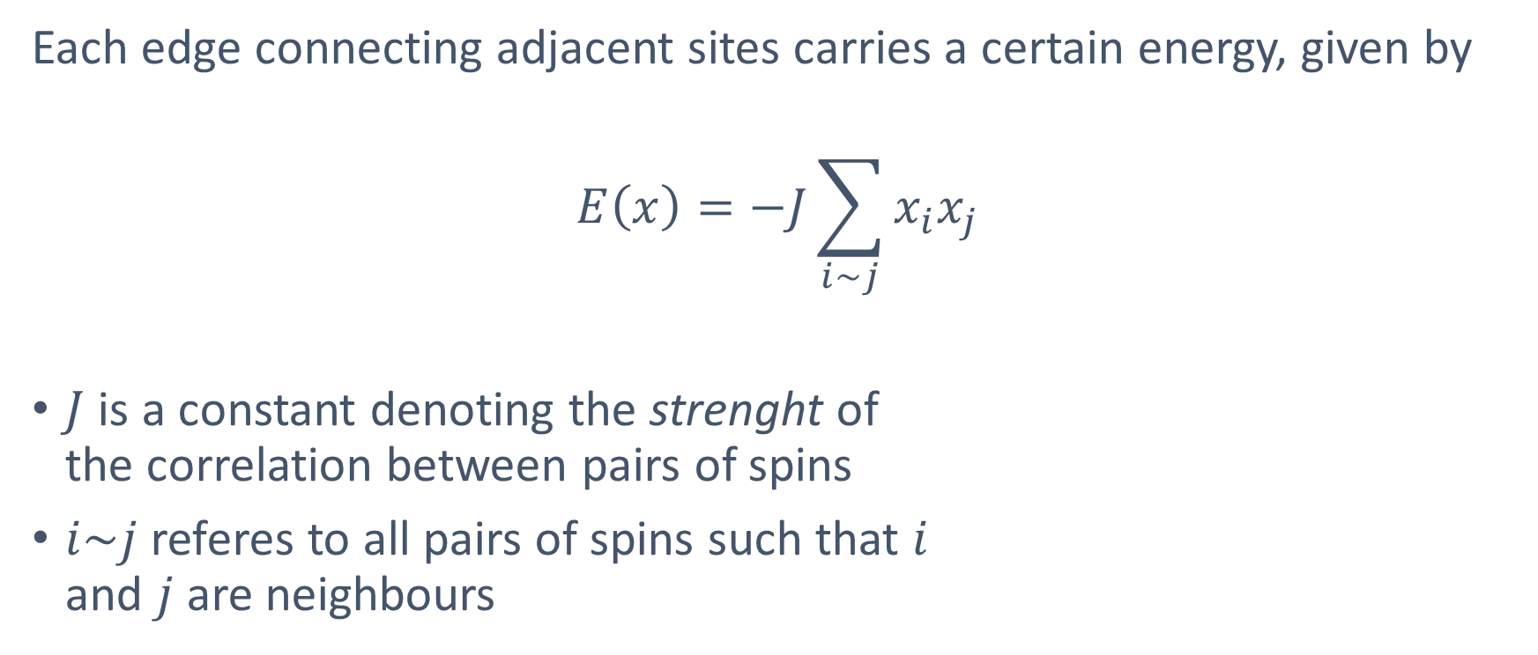
Edge potential
Each edge connecting adjacent sites carries a certain energy, given by
$$E\left(x\right)=−J\sum_{i\sim j}{x_{i}x_{j}}$$
$J$ is a constant denoting the strenght of
the correlation between pairs of spins
$i\sim j$ referes to all pairs of spins such that $i$
and $j$ are neighbours
$$E(x_{i}{,x}_{j})$$

Slide 4
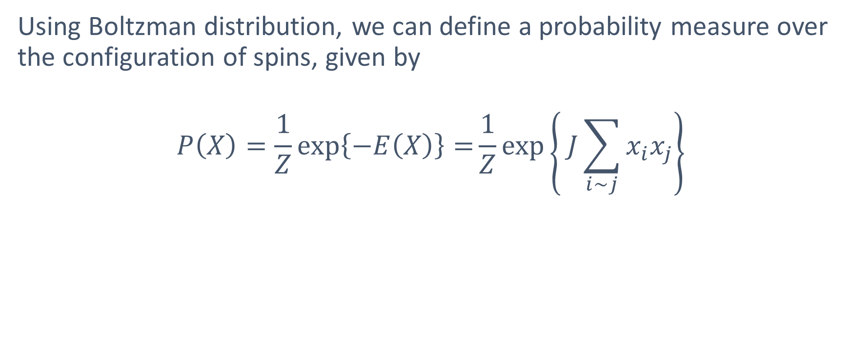
Prior distribution
Using Boltzman distribution, we can define a probability measure over the configuration of spins, given by
$$P\left(X\right)=\frac{1}{Z}\exp\left\{−E\left(X\right)\right\}=\frac{1}{Z}\exp\left\{ J\sum_{i\sim j}{x_{i}x_{j}}\right\}$$

Slide 5
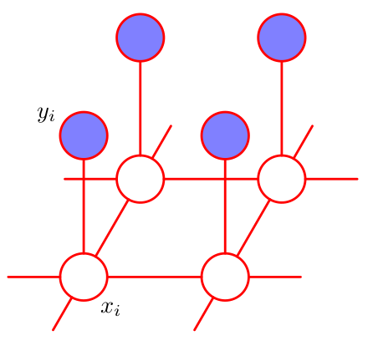
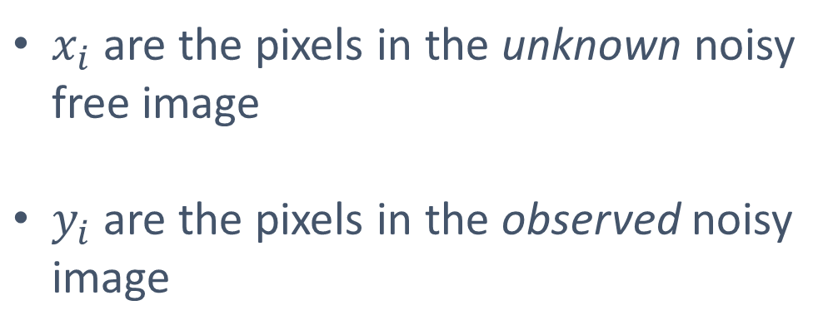
Ising model for Image Denoising
$x_{i}$ are the pixels in the unknown noisy free image
$y_{i}$ are the pixels in the observed noisy image

Slide 6
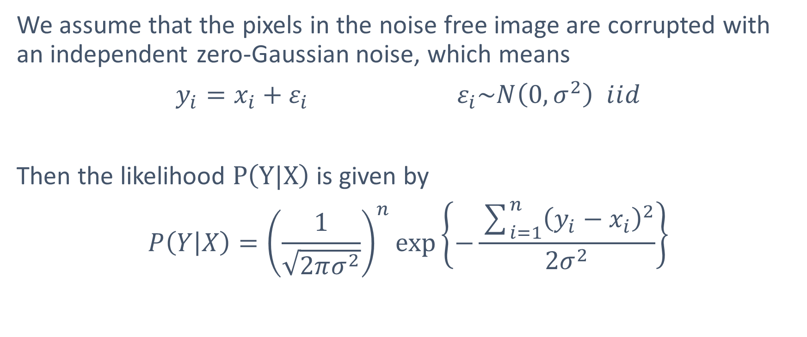
Likelihood
We assume that the pixels in the noise free image are corrupted with an independent zero-Gaussian noise, which means
$$y_{i}=x_{i}+ε_{i}{ ε}_{i}\sim N\left(0,σ^{2}\right) ⅈⅈd$$
Then the likelihood $P\left(Y|X\right)$ is given by
$$P\left(\left.Y\right|X\right)={\left(\frac{1}{\sqrt{2πσ^{2}}}\right)}^{n}\exp\left\{−\frac{\sum_{i=1}^{n}{{\left(y_{i}−x_{i}\right)}^{2}}}{2σ^{2}}\right\}$$

Slide 7
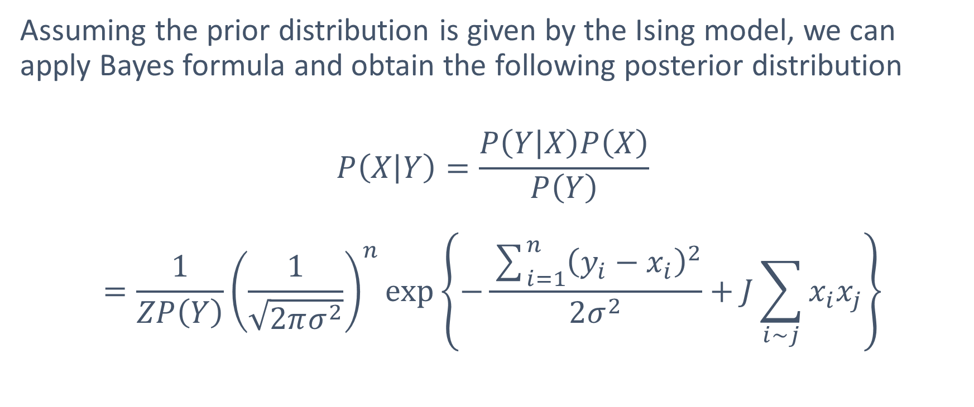
Posterior Distribution
Assuming the prior distribution is given by the Ising model, we can apply Bayes formula and obtain the following posterior distribution
$$P\left(\left.X\right|Y\right)=\frac{P\left(\left.Y\right|X\right)P\left(X\right)}{\begin{aligned}P\left(Y\right) \\ \end{aligned}}=\frac{1}{ZP\left(Y\right)}{\left(\frac{1}{\sqrt{2πσ^{2}}}\right)}^{n}\exp\left\{−\frac{\sum_{i=1}^{n}{{\left(y_{i}−x_{i}\right)}^{2}}}{2σ^{2}}+J\sum_{i\sim j}{x_{i}x_{j}}\right\}$$

Slide 8
Approximate Inference: Sampling
Since exact inference is intractable, we will use two well-known sampling techniques to obtain an approximation of the posterior distribution
  Metropolis-Hastings sampling
  Gibb’s sampling

Slide 9
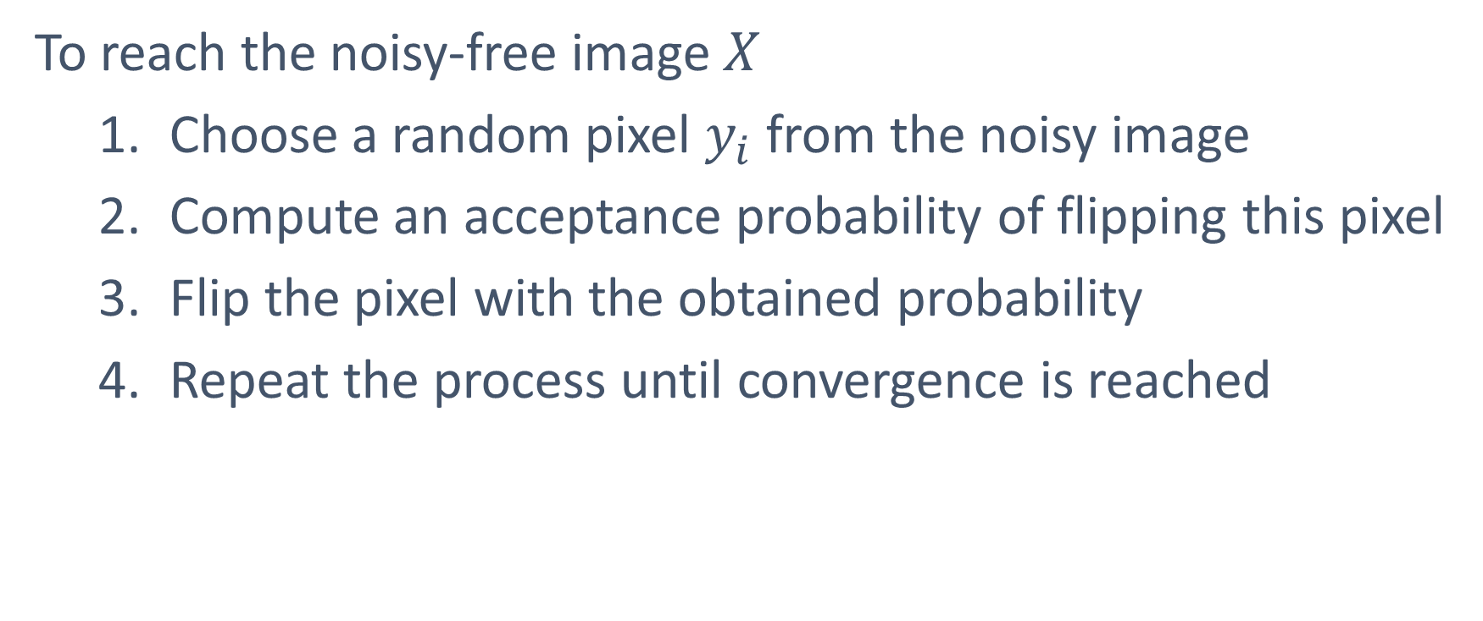
Metropolis-Hastings Sampling
To reach the noisy-free image $X$
  Choose a random pixel $y_{i}$ from the noisy image
  Compute an acceptance probability of flipping this pixel
  Flip the pixel with the obtained probability
  Repeat the process until convergence is reached

Slide 10
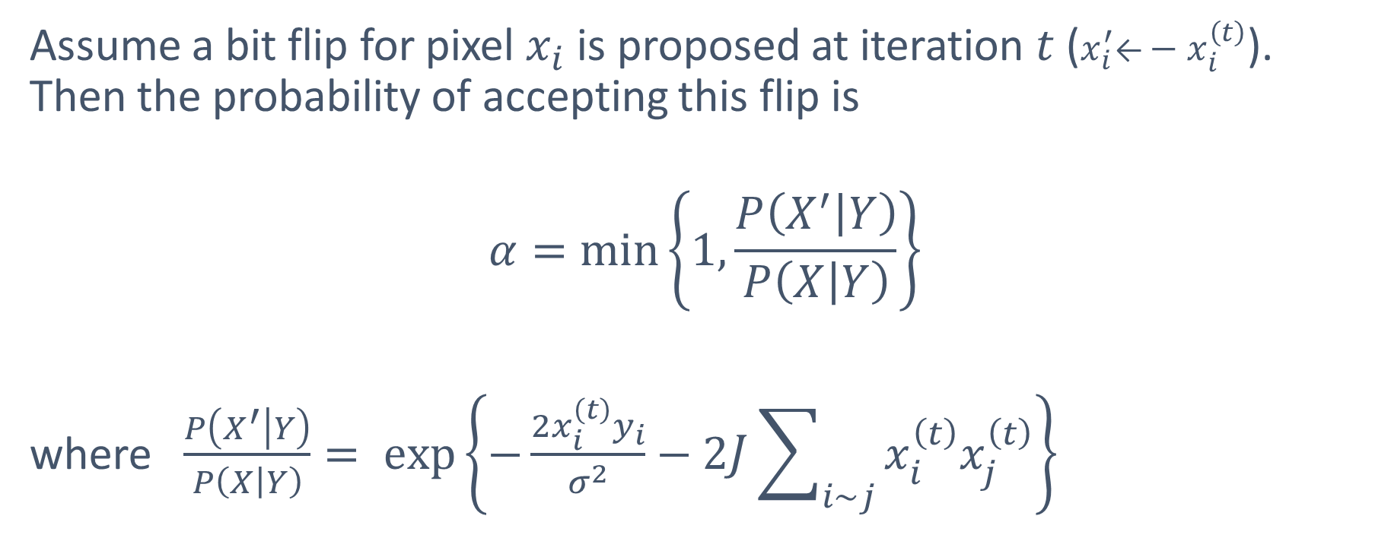
Acceptance probability
Assume a bit flip for pixel $x_{i}$ is proposed at iteration $t$ ($x_{i}^{′}\text{←}−x_{i}^{\left(t\right)}$). Then the probability of accepting this flip is
$$α=\min\left\{1,\frac{P\left(\left.X^{′}\right|Y\right)}{P\left(\left.X\right|Y\right)}\right\}$$
where $\frac{P\left(\left.X^{′}\right|Y\right)}{P\left(\left.X\right|Y\right)}= exp\left\{−\frac{2x_{i}^{\left(t\right)}y_{i}}{σ^{2}}−2J\sum_{i\sim j}{x_{i}^{\left(t\right)}x_{j}^{\left(t\right)}}\right\}$

Slide 11
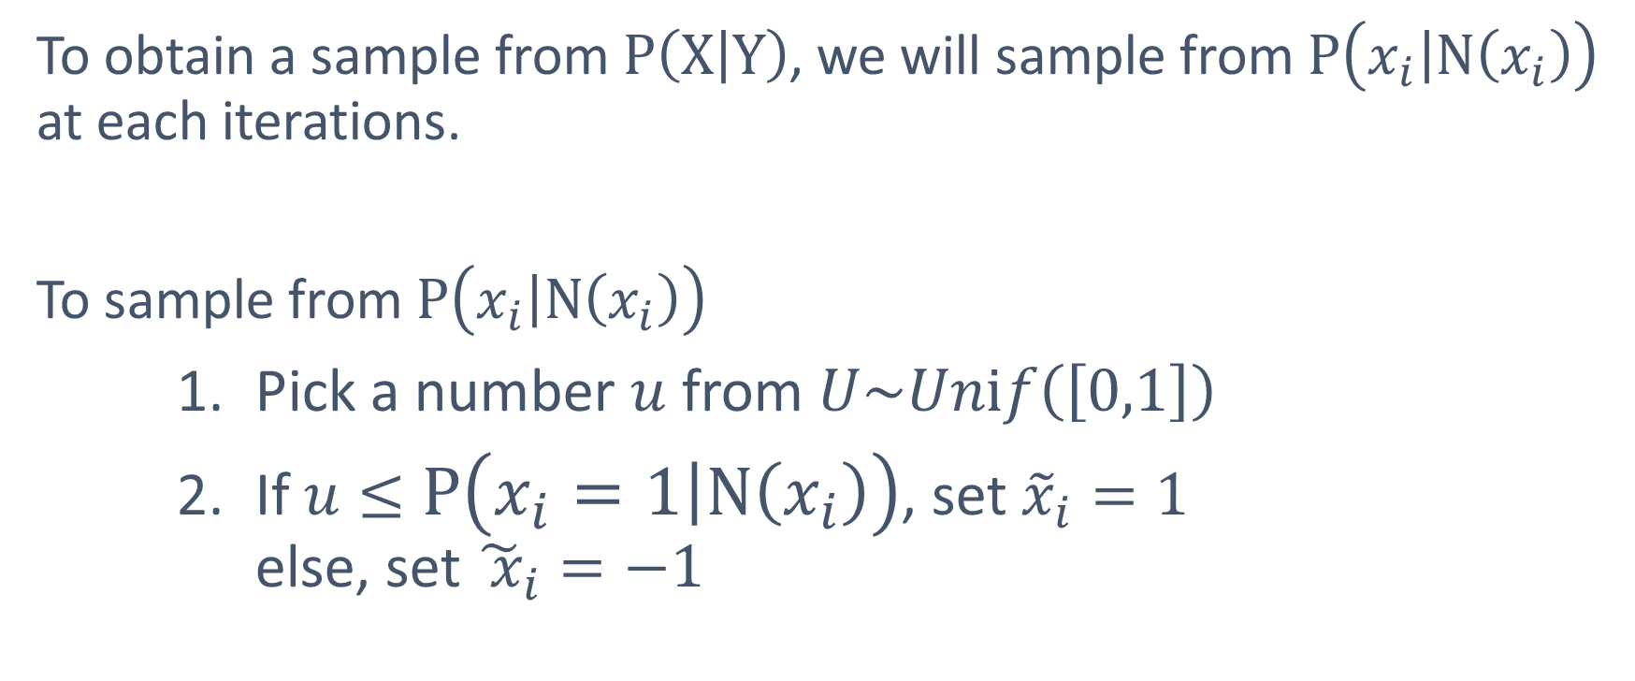
Gibb’s sampling
To obtain a sample from $P\left(\left.X\right|Y\right)$, we will sample from $P\left(\left.x_{i}\right|N\left(x_{i}\right)\right)$ at each iterations.
To sample from $P\left(\left.x_{i}\right|N\left(x_{i}\right)\right)$
    Pick a number $u$from $U\sim Unⅈf\left(\left[0,1\right]\right)$
    If $u≤$ $P\left(\left.x_{i}=1\right|N\left(x_{i}\right)\right)$, set ${\tilde{x}}_{i}=1$
    else, set ${\tilde{ x}}_{i}=−1$

Slide 12
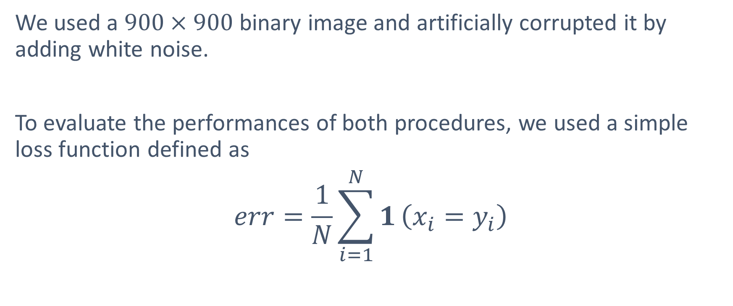
Experimental evaluation
We used a $900×900$ binary image and artificially corrupted it by adding white noise.
To evaluate the performances of both procedures, we used a simple loss function defined as
$$err=\frac{1}{N}\sum_{i=1}^{N}{1}\left(x_{i}=y_{i}\right)$$

Slide 13
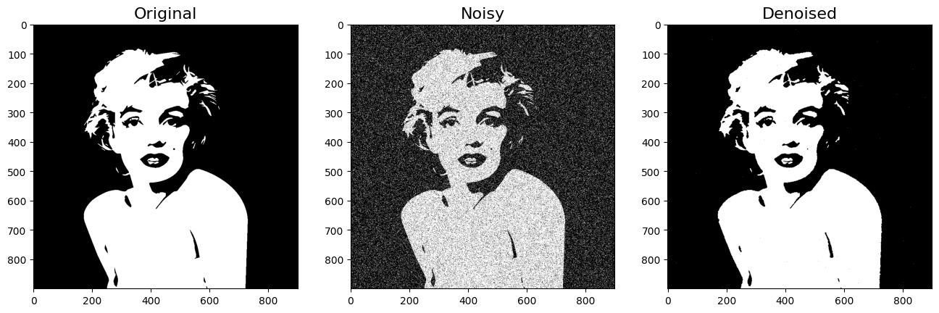
Results using Metropolis-Hastings

Slide 14
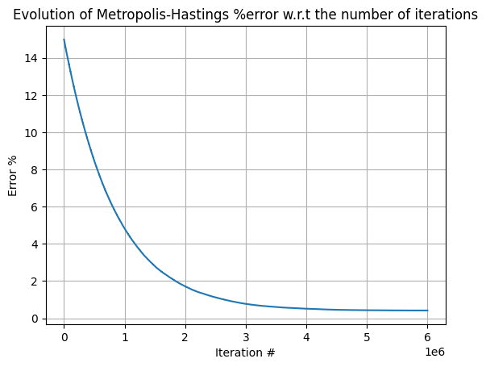
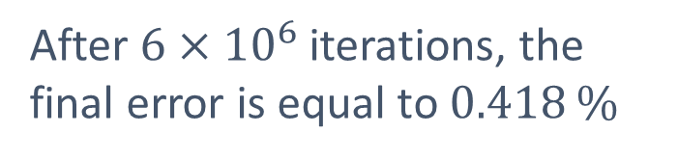
Convergence of Metropolis-Hastings
After $6×{10}^{6}$ iterations, the final error is equal to 0.418 %

Slide 15

Results using Gibbs

Slide 16
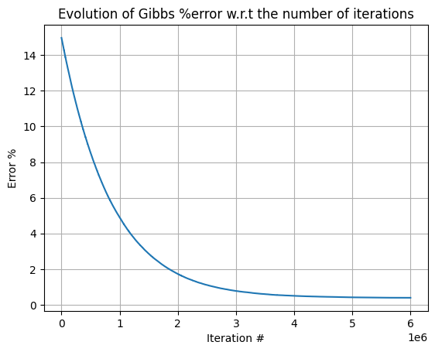
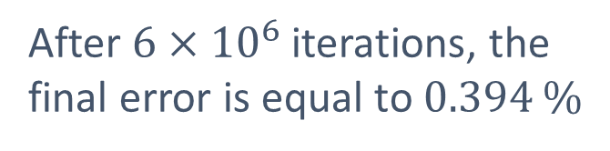
Convergence of Gibbs
After $6×{10}^{6}$ iterations, the final error is equal to 0.394 %

Slide 17
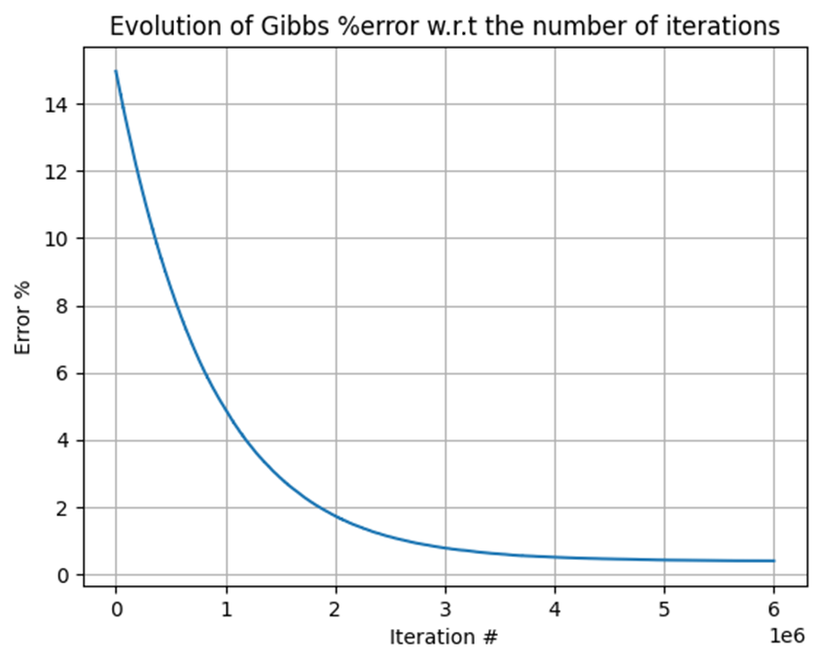
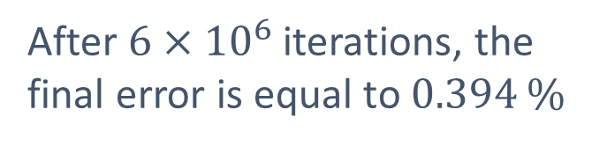
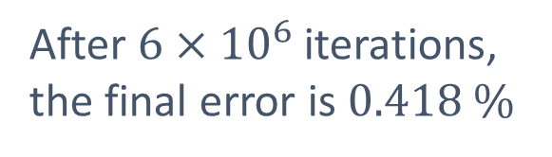
Convergence
After $6×{10}^{6}$ iterations, the final error is 0.418 %

Slide 18
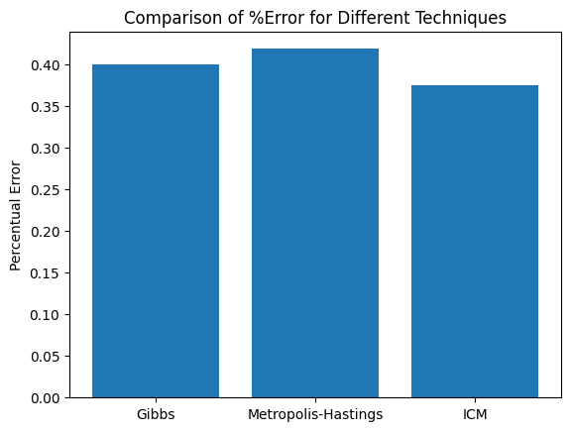
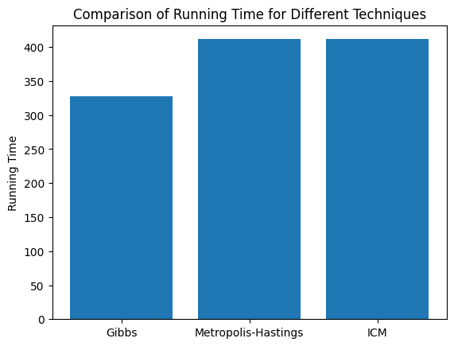
Comparison

