Slide 1

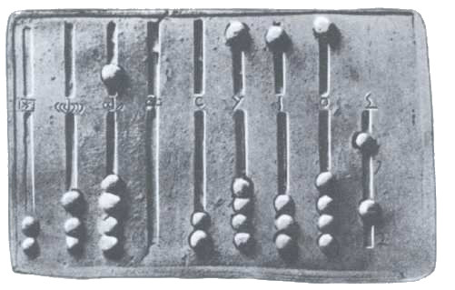
Ancient Math / Modern C++
Petter Holmberg – StockholmCpp XXIII – June 2019

Slide 2
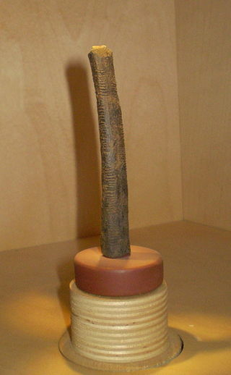
Natural numbers
Ishango bone (D.R. Of Congo, c. 18.000 BC – 20.000 BC)

Slide 3
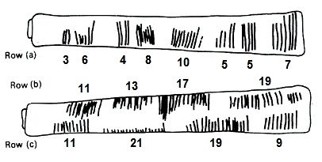
Natural numbers
Ishango bone (D.R. Of Congo, c. 18.000 BC – 20.000 BC)

Slide 4
Natural numbers, prehistoric definition
Defined as:
Written as (today):

Slide 5
Natural numbers as a string of dots
#include <string>
struct PaleolithicNatural
{
std::string k{“.”};
PaleolithicNatural() = default;
// Constructor for the Stone Age person
PaleolithicNatural(std::string const& x)
: k(x.length(), '.')
{}
};

Slide 6
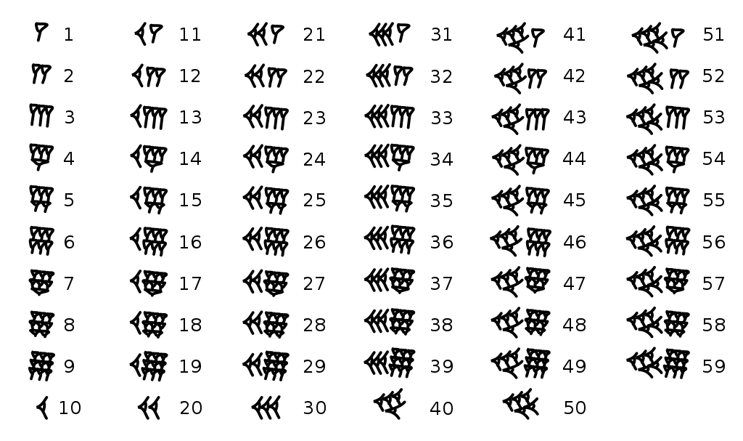
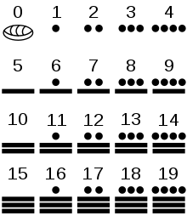
A better representation
Left: Babylonian numerals (c. 2.000 BC)
Right: Mayan numerals (c. 1000 BC)

Slide 7
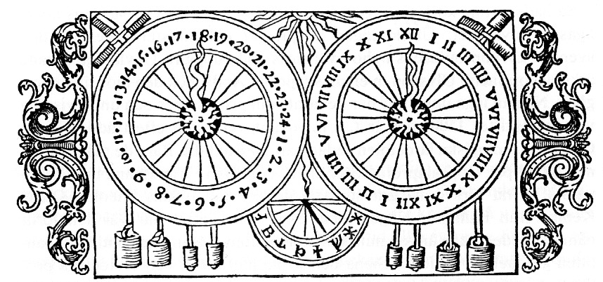
A better representation
Astronomical clock (Uppsala Cathedral, 1506 - 1702)

Slide 8
Highly composite numbers

Slide 9
Rational numbers
Defined as:
Written as:
Rational numbers is the most important example of a Field in mathematics!

Slide 10
Rational numbers
struct Rational
{
int p = 0;
int q = 1;
Rational() = default;
Rational(int x)
: p{x}, q{1}
{}
Rational(int x0, int x1)
//[[expects: x1 != 0]] // In anticipation of C++20 contracts
: p{x0}, q{x1}
{}
};

Slide 11
Relational operators
operator==
operator!=
operator<
operator>=
operator>
operator<=

Slide 12
Rational numbers, equality

Slide 13
Rational numbers, equality
Enables equational reasoning
Enables reasoning about laws of arithmetic
Enables linear search (std::find)

Slide 14
Rational numbers, equality
constexpr auto operator==(Rational x0, Rational x1) -> bool
{
return x0.p * x1.q == x1.p * x0.q;
}
constexpr auto operator!=(Rational x0, Rational x1) -> bool
//[[ensures ret: !(ret == (x0 == x1))]] // Complement
{
return !(x0 == x1);
}

Slide 15
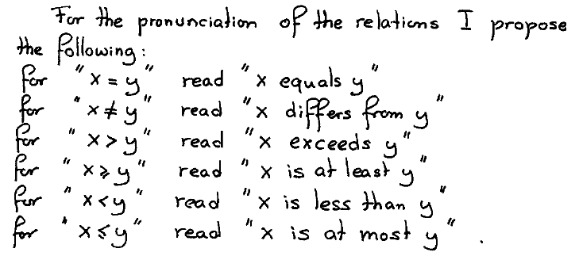
Dijkstra’s nomenclature
EWD768 - “Largely on Nomenclature” - http://www.cs.utexas.edu/users/EWD/ewd07xx/EWD768.PDF

Slide 16
Equivalence relation
Assert that operator== is an equivalence relation!
x ~ x (reflexive)
x ~ y ⇔ y ~ x (symmetric)
x ~ y ∧ y ~ z ⇒ x ~ z (transitive)

Slide 17
Rational numbers, total ordering

Slide 18
Rational numbers, total ordering
Enables fundamental mathematical algorithms (abs, gcd etc.)
Enables sorting (used in std::set, std::map etc.)
Enables binary search (std::lower_bound etc.)

Slide 19
Rational numbers, total ordering
constexpr auto operator<(Rational x0, Rational x1) -> bool
{
return x0.p * x1.q < x1.p * x0.q;
}
constexpr auto operator>=(Rational x0, Rational x1) -> bool
//[[ensures ret: !(ret == (x0 < x1))]] // Complement
{ return !(x0 < x1); }
constexpr auto operator>(Rational x0, T Rational x1) -> bool
//[[ensures ret: !(ret == (x0 <= x1))]] // Converse
{ return x1 < x0; }
constexpr auto operator<=(Rational x0, Rational x1) -> bool
//[[ensures ret: !(ret == (x0 > x1))]] // Complement of converse
{ return !(x1 < x0); }

Slide 20
Weak ordering
x ≺ y ∧ y ≺ z ⇒ x ≺ z (transitive)
Exactly one of the below holds:
(I) (x ≺ y)
(II) (y ≺ x)
(III) (x ~ y) (weak trichotomy)

Slide 21
Total ordering
x < y ∧ y < z ⇒ x < z (transitive)
Exactly one of the below holds:
(I) (x < y)
(II) (y < x)
(III) (x = y) (trichotomy)

Slide 22
Arithmetic operators
operator+
operator*
operator-
operator/

Slide 23
What should this print?
print(“Sweden” + “Cpp”)

Slide 24
What should this print?
print(“Sweden” + “Cpp”)
>>> SwedenCpp

Slide 25
What should this print?
print(“Sweden” * 3)

Slide 26
What should this print?
print(“Sweden” * 3)
>>> SwedenSwedenSweden

Slide 27
What should this print?
print(“Sweden” * “Cpp”)

Slide 28
What should this print?
print(“Sweden” * “Cpp”)
>>> SwedenCpp

Slide 29
Which one is correct?
print(“Sweden” + “Cpp”)
print(“Sweden” * “Cpp”)

Slide 30
Which one is correct?
print(“Sweden” + “Cpp”)
print(“Sweden” * “Cpp”)
C++ std::string got it wrong!
So did Java String…
...and Python string…
...and JavaScript…
...and Go…
…and Swift…
...

Slide 31
Commutativity of addition
x + y = y + x
Holds for ℕ, ℤ, ℚ, ℝ, ℂ
Holds for polynomials
Holds for vectors and matrices
...

Slide 32
Will these print the same string?
print(“Sweden” + “Cpp”)
print(“Cpp” + “Sweden”)

Slide 33
Commutativity of multiplication
x ⋅ y = y ⋅ x
Holds for ℕ, ℤ, ℚ, ℝ, ℂ
Holds for polynomials (regular and scalar multiplication)
Holds for vectors (scalar multiplication)
Does not hold for matrices or quaternions

Slide 34
String concatenation
print(“Sweden” * 3)
print(“Sweden” * “Cpp”)
print(“Sweden” “Cpp”)

Slide 35
Associativity
(x + y) + z = x + (y + z)
(x ⋅ y) ⋅ z = x ⋅ (y ⋅ z)

Slide 36
Associativity
(“This “ “is “ “ a” “sentence ”)
(“consisting “ “of “ “many “ “ words.”)

Slide 37
Associativity
(“This “ “is “ “ a” “sentence ”)
(“consisting “ “of “ “many “ “ words.”)

Slide 38
Semigroups
{ T, ∘ } where:
(x ∘ y) ∘ z = x ∘ (y ∘ z) (associative)
{ int, + } { int, * }
{ int, std::min }
{ bool, & } { bool, | } { bool, ^ }
{ std::string, + } { double, + } { double, * }

Slide 39
Monoids
{ T, ∘, e } where:
(x ∘ y) ∘ z = x ∘ (y ∘ z) (associative)
x ∘ e = e ∘ x = x (identity element)
{ int, +, 0 } { int, *, 1 }
{ int, std::min, std::numeric_limits<int>::max() }
{ bool, &, true } { bool, |, false } { bool, ^, false }
{ std::string, +, “” } { double, +, 0.0 } { double, *, 1.0 }

Slide 40
Distributivity
x ⋅ (y + z) = x ⋅ y + x ⋅ z
(y + z) ⋅ x = y ⋅ x + z ⋅ x

Slide 41
Semirings
{ T, +, 0, ⋅, 1 } where:
{ T, +, 0 } (commutative monoid)
{ T, ⋅, 1} (monoid)
0 ≠ 1
x ⋅ (y + z) = x ⋅ y + x ⋅ z (distributivite)
(y + z) ⋅ x = y ⋅ x + z ⋅ x (distributivite)
{ int, +, 0, *, 1 } { bool, |, false, &, true }
{ int, std::min, std::numeric_limits<int>::max(), +, 0 }

Slide 42
Rational numbers, addition

Slide 43
Rational numbers, additive identity

Slide 44
Rational numbers, addition
constexpr auto
operator+(Rational x0, Rational x1) -> Rational
{
return {x0.p * x1.q + x0.q * x1.p, x0.q * x1.q};
}

Slide 45
Rational numbers, multiplication

Slide 46
Rational numbers, multiplicative identity

Slide 47
Rational numbers, multiplication
constexpr auto
operator*(Rational x0, Rational x1) -> Rational
{
return {x0.p * x1.p, x0.q * x1.q};
}

Slide 48
Rational numbers, subtraction

Slide 49
Groups
{ T, ∘, e } where:
(x ∘ y) ∘ z = x ∘ (y ∘ z) (associative)
x ∘ e = e ∘ x = x (identity element)
x ∘ x⁻¹ = x⁻¹ ∘ x = e (cancellation)
{ int, +, 0 } { int, *, 1 }
{ int, std::min, std::numeric_limits<int>::max() }
{ bool, &, true } { bool, |, false } { bool, ^, false }
{ std::string, +, “” } { double, +, 0.0 } { double, *, 1.0 }

Slide 50
Additive groups enable -
{ T, +, 0 } where:
x + y = y + x (commutative)
(x + y) + z = x + (y + z) (associative)
x + 0 = 0 + x = x (identity element)
x + (-x) = -x + x = 0 (cancellation)
x – y = x + (-y) (subtraction)
T operator-(T const& x) {
return additive_inverse(x);
}
T operator-(T const& x, T const& y) {
return x + (-y);
}

Slide 51
Rational numbers, subtraction

Slide 52
Rational numbers, subtraction
constexpr auto
operator-(Rational x) -> Rational
{
return {-x.p, x.q};
}
constexpr auto
operator-(Rational x0, Rational x1) -> Rational
{
return x0 + (-x1);
}

Slide 53
Rational numbers, generalizing subtraction
constexpr auto
operator-(Rational x) -> Rational
{
return {-x.p, x.q};
}
template <typename G>
constexpr auto
operator-(G const& x0, G const& x1) -> G
{
return x0 + (-x1);
}

Slide 54
Rational numbers, generalizing subtraction
constexpr auto
operator-(Rational x) -> Rational
{
return {-x.p, x.q};
}
#define AdditiveGroup typename // In anticipation of C++20 concepts
template <AdditiveGroup G>
constexpr auto
operator-(G const& x0, G const& x1) -> G
{
return x0 + (-x1);
}

Slide 55
Rings
{ T, +, 0, ⋅, 1 } where:
{ T, +, 0, ⋅, 1 } (semiring)
{ T, +, 0 } (additive group)
{ int, +, 0, *, 1, - }
{ Rational, +, {0, 1} , *, {1, 1}, - }

Slide 56
Integral domains
{ T, +, 0, ⋅, 1 } where:
{ T, +, 0, ⋅, 1 } (ring)
x ⋅ y = y ⋅ x (commutative)
x ⋅ y = 0 ⇒ (x = 0 ∨ y = 0) (no zero divisors)
{ int, +, 0, *, 1, - }
{ Rational, +, {0, 1} , *, {1, 1}, - }

Slide 57
Rational numbers, division
Undefined if:

Slide 58
Rational numbers, division
constexpr auto
operator/(Rational x0, Rational x1) -> Rational
//[[expects: x1 != Rational{0, 1}]]
{
return {x0.p * x1.q, x0.q * x1.p};
}

Slide 59
Fields
{ T, +, 0, ⋅, 1 } where:
{ T, +, 0, ⋅, 1 } (integral domain)
(x ≠ 0) ⇒ x ⋅ x⁻¹ = x⁻¹ ⋅ x = 1 (cancellation)
(y ≠ 0) ⇒ x / y = x ⋅ y⁻¹ (division)
T operator/(T const& x, T const& y)
//[[expects: y != T{0}]]
{
return x * multiplicative_inverse(y);
}

Slide 60
Algebraic concepts
{T, +}
AdditiveSemigroup
MultiplicativeSemigroup
{T, *}
{T, +, 0}
AdditiveMonoid
MultiplicativeMonoid
{T, *, 1}
{T, +, 0, -}
AdditiveGroup
MultiplicativeGroup
{T, *, 1, /}
{T, +, 0, *, 1}
Semiring
{T, +, 0, *, 1, -}
Ring
IntegralDomain
{T, +, 0, *, 1, -, /}
Field

Slide 61
Generalizing rational numbers
struct Rational
{
int p = 0;
int q = 1;
Rational() = default;
Rational(int x)
: p{x}, q{1}
{}
Rational(int x0, int x1)
//[[expects: x0 != 0]]
: p{x0}, q{x1}
{}
};

Slide 62
Generalizing rational numbers
template <IntegralDomain I>
struct Rational
{
I p = 0;
I q = 1;
Rational() = default;
Rational(I const& x)
: p{x}, q{1}
{}
Rational(I const& x0, I const& x1)
//[[expects: x1 != 0]]
: p{x0}, q{x1}
{}
};

Slide 63
Generalizing rational numbers
template <IntegralDomain I>
struct Rational
{
I p = 0;
I q = 1;
Rational() = default;
Rational(I const& x)
: p{x}, q{1}
{}
Rational(I const& x0, I const& x1)
//[[expects: x1 != 0]]
: p{x0}, q{x1}
{}
};

Slide 64
Generalizing rational numbers
template <IntegralDomain I>
struct Rational
{
I p = Zero<I>;
I q = One<I>;
Rational() = default;
Rational(I const& x)
: p{x}, q{One<I>}
{}
Rational(I const& x0, I const& x1)
//[[expects: x1 != Zero<I>]]
: p{x0}, q{x1}
{}
};

Slide 65
Type function, additive identity
template <AdditiveSemigroup S>
struct zero_tf
{
static S const value = S{0}; // Default, other types can specialize
};
template <AdditiveSemigroup S>
S const Zero = zero_tf<S>::value; // Variable template (C++14)

Slide 66
Type function, multiplicative identity
template <MultiplicativeSemigroup S>
struct one_tf
{
static S const value = S{1}; // Default, other types can specialize
};
template <MultiplicativeSemigroup S>
S const One = one_tf<S>::value; // Variable template (C++14)

Slide 67
Rational numbers, Zero and One
template <IntegralDomain I> // Specialization for Zero<Rational<I>>
struct zero_tf<Rational<I>> { static Rational<I> const value; };
template <IntegralDomain I> // Definition of Zero<Rational<I>>
Rational<I> const zero_tf<Rational<I>>::value =
Rational<I>{}; // Default constructor returns {Zero<I>, One<I>}
template <IntegralDomain I> // Specialization for One<Rational<I>>
struct one_tf<Rational<I>> { static Rational<I> const value; };
template <IntegralDomain I> // Definition of One<Rational<I>>
Rational<I> const one_tf<Rational<I>>::value =
Rational<I>{One<I>, One<I>};

Slide 68
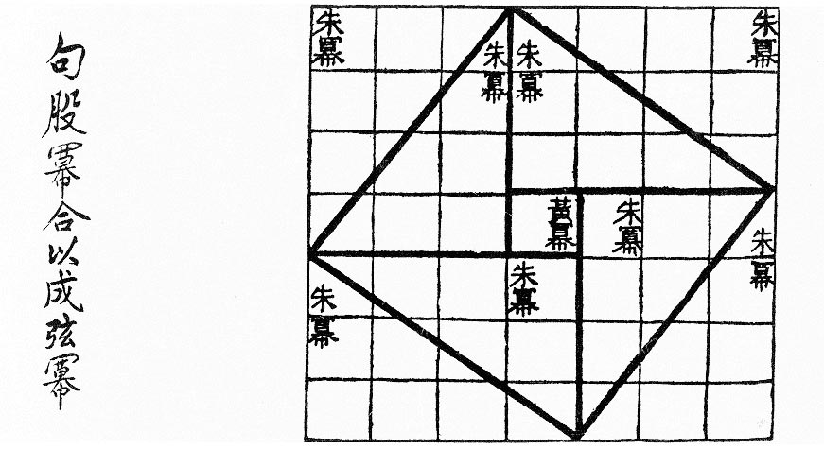
Building on rational numbers
Geometry
Vector2D (Vector Space over the Field Rational<I>)
Point2D (Affine Space over Vector2D)
Line2D (using the Field Rational<I>)
https://github.com/petter-holmberg/talks/blob/master/math.cpp
Zhoubi Suanjing (China, 500–200 BC)

Slide 69
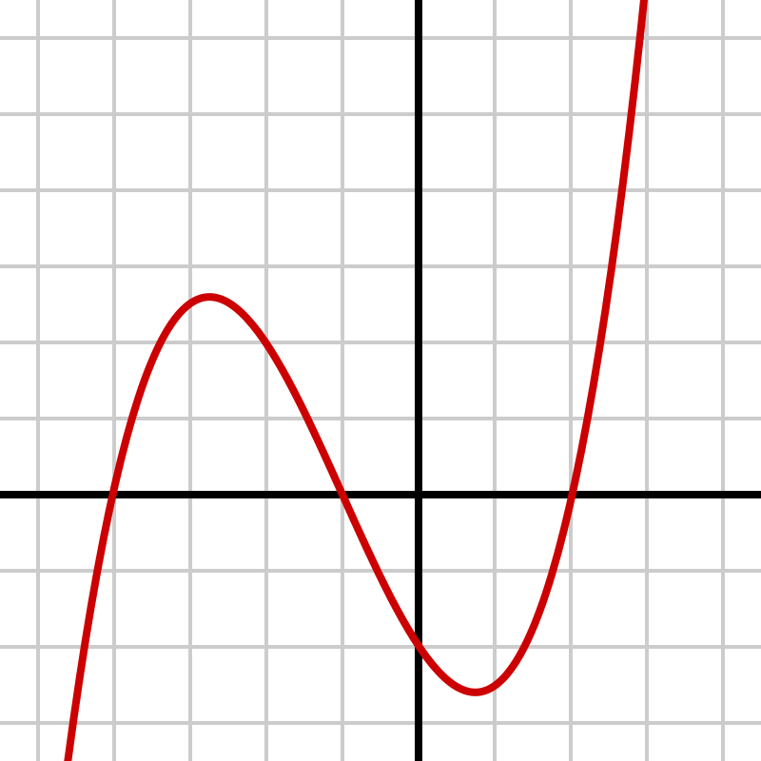
Building on rational numbers
Algebra, Calculus
Polynomial (Ring and Vector Space over any Ring)
https://github.com/petter-holmberg/talks/blob/master/math.cpp

Slide 70
Integers
Defined as:
Written as:
Geometrical interpretation:

Slide 71
Integers
template <Semiring S>
struct Integer
{
S m = Zero<S>;
S n = Zero<S>;
Integer() = default;
Integer(S const& x)
: m{x}, n{Zero<S>}
{}
Integer(S const& x0, S const& x1)
: m{x0}, n{x1}
{}
};

Slide 72
Integers, total ordering

Slide 73
Integers, total ordering
template <Semiring S>
constexpr auto
operator==(Integer<S> const& x0, Integer<S> const& x1) -> bool
{
return x0.m + x1.n == x1.m + x0.n;
}
template <Semiring S>
constexpr auto
operator<(Integer<S> const& x0, Integer<S> const& x1) -> bool
{
return x0.m + x1.n < x1.m + x0.n;
}

Slide 74
Integers, semiring arithmetic

Slide 75
Integers, semiring arithmetic
template <Semiring S>
constexpr auto
operator+(Integer<S> const& x0, Integer<S> const& x1) -> Integer<S> {
return {x0.m + x1.m, x0.n + x1.n};
}
template <Semiring S>
constexpr auto
operator*(Integer<S> const& x0, Integer<S> const& x1) -> Integer<S> {
return {x0.m * x1.m + x0.n * x1.n, x0.m * x1.n + x0.n * x1.m};
}
template <Semiring S>
constexpr auto
operator-(Integer<S> const& x) -> Integer<S> {
return {x.n, x.m};
}

Slide 76
Integers, type functions
template <Semiring S>
struct zero_tf<Integer<S>> { static Integer<S> const value; };
template <Semiring S>
Integer<S> const zero_tf<Integer<S>>::value = Integer<S>{};
template <Semiring S>
struct one_tf<Integer<S>> { static Integer<S> const value; };
template <Semiring S>
Integer<S> const one_tf<Integer<S>>::value = Integer<S>{One<S>};

Slide 77
Natural numbers as a string of dots
#include <string>
struct PaleolithicNatural
{
std::string k;
PaleolithicNatural() = default;
// Constructor for the Stone Age person
PaleolithicNatural(std::string const& x)
: k(x.length(), '.')
{}
// Constructor for the Renissance person
PaleolithicNatural(unsigned x)
: k(x, '.')
{}
};

Slide 78
Natural numbers, total ordering
auto
operator==(PaleolithicNatural const& x0, PaleolithicNatural const& x1) -> bool
{
return x0.k.length() == x1.k.length();
}
auto
operator<(PaleolithicNatural const& x0, PaleolithicNatural const& x1) -> bool
{
return x0.k.length() < x1.k.length();
}

Slide 79
Natural numbers, addition
”...” “.....” = “........”

Slide 80
Natural numbers, addition
auto
operator+(PaleolithicNatural const& x0, PaleolithicNatural const& x1) -> PaleolithicNatural
{
return x0.k + x1.k; // Commutative!
}

Slide 81
Commutativity
”...” “.....” = “........”
“.....” ”...” = “........”

Slide 82
Natural numbers, multiplication
(”...” “...” “...”
“...” “...” “...”
“...” “...” “...”
“...” “...” “...”)

Slide 83
Natural numbers, naïve multiplication
auto
operator*(PaleolithicNatural const& x0, PaleolithicNatural const& x1) -> PaleolithicNatural
{
PaleolithicNatural y;
for (size_t i = 0; i != x0.k.length(); ++i)
{
y = y + x1;
}
return y;
}

Slide 84
Natural numbers, type functions
template <>
struct zero_tf<PaelolithicNatural>
{
static PaleolithicNatural const value;
};
PaleolithicNatural const zero_tf<PaleolithicNatural>::value{""};
template <>
struct one_tf<PaelolithicNatural>
{
static PaleolithicNatural const value;
};
PaleolithicNatural const one_tf<PaleolithicNatural>::value{"."};

Slide 85
Is this good enough?
auto
operator*(PaleolithicNatural const& x0, PaleolithicNatural const& x1) -> PaleolithicNatural
{
PaleolithicNatural y;
for (size_t i = 0; i != x0.k.length(); ++i)
{
y = y + x1;
}
return y;
}

Slide 86
12 ⋅ 3
(”...” “...” “...”
“...” “...” “...”
“...” “...” “...”
“...” “...” “...”)

Slide 87
12 ⋅ 3 = (6 ⋅ 3) + (6 ⋅ 3)
(”...” “...” “...”
“...” “...” “...”)
(“...” “...” “...”
“...” “...” “...”))

Slide 88
12 ⋅ 3 = (6 ⋅ 3) ⋅ 2
(”...” “...” “...”
“...” “...” “...”) * 2

Slide 89
12 ⋅ 3 = (6 ⋅ 3) ⋅ 2
(”...” “...” “...”
“...” “...” “...”) “..................”

Slide 90
13 ⋅ 3
(”...” “...” “...”
“...” “...” “...”
“...” “...” “...”
“...” “...” “...” “...”)

Slide 91
13 ⋅ 3 = (6 ⋅ 3) + (6 ⋅ 3) + 3
(”...” “...” “...”
“...” “...” “...”)
(“...” “...” “...”
“...” “...” “...”) “...”

Slide 92
13 ⋅ 3 = (6 ⋅ 3) ⋅ 2 + 3
(”...” “...” “...”
“...” “...” “...”)
(“..................”) “...”

Slide 93
13 ⋅ 3 = (((1 ⋅ 3) ⋅ 2 + 3) ⋅ 2) ⋅ 2 + 3
(”...”)
(“...”) “...”
(“.........”)
(“..................”) “...” )

Slide 94
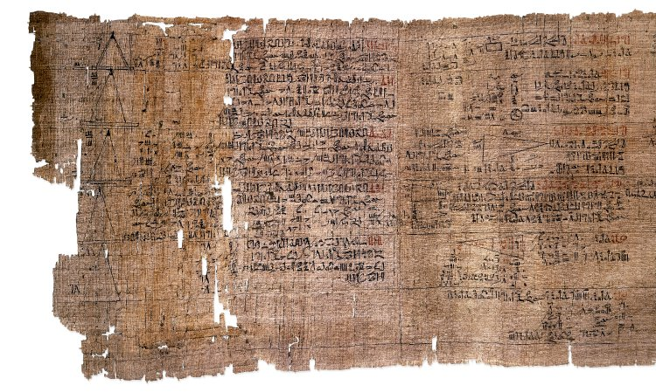
Egyptian multiplication
Rhind mathematical papyrus (Thebes, c. 1550 BC)

Slide 95
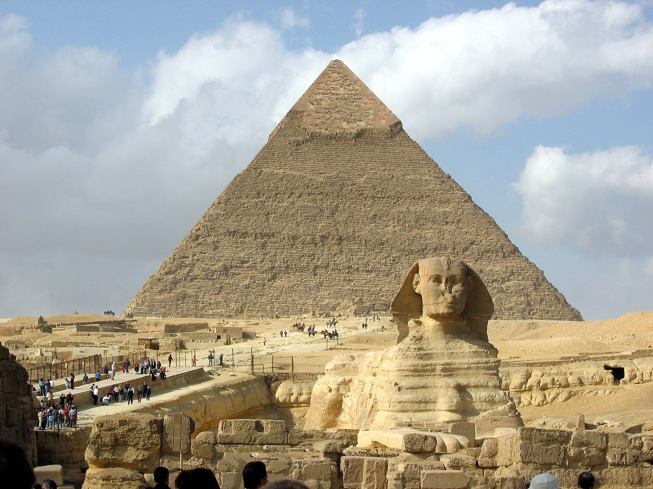
Egyptian multiplication
Pyramid of Khafre and Sphinx (Giza, c. 2532 - 2570 BC)

Slide 96
Natural numbers, egyptian multiplication
auto
multiply(PaleolithicNatural x0, PaleolithicNatural x1) -> PaleolithicNatural
{
if (x0 == Zero<PaleolithicNatural>) return Zero<PaleolithicNatural>;
if (x0 == One<PaleolithicNatural>) return x1;
auto y = multiply(half(x0), x1 + x1); // Done if x0 is even
if (is_odd(x0)) y = y + x1;
return y;
}

Slide 97
Natural numbers, egyptian multiplication
auto
multiply(PaleolithicNatural x0, PaleolithicNatural x1) -> PaleolithicNatural
{
if (x0 == Zero<PaleolithicNatural>) return Zero<PaleolithicNatural>;
if (x0 == One<PaleolithicNatural>) return x1;
auto y = multiply(half(x0), x1 + x1); // Done if x0 is even
if (is_odd(x0)) y = y + x1;
return y;
}

Slide 98
Natural numbers, half, is_odd
auto half(PaleolithicNatural const& x) -> PaleolithicNatural
{
return PaleolithicNatural(x.k.length() >> 1);
}
auto is_odd(PaleolithicNatural const& x) -> bool
{
return x.k.length() & 1;
}

Slide 99
Challenge: Optimize this algorithm!
Convert from recursive to iterative
Optimize the loop
Think about how to generalize it
What are the algebraic concept requirements?
auto
multiply(PaleolithicNatural x0, PaleolithicNatural x1) -> PaleolithicNatural
{
if (x0 == Zero<PaleolithicNatural>) return Zero<NeolithicNatural>;
if (x0 == One<PaleolithicNatural>) return x1;
auto y = multiply(half(x0), x1 + x1); // Done if x0 is even
if (is_odd(x0)) y = y + x1;
return y;
}

Slide 100
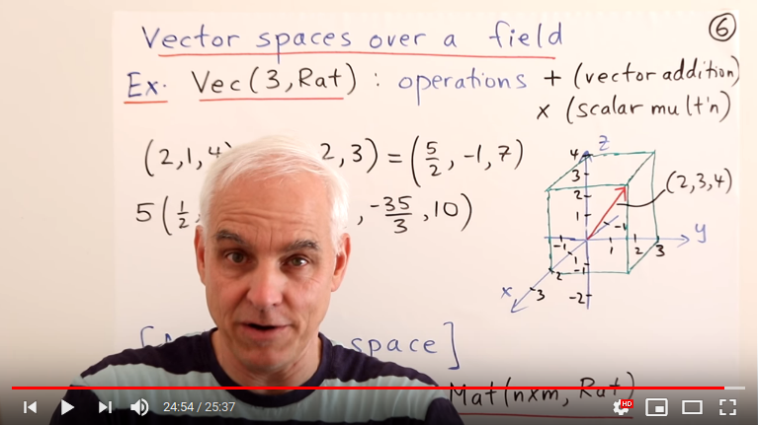
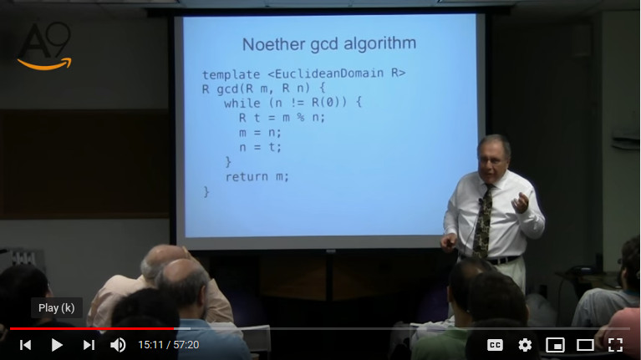
Inspiration for this talk
Norman J. Wildberger – Math Foundations Alexander A. Stepanov – Four Mathematical Journeys

Slide 101
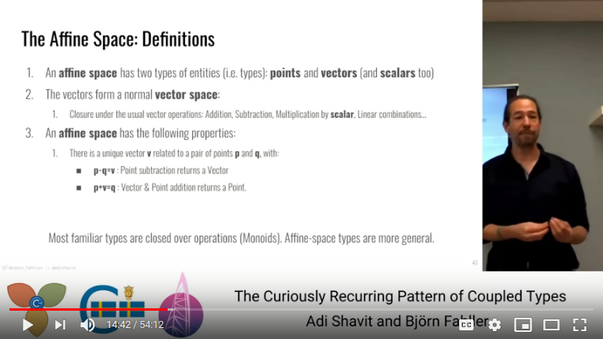
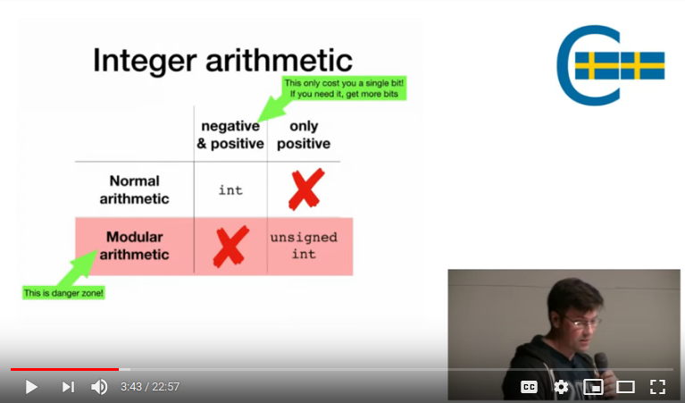
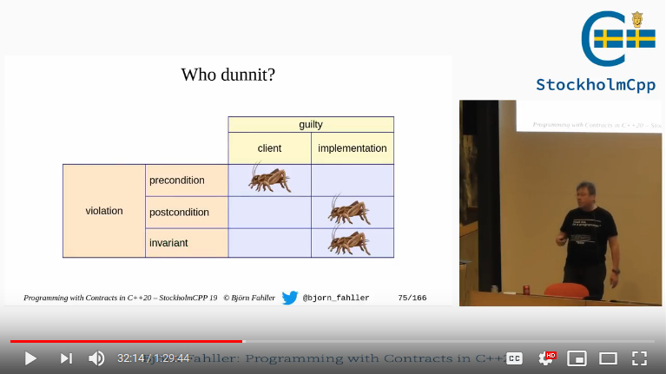
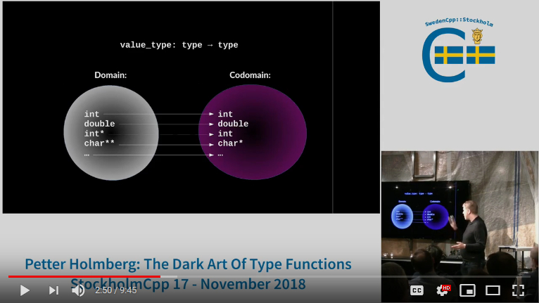
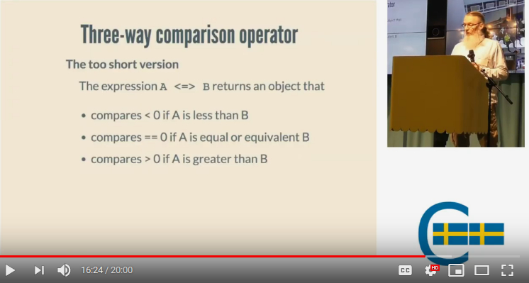
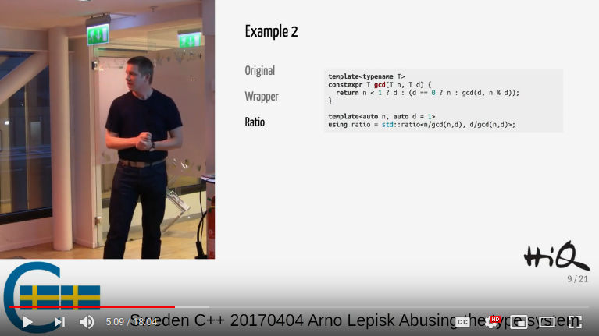
More inspiration for this talk!
Adi Shavit & Björn Fahller – The Curiously Recurring Pattern of Coupled Types
Arvid Norberg – Integers in C++
Björn Fahller – Programming with Contracts in C++20
Petter Holmberg – The Dark Art of Type Functions
Harald Achitz – Less is more, let’s build a spaceship!
Arno Lepisk – Abusing the type system for fun and profit

Slide 102
Takeaways
Remember equivalence, weak and total ordering
Remember commutativity, associativity, distributivity
When overloading operators, math (and C++) decides the semantics
C++ provides a good framework for exploring algebraic concepts
Ancient elementary math is fundamentally important in programming
Slides: https://github.com/petter-holmberg/talks/blob/master/AncientMathModernC++CppSthlm17.pdf
Code: https://github.com/petter-holmberg/talks/blob/master/math.cpp

