Slide 1
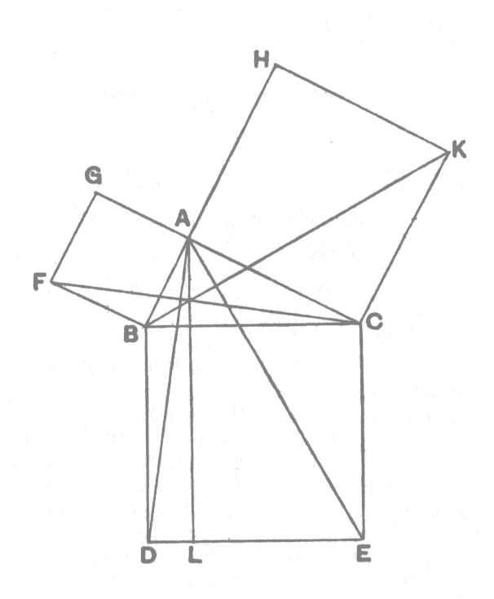
From type to concept
Petter Holmberg – C++ Stockholm 0x06 – September 2017

Slide 2
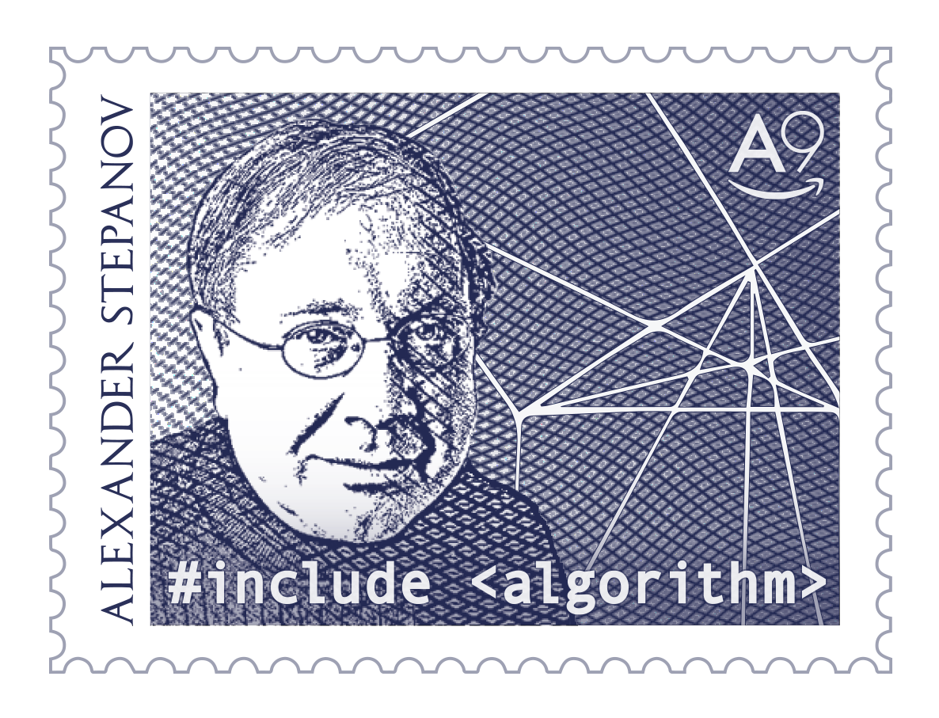
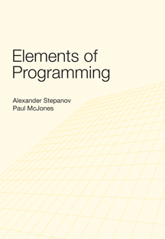
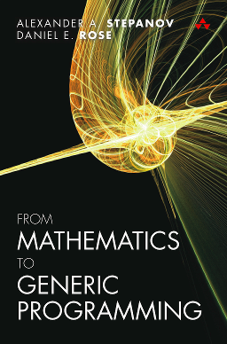
Origins

Slide 3
Concepts
Natural science | Mathematics | Programming
genus species individual | theory model element | concept type or class instance
From Mathematics to Generic Programming §10.3

Slide 4
Concepts
Integral: int, uint8_t, int32_t, …
Character: uint8_t, char, wchar_t, …
Mutex: mutex, recursive_mutex, timed_mutex, …
Clock: chrono::system_clock, chrono::high_resolution_clock, …

Slide 5
Concepts
“A concept can be viewed as a set of requirements on types, or as a predicate that tests whether types meet those requirements. The requirements concern
- The operations the types must provide
- Their semantics
- Their time/space complexity
A type is said to satisfy a concept if it meets these requirements.”
From Mathematics to Generic Programming §10.3

Slide 6
STL concepts
Container: vector<double>, map<uint64_t, string>, …
Iterator: list<bool>::iterator, istream_iterator<int>, int*, …
Invocable: min, [](char&){}, void (fn*)(), …
Regular: int, string, vector<pair<int, string>>, …

Slide 7
Foundations
Semiregular: int, string, class{char, vector<double>}, …
Types with value semantics
Are easily understood by both programmers and compilers
Can be passed to and returned from functions
Compose naturally in standard data structures
Satisfy basic requirements for standard algorithms

Slide 8
C++20 Concepts
template <typename T>
concept Semiregular = true;

Slide 9
C++20 Concepts
template <typename T>
concept Semiregular = true;
template <typename T>
void fn(T t) {}
template <typename T>
struct s {
T t;
};
template <typename T>
constexpr T v = {1, 2, 3};

Slide 10
C++20 Concepts
template <typename T>
concept Semiregular = true;
template <typename T>
requires Semiregular<T>
void fn(T t) {}
template <typename T>
requires Semiregular<T>
struct s {
T t;
};
template <typename T>
requires Semiregular<T>
constexpr T v = {1, 2, 3};

Slide 11
C++ Extensions for Concepts TS
template <typename T>
concept Semiregular = true;
// C++ Extensions for Concepts TS fallback (GCC6+)
#define concept concept bool
// Without concepts
template <typename T>
// requires Semiregular<T>
void fn(T t) {}

Slide 12
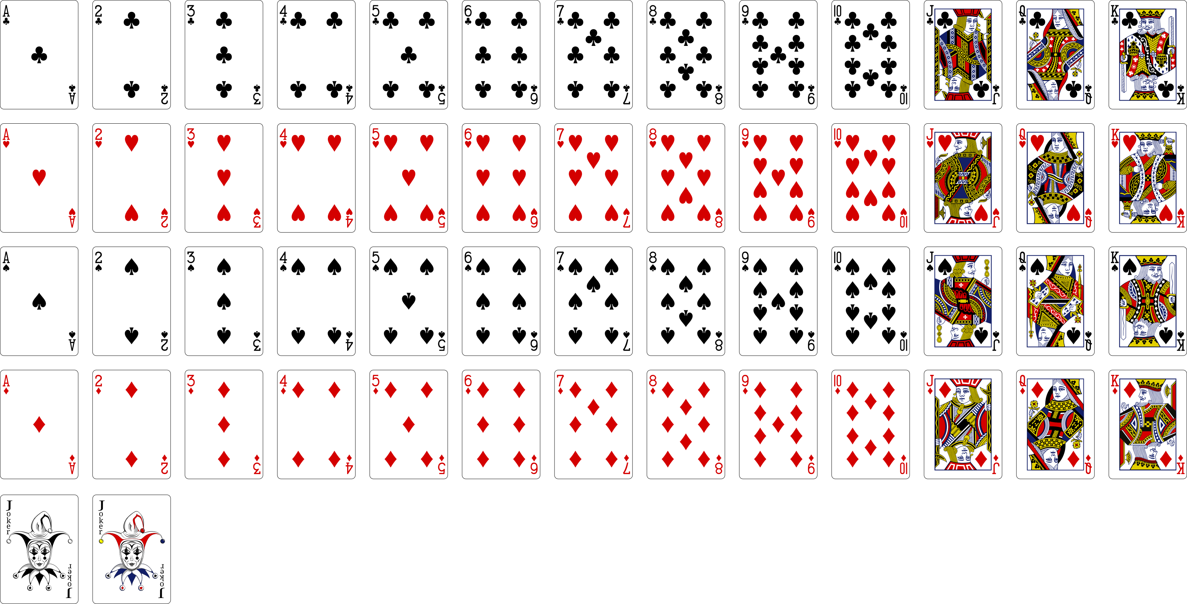
An example type
Vectorized Playing Cards 2.0 - http://sourceforge.net/projects/vector-cards/
Copyright 2015 - Chris Aguilar - conjurenation@gmail.com
Licensed under LGPL 3 - www.gnu.org/copyleft/lesser.html

Slide 13
An example type
enum class rank_t {
joker = 0,
ace_low = 1,
// pip cards not named
jack = 11,
queen = 12,
king = 13,
ace_high = 14 struct card {
}; rank_t rank;
suit_t suit;
enum class suit_t { };
none,
clubs,
diamonds,
hearts,
spades
};

Slide 14
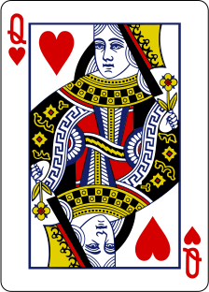
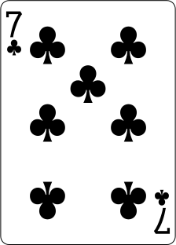

Slide 15
Copy assignment

Slide 16
Copy assignment
←

Slide 17
Copy assignment
=

Slide 18
struct card {
rank_t rank;
suit_t suit;
card& operator=(const card& a) {
rank = a.rank;
suit = a.suit;
return *this;
}
};

Slide 19
template <typename T>
concept Assignable =
requires (T a, const T& b) {
{ a = b } -> T&;
};
// axiom copy_semantics:
// eq(a = b, b)
// complexity:
// O(areaof(b))

Slide 20
Composite objects
local parts
remote parts
vector<int>
int* first int* last int* cap
1 | 2 | 3
vector<int> v {1, 2, 3};
assert(sizeof(v) == 3 * sizeof(int*));
assert(areaof(v) == sizeof(v) + 3 * sizeof(int));
Elements of Programming §12.1

Slide 21
template <typename T>
concept Semiregular =
Assignable<T>;

Slide 23
Destruction

Slide 24
Destruction

Slide 25
struct card {
rank_t rank;
suit_t suit;
card& operator=(const card&);
~card() {}
};

Slide 26
template <typename T>
concept Destructible =
std::is_nothrow_destructible_v<T>;
// axiom end_of_object_lifetimes:
// see §3.4, §12.4 in ISO/IEC N4296
// complexity:
// O(areaof(a))

Slide 27
template <typename T>
concept Semiregular =
Assignable<T> &&
Destructible<T>;

Slide 28
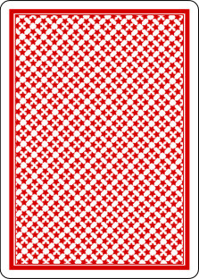

Slide 29
Default construction

Slide 30
Default construction
void fn() {
int i; // what is the value of i?
int j = i; // undefined behavior
i = 52; // OK to assign to i
} // OK to destruct i

Slide 31
Default construction
“An object is in a partially formed state if it can be assigned to or destroyed. For an object that is partially formed but not well formed, the effect of any procedure other than assignment (only on the left side) and destruction is not defined.”
Elements of Programming §1.5

Slide 32
Default construction

Slide 33

Default construction

Slide 34
struct card {
rank_t rank;
suit_t suit;
card& operator=(const card& a) {
rank = a.rank;
suit = a.suit;
return *this;
}
~card() {}
card() {}
};

Slide 35
template <typename T, typename ...Args>
concept Constructible =
Destructible<T> &&
std::is_constructible_v<T, Args...>;

Slide 36
template <typename T>
concept Default_constructible =
Constructible<T>;

Slide 37
template <typename T>
concept Semiregular =
Assignable<T> &&
Default_constructible<T>;
// axiom partially_formed:
// T a is not necessarily well-formed
// T a => eq(a = b, b)
// T a => ~a()
// complexity of default constructor:
// O(sizeof(a))

Slide 38
Default construction + assignment

Slide 39
Default construction + assignment

Slide 40
Default construction + assignment

Slide 41
Default construction + assignment
←

Slide 42
Default construction + assignment
=

Slide 43
Copy construction

Slide 44
Copy construction

Slide 45
Copy construction
←

Slide 46
Copy construction
=

Slide 47
struct card {
rank_t rank;
suit_t suit;
card& operator=(const card&);
~card();
card();
card(const card& a)
: rank{a.rank}
, suit{a.suit}
{}
};

Slide 48
template <typename T>
concept Copy_constructible =
Constructible<T, const T&>;
// axiom copy_semantics:
// eq(T{a}, a)
// complexity:
// O(areaof(a))

Slide 49
template <typename T>
concept Copyable =
Copy_constructible<T> &&
Assignable<T>;

Slide 50
template <typename T>
concept Semiregular =
Copyable<T> &&
Default_constructible<T>;
// axiom partially_formed:
// T a is not necessarily well-formed
// T a => eq(a = b, b)
// T a => ~a()
// complexity of default constructor:
// O(sizeof(a))

Slide 51
Move assignment

Slide 52
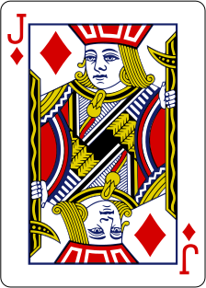
Move assignment

Slide 53
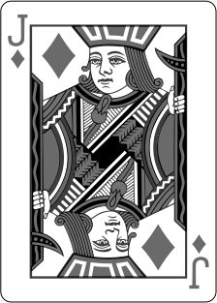
Move assignment
←

Slide 54
Standard library requirements
MoveAssignable requirements:
Expression Return type Return value Post-condition
T = rv T& t t is equivalent to the value of rv before the assignment
rv’s state is unspecified [Note: rv must still meet the requirements of the library component that is using it. The operations listed in those requirements must work as specified whether rv has been moved from or not. — end note]
ISO/IEC N4296 §17.6.3.1, Table 22

Slide 55

Standard library requirements
←

Slide 56
struct card {
rank_t rank;
suit_t suit;
card& operator=(const card&);
~card();
card();
card(const card&);
card& operator=(card&& a) {
rank = a.rank;
suit = a.suit;
return *this;
}
};

Slide 57
template <typename T, typename U>
concept Assignable =
requires (T a, U&& b) {
{ a = std::forward<U>(b) } -> T&;
};
// axiom copy_semantics:
// eq(a = b, b)
// axiom move_semantics:
// eq(a, b) => eq(a, c = std::move(b))
// op(a) requires no specified value =>
// b = std::move(a) => op(a)
// }
// complexity of copy assignment:
// O(areaof(b))
// complexity of move assignment:
// O(sizeof(b))

Slide 58
template <typename T>
concept Semiregular =
Copyable<T> &&
Default_constructible<T>;
// axiom partially_formed:
// T a is not necessarily well-formed
// T a => a = std::move(b)
// T a => eq(a = b, b)
// T a => ~a()
// complexity of default constructor:
// O(sizeof(a))

Slide 59
Move construction

Slide 60
Move construction

Slide 61
Move construction
←

Slide 62
struct card {
rank_t rank;
suit_t suit;
card& operator=(const card&);
~card();
card();
card(const card&);
card& operator=(card&&);
card(card&& a)
: rank{a.rank}
, suit{a.suit}
{}
};

Slide 63
template <typename T>
concept Move_constructible =
Constructible<T, T&&>;
// axiom move_semantics:
// eq(a, b) => eq(T{std::move(a)}, b)
// op(a) requires no specified value =>
// T b{std::move(a)} => op(a)
// }
// complexity:
// O(sizeof(a))

Slide 64
template <typename T>
concept Copy_constructible =
Move_constructible<T> &&
Constructible<T, const T&>;

Slide 65
template <typename T>
concept Movable =
Move_constructible<T> &&
Assignable<T, T&&>;

Slide 66
template <typename T>
concept Copyable =
Movable<T> &&
Copy_constructible<T> &&
Assignable<T, const T&>;

Slide 67
template <typename T>
concept Semiregular =
Copyable<T> &&
Default_constructible<T>;
// axiom partially_formed:
// T a is not necessarily well-formed
// T a => a = std::move(b)
// T a => a = b
// T a => ~a
// complexity of default constructor:
// O(sizeof(a))

Slide 68
struct card {
rank_t rank;
suit_t suit;
card& operator=(const card& a) {
rank = a.rank; suit = a.suit; return *this;
}
~card() {}
card(const card& a) : rank{a.rank}, suit{a.suit} {}
card() {}
card(card&& a) : rank{a.rank}, suit{a.suit} {}
card& operator=(card&& a) {
rank = a.rank; suit = a.suit; return *this;
}
};

Slide 69
struct card {
rank_t rank;
suit_t suit;
};

Slide 70
Destructible
Assignable
Constructible
Default_constructible
Move_constructible
Copy_constructible
Movable
Copyable
Semiregular

Slide 71
Equality_comparable
Destructible
Assignable
Constructible
Default_constructible
Move_constructible
Copy_constructible
Movable
Copyable
Default_totally_ordered*
Semiregular
Underlying_type*
Regular
*Required by Stepanov, not in std proposals
Totally_ordered

Slide 72
“One of your central goals as a programmer should be to identify existing concepts in your application. You will often develop new algorithms, occasionally develop a new data structure, and only rarely define a new concept. In that rare situation, a lot of work is needed to ensure that it is a true concept and not just a collection of unrelated requirements.”
From Mathematics to Generic Programming §10.9

Slide 73
More information
Generic programming
Alexander A. Stepanov, Paul McJones, Dave Musser et al.
http://stepanovpapers.com/
Overload Journal article series on concepts, issues #129, #131, #136
Andrew Sutton
https://accu.org/index.php/journals/c78/
Concepts: The Future of Generic Programming
Bjarne Stroustrup
http://stroustrup.com/good_concepts.pdf
STL2 (“C++ Extensions for Ranges")
Casey Carter, Eric Niebler
https://github.com/CaseyCarter/cmcstl2

