Slide 1
Functional Parsing in C++20
Petter Holmberg – C++ Stockholm 0x1F – February 2022

Slide 2
Open Question
“C++ is a general-purpose language with a bias towards systems programming that
is a better C
supports data abstraction
supports object-oriented programming
supports generic programming”
[Bjarne Stroustrup, HOPL-IV, §2.1]
With C++20, could we add “supports functional programming” to the list?
https://dl.acm.org/doi/abs/10.1145/3386320

Slide 3








What is Functional Programming?
Some Core Ideas:
Immutable data (easier to reason about, good for parallelism)
Pure functions (equality-preserving, no observable side effects)
Higher order functions (take functions as arguments, return functions as results)
Iteration via recursion instead of loops (no imperative code)
Partial application (apply only some arguments to functions, like e.g. std::bind)
Example Languages:

Slide 4
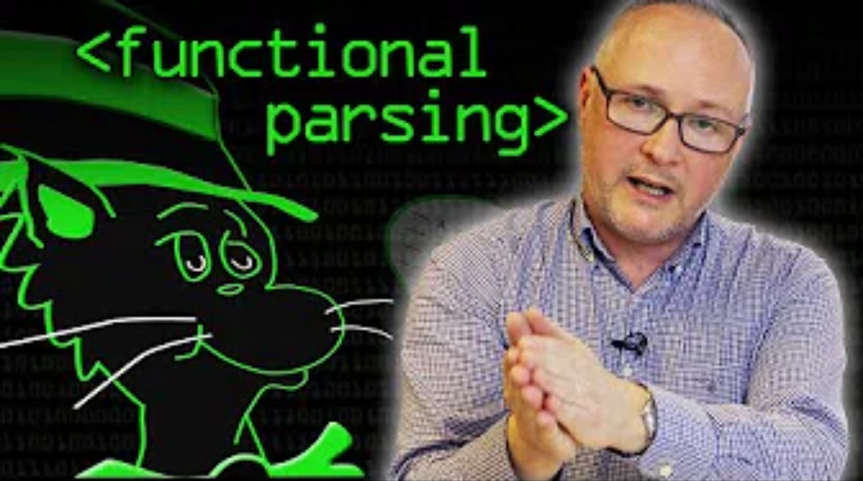
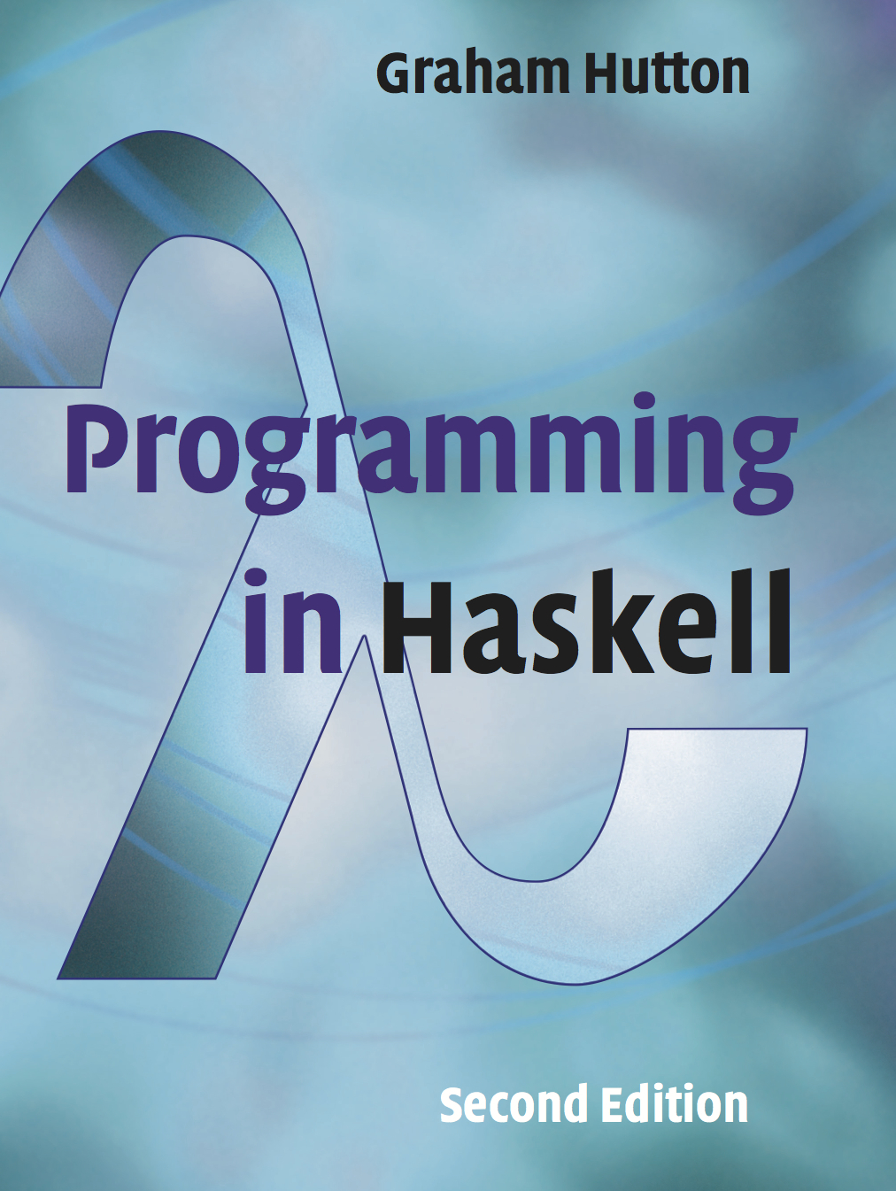
Inspiration
https://www.youtube.com/watch?v=dDtZLm7HIJs

Slide 5
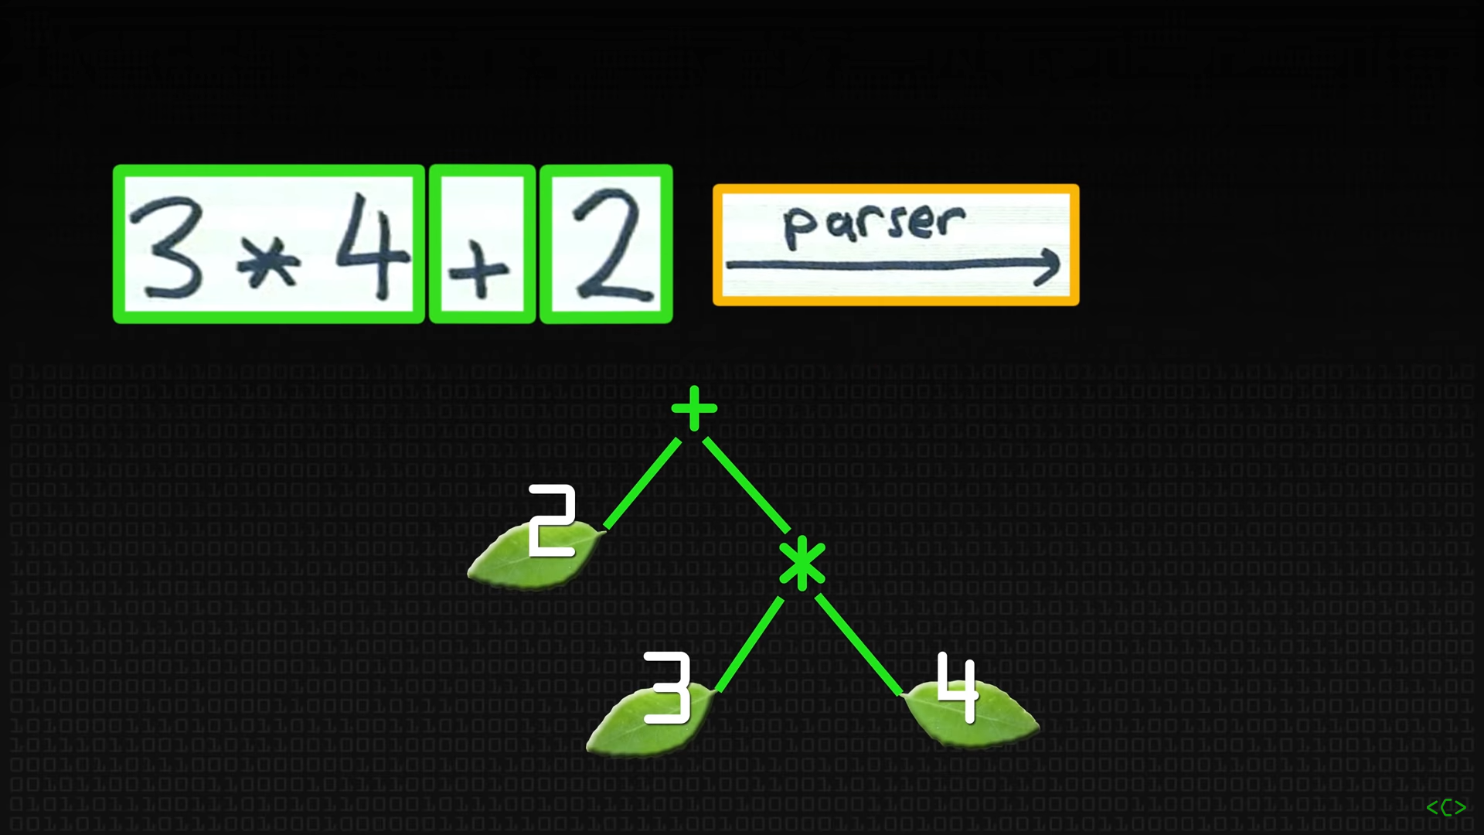
String Parsing
https://www.youtube.com/watch?v=dDtZLm7HIJs

Slide 6
Grammar (EBNF, Niklaus Wirth 1977)
expr = term "+" expr | term.
term = factor "*" term | factor.
factor = "(" expr ")" | integer.
integer = ["-"] digit {digit}.
digit = "0" | "1" | "2" | "3" | "4" | "5" | "6" | "7" | "8" | "9".
https://dl.acm.org/doi/10.1145/359863.359883

Slide 7
Two Approaches to Writing a Parser
Parser Generator:
Tool turns grammar into parser source code in host language
Programmer adds code to handle the parsed tokens
Compiled parser parses full input
Parser Combinator:
Trivial parser functions written directly in the parser’s host language parse partial input
Generic higher-order functions combine simple parsers into more complex parsers
Programmer adds custom parsers with code to handle the parsed tokens
Compiled parser parses full input

Slide 8
Parsers

Slide 9
Signature of a Parser
// Suggested parser signature, take #1
auto parser(std::string_view input) -> T;

Slide 10
Signature of a Parser
// Suggested parser signature, take #2
auto parser(std::string_view input) -> std::pair<T, std::string_view>;

Slide 11
Signature of a Parser
// Suggested parser signature, take #3
auto parser(std::string_view input) -> std::optional<std::pair<T, std::string_view>>;

Slide 12
Signature of a Parser
// Type constructor (alias template) that returns the type of a parsed T
template <typename T>
using Parsed_t = std::optional<std::pair<T, std::string_view>>;
auto parser(std::string_view input) -> Parsed_t<T>;

Slide 13
Signature of a Parser
// Type constructor (alias template) that returns the type of a parsed T
template <typename T>
using Parsed_t = std::optional<std::pair<T, std::string_view>>;
auto parser(std::string_view input) -> Parsed_t<T>;
”A Parser of Things”
”Is a function from strings”
“To an optional pair”
“of Things and strings”
Credit: Fritz Ruehr, Willamette University

Slide 14
What is a Concept?
“A concept can be viewed as a set of requirements on types, or as a predicate that tests whether types meet those requirements. The requirements concern
- The operations the types must provide
- Their semantics
- Their time/space complexity
A type is said to satisfy a concept if it meets these requirements.”
[From Mathematics to Generic Programming §10.3]
“… components that C++ programs may use to perform compile-time validation of template arguments and perform function dispatch based on properties of types.”
[ISO/IEC 14882:2020, §18.1]

Slide 15
Two C++20 Standard Concepts
// Check if two types are the same
static_assert(std::same_as<int, int>); // Compiles
static_assert(std::same_as<int, double>); // Error
// Check if a type is callable with argument types (by passing it to std::invoke)
// and is a “pure function” (equality-preserving, no observable side effects etc.)
static_assert(std::regular_invocable<decltype(::atoi), char const*>); // Compiles
static_assert(std::regular_invocable<decltype(::rand)>); // Compiles (!)
static_assert(std::regular_invocable<int>); // Error

Slide 16
Parser as a Concept, take #1
template <typename P>
concept Parser =
"A Parser of Things"
"Is a function from strings"
"To an optional pair"
"of Things and strings";

Slide 17
Parser as a Concept, take #2
template <typename P>
concept Parser =
std::regular_invocable<P, std::string_view> &&
"To an optional pair"
"of Things and strings";
”A Parser of Things”
”Is a function from strings”

Slide 18
Parser as a Concept, take #2
template <typename P>
concept Parser =
std::regular_invocable<P, std::string_view> &&
requires (std::invoke_result_t<P, std::string_view> result) {
std::same_as<
decltype(result),
Parsed_t<typename decltype(result)::value_type::first_type>>;
};
”A Parser of Things”
”Is a function from strings”
“To an optional pair”
“of Things and strings”

Slide 19
Parser Type Functions
template <typename P>
concept Parser =
std::regular_invocable<P, std::string_view> &&
requires (std::invoke_result_t<P, std::string_view> result) {
std::same_as<
decltype(result),
Parsed_t<typename decltype(result)::value_type::first_type>>;
};
template <Parser P>
using Parser_result_t = std::invoke_result_t<P, std::string_view>;
template <Parser P>
using Parser_value_t = typename Parser_result_t<P>::value_type::first_type;

Slide 20
Parsing Single Characters
// A Parser that consumes the first character (if any) of the input string
inline constexpr auto
item = [](std::string_view input) -> Parsed_t<char>
{
if (input.empty()) {
return {};
} else {
return {{input[0], input.substr(1)}};
}
};
static_assert(Parser<decltype(item)>);
// Examples
static_assert(item("foo") == Parsed_t<char>{{'f', "oo"}});
static_assert(item("") == Parsed_t<char>{});

Slide 21
Empty Parsers
// Parsers that always produce an empty result
template <typename T>
inline constexpr auto
empty = [](std::string_view) -> Parsed_t<T>
{
return {};
};
static_assert(Parser<decltype(empty<int>)>);
// Examples
static_assert(empty<char>("foo") == Parsed_t<char>{});
static_assert(empty<int>("") == Parsed_t<int>{});

Slide 22
Parser Combinators

Slide 23
Parser Combinator as a Concept
template <typename F, typename... Args>
concept Parser_combinator =
std::regular_invocable<F, Args...> &&
Parser<std::invoke_result_t<F, Args...>>;
template <typename F, typename... Args>
requires Parser_combinator<F, Args...>
using Parser_combinator_value_t = std::invoke_result_t<F, Args...>;

Slide 24
Parsing Strings
// Return a Parser that matches the beginning of the input
constexpr Parser auto
str(std::string_view match)
{
return [match](std::string_view input) -> Parsed_t<std::string>
{
if (input.starts_with(match)) {
return {{
std::string{match}, {input.begin() + match.size(), input.end()}
}};
} else {
return {};
}
};
}
static_assert(Parser_combinator<decltype(str), std::string_view>);
// Example
assert(str("foo")("foobar")->first == "foo");

Slide 25
Parsing a Thing without doing any Parsing
// Return a Parser that returns an instance of T and the unconsumed input
template <typename T>
constexpr Parser auto
unit(T const& thing)
{
return [thing](std::string_view input) -> Parsed_t<T>
{
return {{thing, input}};
};
}
static_assert(Parser_combinator<decltype(unit('x')), char>);
// Examples
static_assert(unit('x')("foo") == Parsed_t<char>{{'x', "foo"}});
static_assert(unit(42)("") == Parsed_t<int>{{42, ""}});

Slide 26
Making Choices
// Try one Parser and invoke a second Parser if the first one fails
template <Parser P, Parser Q>
requires std::convertible_to<Parser_value_t<P>, Parser_value_t<Q>>
constexpr Parser auto
operator|(P p, Q q)
{
return [=](std::string_view input) -> Parser_result_t<Q>
{
if (auto const& result = std::invoke(p, input)) {
return result;
} else {
return std::invoke(q, input);
}
};
}
// Example
static_assert((empty<char> | item | unit('x'))("") == unit('x')(""));

Slide 27
Making Choices with a Fold Expression
constexpr Parser auto
choice(Parser auto parser, Parser auto... parsers)
{
if constexpr (std::is_pointer_v<decltype(parser)>) {
return ([parser](auto input){ return std::invoke(parser, input); }
| ... | parsers);
} else {
return (parser | ... | parsers); // Binary left fold
}
}
// Examples
static_assert((empty<char> | item | unit('x'))("") == unit('x')(""));
static_assert(choice(empty<char>, item, unit('x'))("") == unit('x')(""));

Slide 28
Chaining Parsers
// Compose a Parser with a unary function returning a Parser
template <Parser P, Parser_combinator<Parser_value_t<P>> F>
constexpr Parser auto
operator&(P parser, F func)
{
using Parser_t = Parser_combinator_value_t<F, Parser_value_t<P>>;
return [=](std::string_view input) -> Parser_result_t<Parser_t>
{
if (auto const& result = std::invoke(parser, input)) {
return std::invoke(std::invoke(func, result->first), result->second);
} else {
return {};
}
};
}
// Example
static_assert((item & unit<char>)("foo") == item("foo"));

Slide 29
Chaining Parsers with a Fold Expression
constexpr Parser auto
chain(Parser auto parser, auto... funcs)
{
if constexpr (std::is_pointer_v<decltype(parser)>) {
return ([parser](auto input){ return std::invoke(parser, input); }
& ... & funcs);
} else {
return (parser & ... & funcs); // Binary left fold
}
}
// Examples
static_assert((item & unit<char>)("foo") == item("foo"));
static_assert(chain(item, unit<char>)("foo") == item("foo"));

Slide 30
Skipping a Parsed Thing
// Invoke one Parser, throw away its result and invoke a second Parser
constexpr Parser auto
skip(Parser auto p, Parser auto q)
{
return [=](std::string_view input)
{
if (auto const& result = std::invoke(p, input)) {
return std::invoke(q, result->second);
} else {
return std::invoke(q, input);
}
};
}
// Example
static_assert(skip(item, unit('x'))("foo") == Parsed_t<char>{{'x', "oo"}});

Slide 31
Skipping a Parsed Thing
// Invoke one Parser, throw away its result and invoke a second Parser
constexpr Parser auto
skip(Parser auto p, Parser auto q)
{
return [=](std::string_view input)
{
if (auto const& result = std::invoke(p, input)) {
return std::invoke(q, result->second);
} else {
return std::invoke(q, input);
}
};
}
// Alternative version, using a composition of choice and chain
constexpr Parser auto
skip(Parser auto p, Parser auto q)
{
return choice(chain(p, [q](auto const&){ return q; }), q);
}

Slide 32
Parsing Digits
// A Parser that consumes one digit
auto digit(std::string_view input) -> Parsed_t<char>
{
if (!input.empty() && ::isdigit(input[0])) {
return {{input[0], input.substr(1)}};
} else {
return {};
}
}

Slide 33
Parsing Lowercase Letters
// A Parser that consumes one lowercase character
auto lower(std::string_view input) -> Parsed_t<char>
{
if (!input.empty() && ::islower(input[0])) {
return {{input[0], input.substr(1)}};
} else {
return {};
}
}

Slide 34
Parsing Uppercase Letters
// A Parser that consumes one uppercase character
auto upper(std::string_view input) -> Parsed_t<char>
{
if (!input.empty() && ::isupper(input[0])) {
return {{input[0], input.substr(1)}};
} else {
return {};
}
}

Slide 35
Factoring Out the Logic
// Return a Parser that applies a std::predicate to another Parser
template <typename Pr, Parser P = decltype(item)>
requires std::predicate<Pr, Parser_value_t<P>>
constexpr Parser auto
satisfy(Pr pred, P parser = item)
{
return chain(
parser,
[pred](auto const& th) -> Parser auto
{
return [pred, th](std::string_view input) -> Parsed_t<Parser_value_t<P>>
{
if (std::invoke(pred, th)) return {{th, input}}; else return {};
};
}
);
}

Slide 36
Predicate-based Single-character Parsers
Parser auto digit = satisfy(::isdigit);
Parser auto lower = satisfy(::islower);
Parser auto upper = satisfy(::isupper);
Parser auto letter = choice(lower, upper);
Parser auto alphanum = choice(letter, digit);
constexpr Parser auto
symbol(char x)
{
return satisfy([x](char y){ return x == y; });
}
inline constexpr Parser auto plus = symbol('+');

Slide 37
Iteration

Slide 38
Parsing Things 0+ Times
template <typename T, Parser P, std::regular_invocable<T, Parser_value_t<P>> F>
requires std::convertible_to<std::invoke_result_t<F, T, Parser_value_t<P>>, T>
class reduce_many
{
T init; P parser; F func;
public:
reduce_many(T const& thing, P const& p, F const& fn)
: init{thing}, parser{p}, func{fn}
{}
constexpr auto operator()(std::string_view input) const -> Parsed_t<T>
{
return choice(
chain(parser, [this](auto const& thing)
{
return reduce_many{std::invoke(func, init, thing), parser, func};
}),
unit(init)
)(input);
}
};

Slide 39
Parsing Things 0+ Times
// Repeat a char parser 0+ times and concatenate the result into a string
template <Parser P>
requires std::same_as<Parser_value_t<P>, char>
constexpr Parser auto
many(P parser)
{
return reduce_many(
std::string{},
parser,
[](std::string const& str, char ch){ return str + ch; }
);
}
// Examples
assert(many(symbol('+'))("+++---")->first == "+++"); // OK
assert(many(symbol('+'))("---+++")->first == ""); // OK

Slide 40
Parsing Tokens
Parser auto whitespace = many(satisfy(::isspace));
constexpr Parser auto
token(Parser auto parser)
{
return chain(
skip(whitespace, parser),
[](auto const& thing){ return skip(whitespace, unit(thing)); }
);
}
// Examples
assert(token(str("foo"))(" foo bar ")->first == "foo"); // OK
assert(token(str("foo"))(" foo bar ")->second == "bar "); // OK

Slide 41
Parsing Things 1+ Times
// Repeat a char parser 1+ times and concatenate the result into a string
template <Parser P>
requires std::same_as<Parser_value_t<P>, char>
constexpr Parser auto
some(P parser)
{
return chain(
parser,
[=](char ch){ return many(parser); },
[=](std::string const& str){ return unit(std::string(1, ch) + str); }
);
}
// Examples
assert(some(symbol('+'))("+++---")->first == "+++"); // OK
assert(some(symbol('+'))("---+++")); // Not OK

Slide 42
Parsing Things 1+ Times
// Repeat a char parser 1+ times and concatenate the result into a string
template <Parser P>
requires std::same_as<Parser_value_t<P>, char>
constexpr Parser auto
some(P parser)
{
return chain(
parser,
[=](char ch)
{
[=](char ch){ return many(parser); },
[=](std::string const& str){ return unit(std::string(1, ch) + str); }
}
);
}

Slide 43
Parsing Things 1+ Times
// Repeat a char parser 1+ times and concatenate the result into a string
template <Parser P>
requires std::same_as<Parser_value_t<P>, char>
constexpr Parser auto
some(P parser)
{
return chain(
parser,
[=](char ch)
{
return chain(
[=](char ch){ return many(parser); },
[=](std::string const& str){ return unit(std::string(1, ch) + str); }
);
}
);
}

Slide 44
Parsing Things 1+ Times
// Repeat a char parser 1+ times and concatenate the result into a string
template <Parser P>
requires std::same_as<Parser_value_t<P>, char>
constexpr Parser auto
some(P parser)
{
return chain(
parser,
[=](char ch)
{
return chain(
many(parser),
[=](std::string const& str){ return unit(std::string(1, ch) + str); }
);
}
);
}

Slide 45
Parsing Numbers
Parser auto natural = chain(
some(digit),
[](std::string const& digits){ return unit(std::stoi(digits)); }
);
Parser auto integer = choice(
natural,
chain(
symbol('-'),
[](auto){ return natural; },
[](int nat){ return unit(-nat); }
)
);
// Example
assert(integer("42")->first == 42); // OK
assert(integer("-42")->first == -42); // OK

Slide 46
Associative Property of chain
chain( chain(
token(integer), token(integer),
[](int x){ return token(integer); }, [](int x){ return chain(
[](int y){ return token(integer); }, token(integer),
[](int z){ return unit(x + y + z); } [x](int y){ return chain(
); token(integer),
[x, y](int z){ return unit(
x + y + z
);
});
});
});

Slide 47
Associative Property of chain
chain( chain(
token(integer), token(integer), [](int x){ return chain(
[](int x){ return token(integer); }, token(integer), [x](int y){ return chain(
[](int y){ return token(integer); }, token(integer), [x, y](int z){ return
[](int z){ return unit(x + y + z); } unit(x + y + z); }); }); });
);

Slide 48
Associative Property of chain
chain( chain(
token(integer), token(integer), [](int x){ return chain(
[](int x){ return token(integer); }, token(integer), [x](int y){ return chain(
[](int y){ return token(integer); }, token(integer), [x, y](int z){ return
[](int z){ return unit(x + y + z); } unit(x + y + z); }); }); });
);

Slide 49
Associative Property of chain
chain( chain(
token(integer), token(integer), [](int x){ return chain(
[](int x){ return token(integer); }, token(integer), [x](int y){ return chain(
[](int y){ return token(integer); }, token(integer), [x, y](int z){ return
[](int z){ return unit(x + y + z); } unit(x + y + z); }); }); });
);
-- Haskell do notation
do x <- token integer
y <- token integer
z <- token integer
return (x + y + z)

Slide 50
Applicative Parsing

Slide 51
Partial Function Application
// Examples
constexpr int sum_3(int x, int y, int z){ return x + y + z; }
static_assert(sum_3(4, 5, 6) == 15); // Compiles
static_assert(sum_3(4, 5)); // Error: Too few arguments
static_assert(sum_3(4)); // Error: Too few arguments
static_assert(sum_3()); // Error: Too few arguments

Slide 52
Partial Function Application
inline constexpr decltype(auto)
papply = []<typename F, typename... Args>(F&& f, Args&&... args)
{
if constexpr (std::invocable<F, Args...>) {
return std::invoke(std::forward<F>(f), std::forward<Args>(args)...);
} else { // Assuming too few args to invoke f
return std::bind_front(std::forward<F>(f), std::forward<Args>(args)...);
}
};
// Examples
constexpr int sum_3(int x, int y, int z){ return x + y + z; }
static_assert(papply(sum_3, 4, 5, 6) == 15); // Compiles
static_assert(papply(sum_3, 4, 5)(6) == 15); // Compiles
static_assert(papply(sum_3, 4)(5, 6) == 15); // Compiles
static_assert(papply(sum_3)(4)(5)(6) == 15); // Compiles (currying!)

Slide 53
Applicative Sequencing of Parsers
// Combine two Parsers using the Callable returned by the first Parser
template <Parser P, Parser Q>
constexpr Parser auto
operator^(P p, Q q)
{
using Result_t =
std::invoke_result_t<decltype(papply), Parser_value_t<P>, Parser_value_t<Q>>;
return [=](std::string_view input) -> Parsed_t<Result_t>
{
if (auto const& pr = std::invoke(p, input)) {
if (auto const& qr = std::invoke(q, pr->second)) {
return {{papply(pr->first, qr->first), qr->second}};
} else {
return {};
}
} else {
return {};
}
};
}

Slide 54
Applicative Sequencing of Parsers
template <typename F, Parser... Ps>
requires std::regular_invocable<F, Parser_value_t<Ps>...>
constexpr Parser auto
sequence(F func, Ps... parsers)
{
return (unit(func) ^ ... ^ parsers); // Binary left fold
}
// Example
Parser auto sum3_parser = sequence(
[](int x, int y, int z){ return x + y + z; }
token(integer), // do x <- token integer
token(integer), // y <- token integer
token(integer) // z <- token integer
); // return (x + y + z)
assert(sum3_parser("4 5 6")->first == 15);
// Exercise: Implement operator^ using chain

Slide 55
Parsing Things 1+ Times, take #2
// Repeat a char parser 1+ times and concatenate the result into a string
template <Parser P>
requires std::same_as<Parser_value_t<P>, char>
constexpr Parser auto
some(P parser)
{
return chain(
parser,
[=](char ch)
{
return chain(
many(parser),
[=](std::string const& str){ return unit(std::string(1, ch) + str); }
);
}
);
}

Slide 56
Parsing Things 1+ Times, take #2
// Repeat a char parser 1+ times and concatenate the result into a string
template <Parser P>
requires std::same_as<Parser_value_t<P>, char>
constexpr Parser auto
some(P parser)
{
return sequence(
[](char ch, std::string const& str){ return std::string(1, ch) + str; },
parser,
many(parser)
);
}

Slide 57
Three Complex Parsers

Slide 58
Example #1: Parsing Mathematical Expressions
auto expr(std::string_view input) -> Parsed_t<int>;
auto term(std::string_view input) -> Parsed_t<int>;
auto factor(std::string_view input) -> Parsed_t<int>;
expr = term "+" expr | term.
term = factor "*" term | factor.
factor = "(" expr ")" | integer.
integer = ["-"] digit {digit}.
digit = "0" | "1" | "2" | "3" | "4" | "5" | "6" | "7" | "8" | "9".

Slide 59
Example #1: Parsing Mathematical Expressions
auto expr(std::string_view input) -> Parsed_t<int>
{
return choice(
sequence(
[](int x, auto, int y){ return x + y; },
term,
symbol('+'),
expr
),
term
)(input);
}
expr = term "+" expr | term.

Slide 60
Example #1: Parsing Mathematical Expressions
auto term(std::string_view input) -> Parsed_t<int>
{
return choice(
sequence(
[](int x, auto, int y){ return x * y; },
factor,
symbol('*'),
term
),
factor
)(input);
}
term = factor "*" term | factor.

Slide 61
Example #1: Parsing Mathematical Expressions
auto factor(std::string_view input) -> Parsed_t<int>
{
return token(
choice(
sequence(
[](auto, int x, auto){ return x; },
symbol('('),
expr,
symbol(')')
),
integer
)
)(input);
}
factor = "(" expr ")" | integer.

Slide 62
Example #1: Parsing Mathematical Expressions
assert(expr("3 * 4 + 2")->first == 14);
assert(expr("3 * (4 + 2)")->first == 18);
assert(expr("3 * (-4 + 2)")->first == -6);
assert(expr(" ( 3 * ((-4) + 2) ) ")->first == -6);
assert(expr("3 * (4 - 2)")->first == 3);
assert(expr("3 * (4 - 2)")->second == "* (4 - 2)");
assert(!expr("three * 4 + 2"));

Slide 63
Example #1: Haskell Version
expr :: Parser Int
expr = do x <- term
symbol '+'
y <- expr
return (x + y)
<|> term
term :: Parser Int
term = do x <- factor
symbol '*'
y <- term
return (x * y)
<|> factor
factor :: Parser Int
factor = token (do symbol '('
x <- expr
symbol ')'
return x
<|> integer)
expr = term "+" expr | term.
term = factor "*" term | factor.
factor = "(" expr ")" | integer.

Slide 64
Example #2: Parsing EBNF Grammars
syntax = {production}.
production = identifier "=" expression ".".
expression = term {"|" term}.
term = factor {factor}.
factor = identifier | literal
| "(" expression ")"
| "[" expression "]"
| "{" expression "}".
literal = """" character {character} """".
https://dl.acm.org/doi/10.1145/359863.359883

Slide 65
Example #2: A C++ EBNF Parser Generator
// production = identifier "=" expression "."
auto production(std::string_view input) -> Parsed_t<Ast>
{
return
sequence(
[](auto id, auto, auto ex, auto){ return Ast{Production{id, ex}}; },
token(identifier),
token(symbol('=')),
expression,
symbol('.')
)(input);
}
auto production(std::string_view input)
{
return
sequence(
[](auto, auto, auto, auto){ return /* TODO */; },
identifier,
symbol('='),
expression,
symbol('.')
)(input);
}

Slide 66
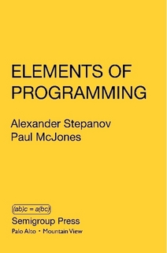
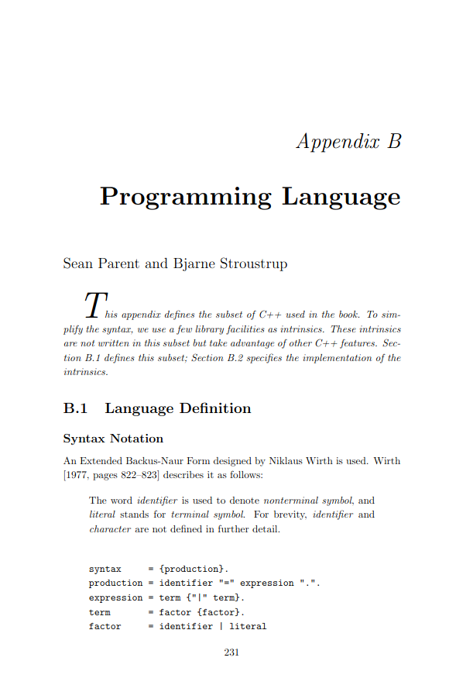
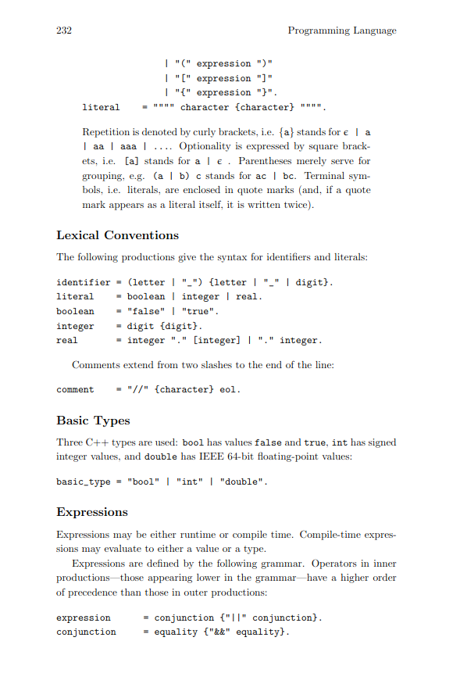
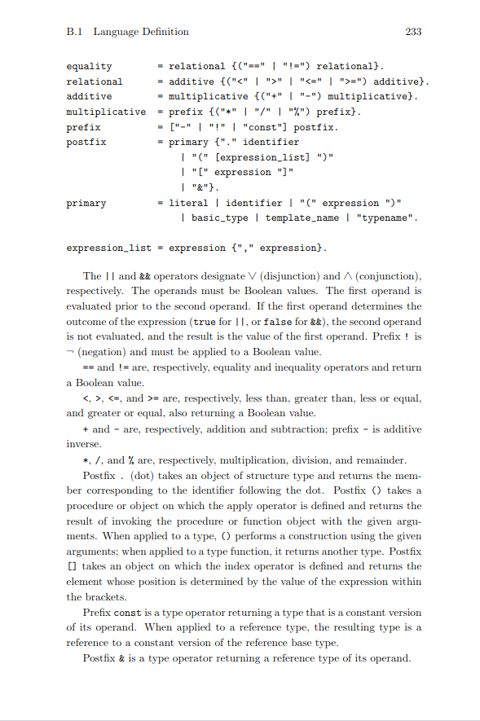
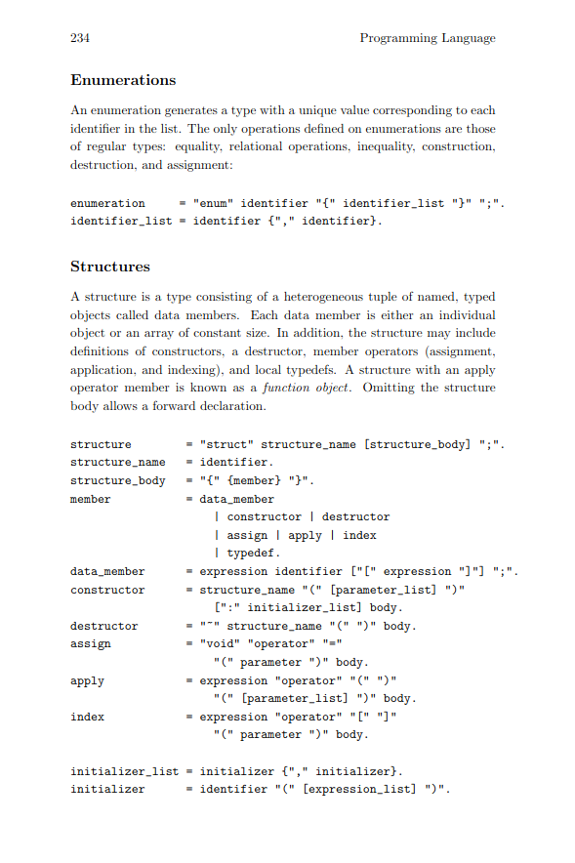
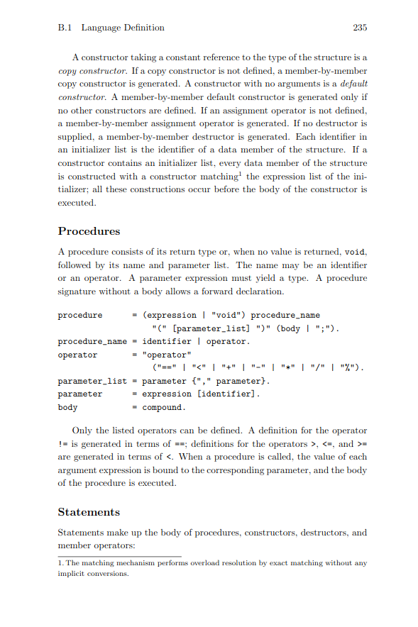
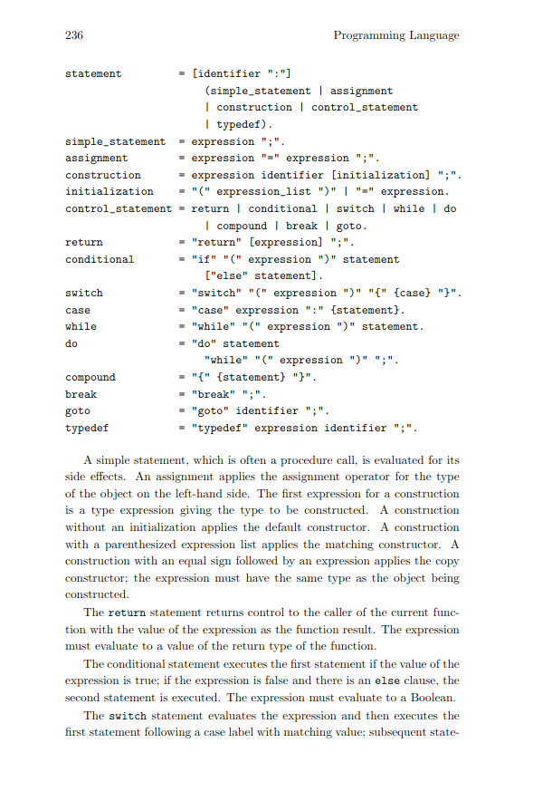
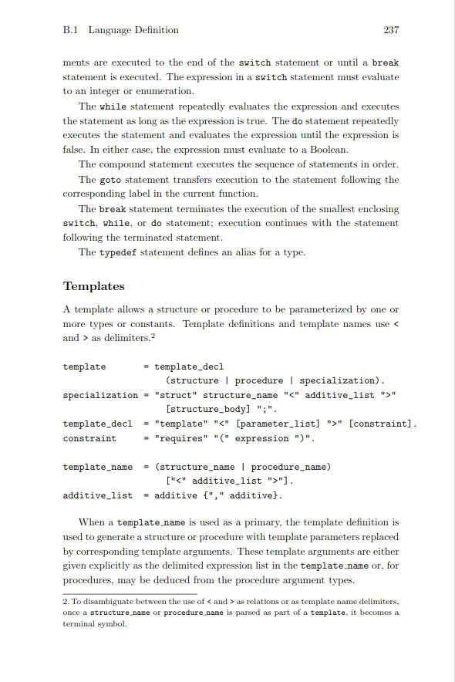
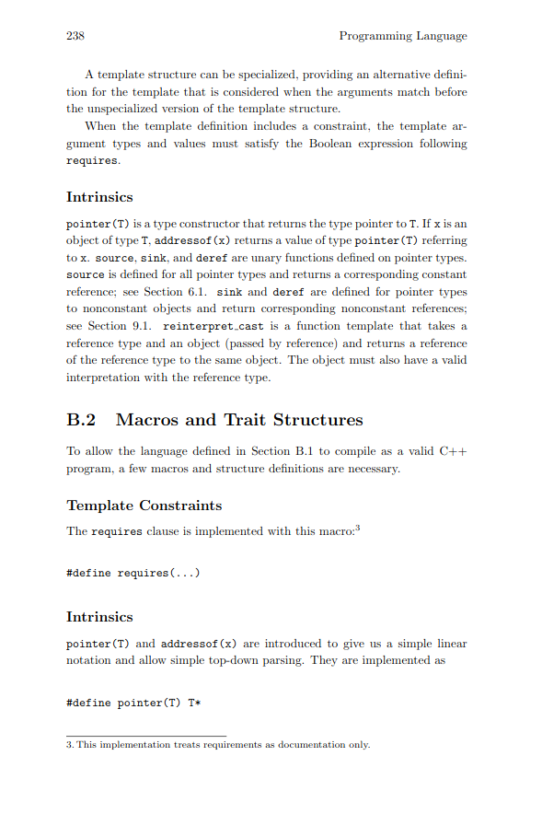
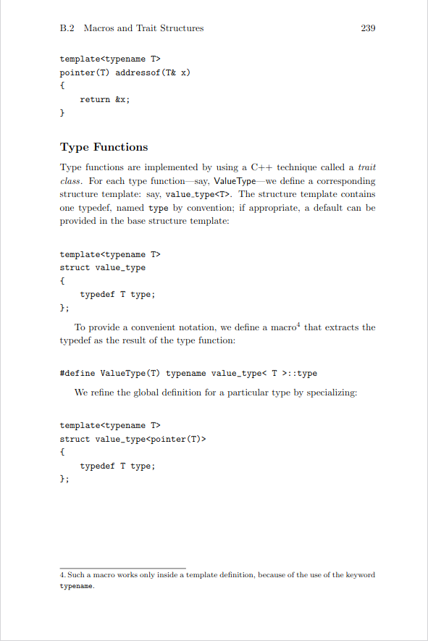
Example #3: Parsing C++
http://elementsofprogramming.com

Slide 67
Example #3: Parsing C++
// while = "while" "(" expression ")" statement.
auto eop_while(std::string_view input) -> Parsed_t<Eop>
{
return sequence(
[](auto, auto, auto const& match, auto, auto const& statement)
{
return Eop{While{match, statement}};
},
str("while"),
token(symbol('(')),
eop_expression,
token(symbol(')')),
eop_statement
)(input);
}

Slide 68
Demo
https://github.com/petter-holmberg/eop-parser

Slide 69
Takeaways
Positive:
C++20 is a language that supports a functional style of programming (syntactically!)
Concepts, alias templates, value templates can be of great help to you and the compiler
Neutral:
Many variants of Callable (invocable) types in C++, all have their uses
Purely functional C++ code will not be as “naturally terse” as in a functional language
Negative:
Performance may easily suffer (no tail-call optimization, extra copying of objects)
Hard work for the compiler, lots of small functions generated

Slide 70
Links
Slides:
https://github.com/petter-holmberg/talks/blob/master/FunctionalParsingCppSthlm1F.pdf
Code:
https://github.com/petter-holmberg/talks/tree/main/wirth-parser
https://github.com/petter-holmberg/eop-parser
People who often talk about functional programming in C++:
Bartosz Milewski: https://bartoszmilewski.com
Ivan Čukić: https://cukic.co/
Ben Deane: http://www.elbeno.com/blog/
Jonathan Müller: https://www.jonathanmueller.dev/
Sy Brand: https://blog.tartanllama.xyz/

