Slide 1
Programming with Concepts
Petter Holmberg – C++ Stockholm 0x25 – January 2023

Slide 2
My Meetup Talks
Previous Talks:
2017 - From Type to Concept
2018 - The Dark Art of Type Functions
2019 - Ancient Math / Modern C++
2022 - Functional Parsing in C++20
This Time:
How to think about and use standard C++20 concepts in practice
Not included:
C++20 concepts and constraints syntax
How the standard library concepts are implemented
How to implement your own concepts
Technical details on how concepts and constrains work together with templates

Slide 3
Terminology
Concept:
A named set of type requirements:
Syntactic (what must the type’s public interface include)
Semantic (how does the type work)
Contractual (what are the pre- and post-conditions on the public interface)
Complexity (what are the performance guarantees on the type’s operations)
Concepts may also express requirements of relationships between multiple types.
Model:
A type (or type combination) that fulfills all of the type requirements (satisfies a concept).
Constraint:
A requirement on template arguments that is used to select the most appropriate overload/specialization at compile time (often a concept or combination of concepts).

Slide 4
Example: Integral Types
std::integral
int*
std::signed_integral
std::unsigned_integral
int
unsigned int
long int
unsigned long int
long long int
unsigned long long int
short int
signed char
unsigned short int
const volatile int
unsigned char
bool
float
int&
char8_t
double
bool&&
Examples:
int models std::integral (because it satisfies the concept’s requirements)
int also models std::signed_integral
int does not model std::unsigned_integral

Slide 5
Using Concepts
type attribute
When you use a C++ concept, think of it as calling a compile-time function that takes one or more types as input and returns a bool:
If it returns false, your type(s) does not model the concept.
If it returns true, your type(s) interface fulfills the syntactic requirements of the concept.
C++ concepts are implemented by stating syntactic requirements, which can be checked by the compiler.
C++ concepts cannot save you from errors due to bugs in a type’s use or implementation!
The C++ concepts in the standard define the other kinds of requirements in writing (and so should you!)

Slide 6
Better Error Messages, Faster Compile Times
// Version 1, no constraints
template <typename T>
T compute(T a, T b)
{
/*
lots of code
*/
return a + b;
}
// Version 2, constrained by concept
template <std::integral T>
T compute(T a, T b)
{
/*
lots of code
*/
return a + b;
}
Inability to add T:s would be caught here
Same error would be caught here
Nothing to prevent us from doing something invalid with T here

Slide 7
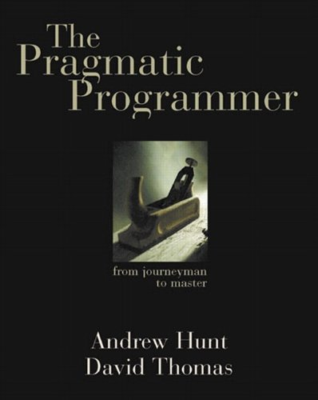
Why Do We Write Templates?
type attribute
The DRY Principle:
“Every piece of knowledge must have a single, unambiguous,
authoritative representation within a system.”
Not just about code duplication, also documentation, database schemas etc.
[The Pragmatic Programmer, 1st ed, §11 – DRY–Don’t Repeat Yourself, pp 30-34]

Slide 8
Concepts vs. OOP
class ui_widget
{
public:
virtual ~ui_widget() = default;
virtual void draw() const = 0;
virtual void on_select() = 0;
};
class button : public ui_widget
{
public:
void draw() const override;
void on_select() override;
};
class text_box : public ui_widget
{
public:
void draw() const override;
void on_select() override;
};
<<interface>> ui_widget
+draw() +on_select()
button
text_box

Slide 9
Concepts vs. OOP
class ui_widget
{
public:
virtual ~ui_widget() = default;
virtual void draw() const = 0;
virtual void on_select() = 0;
};
class button : public ui_widget
{
public:
void draw() const override;
void on_select() override;
};
class text_box : public ui_widget
{
public:
void draw() const override;
void on_select() override;
};
Class must explicitly derive from interface
Member functions are virtual, require vtable lookup
Only member functions are overrideable

Slide 10
Concepts vs. OOP
template <typename T>
concept ui_widget = /* impl */;
class button
{
public:
void draw() const;
void on_select();
};
class text_box
{
public:
void draw() const;
void on_click();
};
static_assert(ui_widget<button>);
static_assert(ui_widget<text_box>);
Implicitly satisfies the ui_widget concept
No virtual functions needed, zero overhead
No common type conversions with button
Compile-time checking (no code generated)

Slide 11
<concepts> Library
type attribute
Language: same_as, derived_from, convertible_to, common_reference_with, common_with
Arithmetic: integral, signed_integral, unsigned_integral, floating_point
Initialization: assignable_from, swappable, destructible, constructible_from, default_initializable, move_constructible, copy_constructible
Comparison: equality_comparable, equality_comparable_with, totally_ordered, totally_ordered_with
Object: movable, copyable, semiregular, regular
Callable: invocable, regular_invocable, predicate, relation, equivalence_relation, strict_weak_order
[ISO/IEC 14882:2020, §18 – Concepts Library]

Slide 12
Concepts and Containers
template <typename T>
class my_vector
{
T* data;
std::size_t size;
/* impl */
};
struct int_tree
{
int root;
my_vector<int_tree> subtrees;
};
1
2
3
5
4
7
9
1
8
7
4

Slide 13
Concepts and Containers
template <std::copyable T>
class my_vector
{
T* data;
std::size_t size;
/* impl */
};
struct int_tree
{
int root;
my_vector<int_tree> subtrees;
};
Oops! Compiler wants to check if int_tree is std::copyable

Slide 14
Concepts and Containers
template <typename T>
class my_vector
{
T* data;
std::size_t size;
/* impl */
};
struct int_tree
{
int root;
my_vector<int_tree> subtrees;
};
static_assert(std::copyable<std::vector<std::unique_ptr<int>>>);
Ok! int_tree is incomplete at this point...
…but now we can determine int_tree’s layout!
Compiles (surprise!)

Slide 15
Concepts and Containers
template <typename T>
class my_vector
{
T* data;
std::size_t size;
public:
my_vector(my_vector const& other)
{
static_assert(std::copyable<T>, "Cannot implement copy ctor, T is not copyable!");
/* impl */
}
/* impl */
};
Not a constraint but catches errors earlier in implementation!

Slide 16
Not Just About Templates!
void redraw_selected_button()
{
auto it = std::ranges::find_if(buttons, is_selected);
if (it != std::end(buttons)) (*it).draw();
};

Slide 17
Not Just About Templates!
void redraw_selected_button()
{
std::forward_iterator auto it = std::ranges::find_if(buttons, is_selected);
if (it != std::end(buttons)) (*it).draw();
};
Compiler error if changed to something that doesn’t return a type that models forward_iterator

Slide 18
Iterator Concepts
Concept | Example range
input_iterator | file stream opened for reading
output_iterator | file stream opened for writing
forward_iterator | singly linked list
bidirectional_iterator | doubly linked list
random_access_iterator | deque
contiguous_iterator | array

Slide 19
A Minimal C++20 Input Iterator
struct my_minimal_input_iterator
{
int* p;
using value_type = int; // Use std::iter_value_t<T> to retrieve
using difference_type = std::ptrdiff_t; // Use std::iter_difference_t<T> to retrieve
// Non-copyable
my_minimal_input_iterator(my_minimal_input_iterator const&) = delete;
my_minimal_input_iterator& operator=(my_minimal_input_iterator const&) = delete;
// Movable
my_minimal_input_iterator(my_minimal_input_iterator&&) = default;
my_minimal_input_iterator& operator=(my_minimal_input_iterator&&) = default;
// Dereference (input-only, so const is ok)
int const& operator*() const { return *p; }
// Pre-increment
my_minimal_input_iterator& operator++() { ++p; return *this; }
// Post-increment (must increment but does not need to return a value)
void operator++(int) { ++p; }
};
static_assert(std::input_iterator<my_minimal_input_iterator>);

Slide 20
Writing a Generic Algorithm

Slide 21
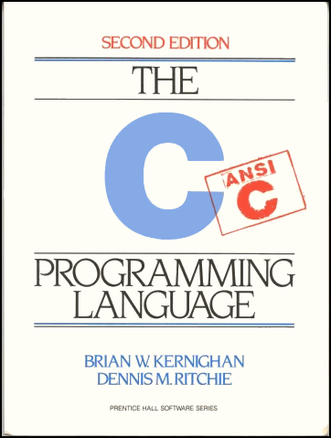
Back to K&R

Slide 22
strlen, Version 1
/* strlen: return length of s */
int strlen(char[] s)
{
int i;
i = 0;
while (s[i] != '\0')
++i;
return i;
}
[The C Programming Language, §2.3 – Constants, p 39]

Slide 23
strlen, Version 2
/* strlen: return length of string s */
int strlen(char *s)
{
int n;
for (n = 0; *s != '\0'; s++)
n++;
return n;
}
[The C Programming Language, §5.3 – Pointers and Arrays, p 99]

Slide 24
strlen, Version 3
/* strlen: return length of string s */
int strlen(char *s)
{
char *p = s;
while (*p != '\0')
p++;
return p - s;
}
[The C Programming Language, §5.4 – Address Arithmetic, p 103]

Slide 25
The Law of Useful Return
“A procedure should return all the potentially useful information it computed.”
[From Mathematics to Generic Programming, §11.2 – Permutation Algorithms, p 202]

Slide 26
The Law of Useful Return
/* strlen: return length of string s */
int strlen(char *s)
{
char *p = s;
while (*p != '\0')
p++;
return p - s;
}
Could be of use to the caller

Slide 27
Refactoring
/* find_eos: return end of string s */
char *find_eos(char *s)
{
char *p = s;
while (*p != '\0')
p++;
return p;
}
/* strlen: return length of string s */
int strlen(char *s)
{
return find_eos(s) - s;
}

Slide 28
Optimization
/* find_eos: return end of string s */
char *find_eos(char *s)
{
while (*s != '\0')
s++;
return s;
}
/* strlen: return length of string s */
int strlen(char *s)
{
return find_eos(s) - s;
}

Slide 29
Generalization, Documentation
/* find_char_unguarded: return position of first c in string s */
/* precondition: c exists in string s */
char *find_char_unguarded(char *s, char c)
{
while (*s != c)
s++;
return s;
}
/* find_eos: return end of string s */
char *find_eos(char *s)
{
return find_char_unguarded(s, '\0');
}

Slide 30
Generalization, C++ Template
/* find_unguarded: return position of value in array starting from first */
/* precondition: value exists between first and end of array */
template <typename T>
T* find_unguarded(T* first, T value)
{
while (*first != value)
++first;
return first;
}

Slide 31
Analysis: Requirements of type T
/* find_unguarded: return position of value in array starting from first */
/* precondition: value exists between first and end of array */
template <typename T>
T* find_unguarded(T* first, T value)
{
while (*first != value)
++first;
return first;
}
Could incur a copy-construction
Inequality-comparison
Constructible (can take the address of)

Slide 32
Optimization: Pass by const-ref
/* find_unguarded: return position of value in array starting from first */
/* precondition: value exists between first and end of array */
template <typename T>
T* find_unguarded(T* first, T const& value)
{
while (*first != value)
++first;
return first;
}
Inequality-comparison
Constructible (can take the address of)

Slide 33
What’s Missing Here?
/* my_minimal_type: should work with find_unguarded */
struct my_minimal_type
{
// impl
};
bool operator!=(my_minimal_type const& t, my_minimal_type const& u)
{
// impl
}

Slide 34
The Law of Completeness
“When designing an interface, consider providing all the related procedures.”
[From Mathematics to Generic Programming, §11.2 – Permutation Algorithms, p 203]

Slide 35
Does This Code Look Natural?
void modify(my_minimal_type& t, my_minimal_type& u)
{
if (!(t != u)) return; // exit if t == u
// impl
}

Slide 36
Completing the Interface
/* my_minimal_type: should work with linear search algorithms */
struct my_minimal_type
{
// impl
};
bool operator==(my_minimal_type const& t, my_minimal_type const& u)
{
// impl
}
bool operator!=(my_minimal_type const& t, my_minimal_type const& u)
{
return !(t == u);
}
static_assert(std::equality_comparable<my_minimal_type>);

Slide 37
Constraining T
/* find_unguarded: return position of value in array starting from first */
/* precondition: value exists between first and end of array */
template <std::equality_comparable T>
T* find_unguarded(T* first, T const& value)
{
while (*first != value)
++first;
return first;
}
T constrained by concept
Many compiler errors no longer caught here
The purpose of the constraint is not to specify the implementation but to to specify the meaning of the algorithm!

Slide 38
equality_comparable Requirements
Consider two values t, u of type T:
Syntactically, these expressions must be valid:
bool(t == u)
bool(u == t)
bool(t != u)
bool(u != t)

Slide 39
equality_comparable Requirements
Consider two values t, u of type T:
Semantically, the expressions reflect equality:
bool(t == u) == true iff operands are equal
bool(u == t) == true iff operands are equal
bool(t != u) == true iff operands are not equal
bool(u != t) == true iff operands are not equal

Slide 40
equality_comparable Requirements
Consider two values t, u of type T:
Contractually, the expressions must have the same domain:
t == u
u == t
t != u
u != t
All have the same preconditions.
(Domain cannot be fully unit-tested in the general case, should be documented if applicable.)

Slide 41
equality_comparable Requirements
Consider two values t, u of type T:
Further, the expressions must be equality-preserving and stable:
t == u
u == t
t != u
u != t
All can be called multiple times without modifying t or u and always returning the same values.
(This implies that the operator parameters could be const&.)

Slide 42
This Function Has a Bug
bool operator==(my_type const& t, my_type const& u)
{
return false;
}

Slide 43
This Function Has a Bug
bool operator==(my_type const& t, my_type const& u)
{
return false;
}
void my_unit_test()
{
my_type t{};
assert(t == t);
}

Slide 44
Does this Function Have a Bug?
bool operator==(my_type const& t, my_type const& u)
{
return true;
}

Slide 45
Testing Semantic Requirements
// assert_equality_comparable: unit test for std::equality_comparable values
// precondition: t, u, v are all in the domain of == and !=
template <std::equality_comparable T>
void assert_equality_comparable(T const& t, T const& u, T const& v)
{
assert(bool(t != u) == !bool(t == u)); // inverse
assert(bool(t == t)); // reflexivity
assert(!bool(t != t)); // anti-reflexivity
assert(bool(t == u) == bool(u == t)); // symmetry
assert(bool(t != u) == bool(u != t)); // symmetry
if (bool(t == u) && bool(u == v)) {
assert(bool(t == v)); // transitivity
}
}

Slide 46
Complexity Requirements
Consider two values t, u of type T:
There is an implicit complexity, requirement:
t == u
u == t
t != u
u != t
Must be linear (worst case) in the area (i.e. total size of all parts) of the objects.
(Average-case complexity of equality is often nearly constant, since unequal objects tend to test unequal in an early part.)

Slide 47
Generalization: Support Other Kinds of Ranges
/* find_unguarded: return position of value in array starting from first */
/* precondition: value exists between first and end of array */
template <std::equality_comparable T>
T* find_unguarded(T* first, T const& value)
{
while (*first != value)
++first;
return first;
}

Slide 48
Generalization: Pointers to Iterators
/* find_unguarded: return position of value in range starting from first */
/* precondition: value exists between first and end of range */
template <typename I, std::equality_comparable T>
I find_unguarded(I first, T const& value)
{
while (*first != value)
++first;
return first;
}

Slide 49
Analysis: Requirements of Type I
/* find_unguarded: return position of value in range starting from first */
/* precondition: value exists between first and end of range */
template <typename I, std::equality_comparable T>
I find_unguarded(I first, T const& value)
{
while (*first != value)
++first;
return first;
}
Potentially a copy
Dereference into value compared with T (read-only)
Pre-increment, no subsequent access to earlier values

Slide 50
Constraining I
/* find_unguarded: return position of value in range starting from first */
/* precondition: value exists between first and end of range */
template <std::input_iterator I, std::equality_comparable T>
I find_unguarded(I first, T const& value)
{
while (*first != value)
++first;
return first;
}

Slide 51
Strengthening the Constraints
/* find_unguarded: return position of value in range starting from first */
/* precondition: value exists between first and end of range */
template <std::input_iterator I, std::equality_comparable T>
I find_unguarded(I first, T const& value)
{
while (*first != value)
++first;
return first;
}
These types are related!
Here is where they interact

Slide 52
The Law of Separating Types
“Do not assume that two types are the same when they may be different.”
[From Mathematics to Generic Programming, §11.2 – Permutation Algorithms, p 202]

Slide 53
The Law of Separating Types
/* find_unguarded: return position of value in range starting from first */
/* precondition: value exists between first and end of range */
template <std::input_iterator I, std::equality_comparable_with<std::iter_value_t<I>> T>
I find_unguarded(I first, T const& value)
{
while (*first != value)
++first;
return first;
}

Slide 54
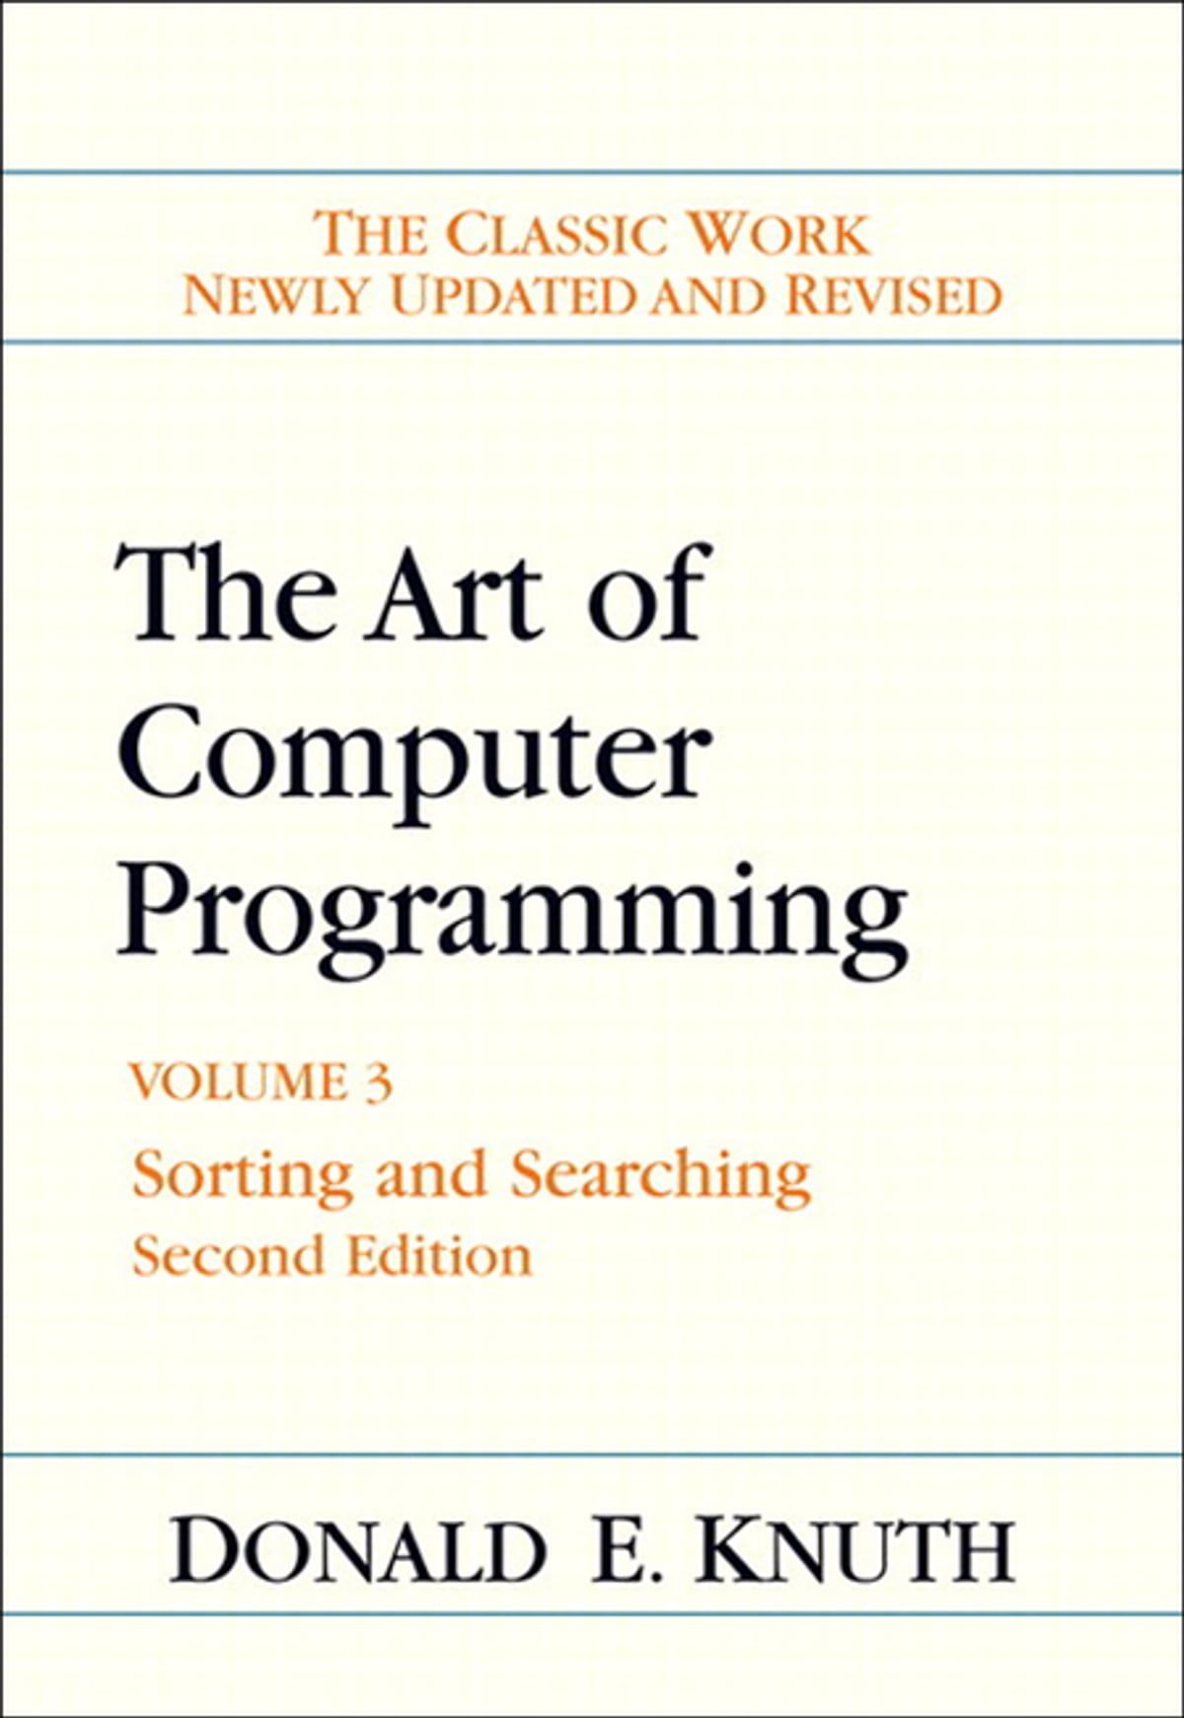
Performance vs. Safety

Slide 55
A Faster Safe find
H | e | l | l | o |  | W | o | r | l | d | !
A
[The Art of Computer Programming, vol. 3, 2nd ed, §6.1 – Sequential Searching, pp 397-398]

Slide 56
A Faster Safe find
H | e | l | l | o |  | W | o | r | l | d | !
A
H | e | l | l | o |  | W | o | r | l | d | A
!
[The Art of Computer Programming, vol. 3, 2nd ed, §6.1 – Sequential Searching, pp 397-398]

Slide 57
A Faster Safe find
H | e | l | l | o |  | W | o | r | l | d | !
A
H | e | l | l | o |  | W | o | r | l | d | A
!
find_unguarded(s, 'A');
[The Art of Computer Programming, vol. 3, 2nd ed, §6.1 – Sequential Searching, pp 397-398]

Slide 58
A Faster Safe find
H | e | l | l | o |  | W | o | r | l | d | !
A
H | e | l | l | o |  | W | o | r | l | d | A
!
find_unguarded(s, 'A');
H | e | l | l | o |  | W | o | r | l | d | !
A
[The Art of Computer Programming, vol. 3, 2nd ed, §6.1 – Sequential Searching, pp 397-398]

Slide 59
A Faster find for Mutable Bidirectional Ranges
/* find_guarded: return position of value in the range [first, last)
returns last if value is not found
*/
template <std::bidirectional_iterator I>
requires std::indirectly_swappable<I, std::iter_value_t<I>*> &&
std::equality_comparable<std::iter_value_t<I>>
I find_guarded(I first, I last, std::iter_value_t<I> value)
{
if (first == last) return first;
--last;
std::ranges::iter_swap(last, &value);
first = find_unguarded(first, *last);
std::ranges::iter_swap(last, &value);
if (first == last && *first != value) ++first;
return first;
}

Slide 60
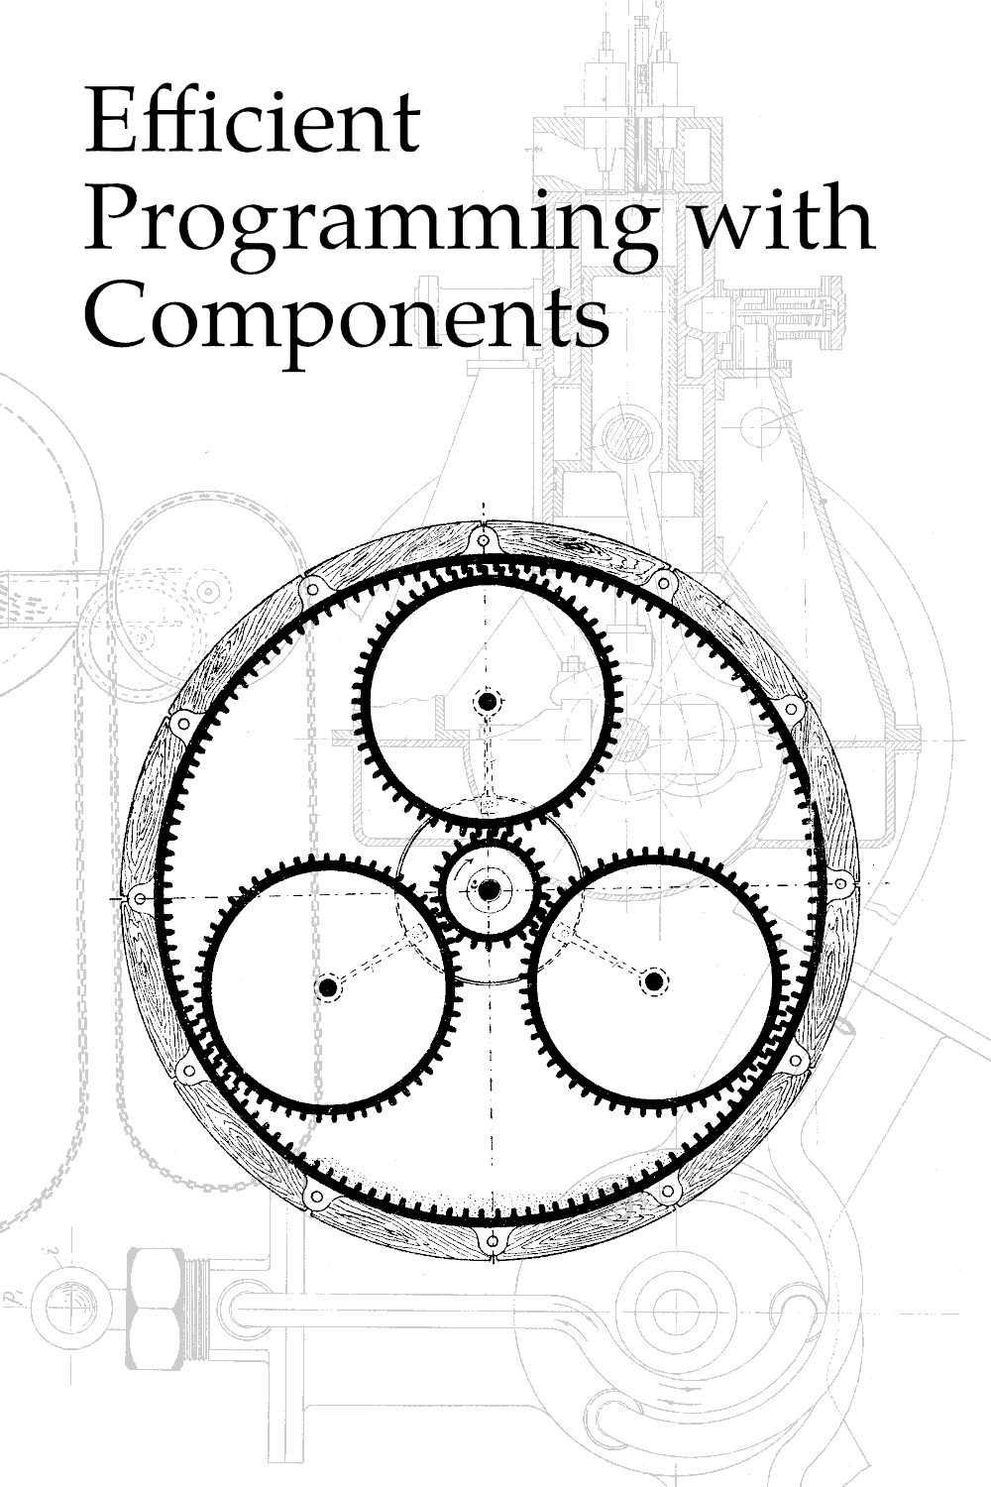
Recommended Reading
https://www.jmeiners.com/efficient-programming-with-components/

