Slide 1
TEST DRIVEN DEVELOPMENT
For iOS Developers

Slide 2
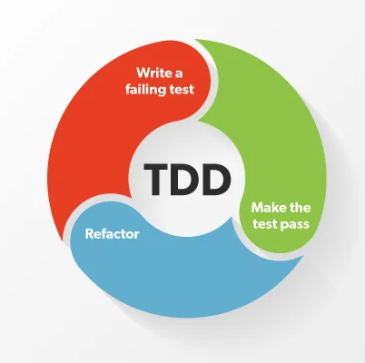
What is TDD?
Write a failing test case
Write the minimum implementation to make the test pass
Repeat steps 1-2 until you run out of test cases
Tidy your code

Slide 3

Why do I love it?
It’s more fun!
It results in higher quality tests
Forces me to think about interface before implementation details -> Better design
Helps keep the units-under-test small and less complex
It’s faster
Less time spent manually testing
Less stressful! Easier to context switch, higher confidence in tests
Notes:
-Writing tests is more intellectually challenging than writing implementations code
-Tests communicate by failing. You know the tests actually work because you have seen them fail
-Have you ever seen a class with 1000 LOC and 20 static dependencies? Ever tried to test one? TDD will never produce something like that
-TDD is definitely faster than writing tests after. And surprisingly, it’s often faster than skipping the tests.
-Manually testing code is tiresome. Clicking, manually entering data
It off-loads the brain. You don’t need to keep as much information in your head.

Slide 4
Development Cycle
Without TDD
With TDD
Write implementation
Test manually
Repeat 1-2 until satisfied
Write test cases (If you “have the time”)
Deliver
Write test case
Write implementation
Repeat 1-2 until satisfied
Test manually
Deliver
Notes:
Without TDD, writing test cases tends to become the boring part. I often find myself doing it under stress. It’s more tempting to just skip the tests, since the code is complete.
But with TDD, the manual testing tends to be the boring part.

Slide 5
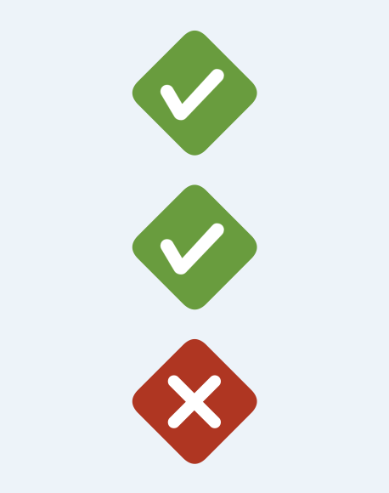
How did I start doing it?
Fixed a bug
Wrote a test to detect said bug in future
“Hmm, does the test work?”
Revert bug fix and run the test
Result: often red, sometimes green 🤔
Notes:
Two learnings:
It would be faster to just start by adding the failing test first. Then I could run the test to verify my bug fix
Sometimes I make mistakes when writing tests. Red first means I know they work

Slide 6
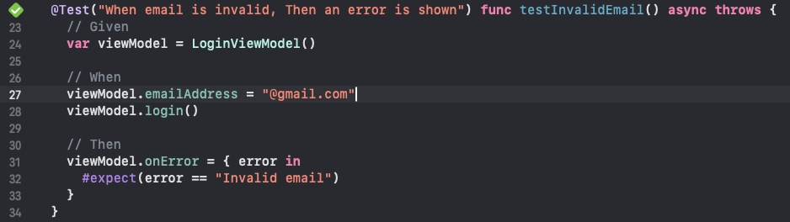
A test that has never failed can not be trusted
Notes:
What’s wrong with this test?
Two things:
Move line 31 to 25
Expectation only happens when closure is called. Not calling the closure also passes the test
A ”void” implementation of the SUT will pass this test -> it’s not a reliable test
With TDD, you would spot this error immediately. Because the first step is to write a FAILING test (and this would not fail)

Slide 7
How TDD works
Tests should do the heavy lifting!
Be clever when writing test cases
Be lazy when writing the implementation
“I know I will need this if-statement!”
- OK, then first, write the test that proves that you need it

Slide 8
Good tests
Help minimize the cost of future changes
Are expressive
Use static input and output
Have no logic (or very little)
Are independent of one another

Slide 9
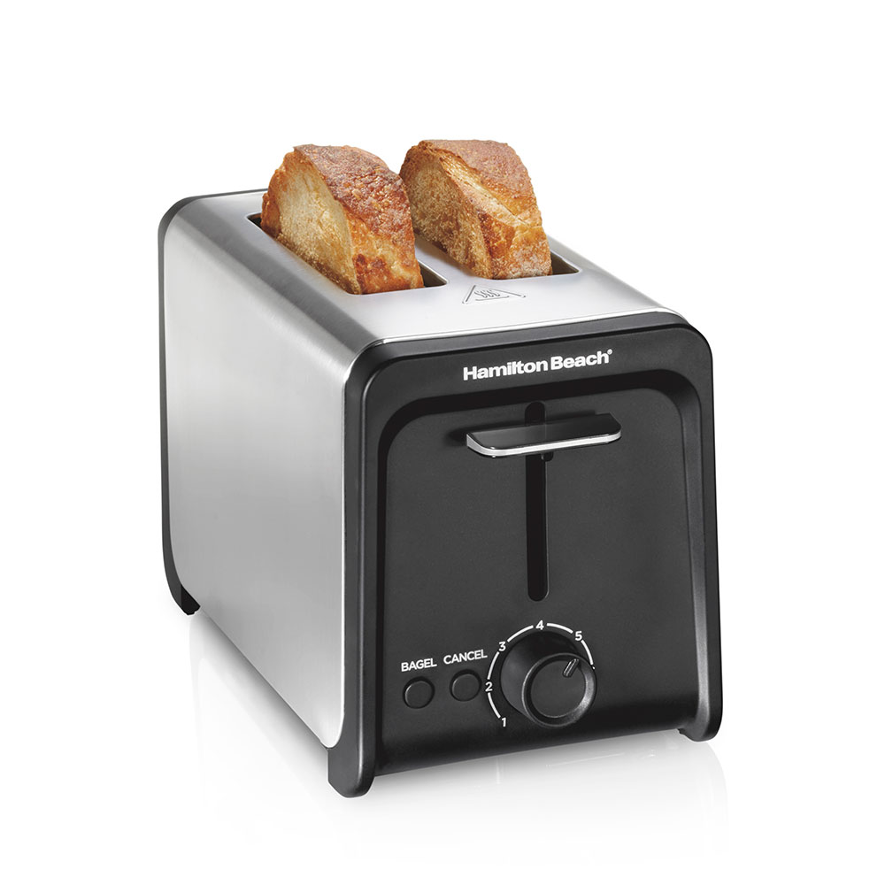
Interface vs implementation
Implementation: data structures, algorithms
Interface: Input and output
A good interface hides implementation details.
What’s hidden can be changed freely

Slide 10
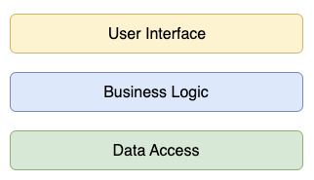
TDD is not a silver bullet
TDD is a great way to write unit tests
Unit tests are not always the way

Slide 11
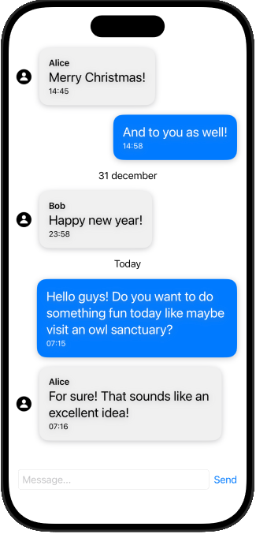
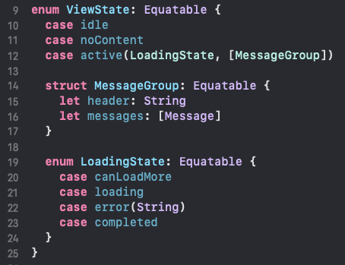
Preview Driven Development ❤️ TDD
Build previews first
Forces you to model the interface of the VM first, tailored to the View’s needs
Use TDD to drive the VM implementation

Slide 12
Where to start the journey?
Tic-tac-toe game
Roman numeral converter
Tennis game score counter
Pascals Triangle

