Slide 1


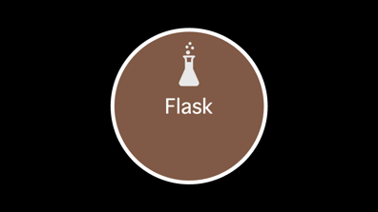
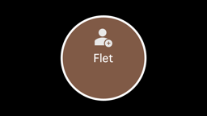
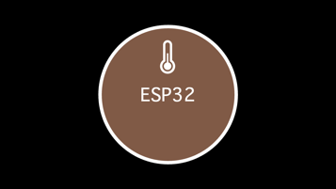

Slide 2

ESP32

Slide 3


DHT11
HTTP
ESP32

Slide 4

Flask

Slide 5
Netbird
Flask
Json Object

Slide 6


MQTT

Slide 7
MQTT
Json Object
VPN
Subscribe

Slide 8

Flet

Slide 9
Temp/ Hum
Flet
Web UI

