Slide 1
E-Monitor
Smart controlling of electric appliance

Slide 2
Inspiration
In our dormitory, there are dozens of people need to do the laundry, however, we only have two washing machine.
We need a smarter way to decrease wasted time including waiting and unnecessary walking.

Slide 3
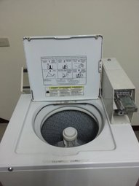
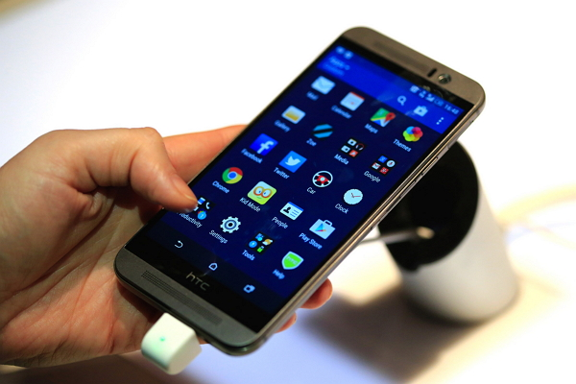
Inspiration
+

Slide 4


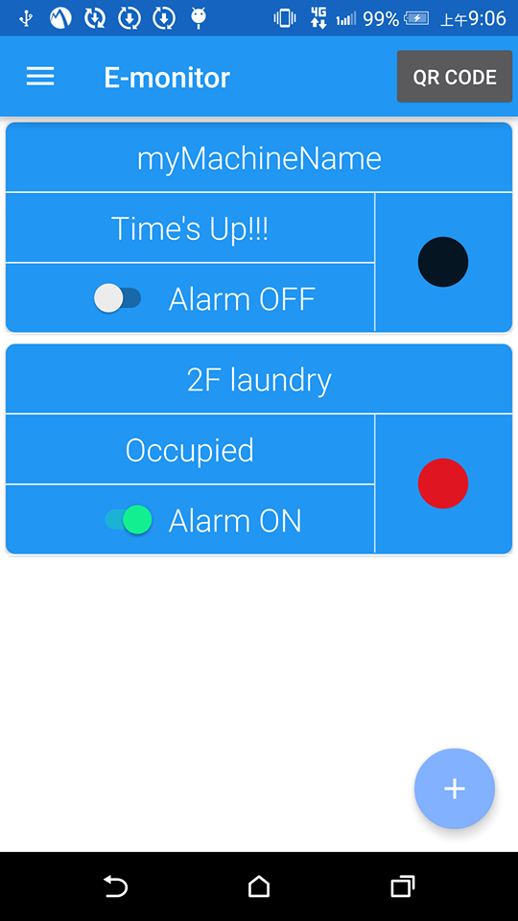
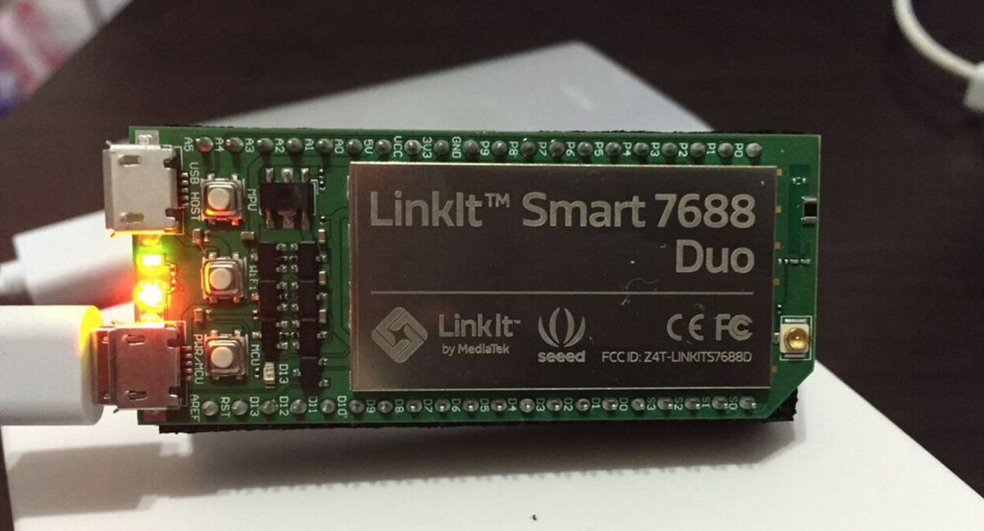
Design Concept

Slide 5
Design Concept

Slide 6
Design Concept
scan QR code to register a new device to monitor

Slide 7
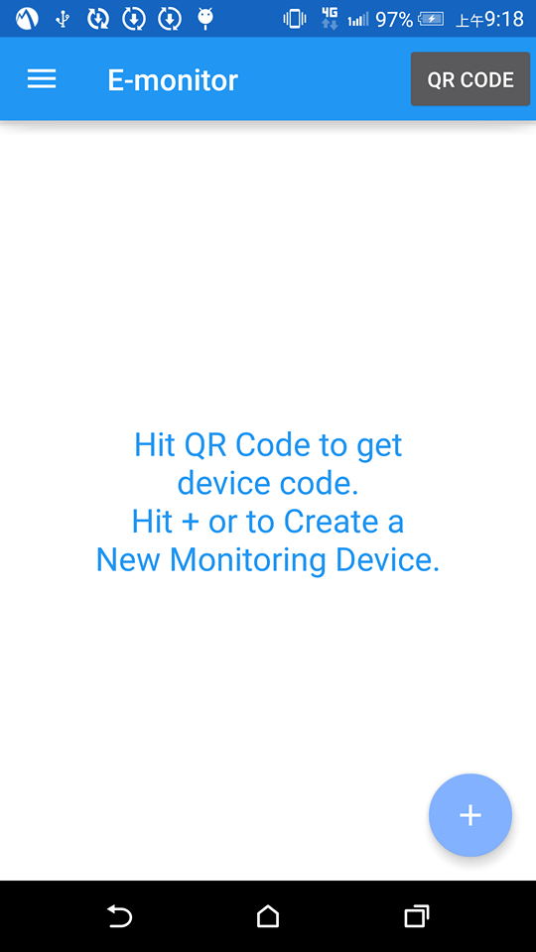
Design Concept

Slide 8
Design Concept
scan QR code to register a new device to monitor
monitor multiple washing machines’ mode (disconnected, available, occupied, abnormal)

Slide 9
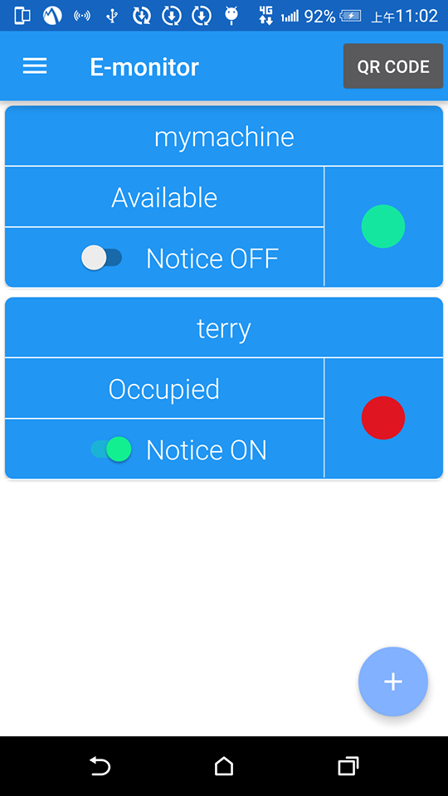
Design Concept

Slide 10
Design Concept
when a monitored washing machine finish washing, a alarm will remind you

Slide 11
Design Concept

Slide 12
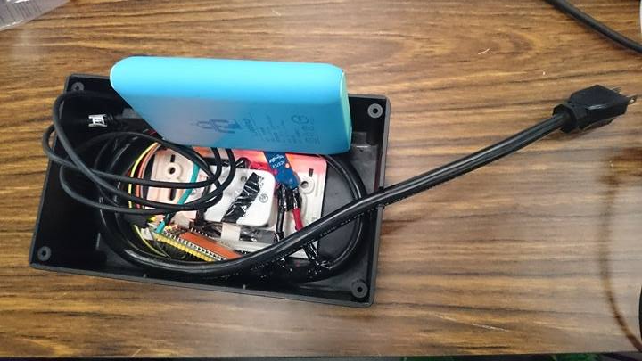
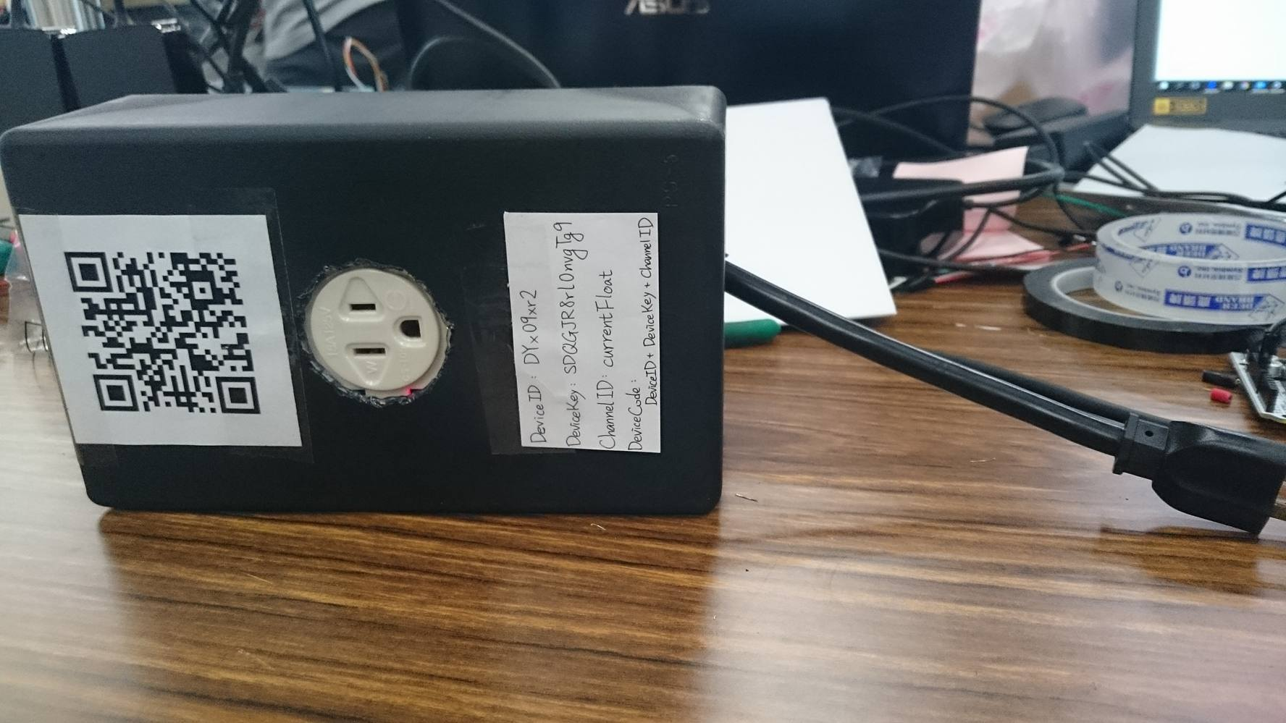
Product

