Slide 1

Water flow sensor for fire hydrant taps

Slide 2
Operation
Tactile push counts elapsed time, saves it into memory each time the tap is being used.
MCU wakes from sleep mode, and switches power of GSM module on.
Communication between MCU and GSM module established via USART interface.
Data transmitted using 2G network.
MCU switches power of GSM module off, returns to sleep mode.

Slide 3
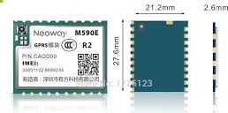
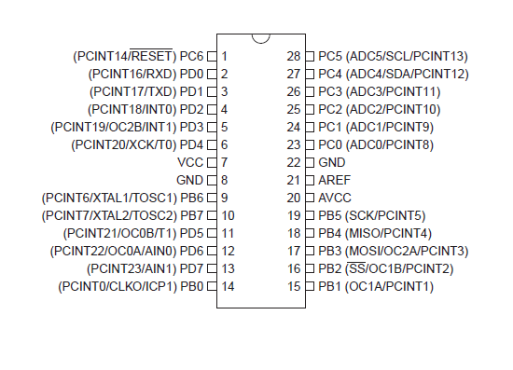
layout
2k resistors for protection
switch
Battery up to 2A supply (lithium-polymer type)
button

Slide 4
requirements
Low power consumption.
Data transmission on a daily basis.
Warning sent in case of too high temperature, theft.
Reliable operation, little maintainance(yearly review, battery replacement).

Slide 5
The current status…
Internal clock set on MCU (event handling) to exactly one second in order to ensure a day elapsed between two transmissions.
Button connected to PORTB, software counts time.
USART module initialized.
Basic plans of PCB (hundreds of problems here).
Power management plans.

