Slide 1
AML – paper images
Prepared by Petar Tzenov and Longway Zhong

Slide 2
General guidelines
Use vector graphics ONLY
Make sure image labels, number etc. are large enough to be clearly visible & distinctive once included in the paper
For label text use Arial text only.
Export images as EPS using metafile converter program or alternatively use inkscape (both open source and free)!
To each new “slide” add title describing what is displayed

Slide 3












Simulation Schematic
(SP + EMC) stage
(MB + TL) stage
Init
$$J(x,t)$$
MB equations
$$V=V_{0}$$
Init
$$t=t_{0}$$
$$t=t+dt$$
SP solver
TL
equations
$$V(x,t)$$
$$V=V+ΔV$$
$$Ψ_{j}\left(z,V\right),E_{j}\left(V\right)$$
$E_{j}\left(V\right), T\left(V\right),$ $z_{UL}\left(V\right),$ $γ_{i→j}\left(V\right)$ …
EMC simulation
$$t<tsim$$
$$YES$$
$$NO$$
$$YES$$
$$V<V_{end}$$
$$NO$$
Fin

Slide 4




0.18
(a)
6
(b)
1.0
INJ
DEPOP
0.14
ULL
RES
Energy (eV)
LLL
4.5
$ℏΩ_{AC}$ (meV)
$z_{UL}$ (nm)
0.3
$$J_{in}$$
0.10
0.25
$$J_{out}$$
RES
LLL
ULL
INJ
0.06
3
0.5
Energy (eV)
8
9
10
11
12
13
14
8
9
10
11
12
13
14
0.2
Bias (kV/cm)
Bias (kV/cm)
0.15
DEPOP
3
(c)
0.1
ULL
LLL
0
10
20
30
40
50
60
70
2
LLL
RES
z (nm)
Rate (1/ps)
1
LLL
DEPOP
RES
DEPOP
0
8
9
10
11
12
13
14
Bias (kV/cm)
1
T = 77 K
4
0.5
Power (a.u.)
Current (A)
2
0
8
9
10
0
Voltage (V)

Slide 5
3
2.5
2
ULL
LLL
1.5
LLL
RES
1
LLL
DEPOP
RES
DEPOP
0.3
0.5
0
0.25
RES
LLL
ULL
INJ
8
9
10
11
12
13
14
0.2
Energy (eV)
0.15
0.1
DEPOP
0
10
20
30
40
50
60
70
z (nm)

Slide 6
1
4
)
T = 77 K
.
u
)
.
A
a
(
(
t
n
r
e
0.5
2
e
r
r
w
u
C
o
P
0
0
8
9
10
Voltage (V)

Slide 7
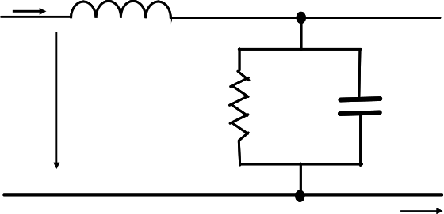



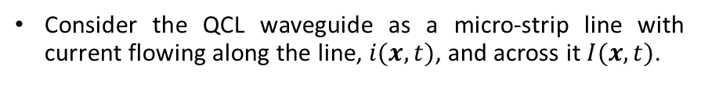


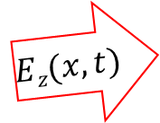


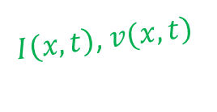


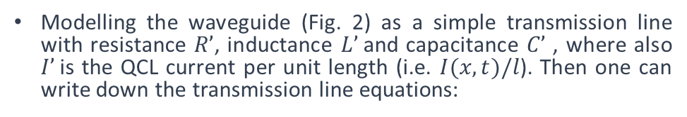


Transmission line model (1)
$$i(x,t)$$
$$L’$$
Consider the QCL waveguide as a micro-strip line with current flowing along the line, $i(x,t)$, and across it $I(x,t)$.
$$A(x,t)$$
$$I’$$
$$C’$$
$$l$$
$$v(x,t)$$
$$i(x,t)$$
$$Ez(x,t)$$
$I\left(x,t\right)$, $v(x,t)$
$$h$$
QCL AR
$$x$$
$$w$$
z
y
Fig. 1: Metal-metal waveguide QCL geometry
x
(1)
Modelling the waveguide (Fig. 2) as a simple transmission line with resistance $R’$, inductance $L’$and capacitance $C’$ , where also $I’$is the QCL current per unit length (i.e. $I(x,t)/l$). Then one can write down the transmission line equations:
(2)

Slide 8

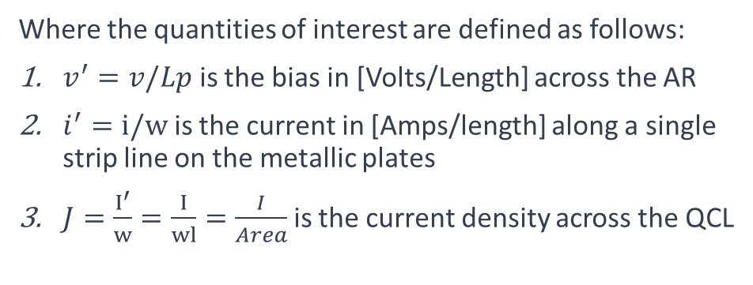


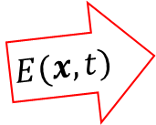

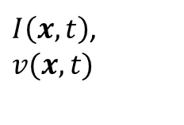
Transmission line model (2)
(3’)
$$l$$
(4’)
$$i(x,t)$$
$$E(x,t)$$
QCL AR
$I\left(x,t\right)$,$v(x,t)$
$$Lp$$
(3)
$$w$$
z
y
Fig. 1: Metal-metal waveguide QCL geometry
x
(4)
Neglect the resistance for now and take the parallel plate capacitance and inductance as:
Where the quantities of interest are defined as follows:
$v^{′}=v/Lp$ is the bias in [Volts/Length] across the AR
$i^{′}=i/w$ is the current in [Amps/length] along a single strip line on the metallic plates
$J=\frac{I^{′}}{w}=\frac{I}{wl}=\frac{I}{Area}$ is the current density across the QCL

Slide 9












QCL geometry and electrical circuit
$$Z_{s}$$
$$L’$$
$$i(x,t)$$
$$C’$$
$$J(x,t)$$
$$v(x,t)$$
$$V_{s}(t)$$
$$x$$
$$V_{0}$$
z
y
$$l$$
x
$$∆x$$
$$h$$
QCL AR
$$w$$

