Slide 2




a
b
c
)
0.1
0.1
0.1
$$A_{init}=10 {ns}^{−1}$$
z
$$A_{init}=0.1 {ns}^{−1}$$
$$A_{init}=1 {ns}^{−1}$$
H
0.05
0.05
0.05
G
(
R
0
0
0
S
F
-0.05
-0.05
-0.05
-0.1
-0.1
-0.1
440
460
480
500
520
440
460
480
500
520
440
460
480
500
520
mode number
mode number
mode number
(a)
(b)
Electron states in the tight binding basis
Electron states in the delocalized basis
$$ℏε$$
$$ℏΩ_{1^{′}3}$$
$δ$E
$$ℏω_{32}$$
$$ℏω_{+}$$
$$ℏω_{−}$$

Slide 3









$$A_{init}=0.1 {ns}^{−1}$$
$$A_{init}=1 {ns}^{−1}$$
$$A_{init}=10 {ns}^{−1}$$
0.1
(a)
0.1
(b)
0.1
)
)
(c)
z
z
)
H
0.05
H
0.05
z
0.05
G
G
H
(
(
G
R
0
R
0
(
S
S
R
0
F
F
S
F
-0.05
-0.05
-0.05
-0.1
-0.1
-0.1
450
500
550
450
500
550
450
500
550
mode number $m$
mode number$m$
mode number $m$
3
(d)
3.65
3
(e)
3.65
3
3.65
(f)
2
3.6
2
3.6
2
3.6
Gain (cm⁻¹)
Gain (cm⁻¹)
Refractive index
Refractive index
Refractive index
Gain (cm⁻¹)
1
3.55
1
3.55
1
3.55
0
3.5
0
3.5
0
3.5
450
500
550
450
500
550
450
500
550
mode number $m$
mode number $m$
mode number $m$

Slide 4









0
(a)
$$f_{2}$$
$$f_{1}$$
(b)
$$f_{2}$$
$$f_{1}$$
Optical power (dB)
$$f_{s}$$
$$f_{a}$$
$$f_{s}$$
$$f_{a}$$
-50
$$Δf=17.2 GHz$$
$$Δf=51.6 GHz$$
3.6
3.8
4.0
3.6
3.8
4.0
Frequency (THz)
Frequency (THz)
1
(c)
$$A_{s}$$
Sideband
Amplitude (a.u.)
$$A_{a}$$
0.5
$$A_{2}=0.25$$
0
0
0.05
0.1
0.15
0.2
0.25
Pump amplitude $A_{1}$ (a.u.)

Slide 6


Non-comb
Comb
Legend:
Mode index
20
(a)
(b)
1
5
(d)
(e)
1
2
1
Phase/$π$
3
0
4
0
Optical power (a.u.)
Phase/$π$
Optical power (a.u.)
0.5
5
0.5
6
-20
7
0
8
-5
0
0
2000
4000
0
2000
4000
9
0
2000
4000
0
2000
4000
Time (T
rt
)
Time (T
rt
)
10
Time (T
)
Time (T
rt
)
1
(c)
10
(f)
rt
9
8
1
10
Optical power (a.u.)
0.5
7
Optical power (a.u.)
5
4
2
6
0.5
9
1
3
7
6
5
8
0
0
1
4
3
2
3.4
3.6
3.8
4
4.2
3.4
3.6
3.8
4
4.2
Frequency (THz)
Frequency (THz)

Slide 7


5
(a)
(b)
(a)
(b)
1
20
1
Phase/$π$
Optical power (a.u.)
0
Phase/$π$
Optical power (a.u.)
0.5
0
0.5
-5
0
-20
0
0
100
200
300
0
100
200
300
0
1000
2000
0
1000
2000
Time (T_{rt})
Time (T_{rt})
Time (T_{rt})
Time (T_{rt})
1
(c)
10
9
(d)
0
1
(c)
9
10
8
(d)
0
8
3
4
5
7
6
7
6
-50
Optical power (a.u.)
1
2
-50
0.5
RF beatnote (dB)
Optical power (a.u.)
5
4
0.5
RF beatnote (dB)
2
3
1
-100
0
3.6
4
4.4
5
10
15
20
0
3.6
3.8
4
4.2
4.4
5
10
15
20
-100
Frequency (THz)
Frequency (GHz)
Frequency (THz)
Frequency (GHz)

Slide 8


5
(a)
(b)
1
(a)
(b)
Phase/$π$
20
0
Optical power (a.u.)
0.5
1
Phase/$π$
-5
0
0
Optical power (a.u.)
0
1000
2000
3000
0
1000
2000
3000
0.5
Time (T_{rt})
Time (T_{rt})
0
-20
0
(c)
(d)
0
1000
2000
3000
0
1000
2000
3000
1
10
9
Time (T_{rt})
Time (T_{rt})
8
6
7
-50
0
Optical power (a.u.)
5
RF beatnote (dB)
(c)
(d)
0.5
4
-100
1
10
2
3
1
8
6
9
0
7
RF beatnote (dB)
4
-50
-150
Optical power (a.u.)
5
3
2
3.6
4
4.4
5
10
15
20
0.5
1
Frequency (THz)
Frequency (GHz)
0
3.6
4
4.4
-100
5
10
15
20
Frequency (THz)
Frequency (GHz)

Slide 10
20
1
0
0.5
-20
0
0
500
1000
1500
2000
2500
0
500
1000
1500
2000
2500
9
10
0
1
7
8
3
4
2
5
6
0.5
1
-50
0
5
10
15
20
-100
3.4
3.6
3.8
4
4.2
4.4

Slide 11













Power spectrum
$$Δω$$
x
$$φ_{21}\left(t\right)≈0$$
$$ω_{1}$$
$$ω_{2}$$
$${ω }_{THz}$$
$$Δω$$
$${ω }_{RF}$$
$$Δω$$
x
$$Δω′$$
x
$$φ_{21}\left(t\right)≠0$$
$${ω }_{THz}$$
$$Δω$$
$${ω }_{RF}$$

Slide 12




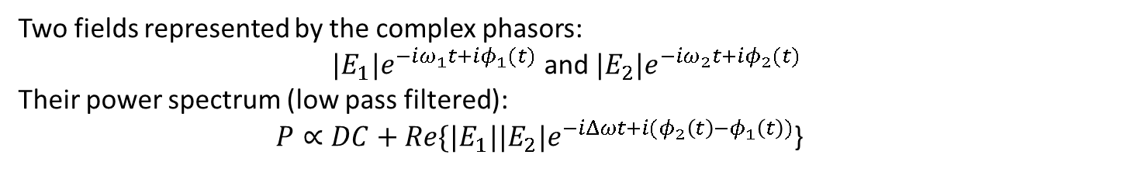
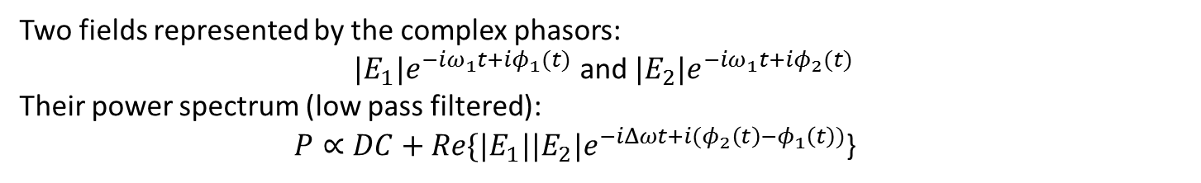
Mutual phase-coherence of comb lines
Two fields represented by the complex phasors:
${|E}_{1}|e^{−iω_{1}t+iφ_{1}(t)}$ and ${|E}_{2}|e^{−iω_{2}t+iφ_{2}(t)}$
Their power spectrum (low pass filtered):
$P∝DC+{Re\{|E}_{1}|{|E}_{2}|e^{−iΔωt+i{(φ}_{2}\left(t\right)−φ_{1}\left(t\right))}$}
Optical spectrum
Power spectrum
$$Δω$$
x
$$φ_{21}\left(t\right)≈0$$
Phase coherent source:
$$ω_{1}$$
$$ω_{2}$$
$${ω }_{THz}$$
$$Δω$$
$${ω }_{RF}$$
$$Δω$$
x
$$Δω′$$
x
$$φ_{21}\left(t\right)≠0$$
Phase in-coherent source:
$${ω }_{THz}$$
$$Δω$$
$${ω }_{RF}$$

Slide 13
$$ω_{2}$$
$$ω_{1}$$
$$ω_{2}$$
$$ω_{1}$$
0
(a)
(b)
(c)
-50
Optical power (dB)
-100
3.9
4
4.1
4.2
4.3
3.9
4
4.1
4.2
4.3
2
3
4
5
6
Frequency (THz)
Frequency (THz)
Frequency (THz)

Slide 14








f = 17.2295 GHz
f = 34.4589 GHz
f = 51.7 GHz
Frequency (THz)
Frequency (THz)
0
$$f_{2}$$
$$f_{1}$$
Optical power (dB)
$$f_{s}$$
$$f_{a}$$
f
f
f
f
f
f
2
1
2
1
2
f
1
s
f
f
f
f
f
a
s
a
s
a
-50
3.6
3.8
4.0
Frequency (THz)
3.6
3.8
4.0
3.6
3.8
4.0
3.6
3.8
4.0
0
(a)
$$f_{2}$$
$$f_{1}$$
(b)
$$f_{2}$$
$$f_{1}$$
Optical power (dB)
$$f_{s}$$
$$f_{a}$$
$$f_{s}$$
$$f_{a}$$
-50
$$Δf=17.2 GHz$$
$$Δf=51.7 GHz$$
3.6
3.8
4.0
3.6
3.8
4.0
Frequency (THz)
Frequency (THz)
1
(c)
$$A_{ω_{s}}$$
Sideband
Amplitude (a.u.)
$$A_{ω_{a}}$$
0.5
$$A_{ω_{2}}=0.25$$
0
0
0.05
0.1
0.15
0.2
0.25
Pump amplitude $A\left(ω_{1}\right)$(a.u.)

Slide 16
f
f
f
0
f
10
0
2
1
0
f
f
2
10
1
10
2
1
f
f
f
f
f
s
a
f
a
s
a
s
10
-5
10
-5
10
-5
3.6
3.8
4
3.6
3.8
4
3.6
3.8
4

Slide 17
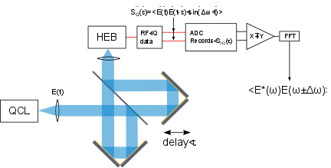
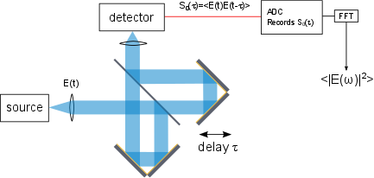
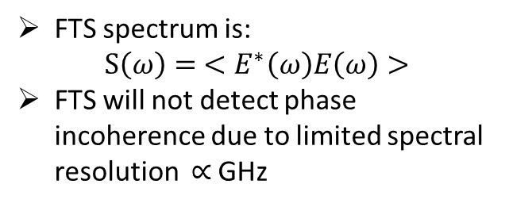
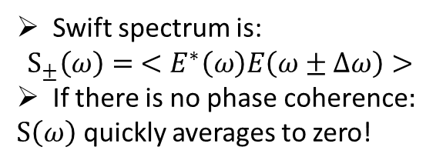
SWIFTs – measure of mutual coherence
FTS
SWITFTs
FTS spectrum is:
$$S\left(ω\right)= <E^{∗}\left(ω\right)E\left(ω\right)>$$
FTS will not detect phase incoherence due to limited spectral resolution $∝$ GHz
Swift spectrum is:
$$S_{±}\left(ω\right)= <E^{∗}\left(ω\right)E\left(ω±Δω\right)>$$
If there is no phase coherence$:$
$S\left(ω\right)$ quickly averages to zero!

