Slide 1
TASK: Investigate the regimes of stability of beatnotes for two different cases:
Long time simulations (5000 round trips) with strong INJ -> ULL dephasing.
Long time simulations (5000 round trips) with negligible INJ-> ULL dephasing.
All simulation parameters were kept the same with the exception of the resonant tunnelling pure dephasing time. In situation a) the pure dephasing rate is set to 0.4 ps, as estimated in [Dupont2010], whereas in situation b) it is set to infinity (i.e. simualtions without INJ -> ULL pure dephasing).
Beatnotes @ 10.8 kV/cm
At 10.8 kv/cm (slightly below injector->ull resonance) simulations with strong pure dephasing in a) demonstrate narrow RF beatnote at the RT and 2xRT frequency, for signal sampled over 100, 200 , 300 and 400 round trips. On the other hand when pure dephasing is “switched off” in b), we observe the chaotic structure of both signals, and an unstable comb operation.
All beatnote calculations were performed with MATLAB’s fft algorithm over a windowed signal with a Hanning windowing function.
a)
1xRT freq
2xRT freq
b)
Attempted division of the time-domain signal into high and low frequency lobes for a) produces clearly separated high and low frequency pulses, as in the results presented before, whereas for b) the separation is somewhat less well defined, if any (see next slide).

Slide 2
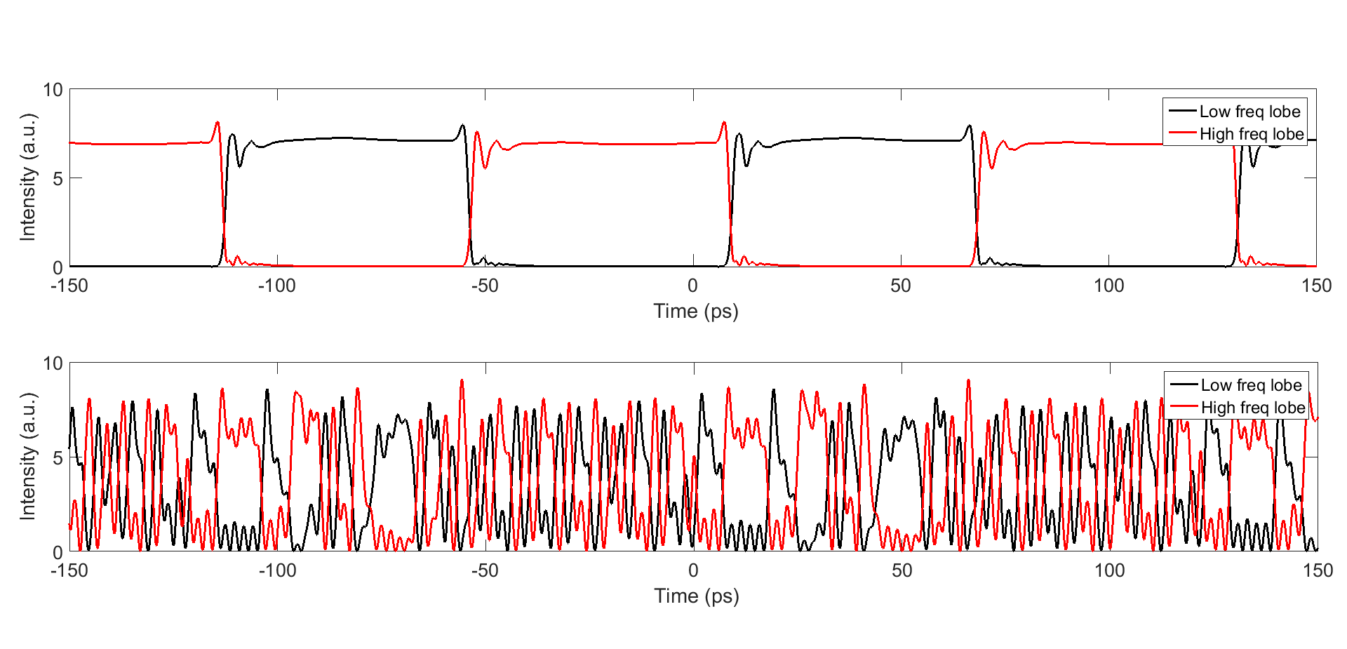
Beatnotes @ 11.0 kV/cm
a)
At 11 kV/cm (at injector->ull resonance) simulations with strong pure dephasing in a) demonstrate narrow RF beatnotes at the RT and 2xRT frequency, for signal sampled over 100, 200 , 300 and 400 round trips. On the other hand when pure dephasing is “switched off” in b), the chaotic structure of both RF signals is maintained.
However, at 11.2 kV/cm, even in simulation a) we observe deterioration of the beatnote shape with increasing RTs.
1xRT freq
2xRT freq
b)
HF/LF pulses 11.0 kV/cm with strong dephasing
Beatnotes @ 11.2 kV/cm
HF/LF pulses 11.0 kV/cm with weak dephasing
a)
1xRT freq
2xRT freq
In the time domain, simulations with strong (inj->ull) dephasing show more regular and clearly separated in time high/low freq lobe pulses, whereas those with weak (inj-> ull) dephasing show a more chaotically varying pulse profile. Simulations for the other bias levels (10.8 and 11.2) yield similar results.
b)

Slide 3
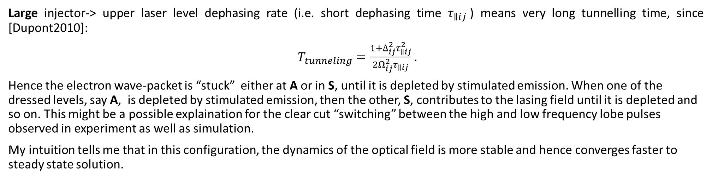
Simplistic interpretation (01):
Strong injector-> upper laser level coupling forms a symmetric (S) and antisymmetric (A) doublet of “dressed” states, spanning the injection barrier, both of which couple radiatively to the LLL [Dupont2010] (also leading to splitting in the spectrum):
INJ
ULL
A
LLL
S
LLL
Large injector-> upper laser level dephasing rate (i.e. short dephasing time $τ_{∥ij}$) means very long tunnelling time, since [Dupont2010]:
$T_{tunneling}=\frac{1+∆_{ij}^{2}τ_{∥ij}^{2}}{2Ω_{ij}^{2}τ_{∥ij}}$ .
Hence the electron wave-packet is “stuck” either at A or in S, until it is depleted by stimulated emission. When one of the dressed levels, say A, is depleted by stimulated emission, then the other, S, contributes to the lasing field until it is depleted and so on. This might be a possible explaination for the clear cut “switching” between the high and low frequency lobe pulses observed in experiment as well as simulation.
My intuition tells me that in this configuration, the dynamics of the optical field is more stable and hence converges faster to steady state solution.

Slide 4
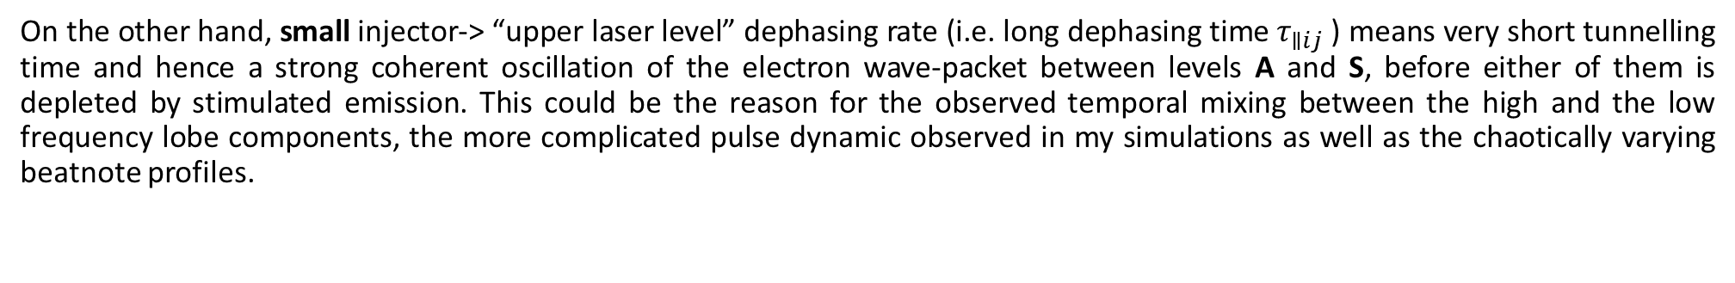
Simplistic interpretation (02):
On the other hand, small injector-> “upper laser level” dephasing rate (i.e. long dephasing time $τ_{∥ij}$) means very short tunnelling time and hence a strong coherent oscillation of the electron wave-packet between levels A and S, before either of them is depleted by stimulated emission. This could be the reason for the observed temporal mixing between the high and the low frequency lobe components, the more complicated pulse dynamic observed in my simulations as well as the chaotically varying beatnote profiles.
In that sense what could be the reason for the experimentally observed “stable comb regimes” in [Burghoff2014]?
Based on the considerations above, my bet is that regions I, II and III might correspond to some alignment of the energy levels such that the injector/ull out-scattering rate is drastically increased, which also increases the injector-> ull dephasing rate since:
$τ_{∥ij}^{−1}=\frac{1}{2}\left(τ_{i}^{−1}+τ_{j}^{−1}\right)+τ_{pure }^{−1}$,where $τ_{i}$ is the i-th level lifetime and $τ_{pure}$ is the pure dephasing time.
Image taken from [Burghoff2014]
A possible candidate for such a scattering mechanism is electron-electron scattering which is supposed to be especially strong near resonance.
Warning. In all of the presented results the simulations were run over 5000 RT or so. The reason for chaotic beatnote behaviour might still be in the fact that our simulations had not yet converged to steady state. Currently I am running simulations for 10 000 RT’s to re-check the results. I am also running one for 50 000 RT’s as a final verification of the results, but due to the large number of iteration this simulation will take considerable time to complete.

Slide 5
References
[Dupont2010] E. Dupont, S. Fathololoumi and H.C. Liu ,” Simplified density-matrix model applied to three-well terahertz quantum cascade lasers”, Phys. Rev B 81 (2010) .
[Burghoff2014] David Burghoff, Tsung-Yu Kao, Ningren Han, Chun Wang Ivan Chan, Xiaowei Cai, Yang Yang, Darren J. Hayton, Jian-Rong Gao, John L. Reno and Qing Hu , “Terahertz laser frequency combs”, Nat. Phot. 8 (2014).
[Jirauschek2014] Christian Jirauschek, Tillmann Kubis, “Modeling techniques for quantum cascade lasers”, Appl. Phys. Rev. 1 (2014).
[Burghoff2015] David Burghoff, Yang Yang, Darren J. Hayton, Jian-Rong Gao, John L. Reno, and Qing Hu “Evaluating the coherence and time-domain profile of quantum cascade laser frequency combs” , Opt. Exp. 1190 (2015).
[BurghoffPhD] D. P. Burghoff. (2014). Ph.D. dissertation, MIT.
[Bastard1990] G. Bastard, “Wave Mechanics Applied to Semiconductor Heterostructures”, Les Éditions de Physique, Les Ulis, France, 1990.
[Kumar2009] Sushil Kumar and Qing Hu, “Coherence of resonant-tunneling transport in terahertz quantum-cascade lasers” , Phys. Rev. B 80 (2009).
[Callebaut2005] Hans Callebaut and Qing Hu, “Importance of coherence for electron transport in terahertz quantum cascade lasers”, J. Appl. Phys. 98 (2005)

