Slide 1
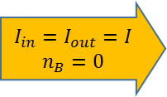
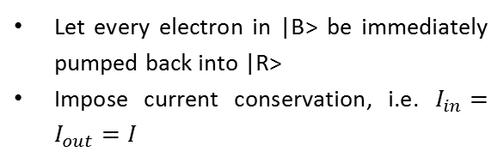
Periodic rate equations
A rate equation model that allows us to calculate the current density flowing through the QCL (not along)
Can be easily generalized to a semi-classical approach by incorporating it within the scattering rates matrix of Maxwell-Bloch equations.
Rate equations:
Carrier Reservoir
Let every electron in |B> be immediately pumped back into |R>
Impose current conservation, i.e. $I_{in}=I_{out}=I$
Carrier Basin
. . .
$$\begin{matrix}I_{in}=I_{out}=I \\ n_{B}=0\end{matrix}$$

Slide 2
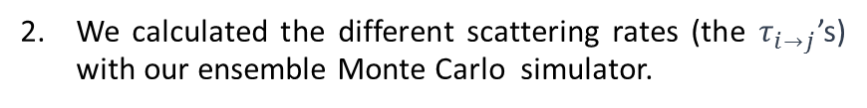
Density Matrix model
We took the FL183S AR specification and calculated the wave functions in the tight binding approximation.
We set up a density matrix model for the full set of energy levels (illustrated in the figure below).
Active region
Injector
0.35
0.3
0.25
0.2
0.15
0.1
Depop.
0.05
0
40
60
80
100
120
140
160
We calculated the different scattering rates (the $τ_{i→j}$’s) with our ensemble Monte Carlo simulator.

Slide 3
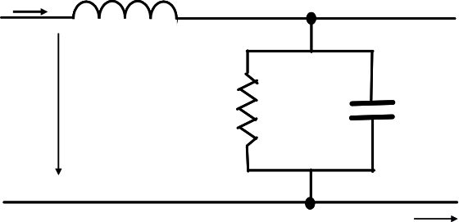



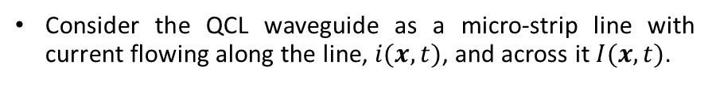





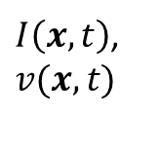


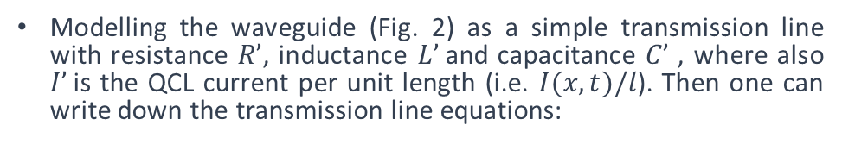


Transmission line model (1)
$$i(x,t)$$
$$L’$$
Consider the QCL waveguide as a micro-strip line with current flowing along the line, $i(x,t)$, and across it $I(x,t)$.
$$A(x,t)$$
$$I’$$
$$C’$$
$$l$$
$$v(x,t)$$
$$i(x,t)$$
$$A(x,t)$$
QCL AR
$I\left(x,t\right)$,$v(x,t)$
$$Lp$$
$$x$$
Fig. 2: Schematic representation of the transmission line model and its main components
$$w$$
z
y
Fig. 1: Metal-metal waveguide QCL geometry
x
(1)
Modelling the waveguide (Fig. 2) as a simple transmission line with resistance $R’$, inductance $L’$and capacitance $C’$ , where also $I’$is the QCL current per unit length (i.e. $I(x,t)/l$). Then one can write down the transmission line equations:
(2)

Slide 4

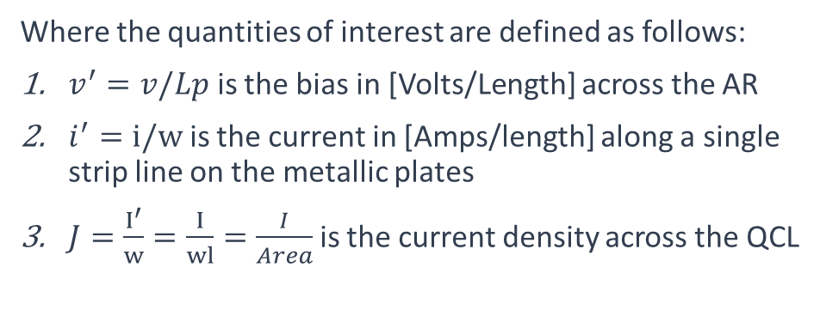


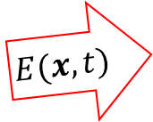

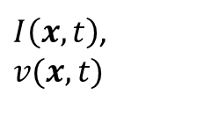
Transmission line model (2)
(3’)
$$l$$
(4’)
$$i(x,t)$$
$$E(x,t)$$
QCL AR
$I\left(x,t\right)$,$v(x,t)$
$$Lp$$
(3)
$$w$$
z
y
Fig. 1: Metal-metal waveguide QCL geometry
x
(4)
Neglect the resistance for now and take the parallel plate capacitance and inductance as:
Where the quantities of interest are defined as follows:
$v^{′}=v/Lp$ is the bias in [Volts/Length] across the AR
$i^{′}=i/w$ is the current in [Amps/length] along a single strip line on the metallic plates
$J=\frac{I^{′}}{w}=\frac{I}{wl}=\frac{I}{Area}$ is the current density across the QCL

Slide 5




Transmission line model (2)
$$l$$
$$i(x,t)$$
$$E_{z}(x,t)$$
$J\left(x,t\right)$,$v(x,t)$
QCL AR
z
y
x

Slide 6

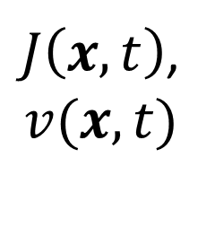

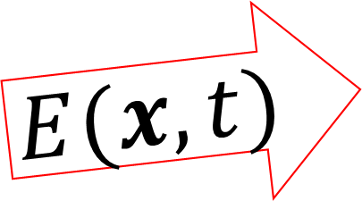
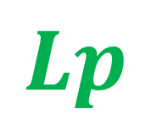


$$l$$
$$E(x,t)$$
$$i(x,t)$$
$$Lp$$
$J\left(x,t\right)$,
$$v(x,t)$$
$$w$$
z
$$∆x$$
y
x

Slide 7






$$i(x,t)$$
$$L’$$
$$v(x,t)$$
$$J(x,t)$$
$$C’$$
$$x$$

Slide 8
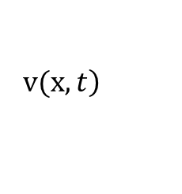

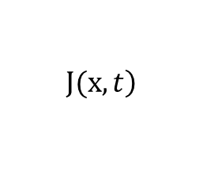
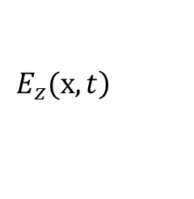
Maxwell:
$$\left.E_{z}(x,t\right)$$
$$<\hat{μ}>$$
Bloch:
$$\left.J(x,t\right)$$
$$\left.v(x,t\right)$$
TL:

Slide 9



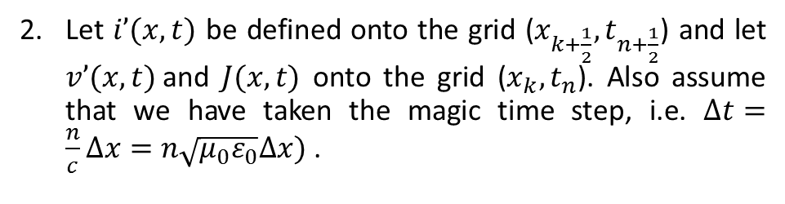




















Transmission line model (3)
Let $i’(x,t)$ be defined onto the grid ($x_{k+\frac{1}{2}},t_{n+\frac{1}{2}}$) and let $v’(x,t)$and $J(x,t)$ onto the grid ($x_{k},t_{n}$). Also assume that we have taken the magic time step, i.e. $∆t=\frac{n}{c}∆x=n\sqrt{μ_{0}ε_{0}}∆x)$ .
We will discretize along a staggered temporal and spatial grid:
$$J_{k−1}$$
$${v′}_{k−1}$$
$$J_{k}$$
$${v′}_{k}$$
$$J_{k+1}$$
$${v′}_{k+1}$$
${v′}_{k+2}$ (bdry)
$$i’(bdry)$$
$${i′}_{k−\frac{1}{2}}$$
$${i′}_{k+\frac{1}{2}}$$
$${i′}_{k+\frac{3}{2}}$$
$$t_{n+2}$$
$$t_{n+\frac{3}{2}}$$
$$t_{n+1}$$
(5)
$$t_{n+\frac{1}{2}}$$
$$t_{n}$$
$$t_{n−\frac{1}{2}}$$
(6)
$$t_{n−1}$$
$$x_{k−\frac{3}{2}}$$
$$x_{k+\frac{3}{2}}$$
$$x_{k−\frac{1}{2}}$$
$$x_{k}$$
$$x_{k+\frac{1}{2}}$$
$$x_{k+1}$$
$$x_{k+2}$$
$$x_{k−1}$$
Fig. 3: TL equations discretization grid
This yields the following staggered in time and space, time-stepping scheme(I believe second order in both t and x):
(7)
(8)
wave impedance

Slide 10





Transmission line model (4)
$$i′(x,0)$$
Boundary conditions:
Initial conditions (TL):
$$i_{0}$$
$$v′(x,0)$$
$$v_{0}$$
$$x=l$$
Initial population distribution – all electrons in upper laser level. Hence:
Active region
N electrons
Injector
-
-
-
-
where N is the average electron density in [cm⁻³] in the QCL.
Depop.

Slide 11
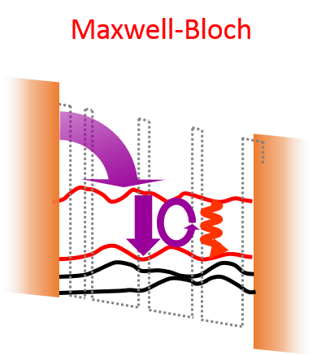
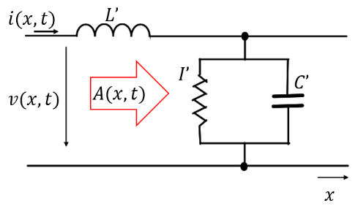
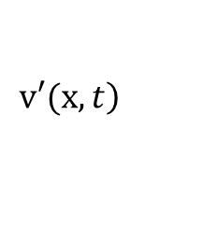
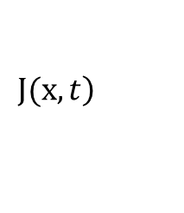
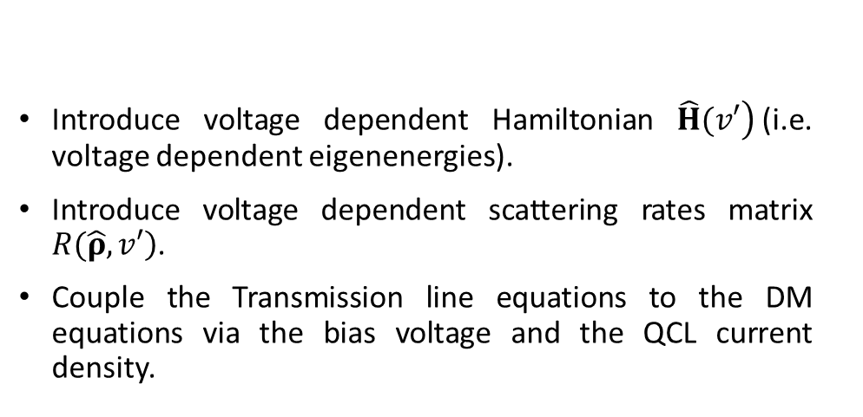
Transmission line + Maxwell-Bloch equations
Maxwell:
$$\left.E_{z}(x,t\right)$$
$$<\hat{μ}>$$
Bloch:
Introduce voltage dependent Hamiltonian $\left.\hat{H}(v′\right)$(i.e. voltage dependent eigenenergies).
Introduce voltage dependent scattering rates matrix $\left.R(\hat{ρ},v′\right)$.
Couple the Transmission line equations to the DM equations via the bias voltage and the QCL current density.
$$\left.J(x,t\right)$$
$$\left.v′(x,t\right)$$
TL:

Slide 12






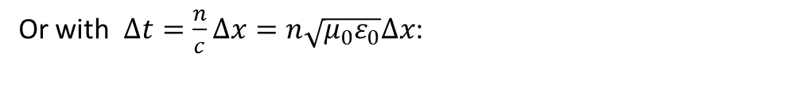






Transmission line model (3’)
Alternatively, eliminate the longitudinal current from eq. (3) and (4) to get:
$$J_{k−1}$$
$${v′}_{k−1}$$
$$J_{k}$$
$${v′}_{k}$$
$$J_{k+1}$$
$${v′}_{k+1}$$
${v′}_{k−2}$ (bdry)
${v′}_{k+2}$ (bdry)
$$t_{n+2}$$
(5)
$$t_{n+1}$$
$$t_{n}$$
(6)
$$t_{n−1}$$
$$x_{k−1}$$
$$x_{k}$$
$$x_{k+1}$$
$$x_{k+2}$$
Simple 2nd order FD discretization yields:
Fig. 3: TL equations discretization grid
Or with $∆t=\frac{n}{c}∆x=n\sqrt{μ_{0}ε_{0}}∆x$:
Together with the “tangential” bdry conditions:
(7)
(8)

Slide 13
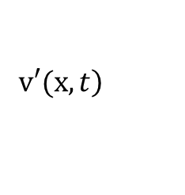

Transmission line + Maxwell-Bloch equations
Maxwell:
$$\left.E_{z}(x,t\right)$$
$$<\hat{μ}>$$
Bloch:
$$\left.J(x,t\right)$$
$$\left.v′(x,t\right)$$
Introduce voltage dependent Hamiltonian $\left.\hat{H}(v′\right)$(i.e. voltage dependent eigen energies).
Introduce voltage dependent scattering rates matrix $\left.R(\hat{ρ},v′\right)$.
Couple the Transmission line equations to the Bloch equations via the bias voltage and the QCL current density.
TL:

