Slide 1



a
b
t = 48.0428 ps
c
t = 96.0857 ps
0.2
II
I
3
3
0.15
Energy (eV)
$$|e〉$$
$$|s〉$$
2
2
0.1
Intensity (a.u.)
Intensity (a.u.)
0.05
$$|g〉$$
1
1
0
0
0
0
10
20
z (nm)
30
40
50
0
1
2
3
4
5
0
1
2
3
4
5
d
e
x (mm)
f
x (mm)
3
t = 144.1285 ps
3
t = 216.1928 ps
3
t = 264.2356 ps
2
2
2
Intensity (a.u.)
Intensity (a.u.)
Intensity (a.u.)
1
1
1
0
0
0
0
1
2
3
4
5
0
1
2
3
4
5
0
1
2
3
4
5
x (mm)
x (mm)
x (mm)

Slide 2



a
b
t = 48.0428 ps
c
t = 96.0857 ps
0.2
II
I
3
3
0.15
Energy (eV)
$$|e〉$$
$$|s〉$$
2
2
0.1
Intensity (a.u.)
Intensity (a.u.)
0.05
$$|g〉$$
1
1
0
0
0
0
10
20
z (nm)
30
40
50
0
1
2
3
4
5
0
1
2
3
4
5
d
e
x (mm)
f
x (mm)
3
t = 144.1285 ps
3
t = 216.1928 ps
3
t = 264.2356 ps
2
2
2
Intensity (a.u.)
Intensity (a.u.)
Intensity (a.u.)
1
1
1
0
0
0
0
1
2
3
4
5
0
1
2
3
4
5
0
1
2
3
4
5
x (mm)
x (mm)
x (mm)
a
b
t = 48.0428 ps
c
t = 96.0857 ps
0.2
II
I
3
3
0.15
Energy (eV)
$$|e〉$$
$$|s〉$$
2
2
0.1
Intensity (a.u.)
Intensity (a.u.)
0.05
$$|g〉$$
1
1
0
0
0
0
10
20
z (nm)
30
40
50
0
1
2
3
4
5
0
1
2
3
4
5
d
e
x (mm)
f
x (mm)
3
t = 144.1285 ps
3
t = 216.1928 ps
3
t = 264.2356 ps
2
2
2
Intensity (a.u.)
Intensity (a.u.)
Intensity (a.u.)
1
1
1
0
0
0
0
1
2
3
4
5
0
1
2
3
4
5
0
1
2
3
4
5
x (mm)
x (mm)
x (mm)

Slide 3



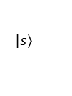



a
b
t = 96.0857 ps
c
t = 144.1285 ps
d
t = 264.2356 ps
0.2
II
I
3
3
3
0.15
Energy (eV)
$$|e〉$$
$$|s〉$$
2
2
2
0.1
Intensity (a.u.)
Intensity (a.u.)
Intensity (a.u.)
0.05
$$|g〉$$
1
1
1
0
0
10
20
30
40
50
0
0
0
z (nm)
0
1
2
3
4
5
0
1
2
3
4
5
0
1
2
3
4
5
x (mm)
x (mm)
x (mm)
II
I
0.2
0.15
Energy (eV)
$$|e〉$$
$$|s〉$$
0.1
0.05
$$|g〉$$
$${ℏω}_{0}$$
0
0
10
20
z (nm)
30
40
50
$$ℏδω$$
$$|e〉$$
$$ℏ{Ω }_{se}$$
$$|s〉$$
$$ℏε$$
$$|g〉$$
$$E_{z}$$

Slide 4
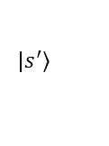
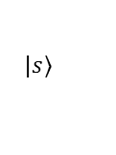
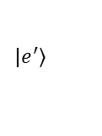
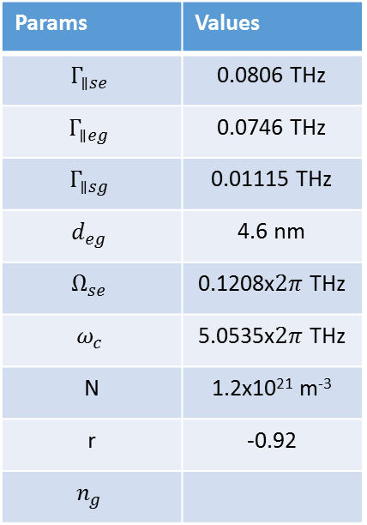
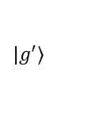
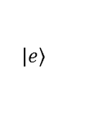
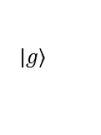
Structure at 4.4 kV/cm
0.2
$$|\left.s\right\rangle$$
0.15
$$|\left.e^{′}\right\rangle$$
$$|\left.s^{′}\right\rangle$$
Energy (eV)
0.1
$$|\left.e\right\rangle$$
$$|\left.g\right\rangle$$
$$|\left.g^{′}\right\rangle$$
0.05
0
20
40
60
80
100
120
z (nm)
Params: 100/90/10/90/70/90/100
Params | Values
$$Γ_{∥se}$$ | 0.0806 THz
$$Γ_{∥eg}$$ | 0.0746 THz
$$Γ_{∥sg}$$ | 0.01115 THz
$$d_{eg}$$ | 4.6 nm
$$Ω_{se}$$ | 0.1208x$2π$ THz
$$ω_{c}$$ | 5.0535x$2π$ THz
N | 1.2x10²¹ m⁻³
r | -0.92
$$n_{g}$$
6
e
n
r
4
2
-4
-2
0
2
4
/2
10
11
5000
n
g
0
-5000
-4
-2
0
2
4
e
/2
10
11
c
1
n
a
t
t
i
m
0.5
s
n
a
r
0
T
-4
-2
0
2
4
/2
10
11

Slide 5
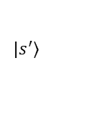
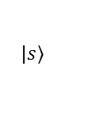
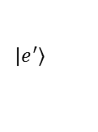

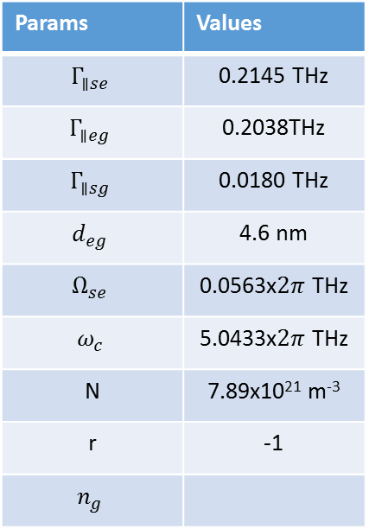
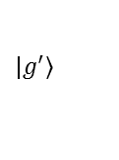

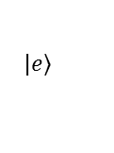
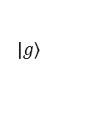
Structure at 4.4 kV/cm
a
b
$$Γ_{∥sg}=0$$
6
$$Γ_{∥sg}=0.018 THz$$
$$n′$$
0.2
$$|\left.s\right\rangle$$
4
c
2
-0.4
-0.2
0
0.2
0.4
0.15
$$|\left.e^{′}\right\rangle$$
$$|\left.s^{′}\right\rangle$$
10³
Energy (eV)
$$n_{g}$$
$$|\left.e\right\rangle$$
d
0
0.1
$$|\left.g^{′}\right\rangle$$
-10³
-0.4
-0.2
0
0.2
0.4
0.05
$$|\left.g\right\rangle$$
1
$$T(δω)$$
0.5
0
20
40
60
80
100
120
0
-0.4
-0.2
0
0.2
0.4
z (nm)
Freq. (THz)
Params: 100/90/10/90/70/90/100
Params | Values
$$Γ_{∥se}$$ | 0.2145 THz
$$Γ_{∥eg}$$ | 0.2038THz
$$Γ_{∥sg}$$ | 0.0180 THz
$$d_{eg}$$ | 4.6 nm
$$Ω_{se}$$ | 0.0563x$2π$ THz
$$ω_{c}$$ | 5.0433x$2π$ THz
N | 7.89x10²¹ m⁻³
r | -1
$$n_{g}$$

Slide 6

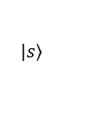







z
$$dA$$
$$dG$$
1
1
2
2
3
3
4
4
M
N_{G}
$n_{g}^{A}$,$l^{A}$
$n_{g}^{G}$,$g^{G}$
…
$$L$$
$$x$$
$$ℏ{Ω }_{se}$$
$$|s〉$$
$$ℏε$$
$$ℏδω$$
$$|e〉$$
$$|g〉$$
$$E_{z}$$

Slide 7



1.2
10
-6
$8 Bits$-input
$$T=484 ps$$
1
$8 Bits$-output
0.8
Intensity (a.u.)
0.6
0.4
0.2
0
$$1$$
$$0$$
$$1$$
$$1$$
$$1$$
$$1$$
$$1$$
$0$
0
200
400
600
800
1000
1200
1400
1600
1800
2000
Time (ps)

