Slide 1
Performance Analysis of GCC Compiler Optimizations
CSCI 5593
Aishwarya Mulkalwar
Courtney Peverley
Stefani Moore

Slide 2
How do compiler optimizations affect program compilation time and runtime, as well as the underlying architecture?

Slide 3

Overview
Reminders from previous presentation
Test Implementation
Experimental Results & Analysis
Conclusions & Future Plans

Slide 4





Reminders From Our Last Presentation
Compiler
Language parser that converts one programming language into another
Compiler optimization goals
Preserve program meaning
Improve source program
GCC contains many predefined compiler optimizations
O0 (default), O1, O2, O3, Os, and Ofast

Slide 5
Reminders From Our Last Presentation, Cont.
Expected Results:
O3 optimization will result in the fastest execution time for most programs
The use of mtune will result in only moderate speedup gains for both systems
The higher the number of compiler optimizations, the longer the compilation will take

Slide 6

Test Implementation
SPEC CPU2017
Reportable runs
Configuration Files
perf
How did we do the things?
bench mark

Slide 7
SPEC CPU2017
Provides performance measurements that can be used to compare compute-intensive workloads on different computer systems
43 benchmarks divided into 4 suites - intrate, intspeed, fprate, fpspeed
Intended to stress CPU, memory architecture, and compilers
Uses workloads that represent real-world problems
Ray tracing
Data compression
Video compression
PERL language interpretation
XML Processing
Notes:
https://www.spec.org/cpu2017/Docs/overview.html#metrics
ftp://ftp.hp.com/pub/c-products/servers/benchmarks/SPEC_CPU2006_Overview_101907.pdf
Many other benchmarks stress I/O, operating system, and other system components other than just the CPU. The benchmarks that stress these other components are much more complicated to run and therefore have a more limited set of published results with which to compare.

Slide 8
SPEC CPU2017 - intrate
SPECrate 2017 Integer | Language | Application Area
500.perlbench_r | C | Perl interpreter
502.gcc_r | C | GNU C compiler
505.mcf_r | C | Combinatorial Optimization: network simplex algorithm
520.omnetpp_r | C++ | Discrete Event simulation - computer network
523.xalancbmk_r | C++ | XML to HTML conversion via XSLT
525.x264_r | C | Video compression
531.deepsjeng_r | C++ | Artificial Intelligence: alpha-beta tree search (Chess)
541.leela_r | C++ | Artificial Intelligence: Monte Carlo tree search (Go)
548.exchange2_r | Fortran | Artificial Intelligence: Recursive solution generator (Sudoku)
557.xz_r | C | General data compression
Notes:
https://www.spec.org/cpu2017/Docs/index.html#intrate

Slide 9
SPEC CPU2017 Execution
runcpu:
Tool that will automatically create Makefiles, build the benchmarks, run them, generate reports, and write log files
Options defined in configuration file and/or command line arguments
runcpu and configuration files are comparable to that of make and makefiles
Heracles run example:
srun -n1 -w “node[10]” time perf stat -d runcpu --config=Heracles_O3 --reportable intrate

Slide 10
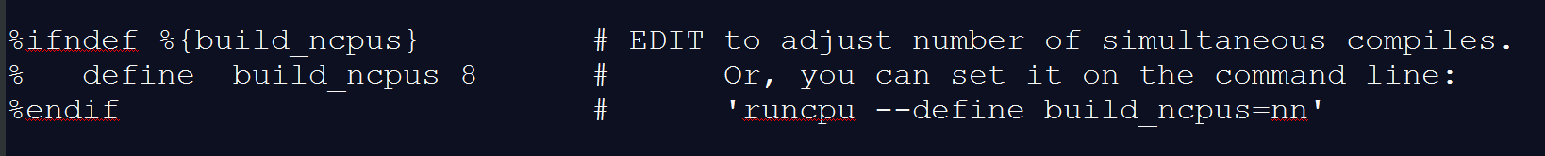
Configuration Files
Defines how to build, run, and report on the SPEC CPU benchmarks in a particular environment
Options are collected into one place, which is key to result reproducibility
If you have the resources and want compiles to complete more quickly try:
runcpu --define build_ncpus=99
specmake will create up to 99 compile jobs at a time.
Notes:
https://www.spec.org/cpu2017/Docs/config.html
-SLURM: Slurm is an open source, fault-tolerant, and highly scalable cluster management and job scheduling system for large and small Linux clusters. https://slurm.schedmd.com/overview.html
- gcc -march=native -Q --help=target will give enabled options available when using march=native → corresponds to march=core-avx2 for Intel Xeon processor (https://stackoverflow.com/questions/943755/gcc-optimization-flags-for-xeon)

Slide 11
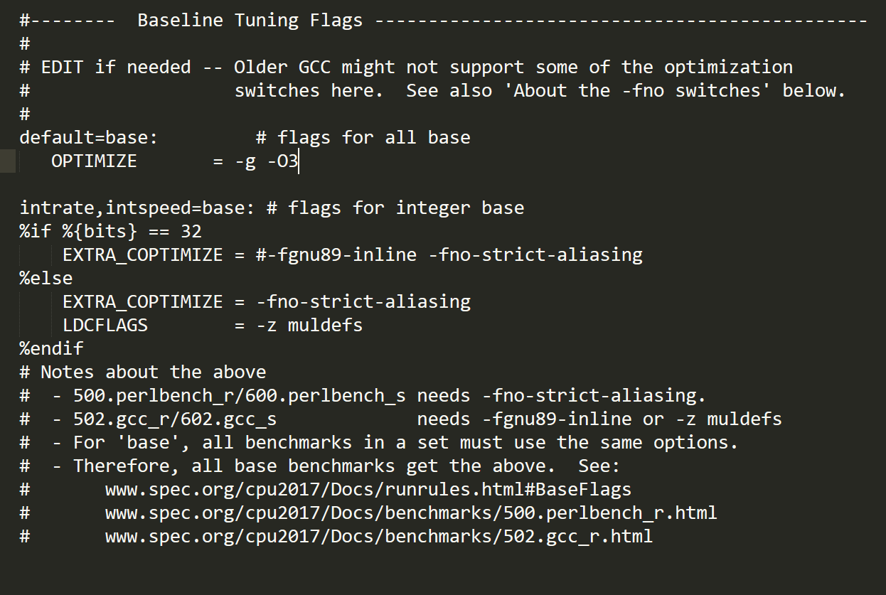
Configuration Files Cont.

Slide 12
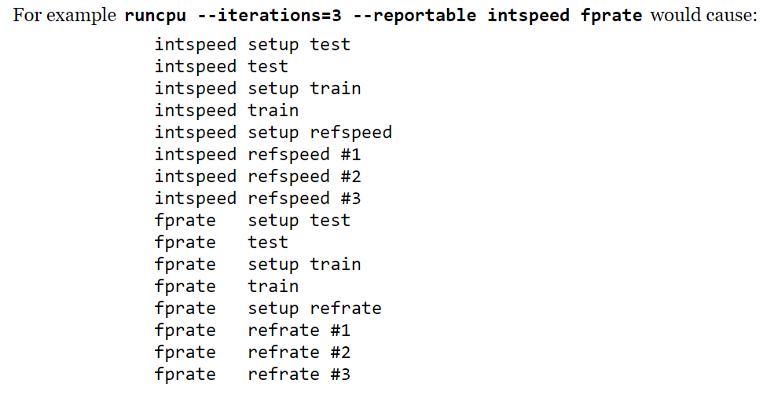
What are reportable runs?
Run rules are automatically enforced to produce results suitable for SPEC
Steps:
Test - Data for a simple test that an executable is functional
Train - Same steps as train workload, for the same reasons, with the same verification, non-reporting, and parallelism.
Ref -The timed data set
Report - Write reports
Notes:
A reportable run does these steps:
Test: Set up all of the benchmarks using the test workload. Run them. Verify that they get correct answers. The test workloads are run merely as an additional verification of correct operation of the generated executables; their times are not reported and do not contribute to overall metrics. Therefore multiple benchmarks can be run simultaneously, as in the example below where the tester has set --parallel_test to allow up to 20 simultaneous tests.
Train: Do the same steps for the train workload, for the same reasons, with the same verification, non-reporting, and parallelism.
Ref: Run the refrate (5xx benchmarks) or the refspeed (6xx) workload
Set up the directories for all benchmarks. If both base and peak tuning are requested, set up both.
Run one benchmark at a time, in order by benchmark number within the requested set, verifying that each gets the correct answer, and recording times.
Repeat. (*)
If --iterations=3, repeat once more. (*)
If both base and peak --tuning are requested, all of base is completed before starting peak.
If running refspeed, multiple --threads are optionally allowed.
If running refrate multiple --copies are optionally allowed, as in the example below which uses 256 copies in base.
(*) For reportable runs, --iterations must be 2 or 3.
Report:
During the reporting phase, if three runs were used, the median run time is selected from each benchmark. If two runs are used, then the slower of the two runs is selected.
Use the selected runs to compute ratios and overall metrics.
Write reports as requested in the --output_format switch.

Slide 13
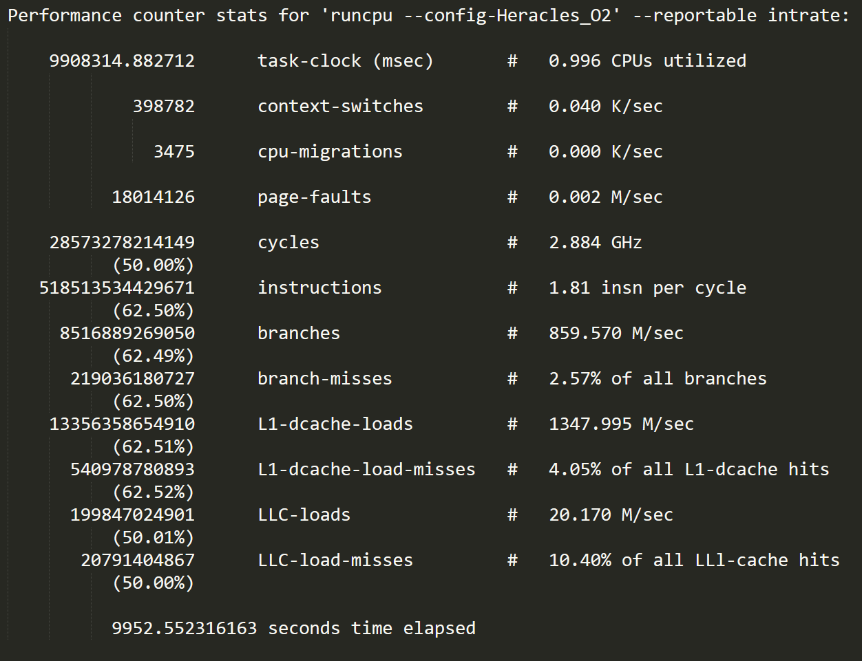
perf - More specifically perf stat
Profiler tool for Linux 2.6+ based systems
Presents a simple command line interface
Keeps a running count during process execution
Software events: pure kernel counters
Hardware events: performance monitoring unit (PMI)
perf stat -d
Notes:
https://perf.wiki.kernel.org/index.php/Tutorial
https://medium.com/@okaleniuk/reasoning-about-performance-linux-style-part-2-obtaining-more-data-with-perf-729443531c68
http://rts.lab.asu.edu/web_438/project_final/CSE_598_Performance_Monitoring_Unit.pdf
Some events are pure kernel counters, in this case they are called software events. Examples include: context-switches, minor-faults.
Another source of events is the processor itself and its Performance Monitoring Unit (PMU). It provides a list of events to measure micro-architectural events such as the number of cycles, instructions retired, L1 cache misses and so on. Those events are called PMU hardware events or hardware events for short. They vary with each processor type and model.
The perf_events interface also provides a small set of common hardware events monikers. On each processor, those events get mapped onto an actual events provided by the CPU, if they exists, otherwise the event cannot be used. Somewhat confusingly, these are also called hardware events and hardware cache events.

Slide 14
Experimental Results & Analysis
Prepare for… a data explosion!

Slide 15

Notes:
BANG!

Slide 16
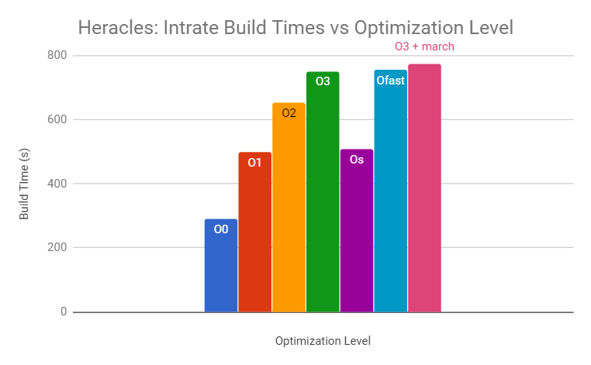
Compilation Times
Compilation times reflect expected results
Unoptimized took the least amount of time to compile
O3, Ofast, and O3+march took most time to compile
Os similar to O1
Notes:
Os: enables all optimizations in O2 that don’t impact code size
Logically, it’ll be faster to compile than O2, which is what we’re seeing

Slide 17
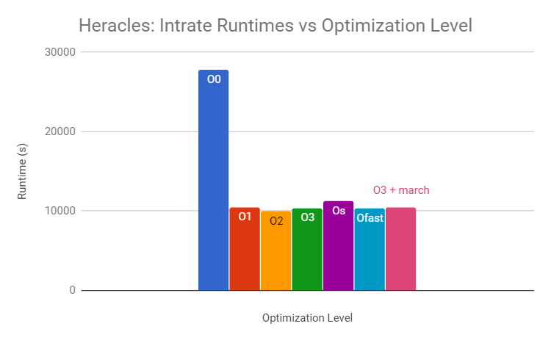
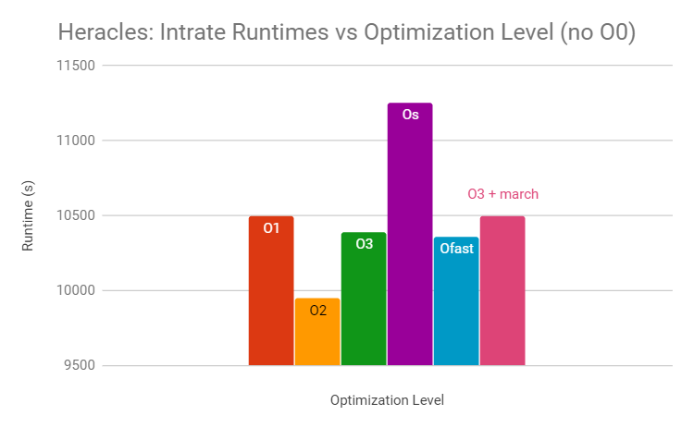
Execution Times
Unoptimized took longest (by far) to execute
O2 took least amount of time (unexpected)
Let’s delve into why that might be!
Mostly inversely proportional to compilation time
O3 + march (processor specific optimization) actually takes longer
Notes:
making the compilation time increase with probably small improvement in execution time.
Os takes less time for compilation hence more execution time.
Improve the execution time of programs at the expense of increased compile time, code size.
Unclear why O3+march is worse than O3

Slide 18
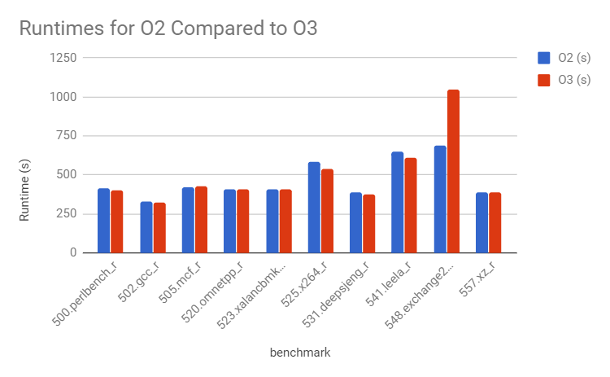
Execution Times
here’s the breakdown of all of the benchmarks in intrate and their runtimes for O2 compared to O3
clear culprit: 548.exchange2
exchange2 is a Fortran program that involves the creation of Sudoku puzzles
Very loop-heavy
Aggressive loop unrolling kicks in at O3
Notes:
exchange2 also only Fortran benchmark in intrate suite (not sure if that’s related)
aggressive loop unrolling that kicks in at O3 could mean some of these loops don’t fit into the instruction cache

Slide 19
Executable Size
Reminder:
Many of the optimizations increase the size of our executable
For example: aligning functions, loop unrolling, function cloning
Others decrease the size of our executable
For example: dead store elimination, common subexpression elimination
We’ll take a look at a few specific examples from 502.gcc_r, which is (perhaps ironically) based on the code used for the GCC compiler
Notes:
We expect the increasing ones to outweigh the decreasing ones - net result: more optimizations, larger executable

Slide 20
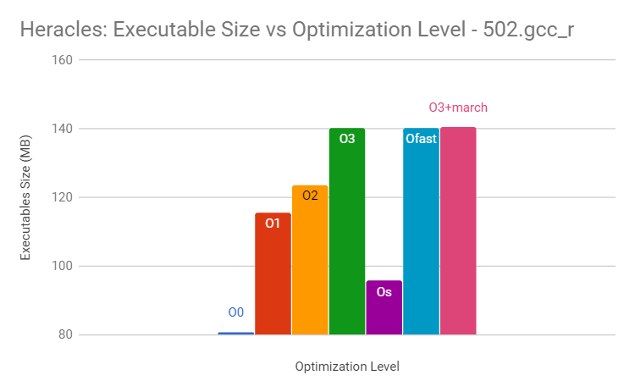
Executable Size - 502.gcc_r
The relative sizes of all the executables (380 of them) within the 502.gcc_r benchmark are as expected
Unoptimized and Os are smallest
Size grows as we do more and more optimizations
Ofast, O3, and O3+march very similar
Notes:
Os is not tiny, but gives us some optimizations without relying on those with a space-speed tradeoff
502.gcc_r: Executable Size in MB is the sum of all the executables

Slide 21
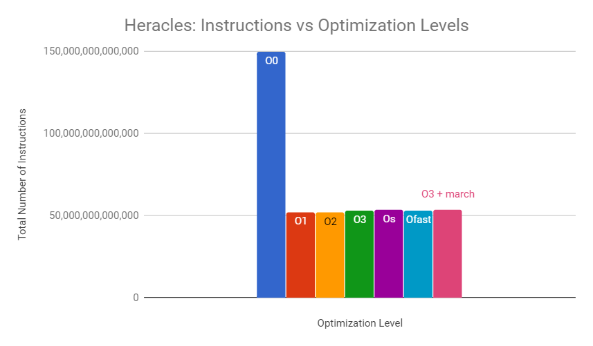
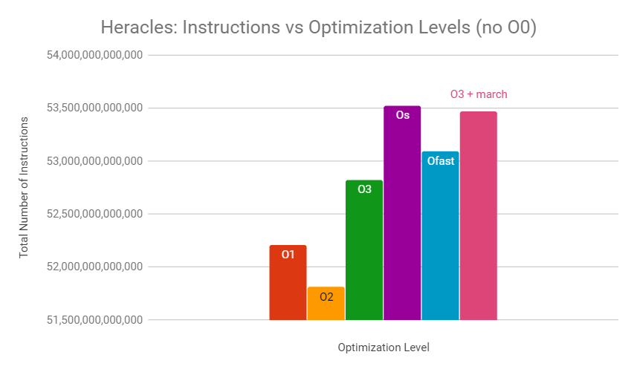
Total Instructions
Even though optimizations increase executable size (vs unoptimized)...
The number of instructions executed by unoptimized code is huge
Mostly correlated with runtimes
More instructions, slower runtime
Notes:
Unclear what the relationship between instruction count and executable size is
Contrary to our intrinsic beliefs - seems like a larger executable should result in more instructions
Repeated instructions? Loop-unrolling, ipa-cp-clone, loop-unswitching
Though most of the loop optimizations kick in at O3, there are some at O1 and O2 that could increase executable size and decrease instruction count
Instruction size? - variable instructions

Slide 22
Total Instructions
Even though optimizations increase executable size (vs unoptimized)...
The number of instructions executed by unoptimized code is huge
Mostly correlated with runtimes
More instructions, slower runtime
Notes:
Correlation with runtimes:
More instructions, slower runtime
Means O0, Os, O3+march should be slowest

Slide 23
Runtime/Instructions Correlation
Notes:
WEIRD THINGS:
O1. relatively few instructions, slow runtime - be on the lookout for things that could impact IPC
O3. More instructions than O1, faster runtime
Look for IPC impacts that could affect performance of O1

Slide 24
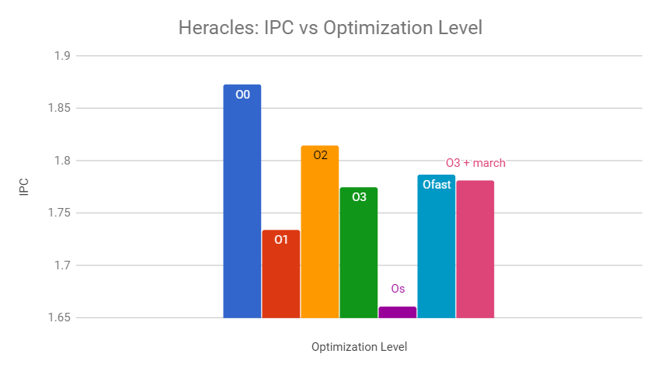
Instructions Per Cycle
Notes:
Os has low IPC
O0, O2 have highest

Slide 25
Instructions Per Cycle
Os has lowest IPC
Unoptimized and O2 have highest
IPC should be correlated to mispredicted branches, cache misses, page faults
More missed things = lower IPC
Mispredicted branch: slowdown from draining the pipeline
Cache miss: slowdown while fetching data from further away
Page Fault: slowdown while the page is made accessible

Slide 26

Predicted branch

Slide 27
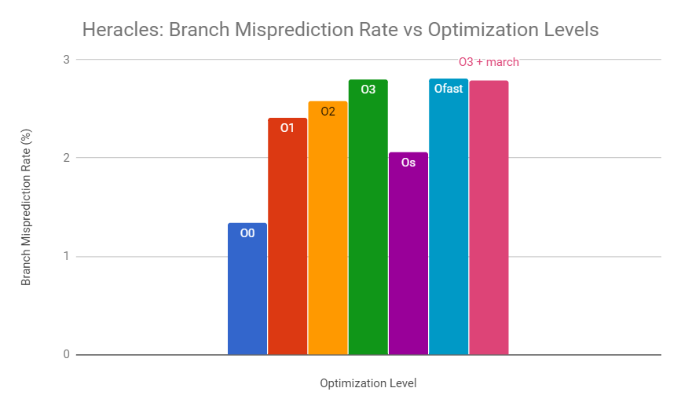
Branch Misprediction Rate
Intel Xeon BPU uses pattern recognition to predict branches
More branches means better chance at establishing patterns
Many loop optimizations lead to fewer branches (particularly in O3)
Doesn’t have huge impact on execution time
The optimization levels with the lowest branch misprediction rate are also those with slowest execution
Notes:
Loop Optimizations: loop-unswitching, loop-unrolling, etc
WEIRD THING: O1 had more branches/instruction than O0
Increase optimizations → increase misprediction rate
Optimization levels with lower branch misprediction rates take longer to execute

Slide 28
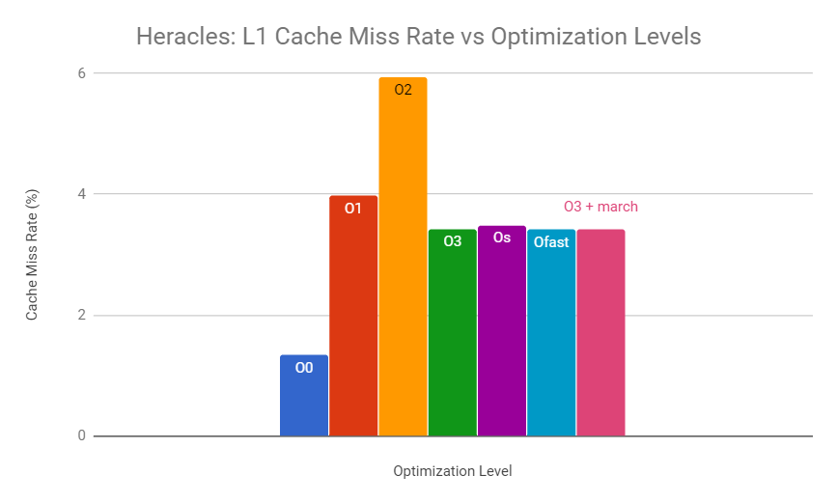
L1 Cache Miss Rate
Tags responsible for improving cache performance:
O3 : loop-interchange, tree-loop-distribution
O2: reorder-blocks-and-partition
Also does not impact execution time too much
O2 has a much higher cache miss rate, but still executes fastest
Notes:
Tree-loop-distribution: improve cache performance on big loop bodies
Breaks up large loop into smaller loops so that all can be in cache when needed
Reorder-blocks-and-partition: partition hot and cold basic blocks (frequently accessed, infrequently accessed)
Improves cache locality because you’re loading hot blocks all together (which you will likely use)

Slide 29
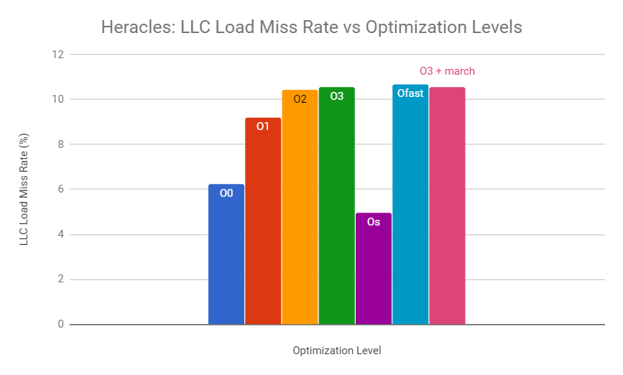
LLC Load Miss Rate
Unoptimized: Slowest execution time, low L3 cache misses
O1: Less execution time, higher L3 cache misses
O3: Even less execution time, Even higher L3 cache misses
Os has lowest L3 cache miss rate
Perhaps because smaller executables means higher percentage of memory accesses serviced by L1 cache

Slide 30
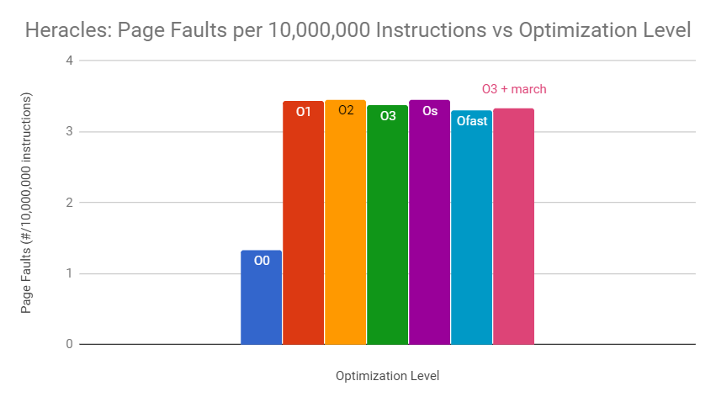
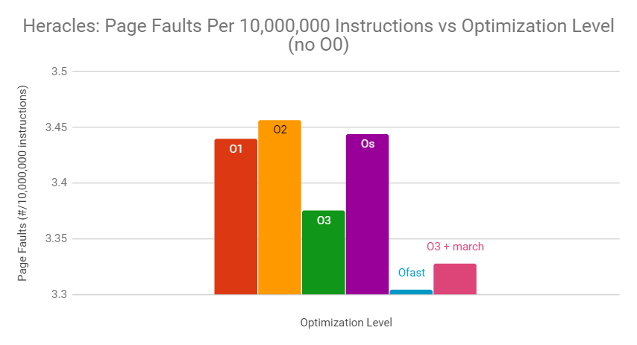
Page Faults
Unoptimized had relatively few page faults
O3 has more page faults than Ofast!
O1 has more page faults than O3!
Notes:
The page faults are contributing to the disparity between instructions and runtime seen previously
More page faults - more of a IPC decrease
Currently unsure about why the page fault numbers are the way they are, just that they seem to impact performance

Slide 31
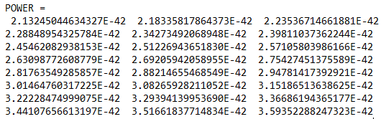
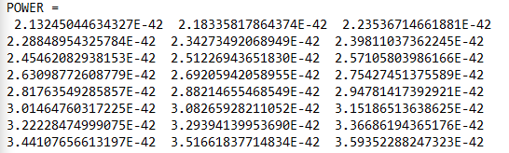
An Indictment Against Ofast
benchmark used: 549.fotonik3d_r
Fortran program
computational electromagnetics
top code is from O3 output
bottom code from Ofast
do you see any differences?
Notes:
Had to look pretty hard for a benchmark that produced erroneous results
fotonik3d_r:
Maxwell’s equations, electric fields for dielectric materials, etc
Fourier transform of electromagnetic fields in power planes to give us the power output
AKA: fun stuff!

Slide 32
An Indictment Against Ofast
benchmark used: 549.fotonik3d_r
Fortran program
computational electromagnetics
top code is from O3 output
bottom code from Ofast
do you see any differences?

Slide 33
An Indictment Against Ofast
benchmark used: 549.fotonik3d_r
Fortran program
computational electromagnetics
top code is from O3 output
bottom code from Ofast
do you see any differences?
O3 runtime: 485 seconds
Ofast runtime: 460 seconds
Notes:
Had to look pretty hard for a benchmark that produced erroneous results
Shaved 25 seconds off execution time
But at what cost?

Slide 34
Conclusions (so far)*
*we think

Slide 35


Conclusions
Results that agreed with our expectations:
Unoptimized code takes the longest to run
For the most part, as we increase the number of optimizations, we lower execution time (and increase build time [see picture])
Os has a smaller executable than O2; takes longer to execute
Cache miss rate improved from O3 till O3 + march
“Fewer passes through the optimizer!”
“HOW DID YOU BUILD
THAT SO FAST?”
Notes:
Because of page fault Os has smaller executable though it takes longer time to execute.
Ofast had more instructions than O3, but executed more quickly - most likely due to fewer page faults (we think)

Slide 36

Conclusions, cont.
Results that disagreed with our expectations:
O2 was faster than O3 (pictured below)
Processor-specific did not speed up execution
Unoptimized had lowest cache miss rate
Cache miss rates, branch mispredictions didn’t have much effect overall
Page faults did affect runtime results slightly - Ofast
Ofast presents a risk of inaccuracy, but perhaps is worth it?
Depends on application
How are you beating
me right now?
Some bunny applications
are fast, bro.

Slide 37
Future Plans
Delve deeper into why we are getting a performance hit on O3 and an additional hit on O3 + march
Systematically remove O3 optimizations (one at a time) to figure out what may be causing the problem
Determine why certain files don’t fit with “normal” executable size pattern
eg. why some O2 executables are larger than their O3 counterpart; why the processor-specific optimization does sometimes make a difference
Fine tune test parameters to get fastest execution time possible for Heracles using our findings from our current data
Will O2 with -march or -mtune yield even better execution times?
Generally: obtain deeper understanding of why results (page faults, cache misses, etc) are the way they are

Slide 38
Overarching Question to Answer
What do programmers gain from understanding compiler optimizations and our computer’s architecture?
Cannot blindly assume more optimizations yields faster execution time for any given program or system
“Why should I use precious turtle brain space on this??”

Slide 39
Progress on Answering that Question
If you’re not super concerned about precision, Ofast might be a resource to use
Os could be useful on embedded systems to save space
O3 is not necessarily the best level
Optimizations are machine- and application-dependent
Knowledge of your program and architecture will go a long way for execution efficiency

Slide 40
Lessons Learned / Problems Encountered
Running benchmarks is a slow process
SLURM not available on Hydra
Unable to run tests without ROOT access or running on the master node
So much data, so little time
GCC optimization documentation is frequently vague
Os “performs additional optimizations designed to reduce code size”
Paul, the Benchmarking Snail: We love him, but he’s even slower than Pete, the Unoptimized Snail

Slide 41

Questions?

Slide 42
References
R. D. Escobar, A. R. Angula, and M. Corsi, “Evaluation of GCC Optimization Parameters”, in Ing. USBMed, Vol. 3, No.2, 2012, pp. 31-39. [Online]. Available: http://web.usbmed.edu.co/usbmed/fing/v3n2/v3n2a4.pdf.
J. Pallister, S. Hollis, and J. Bennett, “Identifying Compiler Options to Minimise Energy Consumption for Embedded Platforms,” Department of Computer Science, University of Bristol, UK. 2013. [Online]. Available: https://arxiv.org/pdf/1303.6485.pdf.
Z. Pan and R. Eigenmann, “Fast and Effective Orchestration of Compiler Optimizations for Automatic Performance Tuning,” Proceedings of the International Symposium on Code Generation and Optimization. 2006.
J. Kaur and A. Kaur, “Role of Compiler in Computer Architecture,” International Journal of Engineering Research and General Science, Vol. 4, Issue 4, 2015, pp. 247-254. [Online]. Available: http://pnrsolution.org/Datacenter/Vol4/Issue3/33.pdf.
Jones, M. Optimization in GCC. 2005 [online] linuxjournal. Available at: http://www.linuxjournal.com/article/7269?page=0,0.
Fog, A. “The microarchitecture of Intel, AMD, and VIA CPUs: An optimization guide for assembly programmers and compiler makers,” Technical University of Denmark. 2018. [online] http://www.agner.org/optimize/microarchitecture.pdf

