Slide 1
PROGRAMAÇÃO AVANÇADA
GENERIC FUNCTIONS IN JAVA
81329 – João Calisto
81596 – Ricardo Xavier

Slide 2
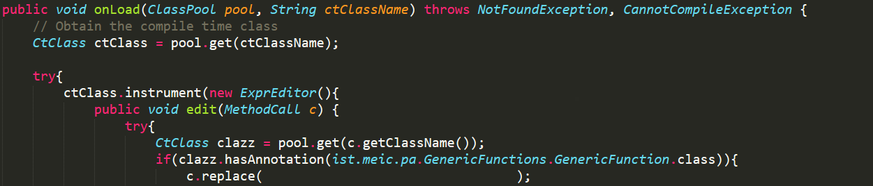
GENERIC FUNCTIONS
Notes:
We add our own Translator to the Class Loader.
We instrument every loaded class, checking for each one if it has a method call to a method of a class with a GenericFunctions Annotation
If it has the annotation we replace that method call with a call to a static method defined by us.
In this static method we have our own logic to solve every conflict in run-time.

Slide 3
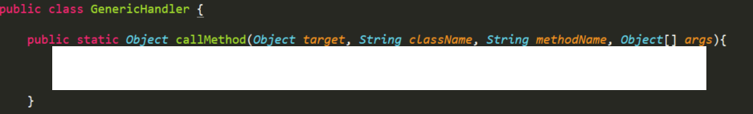
SOLUTION
Notes:
Here we have the GenericHandler with a static method (callMethod)
This method is called everytime we want to call a method declared in a class annotated with @GenericFunctions.
In this static method we have our own logic to solve every conflict in run-time.

Slide 4
CHOOSING THE BEST METHOD
Cost based algorithm.
Iterate every possible method and calculate the cost of each one.
For each hierarchy jump, we add 1 to the cost.
The best method is the one with the lowest cost.
Notes:
Explicar algoritmo

Slide 5
BEFORE AND AFTER METHODS
Cost based algorithm.
Assign a cost to each Before/After Method.
Invoke Before Methods from lowest to highest cost.
Invoke After Methods from highest to lowest cost.

Slide 6
CACHING OF EFFECTIVE METHODS
In our GenericHandler we define a map.
CachedMethod -> Result.
CachedMethod contains the Class Name, Method Name and Method Signature.
Signature contains the Return Type and Parameters Type.
Notes:
Whenever we want to invoke a method, we first check if that method is in the cache.
If it is, we return the cached result without invoking the method.
Else, we invoke the method and put the result and respective method information in the cache to be available next time.

Slide 7


WHAT OUR SOLUTION DOESN’T SOLVE
Expected
Output
Our solution chooses the first method with the lowest cost.
In this case, both have the cost of 2.

