Slide 1



Accessibility in AI-Assisted Web Development
W4A Doctoral Consortium
Peya Mowar
Carnegie Mellon University
https://peyajm29.github.io

Slide 2
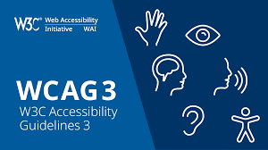
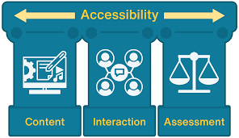
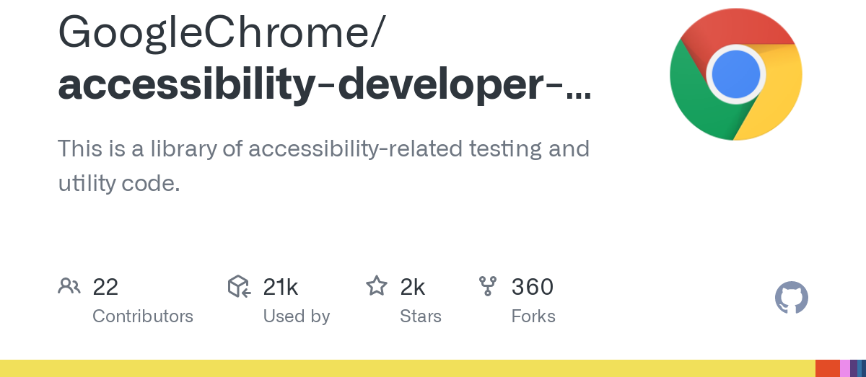

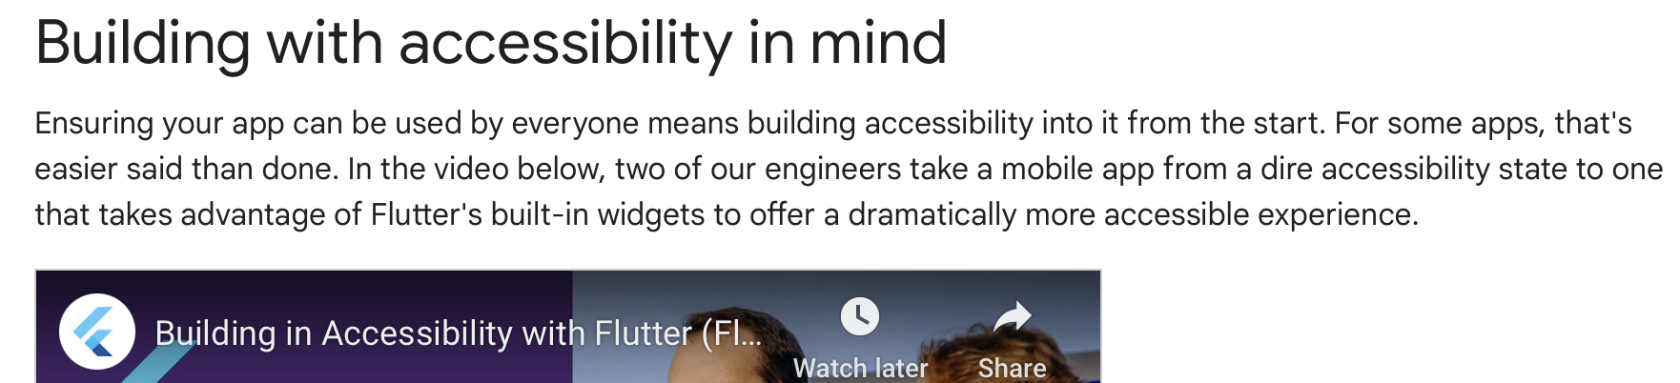
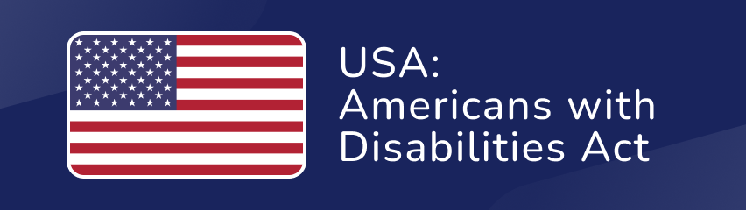
Efforts in Web Accessibility
Web Accessibility Content Guidelines
Accessibility Trainings
Accessibility Developer Tools
Accessibility Research
Legal Requirements
Developer Advocacy and Awareness

Slide 3
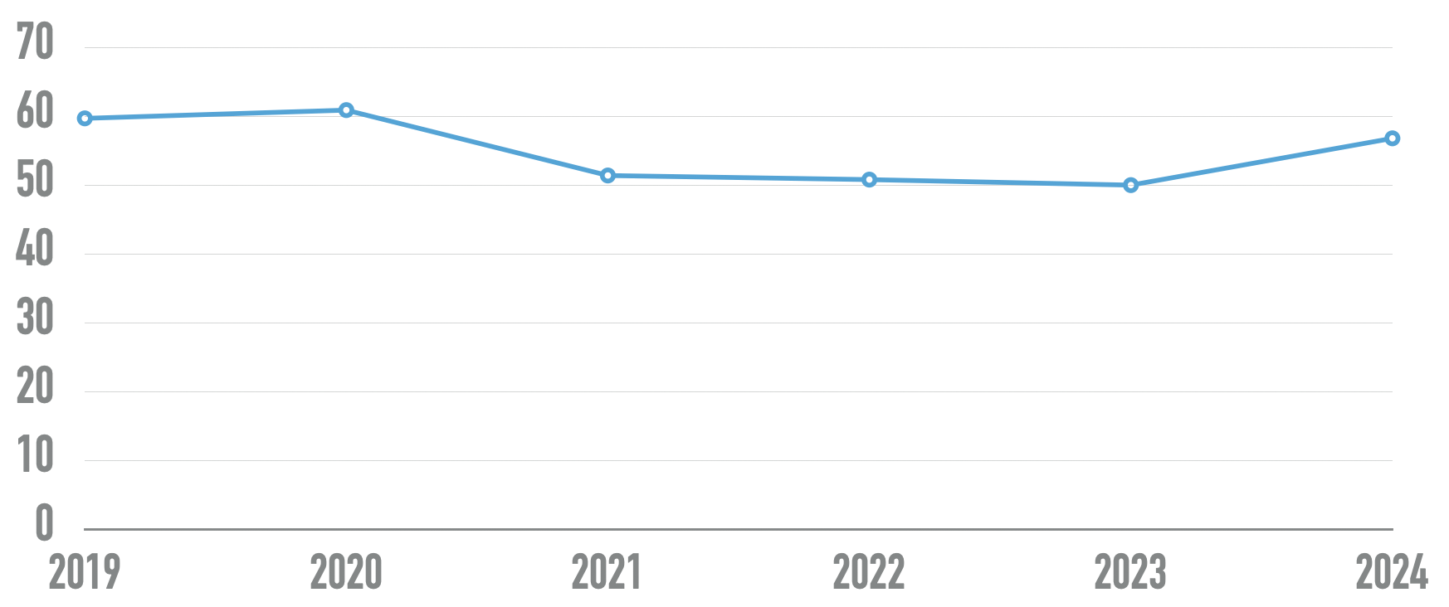
Current State of Web Accessibility
Number of detected accessibility errors per homepage
The WebAim Million Report, 2024

Slide 4
Current State of Web Inaccessibility
increased notably (!)
(13.6%)
since 2023
Number of detected accessibility errors per homepage
The WebAim Million Report, 2024

Slide 5
Why is Web Inaccessibility still prevalent?
Web Accessibility Content Guidelines
Accessibility Trainings
Accessibility Developer Tools
Accessibility Research
Legal Requirements
Developer Advocacy and Awareness
Challenge: Still requires developers to be aware about accessibility!

Slide 6
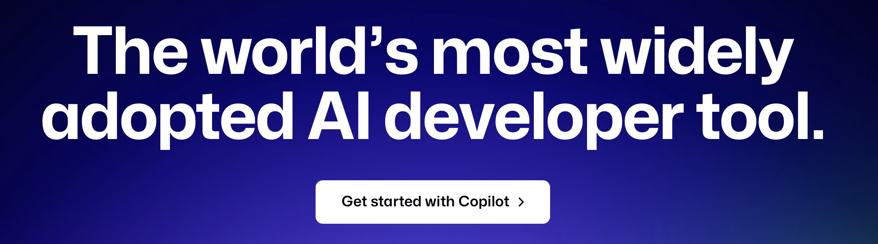

automatically?
How to get developers to produce accessible UI code
Yes, LLMs!
70% of developers are using or are planning to use AI tools in their development process this year.
Stack Overflow Developer Survey, 2023

Slide 7


automatically?
How to get developers to produce accessible UI code
Developers are using AI Coding Assistants.
If these assistants suggest accessible UI code,
we can get developers to create accessible UIs.
Research Questions:
Can AI coding assistants produce accessible UI code?
Can AI coding assistants eliminate the need for developer accessibility awareness?
Further, is the increasing prevalence of these tools
introducing accessibility-related vulnerabilities?
Recall: 13.6% increase in accessibility errors since last year.

Slide 8

Can AI coding assistants produce accessible UI code?
We conducted an empirical evaluation of GitHub Copilot
by comparing its code suggestions against the developer's source code
on real world open-source websites.
More details in the paper.
Key takeaway:
With several caveats.
Yes!
when explicitly instructed to.
for already accessible websites.
And not reliably!
Subject to hallucinations.

Slide 9
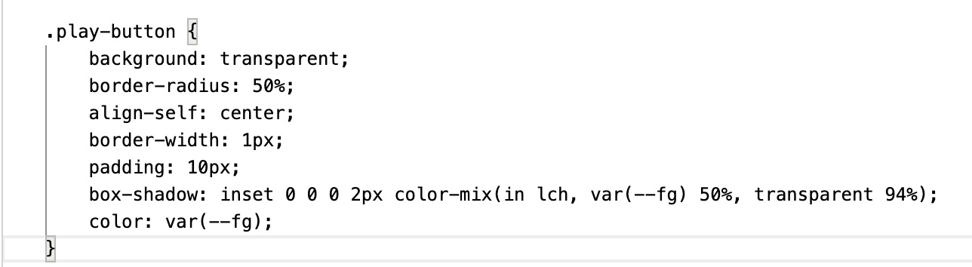
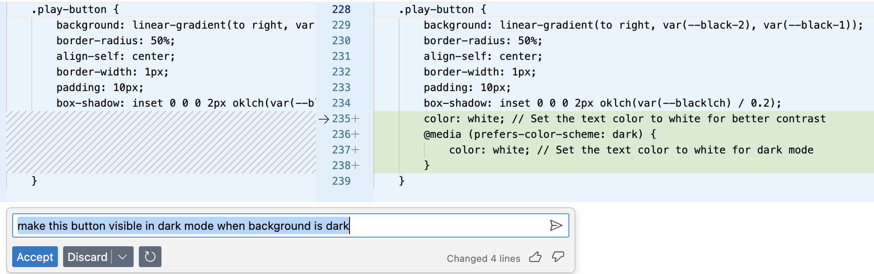
Can AI coding assistants produce accessible UI code?
More details in the paper.
Yes, when explicitly instructed to.
Without AI Coding Assistant
With AI Coding Assistant
Prompt: Make this button visible in dark mode.

Slide 10
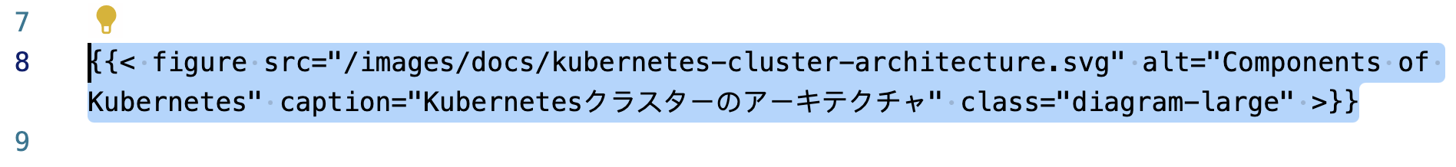
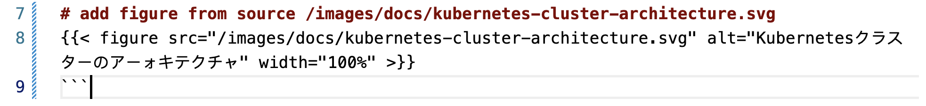
Can AI coding assistants produce accessible UI code?
More details in the paper.
Not reliably! Subject to hallucinations.
Without AI Coding Assistant
With AI Coding Assistant
Alternate text is provided in English.
Alternate text is provided.
However, it is partly in Japanese.

Slide 11
Can they eliminate the need for developer accessibility awareness?
We conducted a user study with 16 developers untrained in accessibility,
tasked with building web user interface components
with and without an AI coding assistant.
Paper under submission to ASSETS.
Key takeaway:
Not yet. Otherwise,
the accessibility that is introduced is likely to not be applied comprehensively.
the features recommended by the assistant are unlikely to be implemented.
the accessibility errors introduced by the assistant are unlikely to be caught.

Slide 12
What next?
Everything else.
We need stronger technical accessibility benchmarks for UI code generation.
Further research in developing accessibility-aware code generative models.
Fine-tuning with accessible UI examples gathered from web crawling data.
Developing effective reward mechanisms for accessibility guidance.
Incorporating additional visual (and other) modality understanding modules.
Exploring AI developer tools as accessibility feedback indicators.

Slide 13


Thank you! Questions?
About me:
MS in Robotics Student at Carnegie Mellon University
yet
Not a doctoral student
Applying to PhD programs in Computer Science for Fall’25
Advisors:
Jeff Bigham
Associate Professor,
CMU HCII and LTI
Aaron Steinfeld
Research Professor,
CMU RI and HCII
Peya Mowar
Carnegie Mellon University
https://peyajm29.github.io
This work is supported by the CMU School of Computer Science.
CMU Accessibility Group: http://accessibility.cs.cmu.edu

