Slide 1
AWS ENTERPRISE SOLUTION ARCHITECTURE
Cloud-Native Enterprise Document Management Platform
Decoupled Serverless Architecture for Immutable Binary Versioning, Native S3 Metadata Annotations, Optimistic Concurrency & CQRS Search Projections
WORM Immutability
S3 Annotations
DynamoDB OCC
CQRS Search
S3 versioning with strict IAM Deny policies for regulatory compliance
Overcomes 2 KB header limits; zero sidecar sprawl with native JSON binding
Sub-10ms transactional control plane with atomic optimistic concurrency
OpenSearch Serverless derived read model with full blast radius isolation
AWS Document Management Platform • Solution Architecture & Sequence Specification
1 / 26

Slide 2
STRATEGIC VALUE & CONTEXT
Executive Summary & Enterprise Architecture Blueprint
Modernizing Enterprise Content Management with Decoupled Cloud-Native Serverless Services
Enterprise Architecture Core Principles
• Consumption-Based Elasticity: 100% serverless compute and on-demand database scaling ensure zero idle cost and automatic capacity expansion.
• Decoupled Authority Model: Separating binary storage, metadata indexing, and full-text search prevents distributed locking and cascading outages.
• Native S3 Object Annotations: Eliminates 2 KB header limits without sidecar files, enabling direct schema-validated metadata mutations.
• Enterprise WORM & Auditability: Enforces immutable content versioning, strict optimistic concurrency control, and continuous CDC stream auditing.
Key Architectural Capabilities & Business Outcomes
✓ Zero-Idle TCO: True serverless compute (Lambda) and storage (S3/DynamoDB/OpenSearch Serverless). Zero compute cost during idle periods.
✓ 11 9s Durability & Compliance: Amazon S3 raw binaries with WORM immutability; explicit s3:DeleteObjectVersion DENY policies prevent malicious deletion.
✓ Sub-Second Latency SLAs: Inline uploads in ~150ms; direct presigned downloads in <50ms; sub-10ms DynamoDB transactional control plane.
✓ CQRS Blast Radius Isolation: OpenSearch search index failures or re-indexing operations never impact core document downloads, uploads, or metadata edits.
AWS Document Management Platform • Solution Architecture & Sequence Specification
2 / 26

Slide 3
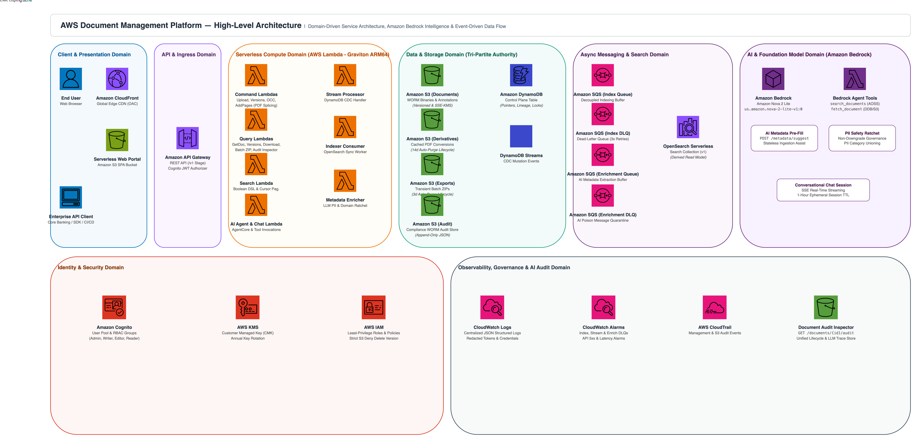
SYSTEM TOPOLOGY
End-to-End Solution Architecture Blueprint
Comprehensive AWS Serverless Topology, Ingress Control, Microservice Compute & Storage Layers
Architecture Highlights
API Gateway Ingress:
Handles REST routing, Cognito JWT token validation, and binary payload passthrough (*/*).
Lambda Micro-Perimeters:
Stateless Command, Query, and Search handlers operating under strict least-privilege IAM roles.
Native S3 Annotations:
Authoritative JSON metadata bound directly to S3 object versions (document-metadata).
DynamoDB Control Table:
Single-table design tracking active pointers, OCC revisions, and upload sessions.
Async CDC Pipeline:
DynamoDB Streams feed S3 Audit Bucket & SQS Indexing Queue to hydrate OpenSearch Serverless.
AWS Document Management Platform • Solution Architecture & Sequence Specification
3 / 26

Slide 4
CORE DATA GOVERNANCE
The 5-Tier Authority & Consistency Model
Eliminating Distributed 2-Phase Transactions by Assigning Strict Authority Boundaries
1. Content Authority
Amazon S3 (Primary Bucket)
Immutable raw binary storage (PDF, TIFF, Office). Versioned objects with strict s3:DeleteObjectVersion DENY policies for absolute WORM compliance. Raw bytes are cryptographically locked via SHA-256.
2. Metadata Authority
Amazon S3 Annotations
Full structured JSON metadata stored as authoritative named annotations (document-metadata) bound directly to S3 object versions. Conforms strictly to schema bank.document-metadata/1.
3. Control Plane Authority
Amazon DynamoDB
Single-table design tracking active document pointers (DOC#{id}), version lineages (VER#{pad}), optimistic concurrency locks, and upload sessions at sub-10ms latency.
4. Search Read Projection
OpenSearch Serverless
Derived CQRS read model (documents-v1) hydrated asynchronously via DynamoDB Streams and SQS. Document ingestion and downloads remain 100% operational if search is offline.
5. Non-Repudiation Audit
Amazon S3 Audit Bucket
Immutable CDC mutation stream logs automatically written to a KMS-encrypted, date-partitioned audit bucket (audit/{date}/{doc_id}_{event_id}.json) for forensics and compliance.
AWS Document Management Platform • Solution Architecture & Sequence Specification
4 / 26

Slide 5
DATA ARCHITECTURE DEEP DIVE
Storage Interplay: S3 Annotations vs. DynamoDB Control Table
Why Both Are Essential: Resolving Object Storage Limitations with Transactional Database Speed
Dimension / Capability | Amazon S3 & S3 Annotations | Amazon DynamoDB Control Table | Why DynamoDB Is Essential
Authoritative Metadata | Primary Authority (Holds full JSON schema payload) | Stores lightweight pointer, revision count & ETag | S3 Annotations bind rich data to object versions; enables Iceberg SQL queries.
Optimistic Concurrency (OCC) | No conditional expressions on arbitrary JSON attributes | Primary: Atomic ConditionExpression on revision | DynamoDB atomically verifies current_metadata_revision = :exp to prevent lost updates.
Active Pointer Resolution | Requires listing all object versions in bucket | Primary: O(1) sub-millisecond key-value lookup | DynamoDB maps DOC#{id} to latest active s3_version_id without slow S3 API listings.
Version History Lineage | Non-sequential, opaque S3 version string IDs | Primary: Sort-Key indexed query begins_with(VER#) | Enables instant retrieval of ordered history (v1, v2, v3) in a single fast read query.
Multi-Item ACID Transactions | No multi-object transactional commit API | Primary: TransactWriteItems binds pointer & locks | Atomically updates pointer, records version item, and commits idempotency lock in 1 call.
Change Data Capture (CDC) | S3 Event Notifications lack before/after diffs | Primary: Ordered DynamoDB Streams (Old/New) | Emits rich event streams to asynchronously drive the S3 audit logger and search index.
AWS Document Management Platform • Solution Architecture & Sequence Specification
5 / 26

Slide 6
EVENT ARCHITECTURE & CQRS
Asynchronous CDC & Search Hydration Pipeline
Event-Driven Downstream Decoupling: DynamoDB Streams → S3 Audit Bucket & SQS → OpenSearch
Pipeline Execution Lifecycle
1. Transactional Commit in DynamoDB:
Upload, versioning, metadata edit, or soft-delete commits to DynamoDB and emits a CDC record to DynamoDB Streams.
2. Stream Processor Lambda:
Consumes batches of stream records in real time and triggers two parallel operations:
• Writes an immutable JSON audit log to the S3 Audit Bucket.
• Dispatches an indexing message to the Amazon SQS Indexing Queue.
3. SQS Indexer Consumer Lambda:
Pulls batches from SQS, reads the authoritative S3 annotation, and updates the OpenSearch Serverless collection (documents-v1).
4. Poison Message Quarantine & DLQ:
If OpenSearch is temporarily unavailable, SQS retries 3 times before isolating failed records in doc-platform-mvp-index-dlq and triggering CloudWatch alarms.
SQS Index Message Contract (JSON)
{
"event_id": "e3b0c442-98fc-1c14-9afb-f4c8996fb924",
"event_type": "DOCUMENT_METADATA_UPDATED",
"document_id": "550e8400-e29b-41d4-a716-446655440000",
"document_class": "loan_agreement",
"application_version": 2,
"metadata_revision": 3,
"status": "ACTIVE",
"timestamp": "2026-08-18T15:05:00.000Z",
"actor_id": "usr_editor_02"
}
Resilience & Self-Healing Properties:
• Idempotent Consumer: Version-guarded upserts prevent out-of-order race conditions.
• Index Rehydration: Search index can be dropped and 100% rebuilt from S3 annotations.
• Blast Radius Isolation: Search outages never block transactional uploads or downloads.
AWS Document Management Platform • Solution Architecture & Sequence Specification
6 / 26

Slide 7
VERSIONING & METADATA GOVERNANCE
Triple-Level Version Lineage & Immutability Matrix
Cryptographic Integrity, Monotonic State Tracking, and Strict Schema Governance
1. Application Version
application_version (1, 2, 3...)
2. Physical S3 VersionId
s3_version_id ("3/L4bqt9...")
3. Metadata Revision
metadata_revision (1, 2, 3...)
Monotonic integer. Increments strictly when new binary content is uploaded via POST /versions. Resets metadata_revision to 1.
Immutable S3-generated cryptographic object version identifier representing raw binary bytes stored in the primary S3 bucket.
Monotonic OCC revision counter. Increments on every PATCH /metadata update. Enforced via DynamoDB ConditionExpressions.
Field Names | Category | Mutability Rule | Update & Governance Mechanism
document_id, document_class, created_at, created_by | System Identity | Strictly Immutable | Assigned once on initial document creation. Reject modification with 400 error.
application_version, content_type, format, page_count, content_length, content_checksum | Binary Specifier | Immutable for Version | Cryptographically bound to raw bytes (SHA-256). Updates only on POST /versions or format conversion.
metadata_revision, metadata_updated_at, metadata_updated_by | Concurrency Tracking | System Monotonic | Automatically managed by Lambda and DynamoDB OCC conditional expressions.
customer_id, complete_customer_id_code, account_id, business_area_code, loan_number, currency... | Domain & Shared Traits | Mutable via PATCH | Modifiable via PATCH /metadata with Ajv JSON Schema validation and expected_metadata_revision.
AWS Document Management Platform • Solution Architecture & Sequence Specification
7 / 26

Slide 8
CONCURRENCY & EVOLUTION
Optimistic Concurrency Control (OCC) & Metadata Evolution
Preventing Lost Overwrites Under High Concurrency & In-Memory Ajv JSON Schema Validation
OCC Algorithm (PATCH /v1/documents/{id}/metadata)
1. Client Passes Revision:
Caller includes expected_metadata_revision: N in the request body along with desired field changes.
2. Read & Consistency Check:
Lambda reads DynamoDB DOC#{id} pointer. If current_metadata_revision != expected_metadata_revision, aborts immediately with 409 METADATA_CONFLICT.
3. Fetch S3 Annotation & Merge:
Fetches current S3 annotation JSON via GetObjectAnnotation, validates that changes contain no immutable fields, increments revision to N+1, and validates against Ajv.
4. S3 Annotation Commit:
S3 PutObjectAnnotation attaches updated JSON to S3 object version.
5. Atomic DynamoDB Conditional Commit:
DynamoDB executes conditional update (ConditionExpression: current_metadata_revision = :expRev). If parallel update raced, DynamoDB throws ConditionalCheckFailedException.
Metadata Schema Evolution & GitOps
Current GitOps Lifecycle (Build-Time Packaging):
• Zero Cold Start Latency: Schemas (schemas/loan_agreement-v1.json) are bundled directly into Lambda artifacts and compiled into memory at startup using Ajv. Zero DB network hops.
• Closed Envelope Contract: additionalProperties: false prevents property pollution and schema drift across document classes.
• Strict Pull Request Governance: Schema updates require code review, automated schema linting, and CI/CD validation before deployment.
• Phase 2 Roadmap (Dynamic Registry): Future phase introduces a dedicated DynamoDB Schema Registry table for runtime administrative schema registration without redeployment.
AWS Document Management Platform • Solution Architecture & Sequence Specification
8 / 26

Slide 9
INGESTION DEEP DIVE
Bimodal Ingestion Architecture: Inline vs. Direct S3
Optimizing Latency and Eliminating API Gateway 10 MiB Payload Bottlenecks
Pathway 1: Inline Binary Upload (≤ 4 MiB)
Single HTTP Request for standard documents, receipts, invoices, and IDs.
POST /v1/documents
Headers:
• Content-Type: application/pdf
• X-Content-SHA256: {hex_hash}
• X-Document-Metadata: {base64_json_envelope}
Body: Raw Binary Bytes
Execution Characteristics:
• Total E2E Latency: ~120ms - 250ms synchronous response.
• Atomic Commit: Binary + S3 Annotation + DynamoDB pointer committed simultaneously.
• Zero Client Coordination: 1 request returns 201 Created with complete metadata.
Pathway 2: Direct S3 Presigned Upload (> 4 MiB)
Two-Phase Protocol designed for large loan dossiers, mortgage archives & CAD files.
Step 1: POST /v1/documents/uploads
→ Validates metadata, mints 15-min S3 presigned PUT URL.
Step 2: PUT {presigned_url}
→ Client streams bytes directly to S3 (line rate).
Step 3: POST /v1/uploads/{id}/complete
→ Lambda validates S3 HeadObject & activates pointer.
Execution Characteristics:
• Bypasses API Gateway 10 MiB Ceiling: Scales to multi-GB uploads.
• Zero Lambda Memory Overhead: Compute handles only metadata coordination.
• Automated Session TTL: Uncompleted sessions cleaned up after 24h via DynamoDB TTL.
AWS Document Management Platform • Solution Architecture & Sequence Specification
9 / 26

Slide 10
API SURFACE & CONTRACTS
Exposed REST APIs: Complete Operations Catalog
20 Production Endpoints Partitioned Across Ingestion, Lifecycle, Metadata, Download, Search, Audit & AI
Method & Path | Operation Name | Target Components | RBAC Role Required | Mode
GET /health | Health Check | DynamoDB, S3, OpenSearch | Public / All Roles | Sync
POST /v1/documents | Inline Document Upload | API GW, Lambda, S3, DynamoDB | Document.Writer / Admin | Sync
POST /v1/documents/uploads | Direct Upload Init | Lambda, S3 Presign, DynamoDB | Document.Writer / Admin | Sync
POST /v1/uploads/{id}/complete | Complete Direct Upload | Lambda, S3 Annotate, DynamoDB | Document.Writer / Admin | Sync
DELETE /v1/uploads/{id} | Cancel Direct Upload | Lambda, S3 Abort, DynamoDB | Document.Writer / Admin | Sync
GET /v1/documents/{id} | Get Document Pointer | API GW, Lambda, DynamoDB | Document.Reader / All | Sync
GET /v1/documents/{id}/versions | List Version History | Lambda, DynamoDB VER# Query | Document.Reader / All | Sync
POST /v1/documents/{id}/versions | Create New Version | Lambda, S3 Binary+Annot, DynamoDB | Document.Writer / Admin | Sync
GET /v1/documents/{id}/versions/{v} | Get Historical Version | Lambda, DynamoDB VER# Item | Document.Reader / All | Sync
GET /v1/documents/{id}/metadata | Get Authoritative Metadata | Lambda, S3 Annotation Get | Document.Reader / All | Sync
PATCH /v1/documents/{id}/metadata | OCC Metadata Update | Lambda, S3 Annotate, DynamoDB | Document.MetadataEditor / Writer | Sync
GET /v1/documents/{id}/download | Get Presigned Download URL | Lambda, S3 Presign (15 min) | Document.Reader / All | Sync
POST /v1/documents/{id}/soft-delete | Soft Delete Document | Lambda, DynamoDB, CDC De-index | Document.Admin (Exclusive) | Sync
POST /v1/documents/{id}/restore | Restore Document | Lambda, DynamoDB, CDC Re-index | Document.Admin (Exclusive) | Sync
POST /v1/search | Search Documents | Lambda, OpenSearch Serverless | Document.Reader / All | Sync
POST /v1/documents/batch-download | Batch ZIP Export | Lambda, JSZip, S3 Presign | Document.Reader / All | Sync
POST /v1/documents/{id}/pages | Add PDF Pages | Lambda, S3, DynamoDB OCC, pdf-lib | Document.Writer / Admin | Sync
POST /v1/agent/chat | Bedrock AI Assistant | Bedrock Nova 2 Lite, Agent Tools | Document.Reader / All | Sync
POST /v1/metadata/suggest | Predictive Metadata | Bedrock Multimodal / Vision | Document.Writer / Admin | Sync
GET /v1/documents/{id}/audit | Audit Trail Query | Lambda, S3 Audit Bucket | Document.Admin / All | Sync
AWS Document Management Platform • Solution Architecture & Sequence Specification
10 / 26

Slide 11
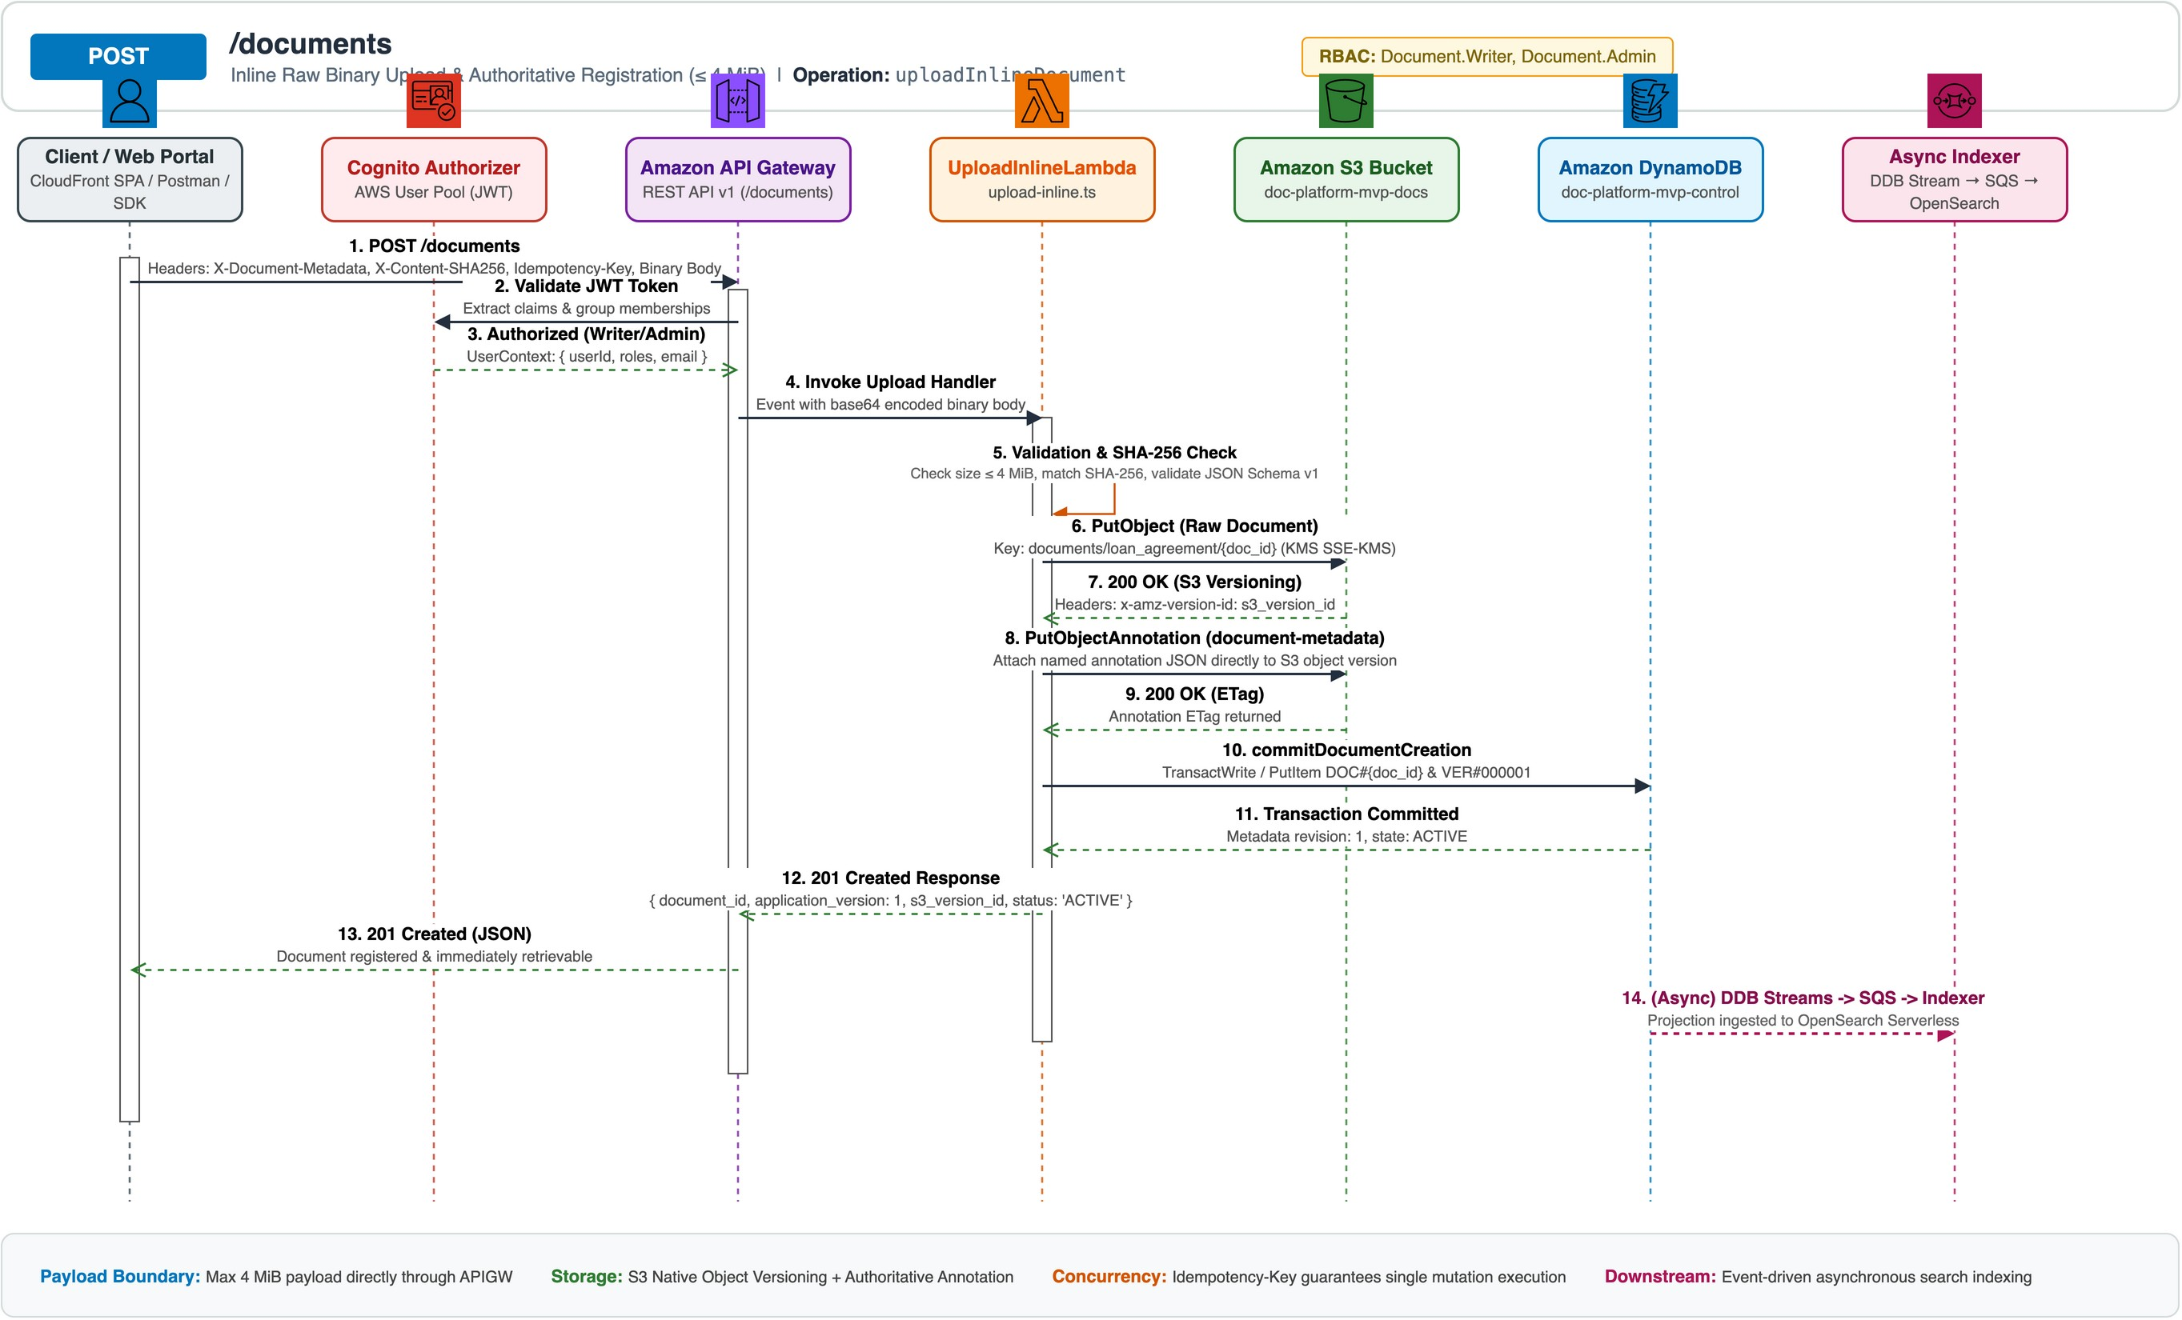
API EXECUTION SEQUENCE
Sequence Deep Dive: Inline Binary Ingestion (≤ 4 MiB)
API Sequence 02: POST /v1/documents — Atomic Single-Transaction Upload Flow
Sequence Breakdown
1. Ingress & Auth:
API Gateway verifies JWT bearer token against Cognito authorizer (requires Document.Writer or Admin).
2. Validation & Checksum:
Lambda calculates SHA-256 over raw binary payload and validates JSON envelope against bank.document-metadata/1 via Ajv in memory.
3. Storage Commit:
Uploads binary to S3: documents/{class}/{doc_id} and attaches native S3 Annotation (document-metadata).
4. Atomic DynamoDB Commit:
Executes TransactWriteItems creating pointer DOC#{id}, initial version VER#0000000001, and idempotency lock.
5. Downstream CDC:
DynamoDB Streams triggers StreamProcessor Lambda asynchronously for S3 audit logging and SQS indexing.
AWS Document Management Platform • Solution Architecture & Sequence Specification
11 / 26

Slide 12
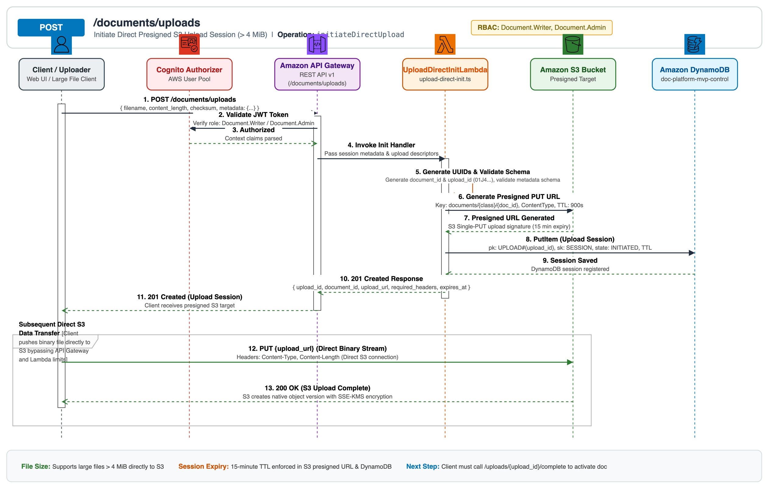
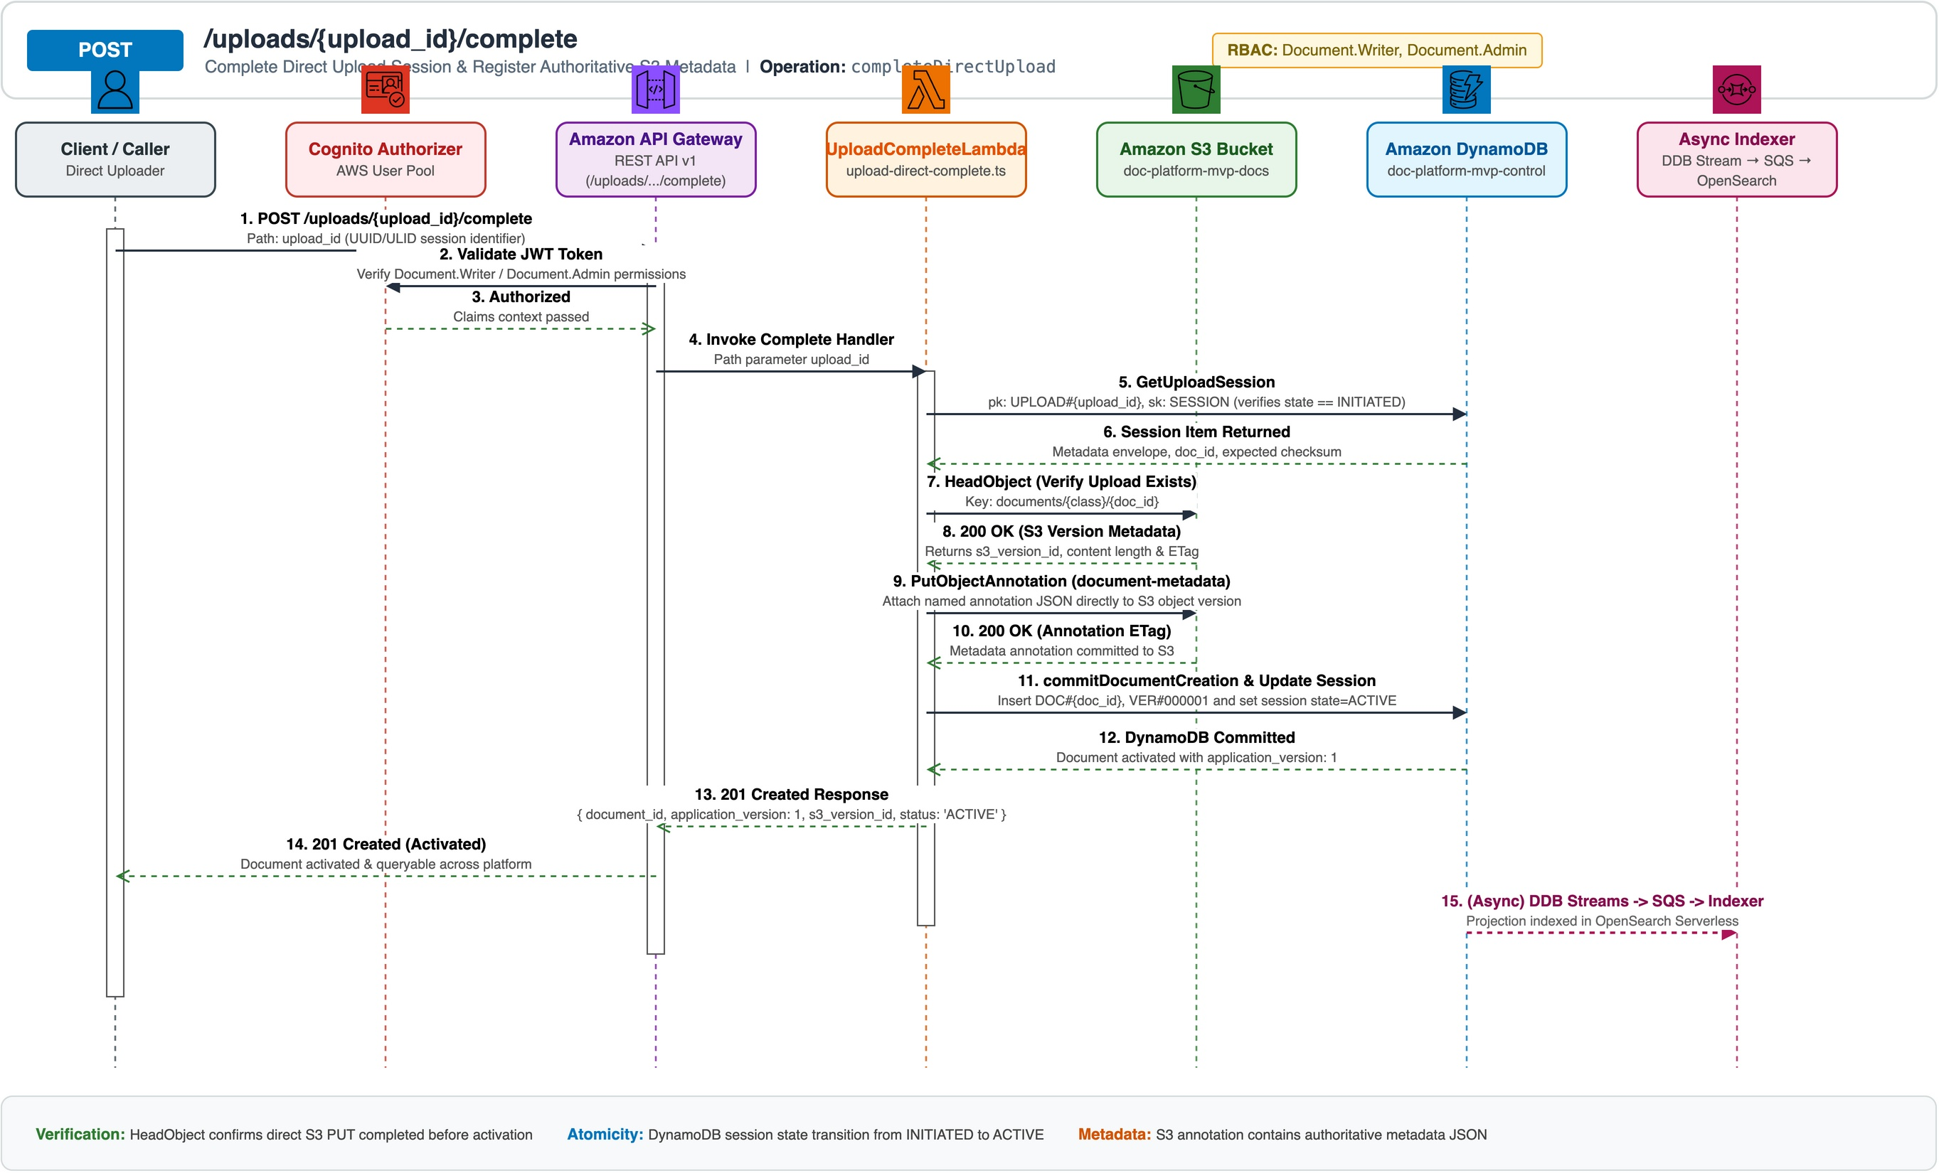
API EXECUTION SEQUENCE
Sequence Deep Dive: Direct S3 Presigned Upload Lifecycle
API Sequences 03 & 04: POST /v1/documents/uploads & POST /v1/uploads/{id}/complete
Two-Phase Upload Protocol Highlights:
• Phase 1 (Init - 03): Validates metadata schema, creates UPLOAD#{id} session in DynamoDB with 24h TTL, and mints 15-min S3 presigned PUT URL.
• Direct Transfer: Client streams multi-megabyte/gigabyte binary directly to S3 without passing through API Gateway or Lambda.
• Phase 2 (Complete - 04): Lambda verifies S3 HeadObject (size/checksum), writes S3 Annotation, updates session state to ACTIVE, and commits DynamoDB document pointer.
AWS Document Management Platform • Solution Architecture & Sequence Specification
12 / 26

Slide 13
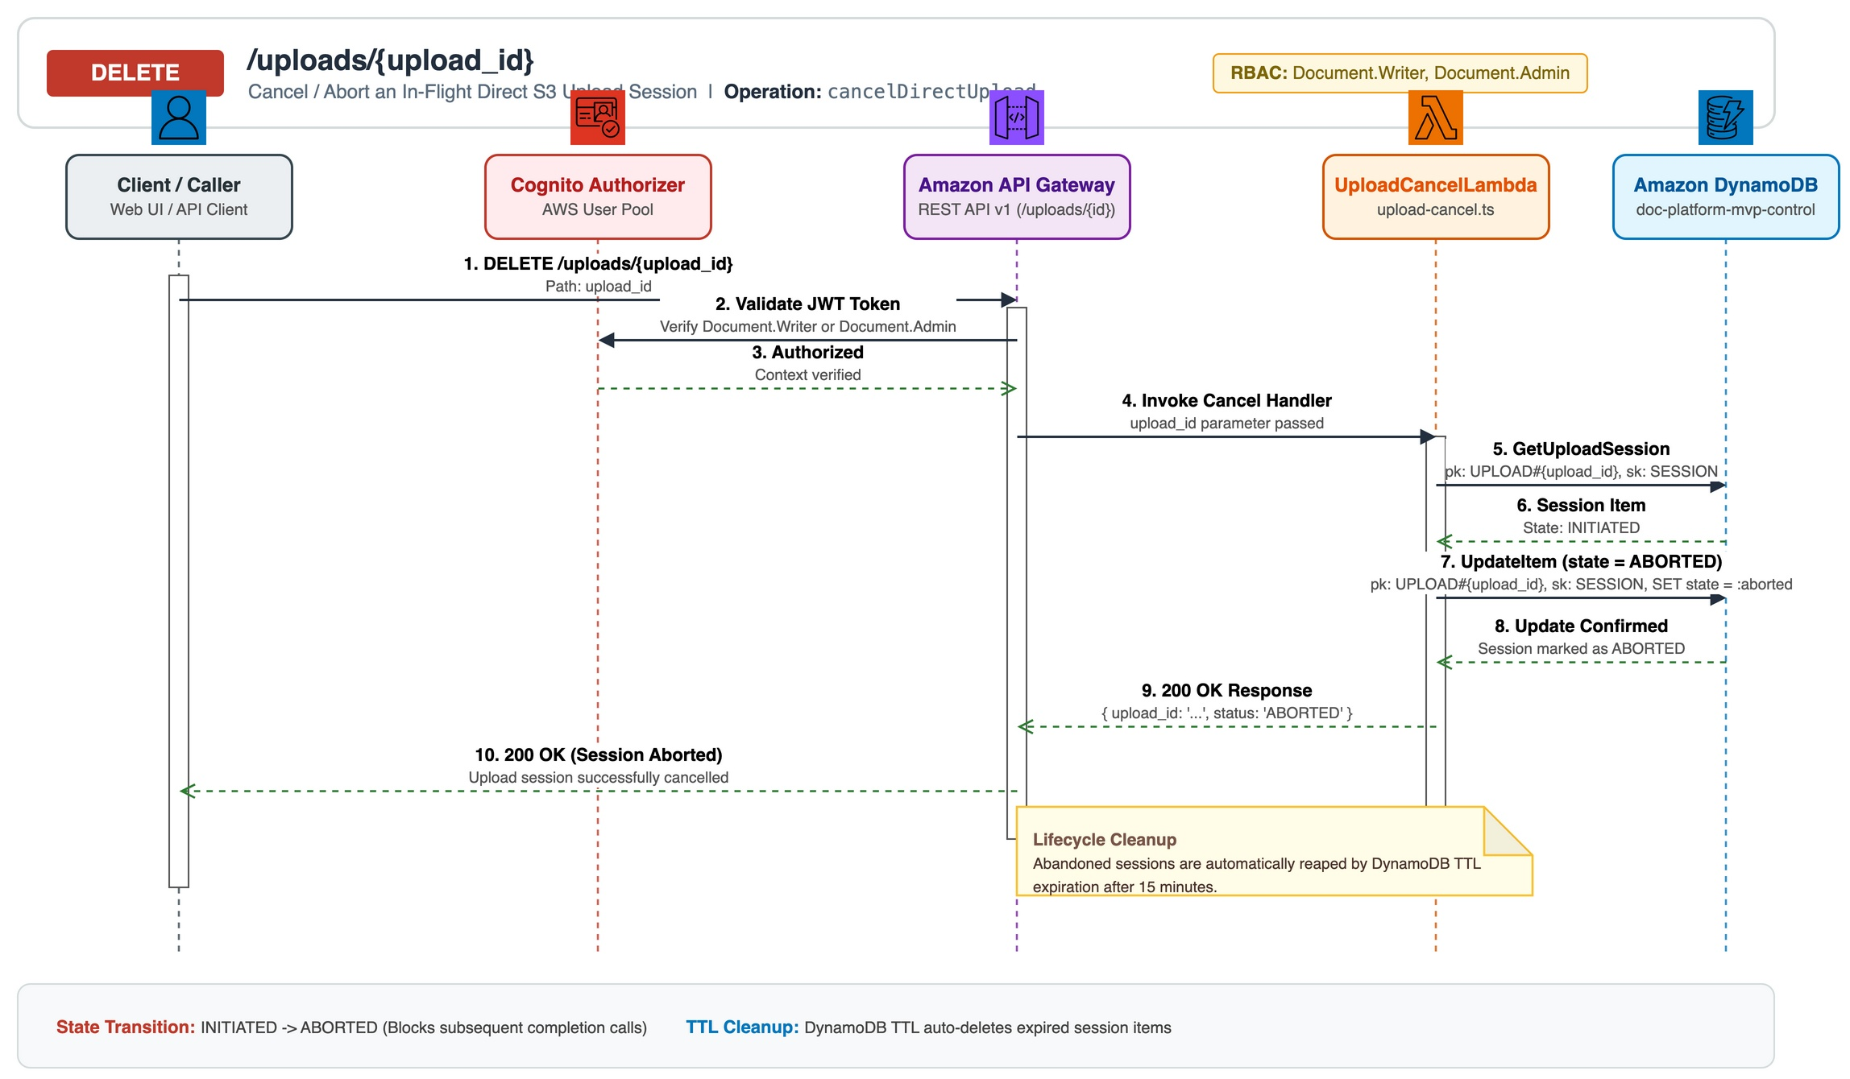
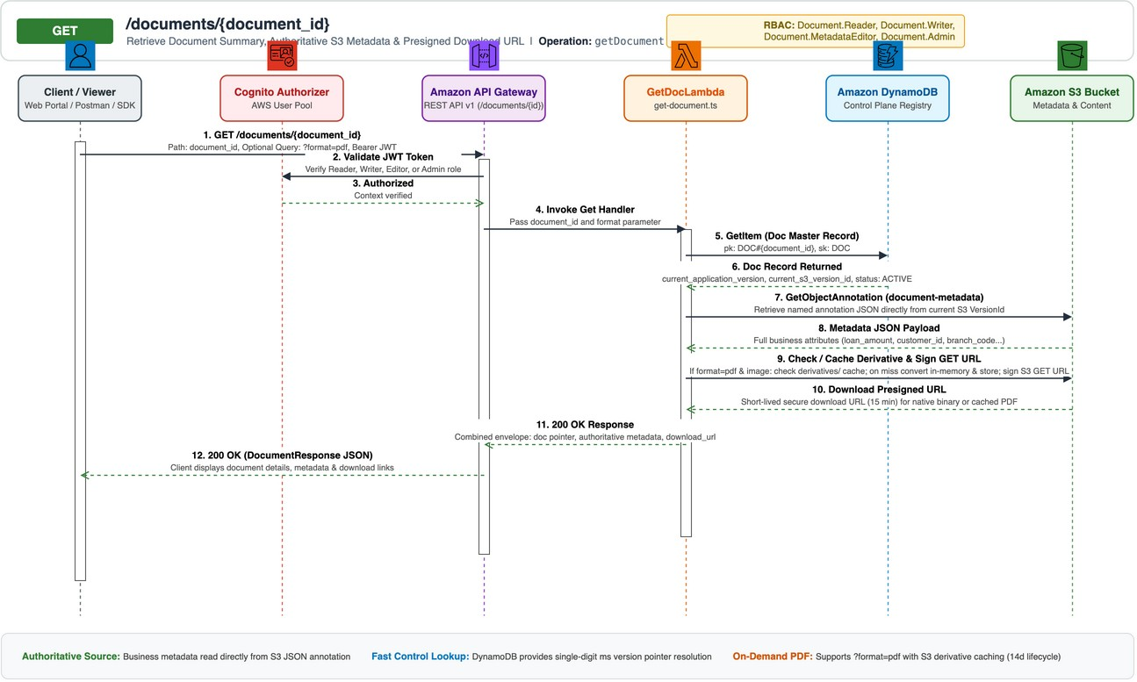
API EXECUTION SEQUENCE
Sequence Deep Dive: Upload Cancellation & Document Inspection
API Sequences 05 & 06: DELETE /v1/uploads/{id} & GET /v1/documents/{id}
Cancellation & Inspection Highlights:
• Cancel Upload (05): Aborts direct upload session in DynamoDB (state = ABORTED) and purges uncommitted staging objects from S3 to prevent orphan storage accumulation.
• Get Document Pointer (06): Executes fast O(1) strongly consistent read on DynamoDB (pk = DOC#{id}, sk = DOC). Returns active version number, S3 version ID, status, and metadata revision in <10ms.
AWS Document Management Platform • Solution Architecture & Sequence Specification
13 / 26

Slide 14
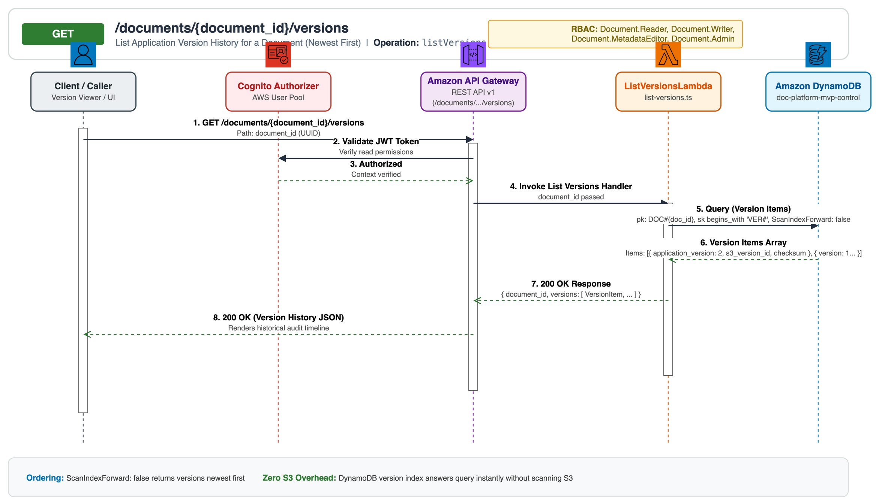
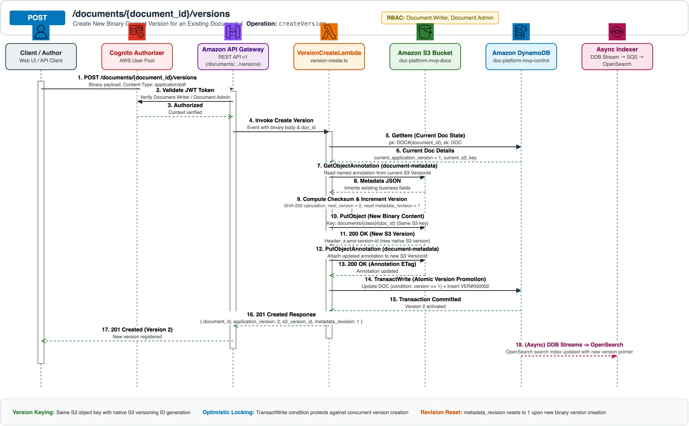
API EXECUTION SEQUENCE
Sequence Deep Dive: Version Lineage & Binary Updates
API Sequences 07 & 08: GET /v1/documents/{id}/versions & POST /v1/documents/{id}/versions
Version Lineage & Binary Evolution Mechanics:
• Version Query (07): Fast DynamoDB query (pk = DOC#{id} AND begins_with(sk, 'VER#')) returns ordered version history without paginating S3.
• New Version Upload (08): Uploads replacement binary to same S3 key, creating a new S3 VersionId. Increments application_version (e.g. 1 → 2), resets metadata_revision to 1, recomputes SHA-256 hash, and inserts new VER# item in DynamoDB.
AWS Document Management Platform • Solution Architecture & Sequence Specification
14 / 26

Slide 15
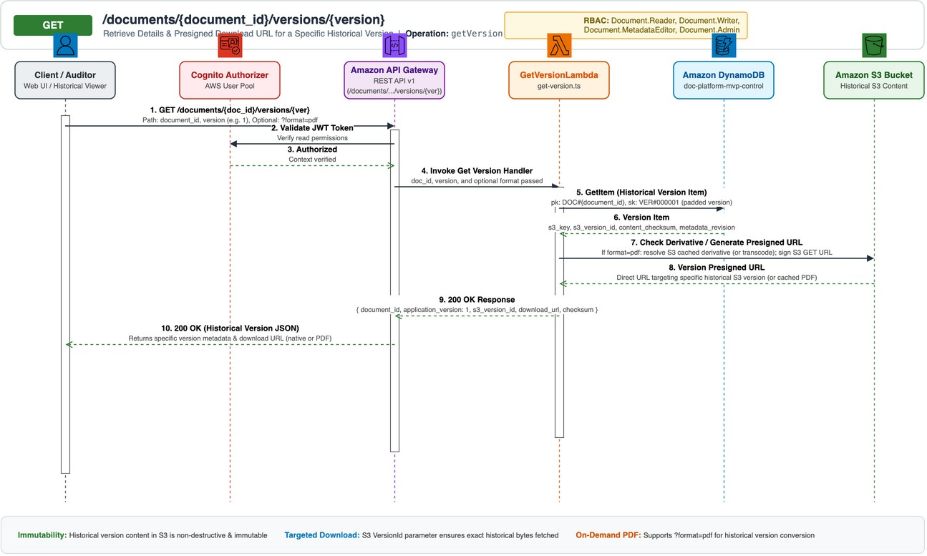
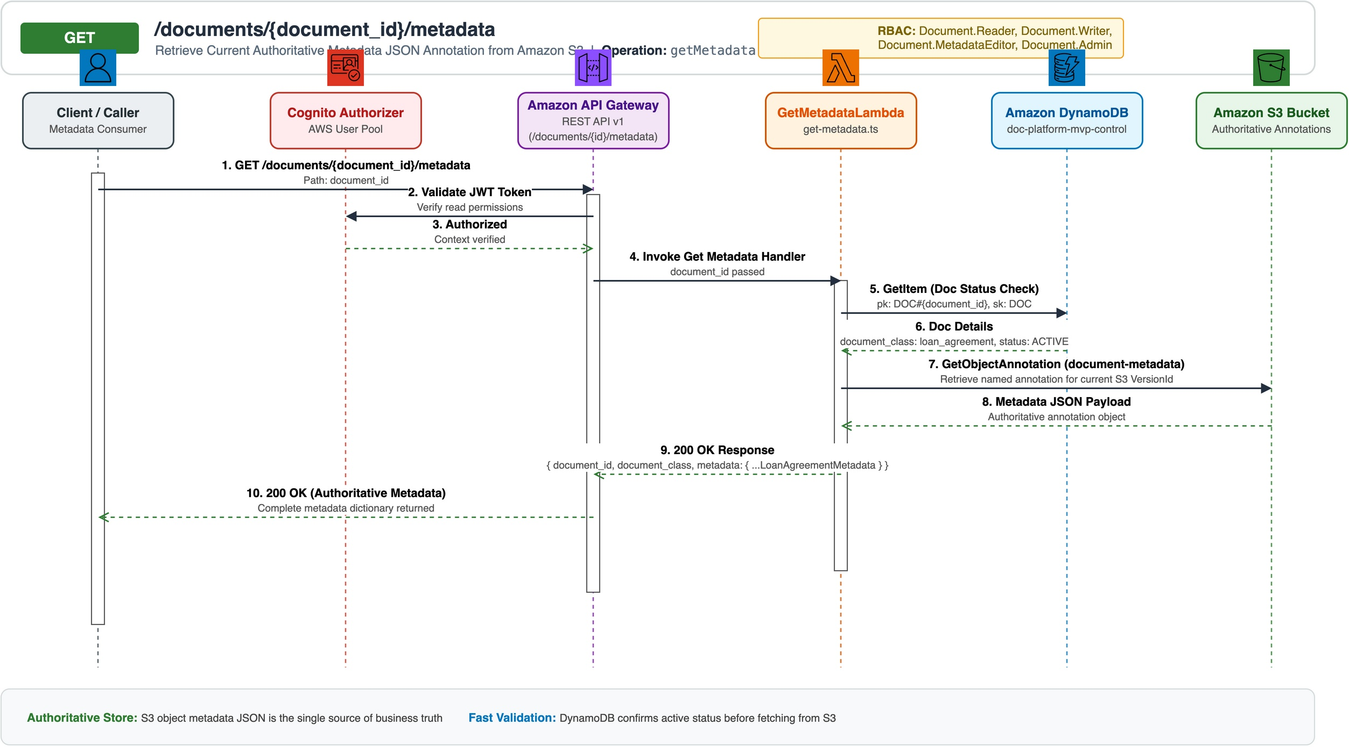
API EXECUTION SEQUENCE
Sequence Deep Dive: Historical Versions & Authoritative Metadata
API Sequences 09 & 10: GET /v1/documents/{id}/versions/{v} & GET /v1/documents/{id}/metadata
Historical & Authoritative Metadata Retrieval:
• Historical Version Details (09): Fetches historical version record (pk = DOC#{id}, sk = VER#{padded_version}) from DynamoDB, returning immutable content length, checksum, and S3 version ID.
• Authoritative Metadata JSON (10): Resolves active version pointer from DynamoDB and fetches the complete authoritative S3 JSON annotation (document-metadata) directly from S3 via GetObjectAnnotation.
AWS Document Management Platform • Solution Architecture & Sequence Specification
15 / 26

Slide 16
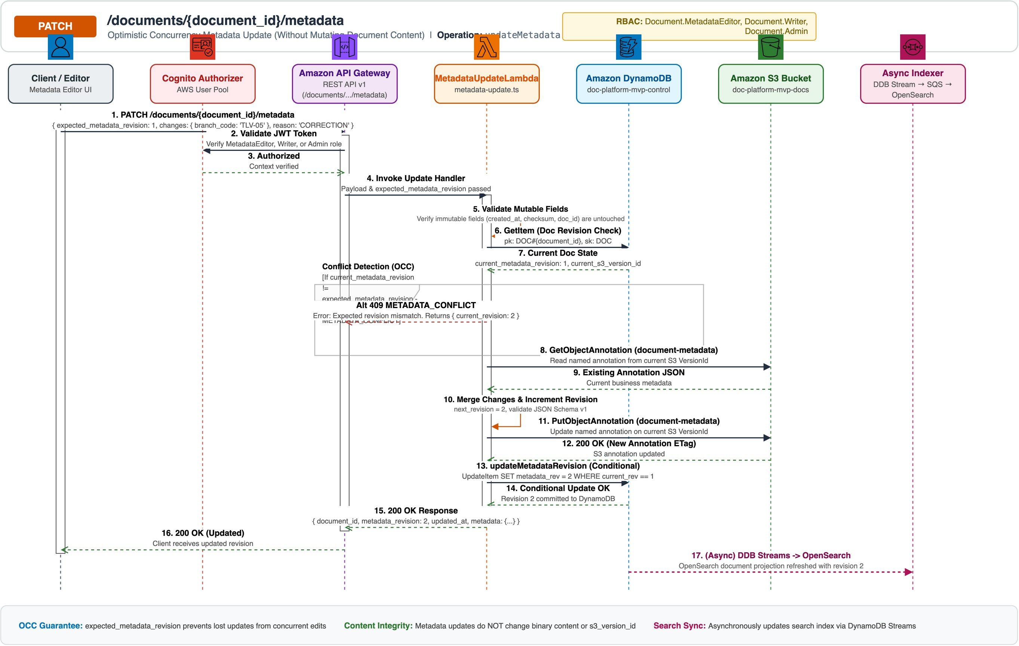
API EXECUTION SEQUENCE
Sequence Deep Dive: Optimistic Concurrency Metadata Patch
API Sequence 11: PATCH /v1/documents/{id}/metadata — Race-Free Metadata Evolution
Execution Sequence Steps
1. Read & OCC Check:
Strongly consistent read on DynamoDB DOC#{id}. Compares expected_metadata_revision with current_metadata_revision (returns 409 Conflict if mismatch).
2. S3 Annotation Retrieval:
Fetches existing JSON annotation from S3 version via GetObjectAnnotation.
3. Validation & Schema Check:
Rejects any attempt to modify immutable fields. Increments revision to N+1 and validates complete merged payload via Ajv.
4. S3 Annotation Update:
Writes updated JSON annotation in-place via PutObjectAnnotationCommand.
5. Atomic Conditional Update:
Updates DynamoDB pointer with ConditionExpression: current_metadata_revision = :expRev, guaranteeing atomicity.
AWS Document Management Platform • Solution Architecture & Sequence Specification
16 / 26

Slide 17
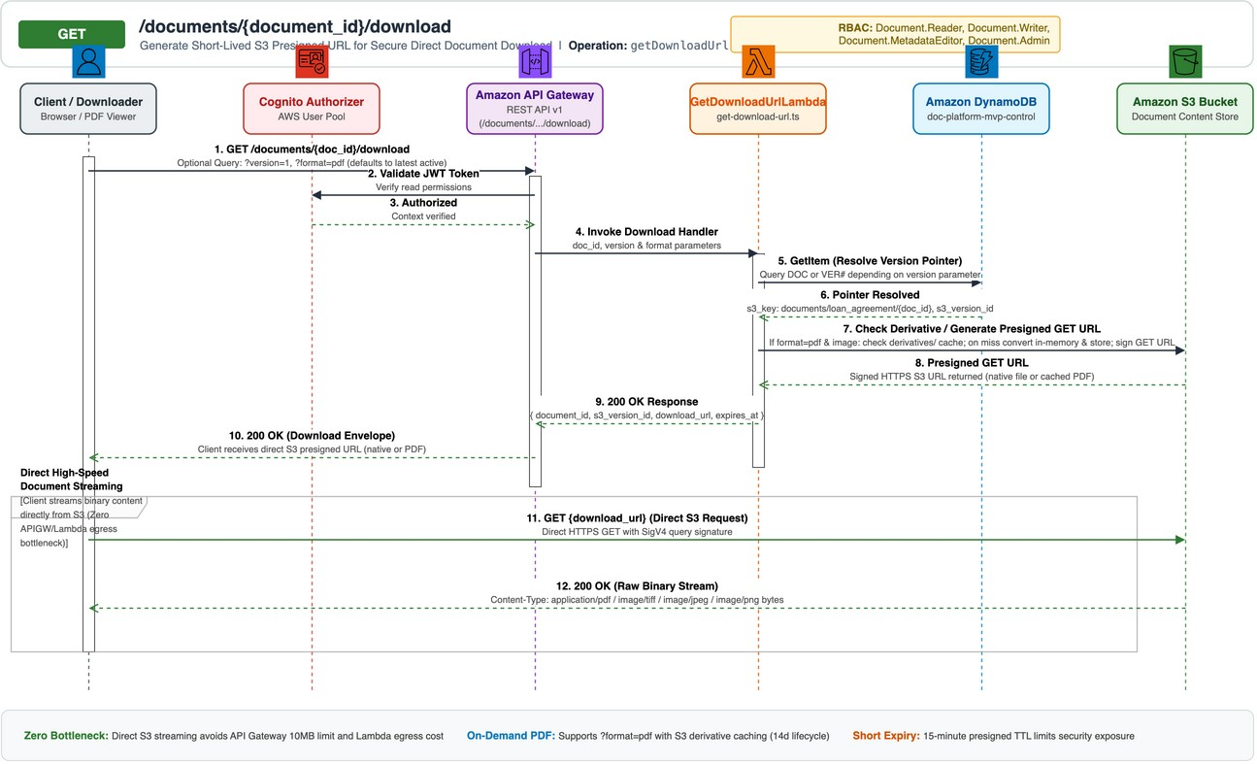
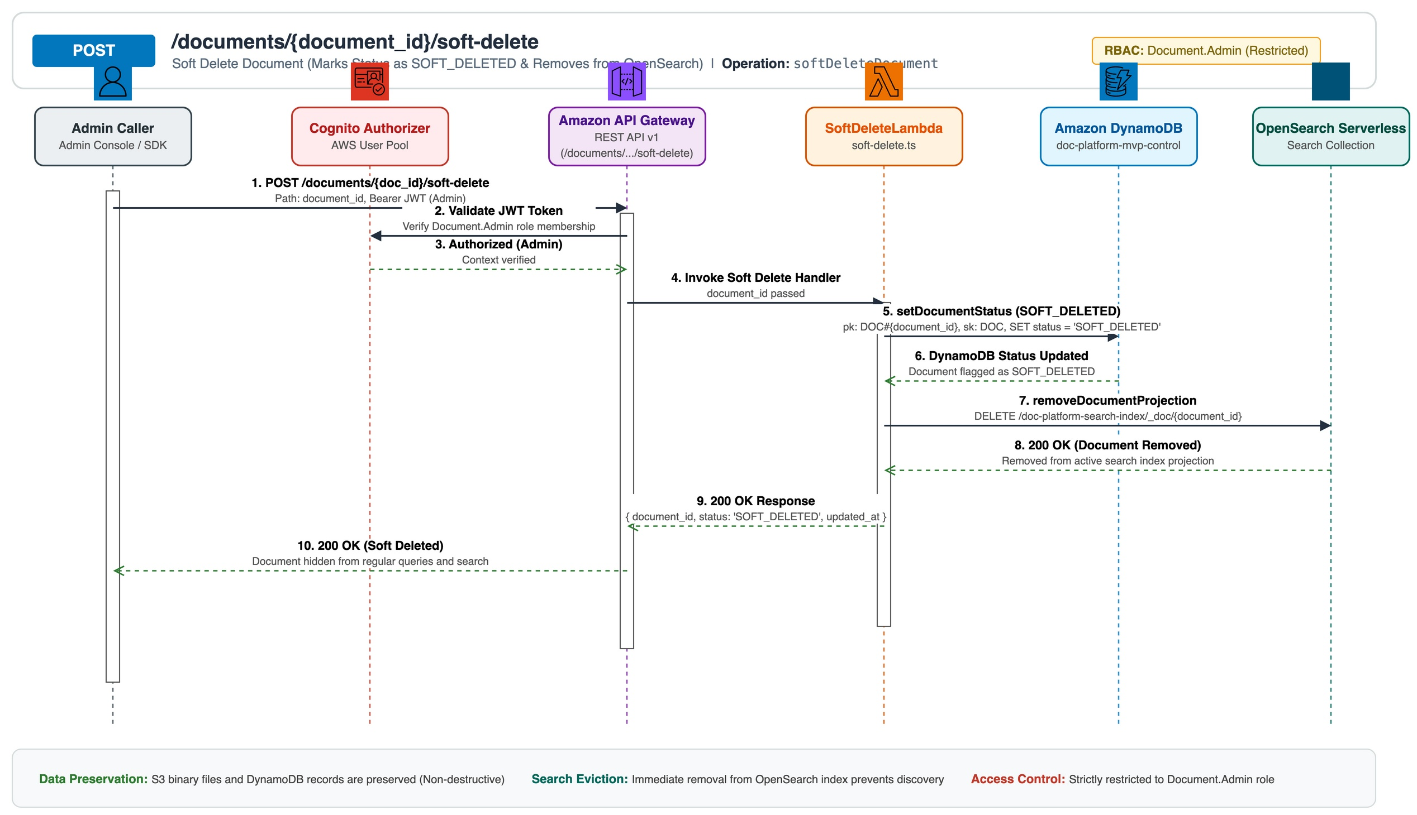
API EXECUTION SEQUENCE
Sequence Deep Dive: Secure Download, Soft Delete & Restore
API Sequences 12, 13 & 14: Direct Binary Access & Non-Destructive Lifecycle Governance
Download & Compliance Lifecycle Highlights:
• Secure Direct Download (12): Generates short-lived (15-min) S3 presigned GET URL. Client streams binary directly from S3, eliminating Lambda egress costs.
• Logical Soft Delete (13): Sets status: 'SOFT_DELETED' in DynamoDB and triggers CDC stream to remove document from OpenSearch index. S3 WORM binary and annotations remain completely untouched for regulatory compliance or restoration (14).
AWS Document Management Platform • Solution Architecture & Sequence Specification
17 / 26

Slide 18
DERIVED READ MODEL & TRANSFORMATION
On-Demand Format Conversion & Derivative Caching (JPEG/PNG to PDF)
Dynamic In-Memory Transformation, S3 Derivative Caching & WORM Lineage Invariance
⚡ In-Memory Transformation
Pure TypeScript Engine: Uses lightweight pdf-lib for in-memory byte streaming without external binaries (ImageMagick/Ghostscript).
AWS Graviton (ARM64): Executes within existing Query Lambdas in ~120ms with zero extra infrastructure overhead.
Dynamic Ingress: Activated seamlessly via `?format=pdf` query parameter across Document, Download, and Version APIs.
🔒 Authority & Derivative Cache
Deterministic S3 Keying: Cached under `derivatives/{class}/{id}/{s3_version_id}.pdf` for instant O(1) cache hits.
WORM Boundary Invariant: Conversions never mutate canonical S3 object versions or DynamoDB active control pointers.
Origin Metadata Tracking: S3 user metadata tags (`x-amz-meta-origin-s3-version-id`, `x-amz-meta-converted-by`) guarantee end-to-end lineage.
💰 FinOps & Lifecycle Rules
14-Day Auto-Purge: Automated S3 Lifecycle Rule permanently expires derivative cache files after 14 days to prevent storage bloat.
80%+ Cache Hit Ratio: Frequent downloads reuse cached derivative S3 presigned URLs without triggering redundant compute.
Graviton Cost Efficiency: ARM64 architecture provides 20% lower price-per-millisecond than x86_64.
End-to-End Client Delivery Workflow:
1. Client calls `GET /documents/{id}?format=pdf` → 2. Query Lambda checks S3 cache → 3. If cache miss: fetches raw JPEG/PNG, converts in memory via Graviton, writes derivative with origin metadata to S3 → 4. Returns 15-min presigned download URL for instant PDF streaming.
AWS Document Management Platform • Solution Architecture & Sequence Specification
18 / 26

Slide 19
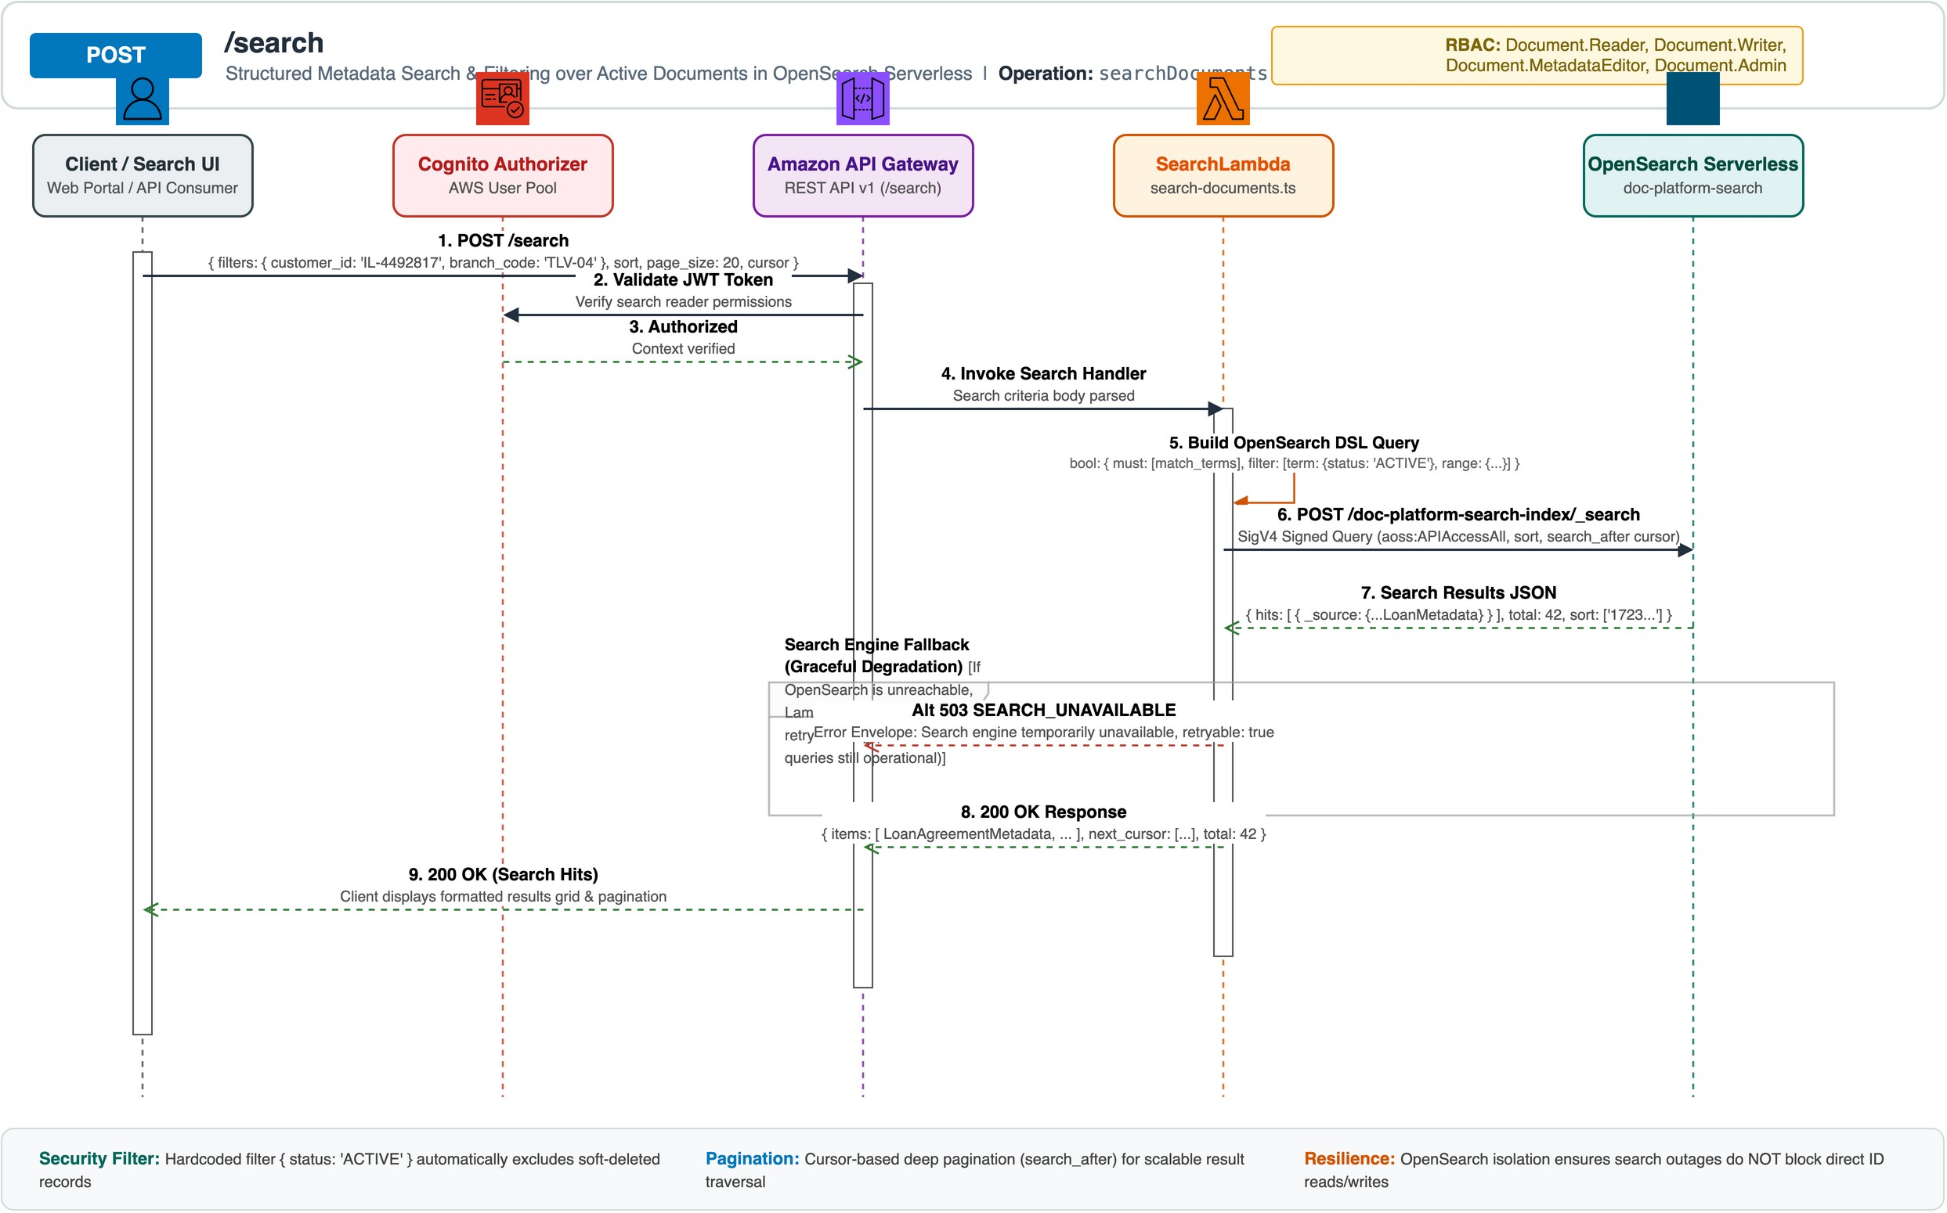
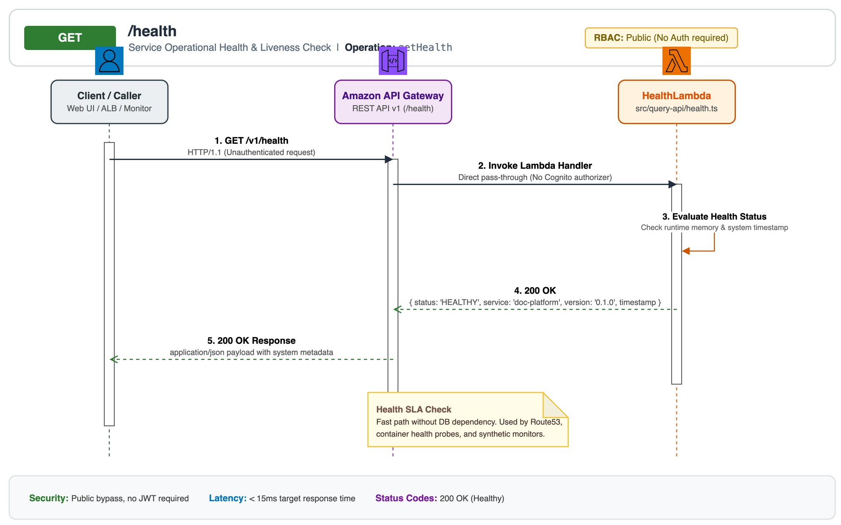
API EXECUTION SEQUENCE
Sequence Deep Dive: OpenSearch Search & Deep Health Probe
API Sequences 15 & 01: POST /v1/search & GET /health
Search Querying & Observability Highlights:
• Search Pipeline (15): OpenSearch Serverless collection executed with multi-attribute filtering and pagination. Bypasses primary S3/DynamoDB datastores for zero read load impact on transactional plane.
• Deep Health Monitoring (01): Verifies active connectivity to DynamoDB, S3 Document Bucket, S3 Audit Bucket, SQS Queue, and OpenSearch Serverless collection in a single diagnostic sweep.
AWS Document Management Platform • Solution Architecture & Sequence Specification
19 / 26

Slide 20
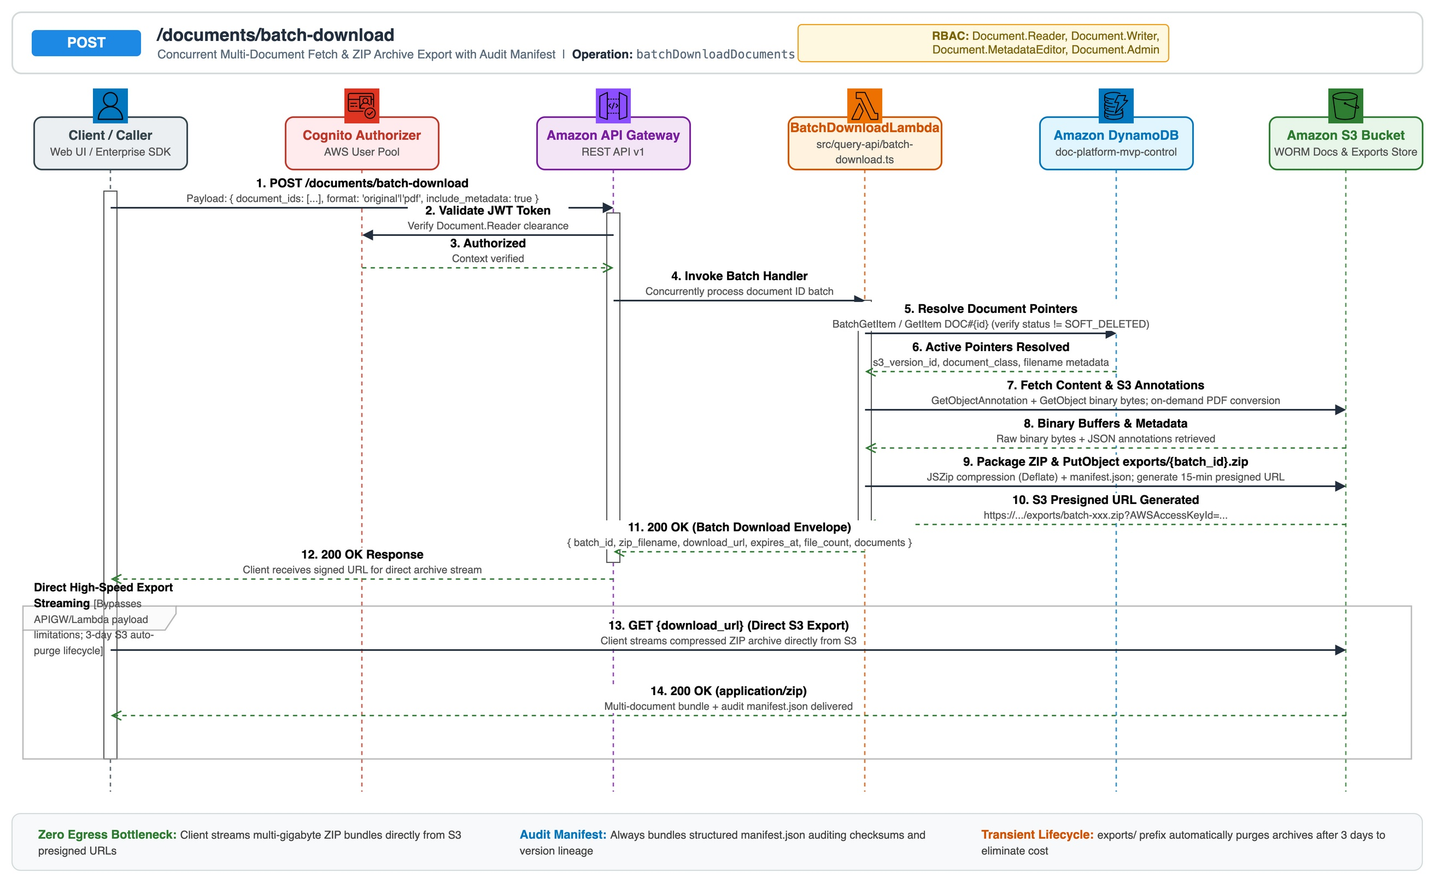
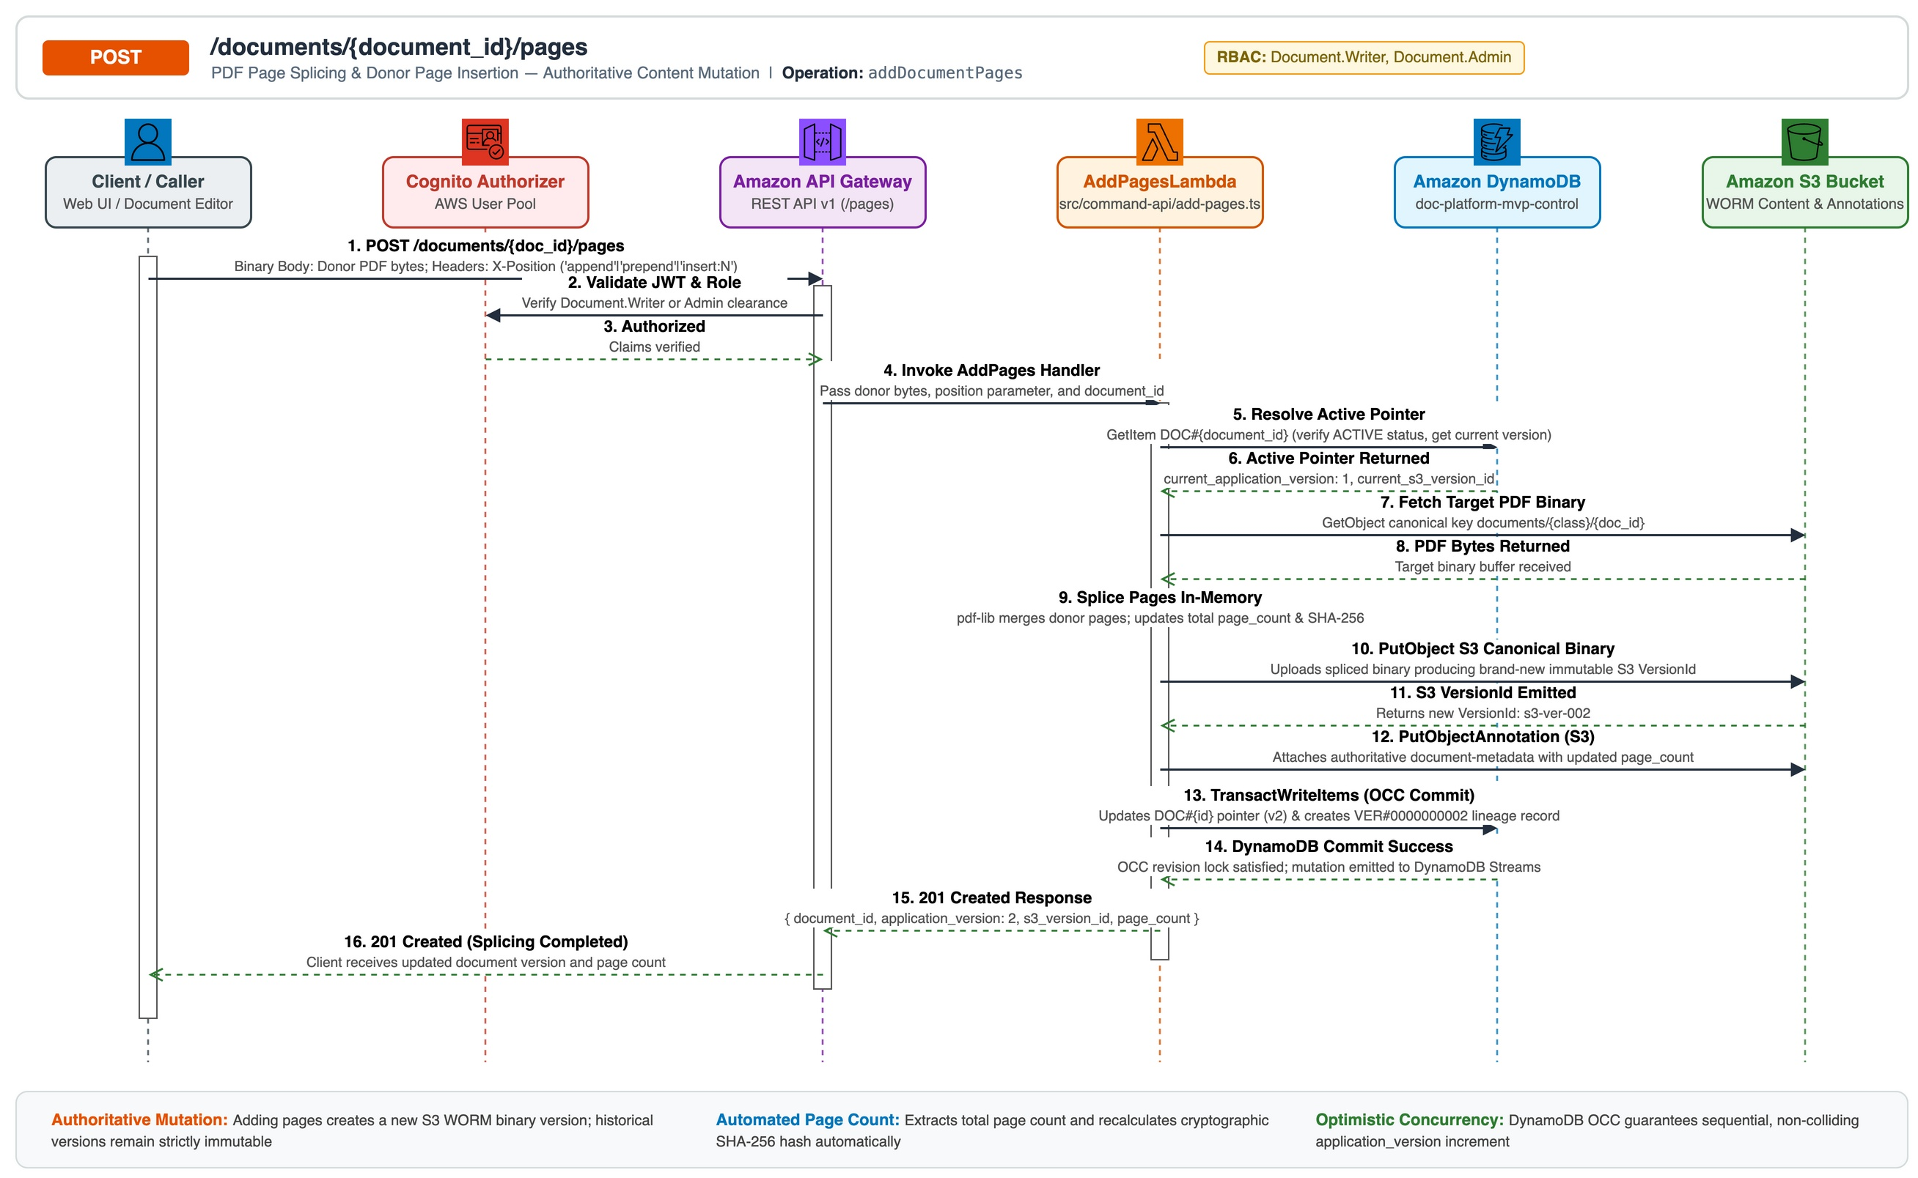
API EXECUTION SEQUENCE
Sequence Deep Dive: Multi-Document Batch Exports & PDF Splicing
API Sequences 17 & 18: POST /v1/documents/batch-download & POST /v1/documents/{id}/pages
Batch Packaging & Authoritative Page Mutation Highlights:
• Batch ZIP Export (17): Streams requested binaries concurrently from S3, bundles them in memory with audit manifest.json via JSZip, writes transient archive to S3 (14-day lifecycle), and returns 15-min presigned URL with zero canonical state mutation.
• PDF Page Splicing (18): Merges incoming PDF/image pages in memory via pdf-lib on ARM64 Graviton, uploads result producing a new S3 VersionId, and atomically increments application_version and page_count via DynamoDB OCC.
AWS Document Management Platform • Solution Architecture & Sequence Specification
20 / 26

Slide 21
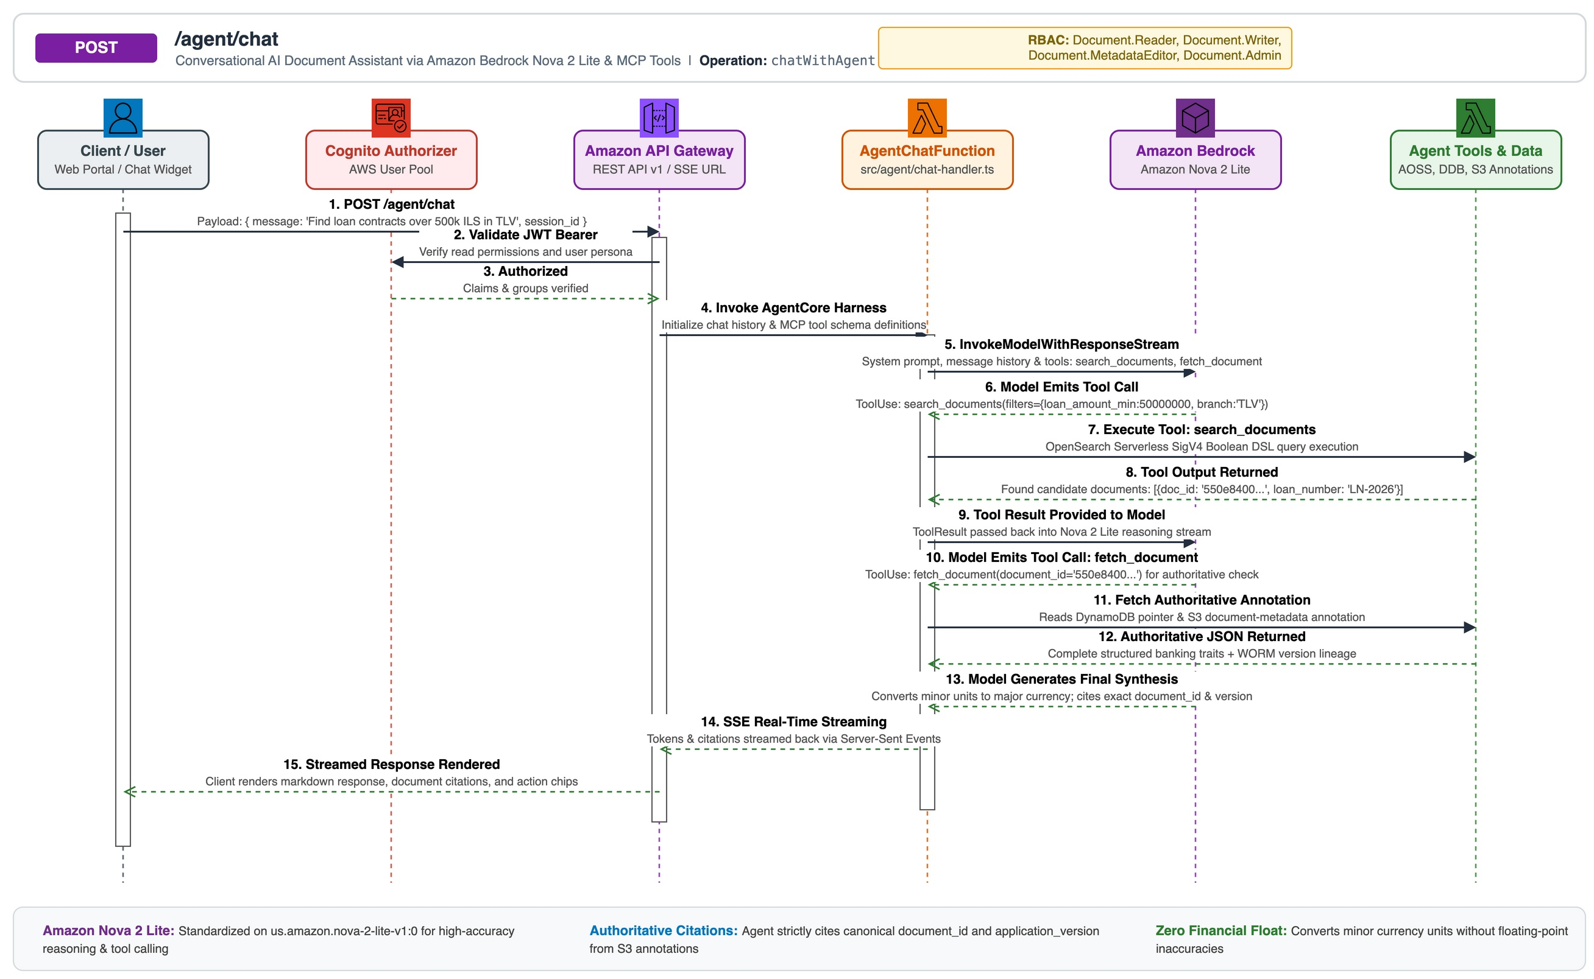
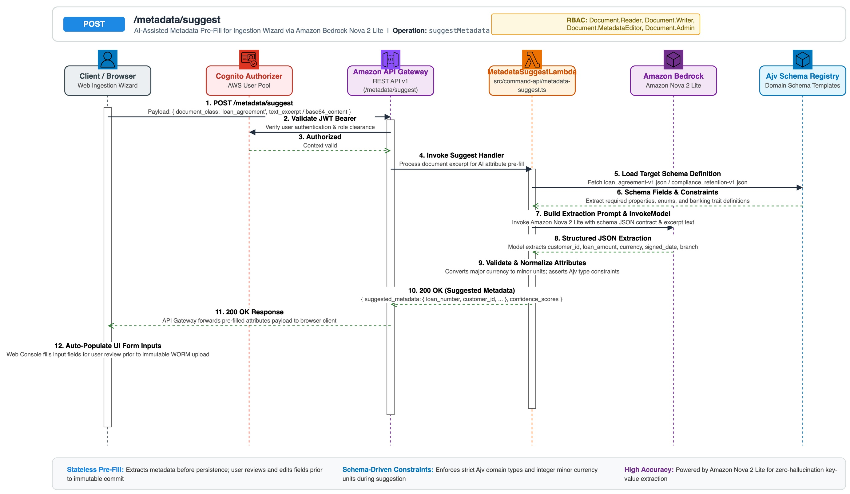
AI & BEDROCK AGENT EXECUTION
Sequence Deep Dive: Conversational AI Assistant & Form Pre-Fill
API Sequences 19 & 20: POST /v1/agent/chat & POST /v1/metadata/suggest (Amazon Bedrock Nova 2 Lite)
Amazon Bedrock Nova 2 Lite Integration Highlights:
• Conversational Document Assistant (19): Operates via Bedrock AgentCore harness with MCP tools (Search, Metadata, Download). Enforces caller RBAC context, formats monetary units accurately, mandates exact document/version citations, and preserves ephemeral session isolation.
• Multimodal Metadata Suggestion (20): Analyzes uploaded PDF/image binaries with Bedrock Nova 2 Lite vision, extracting banking entities matching Ajv schemas with confidence scores to accelerate ingestion forms.
AWS Document Management Platform • Solution Architecture & Sequence Specification
21 / 26

Slide 22
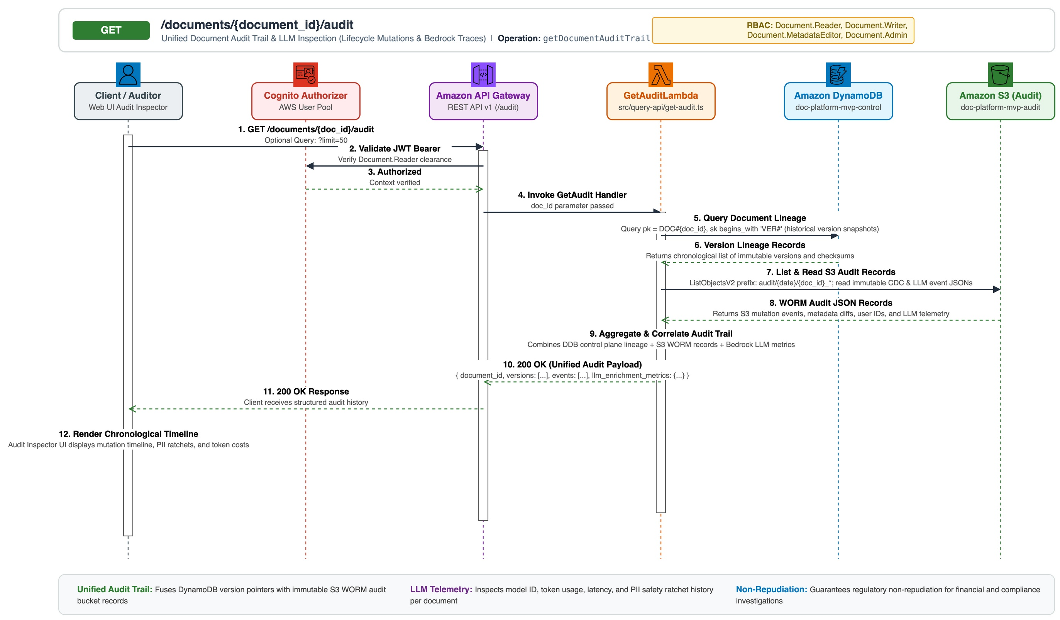
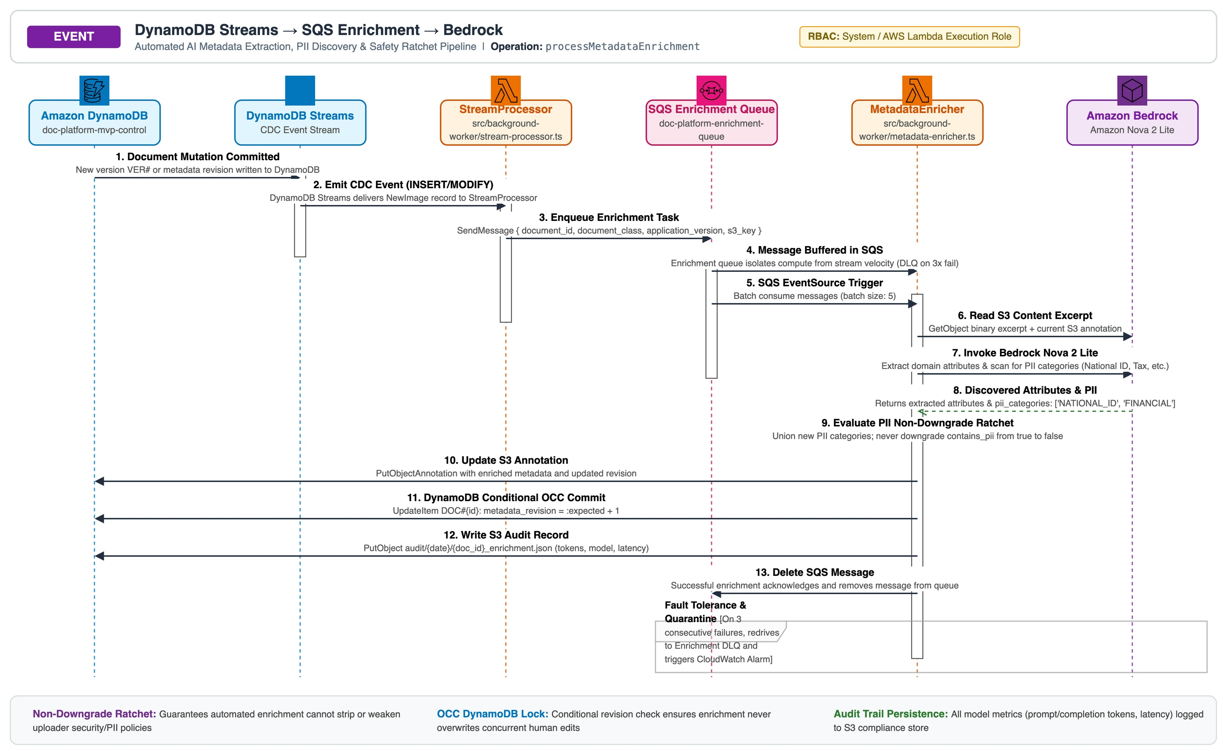
GOVERNANCE, AUDIT & AI ENRICHMENT
Sequence Deep Dive: Unified Audit Inspection & Async LLM/PII Enrichment
API Sequences 21 & 22: GET /v1/documents/{id}/audit & Event-Driven Background LLM Ratchet
Audit Traceability & Non-Downgrade Security Ratchet Highlights:
• Unified Audit Query (21): Directly aggregates WORM audit JSON logs from S3 Audit Bucket (`audit/{doc_id}/...`) with cursor pagination, delivering cryptographically verifiable chronological mutation history for compliance regulators.
• Event-Driven LLM & PII Enrichment (22): SQS-buffered background worker invokes Bedrock Nova 2 Lite for automated entity tagging and PII discovery, updates S3 annotations via DynamoDB OCC, and ratchets security classifications strictly without downgrades.
AWS Document Management Platform • Solution Architecture & Sequence Specification
22 / 26

Slide 23
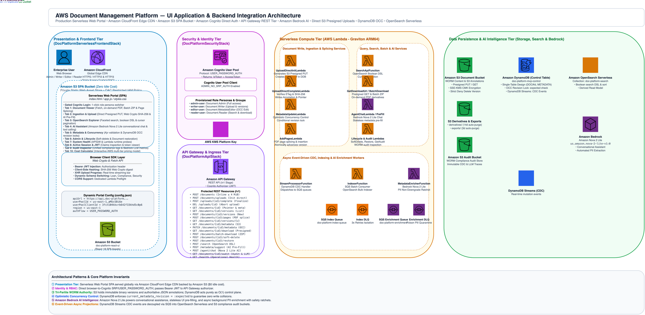
CLIENT INTEGRATION ARCHITECTURE
Serverless Web Portal & Client Integration Architecture
CloudFront + S3 SPA, Cognito JWT Authentication & Client-Side SHA256 Checksums
Integration Highlights
• 1-Click Persona Simulator: Instant token generation for Document.Admin, Document.Writer, Document.Reader, and Compliance Officer.
• Automatic Token Ingress: Signs all HTTP requests with Cognito OAuth 2.0 / OpenID Connect JWT tokens.
• Bimodal File Upload UI: Direct S3 presigned upload with client-side SHA256 hashing and inline binary upload (< 4 MiB).
• On-Demand PDF Delivery: Dynamic in-browser PDF download button with automatic on-the-fly image conversion.
• OpenSearch Discovery: Real-time faceted exploration with dynamic status and attribute filters.
AWS Document Management Platform • Solution Architecture & Sequence Specification
23 / 26

Slide 24
SECURITY & GOVERNANCE
Enterprise Security, KMS Cryptography & Fine-Grained RBAC
Cognito JWT Scopes, Customer Managed KMS Keys (CMK) & WORM Immutability
Cognito RBAC Matrix Enforcement
Enterprise Cryptography & WORM Controls
AWS KMS Customer Managed Key (CMK):
Central key (alias/doc-platform-mvp) with automatic annual rotation encrypting S3 buckets, DynamoDB, SQS queues, and CloudWatch log groups.
WORM Immutability Policy:
Explicit s3:DeleteObjectVersion DENY in IAM execution policies. Raw object versions cannot be overwritten or destroyed.
Zero Public S3 Access:
All S3 buckets enforce S3 Block Public Access with TLS 1.2+ SSL enforcement in bucket policies.
Micro-Perimeter IAM Roles:
Each Lambda has a dedicated execution role granting strictly required actions (e.g. Search Lambda cannot write to S3 or DynamoDB).
Operation | Reader | Writer | Editor | Admin
POST /v1/documents | ❌ | ✅ | ❌ | ✅
GET /v1/documents/{id} | ✅ | ✅ | ✅ | ✅
GET /v1/download | ✅ | ✅ | ✅ | ✅
POST /versions | ❌ | ✅ | ❌ | ✅
POST /pages (PDF Splice) | ❌ | ✅ | ❌ | ✅
PATCH /metadata | ❌ | ✅ | ✅ | ✅
POST /soft-delete | ❌ | ❌ | ❌ | ✅
POST /restore | ❌ | ❌ | ❌ | ✅
POST /search | ✅ | ✅ | ✅ | ✅
POST /batch-download | ✅ | ✅ | ✅ | ✅
POST /agent/chat | ✅ | ✅ | ✅ | ✅
POST /metadata/suggest | ❌ | ✅ | ❌ | ✅
GET /audit | ❌ | ❌ | ❌ | ✅
AWS Document Management Platform • Solution Architecture & Sequence Specification
24 / 26

Slide 25
DEPLOYMENT ARCHITECTURE
Infrastructure as Code: AWS CDK v2 Modular Stacks
Deterministic TypeScript CloudFormation Topologies with Zero Circular Dependencies
1. SecurityStack
• Resources: Cognito User Pool, App Client & KMS CMK Key
• Purpose: Provisions identity directory, RBAC groups & central encryption key.
2. StorageStack
• Resources: S3 Primary Document Bucket & S3 Audit Bucket
• Purpose: Configures versioning, encryption, CORS & WORM protection policies.
3. SearchStack
• Resources: OpenSearch Serverless Collection (documents-v1)
• Purpose: Sets up vector/search collection, encryption & network security policies.
4. MessagingStack
• Resources: Amazon SQS Queues (Search Indexer + LLM Enrichment)
• Purpose: Buffers CDC events with 3x retry limits and CloudWatch alarm triggers.
5. ControlPlaneStack
• Resources: DynamoDB Table (doc-platform-mvp-control)
• Purpose: Provisions single-table design with PITR and DynamoDB Streams enabled.
6. ComputeStack
• Resources: 21 Graviton ARM64 AWS Lambda Functions
• Purpose: Deploys Command, Query, Search, Stream, Indexer & Enricher services.
7. AgentStack
• Resources: Amazon Bedrock Nova 2 Lite Assistant & Gateway
• Purpose: Provisions AgentCore harness, MCP tools, and session execution.
8. ApiStack
• Resources: Amazon API Gateway REST API & Cognito Authorizer
• Purpose: Wires 20 routes, authorizer, throttling limits, and CORS configuration.
9. ServerlessReactFrontendStack
• Resources: CloudFront CDN & S3 React 18 SPA Bucket
• Purpose: Distributes high-speed React 18 static portal assets globally with TLS 1.3.
10. ObservabilityStack
• Resources: CloudWatch Alarms, Dashboards & Global Tagging
• Purpose: Provisions DLQ/5xx alarms, operational dashboards, and global resource tags.
AWS Document Management Platform • Solution Architecture & Sequence Specification
25 / 26

Slide 26
EXECUTIVE SUMMARY & VALUE
Strategic Architecture Summary & Decision Records
Why This Cloud-Native Blueprint Delivers Unrivaled Durability, Cost-Efficiency & Compliance
1. Zero Idle TCO
2. Infinite WORM Durability
3. Blast Radius Isolation
Operational costs scale strictly with business transactions. Dev/Test and staging environments cost $0 when idle, eliminating multi-million dollar annual ECM licenses.
S3 11 9s durability combined with immutable S3 Versioning and explicit IAM Deny policies provides airtight compliance against ransomware or accidental deletion.
Decoupled CQRS storage architecture ensures search cluster re-indexing or outages never disrupt core document ingestion, metadata updates, or downloads.
Architectural Decision | Chosen Approach | Alternative Rejected | Core Strategic Justification
Metadata Storage Model | S3 Native Annotations | S3 Headers (2 KB) / Sidecar Files | Overcomes 2 KB limit, avoids sidecar file proliferation, ready for S3 Iceberg SQL analytics.
Transactional Control Plane | DynamoDB Single-Table | Aurora PostgreSQL / DocumentDB | Single-digit millisecond latency, atomic OCC conditional updates, zero server maintenance.
Search Engine Topology | OpenSearch Serverless | Elasticsearch on EC2 / OpenSearch Cluster | Zero cluster sizing, auto-scaling OCUs, IAM SigV4 authentication, full blast radius isolation.
Format Transformations | On-Demand In-Memory PDF | Eager pre-conversion / Permanent storage | Pure TypeScript Graviton compute, 14-day auto-purge S3 Lifecycle, WORM lineage preserved.
Metadata Schema Validation | Build-Time GitOps (Ajv) | Database Schema Lookups on Cold Start | Zero cold start latency overhead (<1ms validation), strict PR reviews and Git audit trail.
AWS Document Management Platform • Solution Architecture & Sequence Specification
26 / 26

