Slide 1
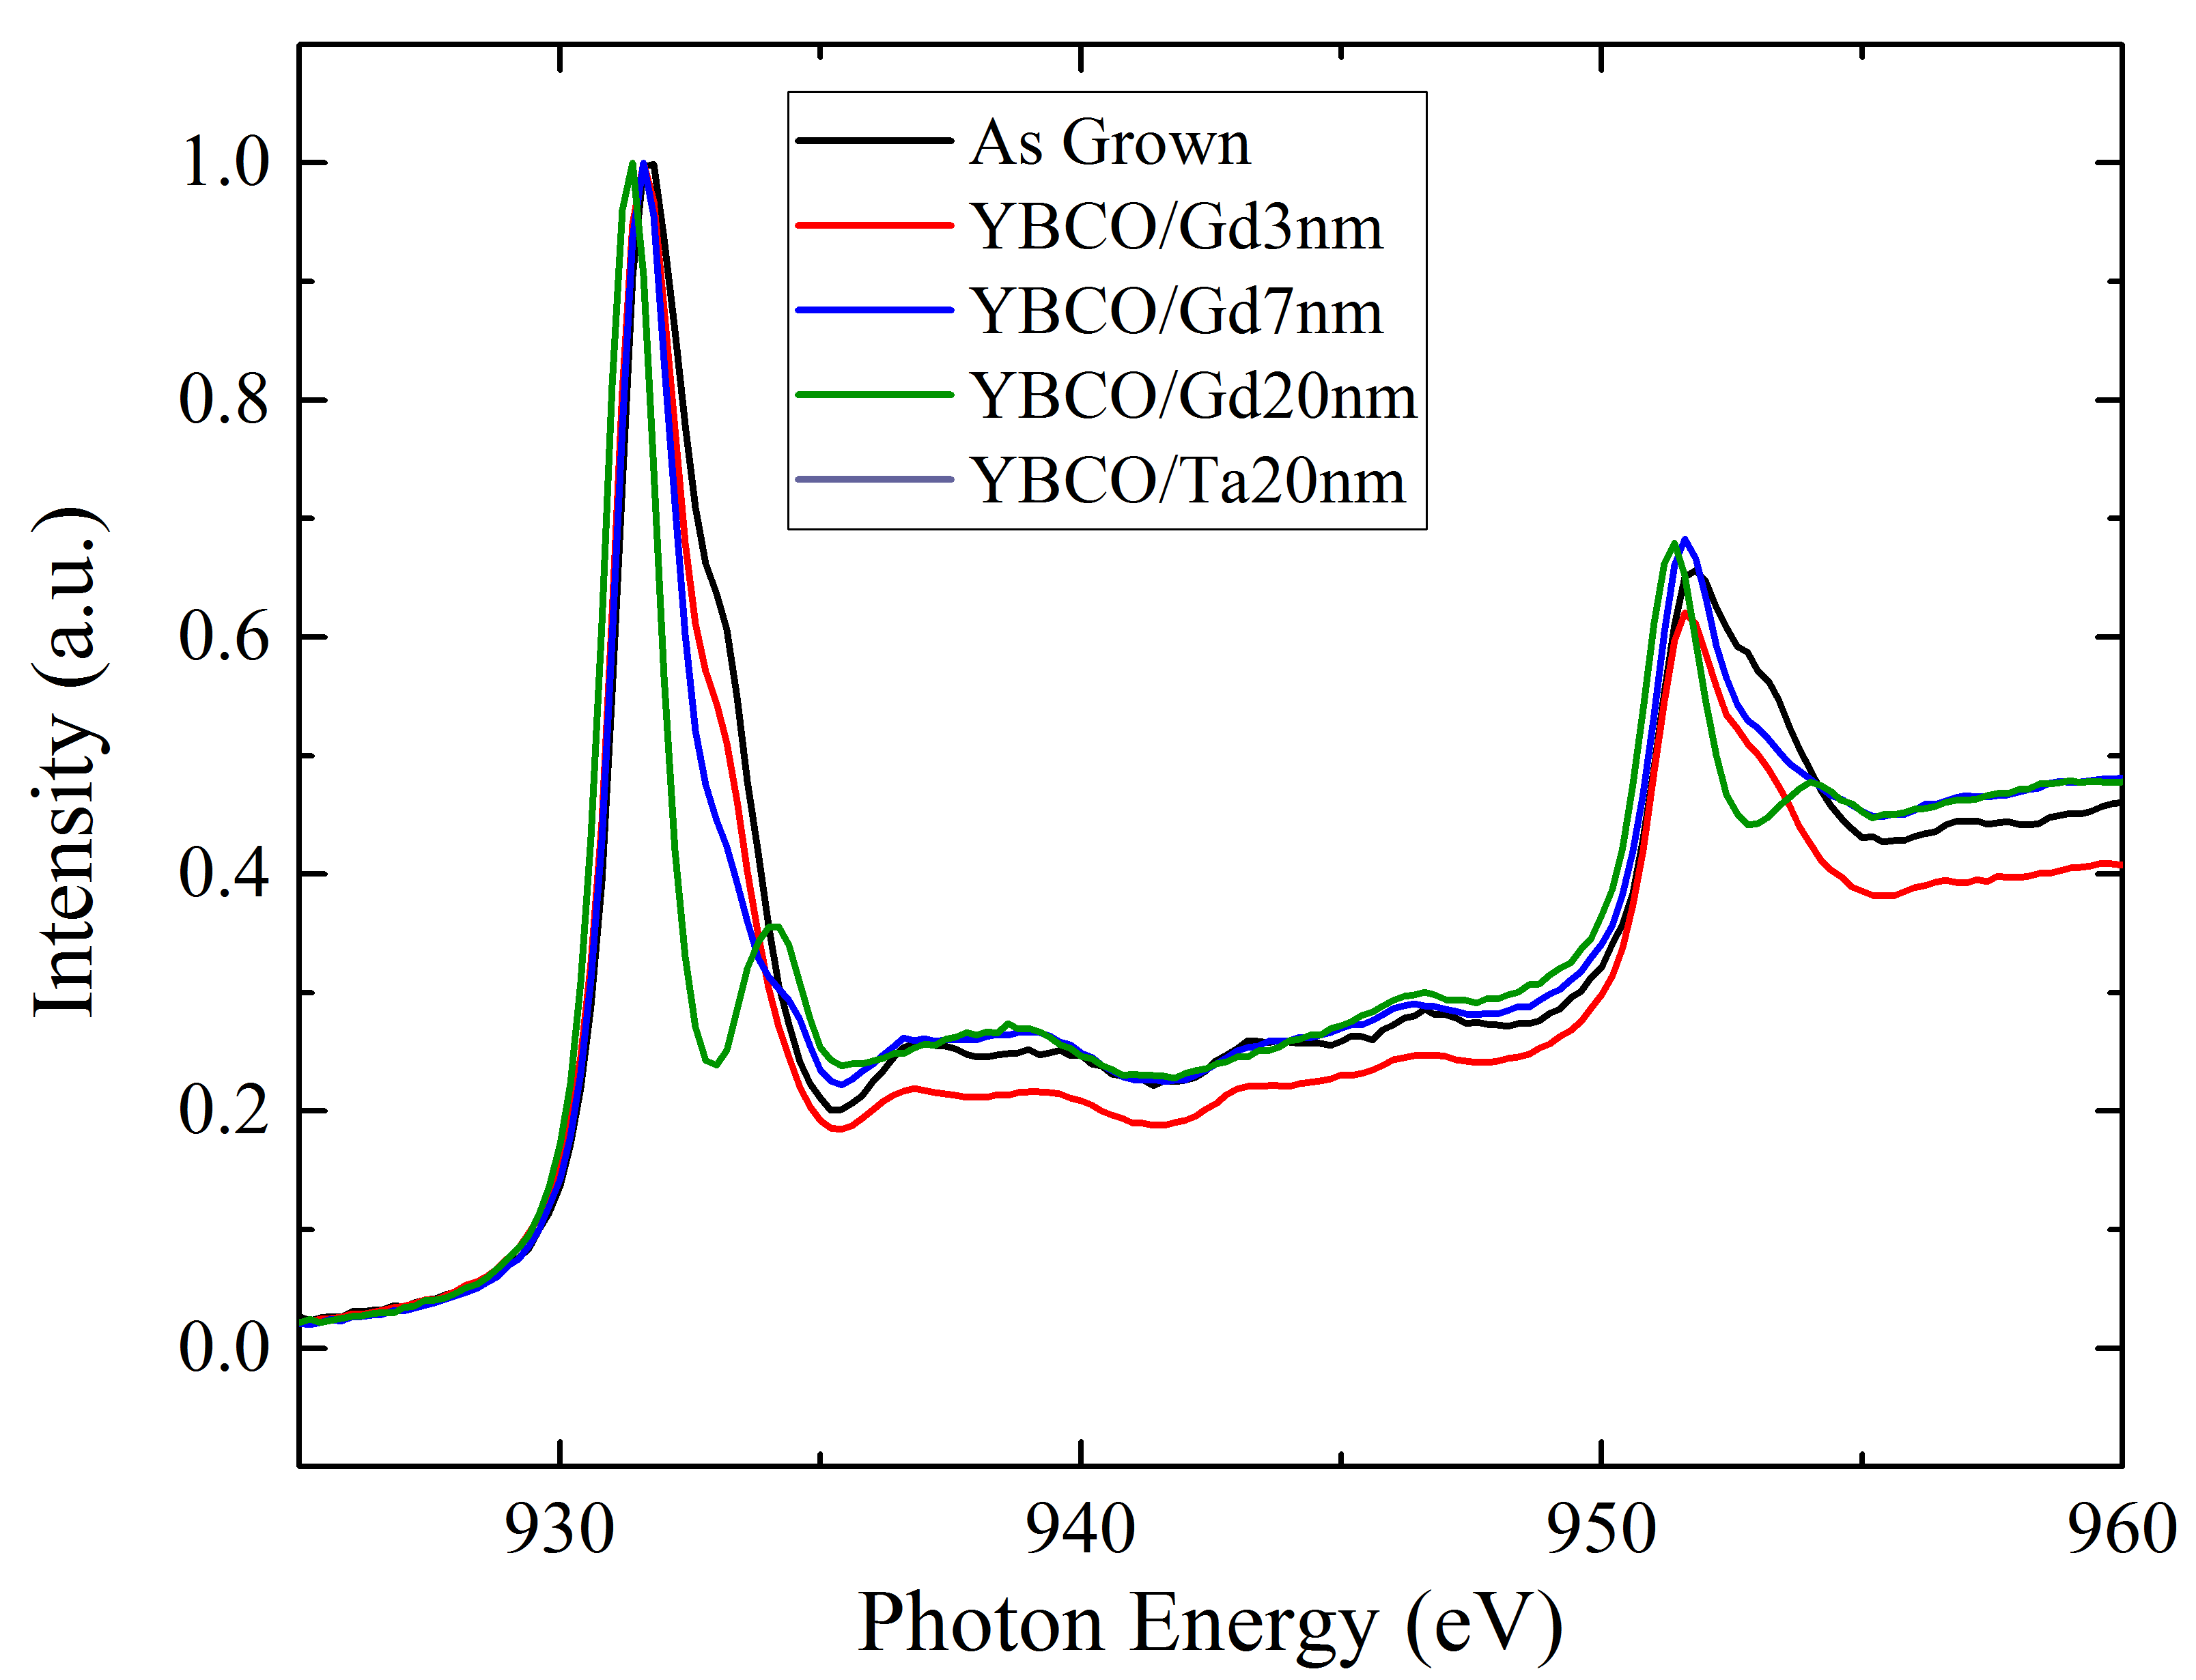
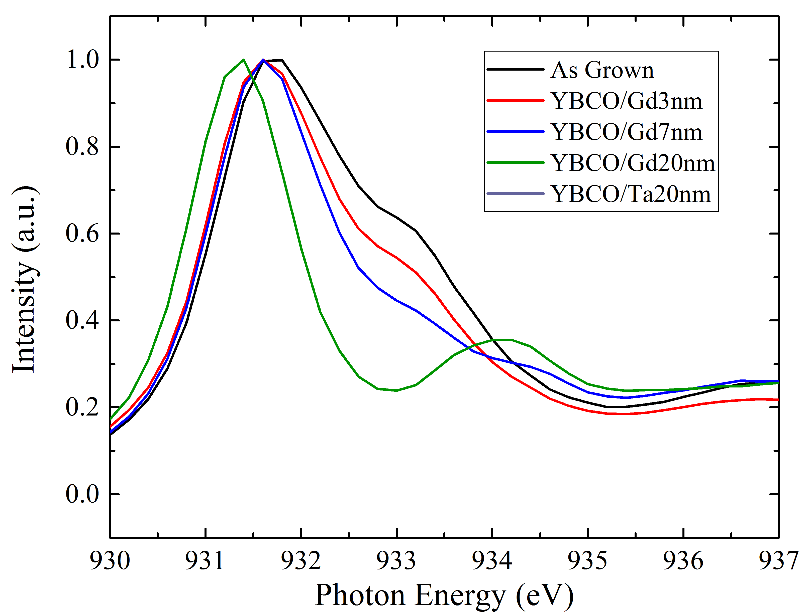
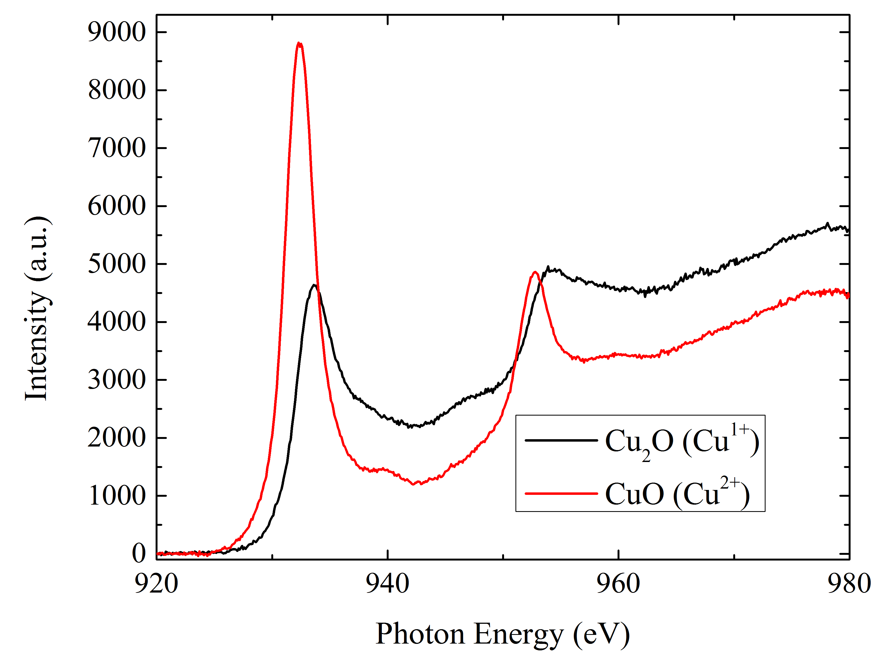
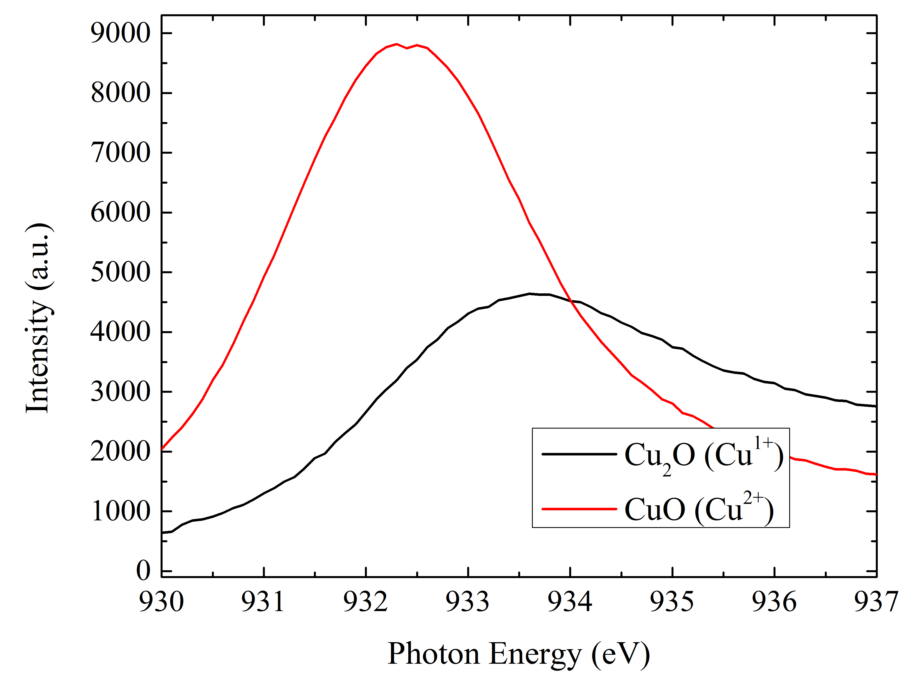
Peak from Cu¹⁺ state

Slide 2
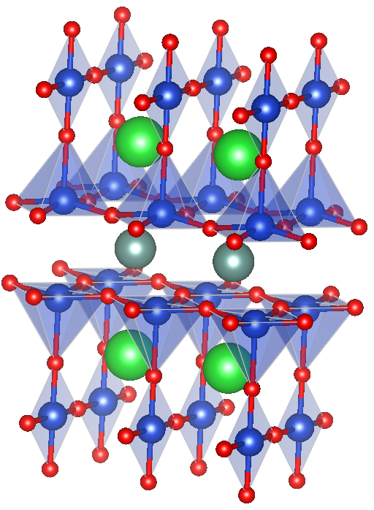
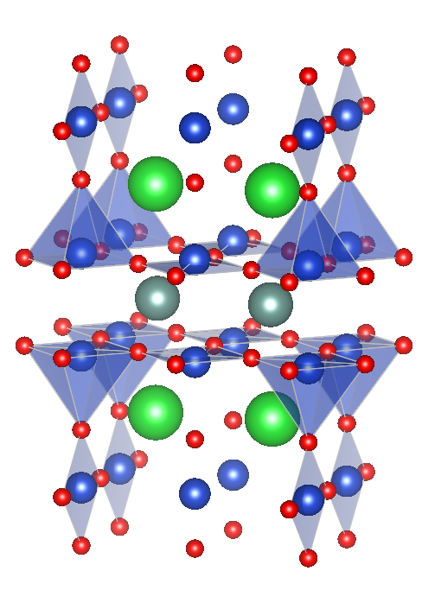
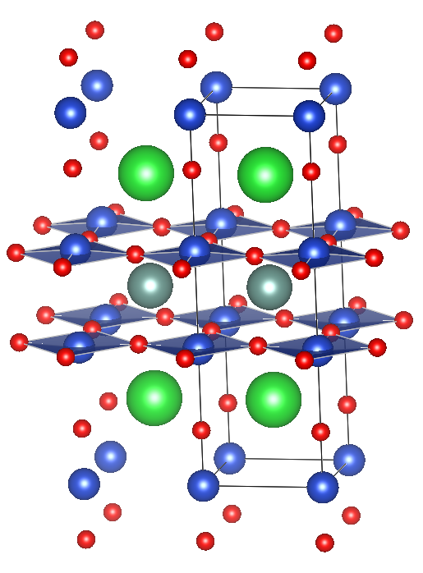
YBa₂Cu₃O₇
(3Cu^{7/3+}=2Cu²⁺ + Cu³⁺)
YBa₂Cu₃O_{6.5}
(3Cu²⁺)
YBa₂Cu₃O₆
(3Cu^{5/3+}=2Cu²⁺+Cu¹⁺)

Slide 3
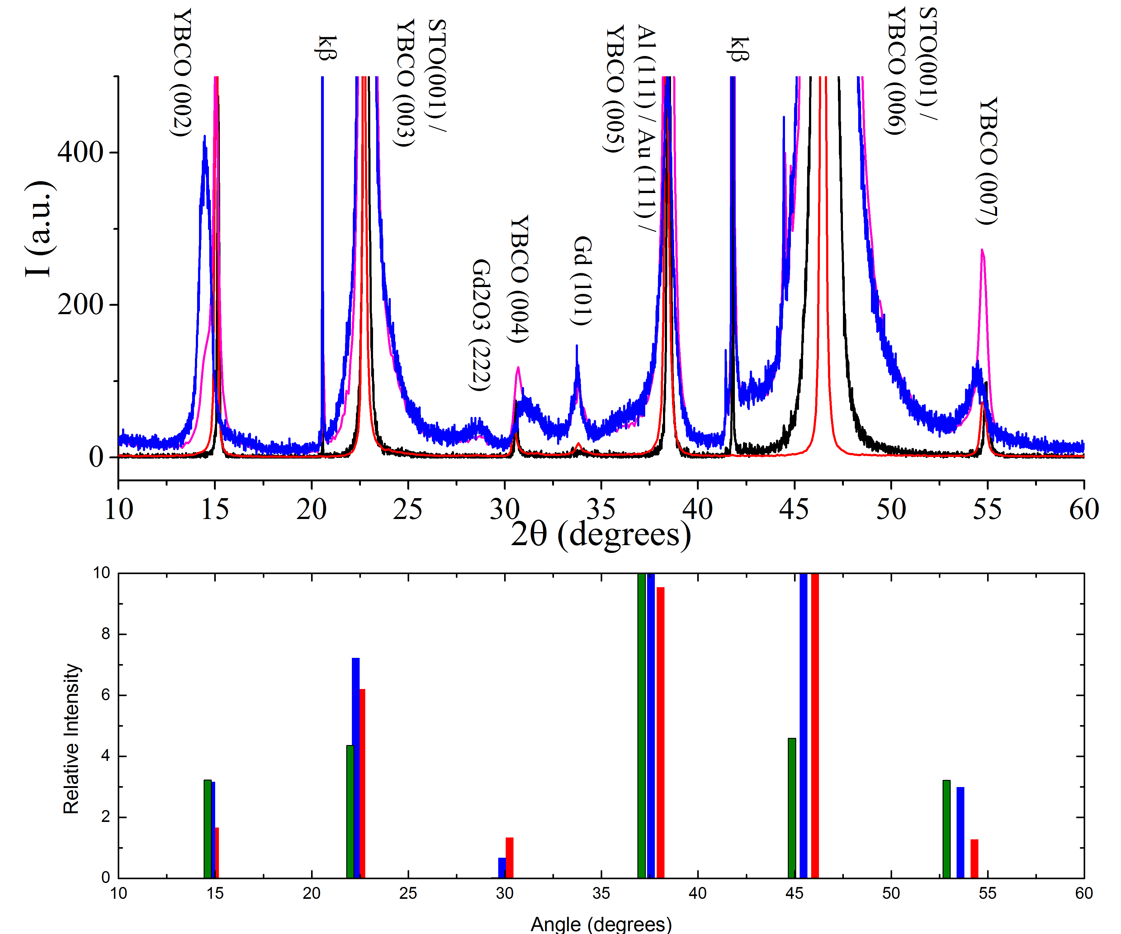
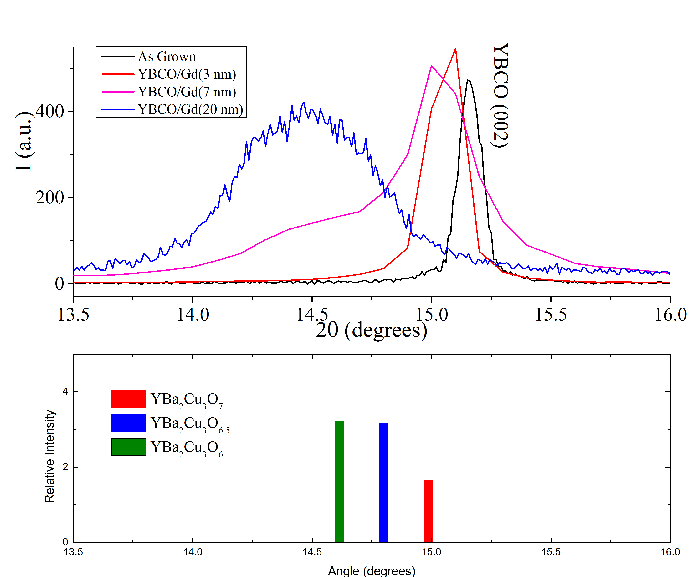
Emergent New Phase?

Slide 4
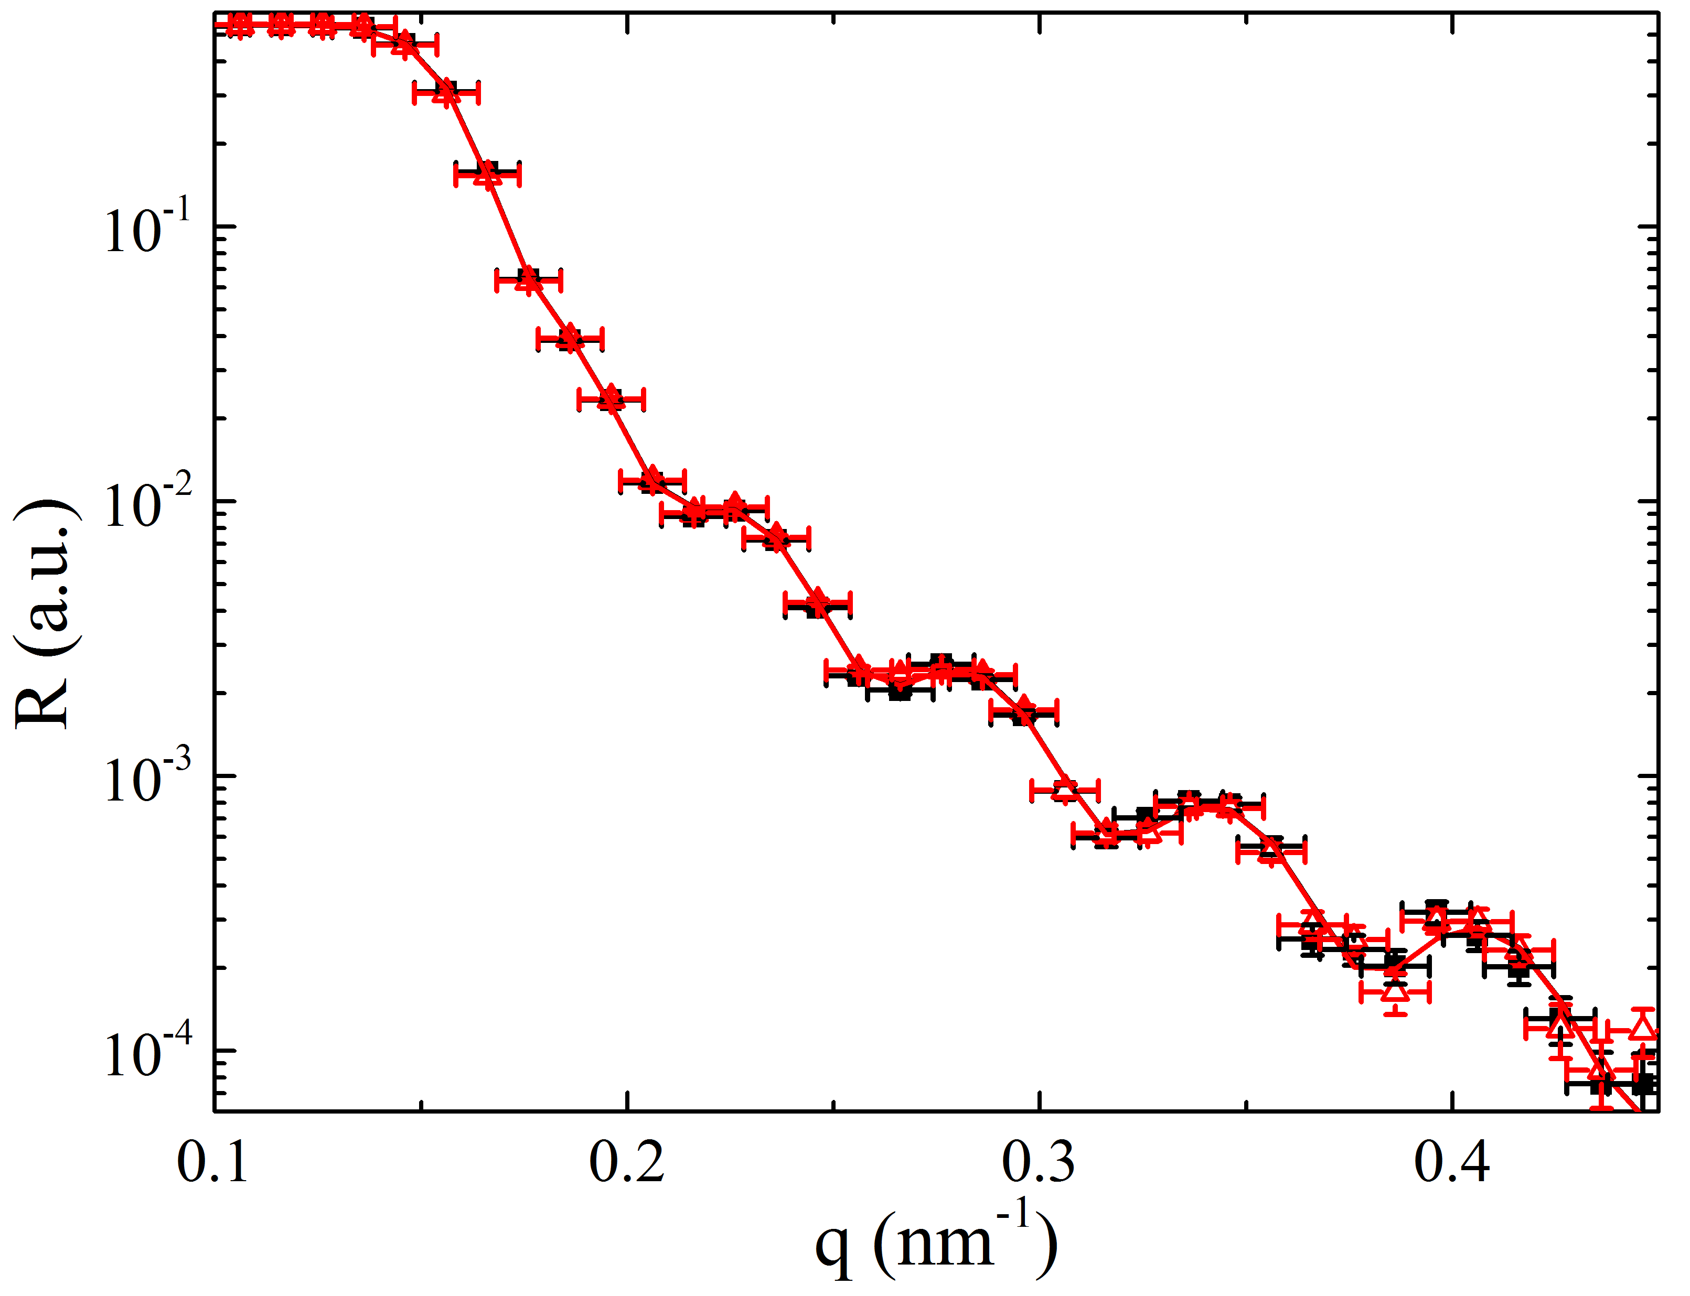
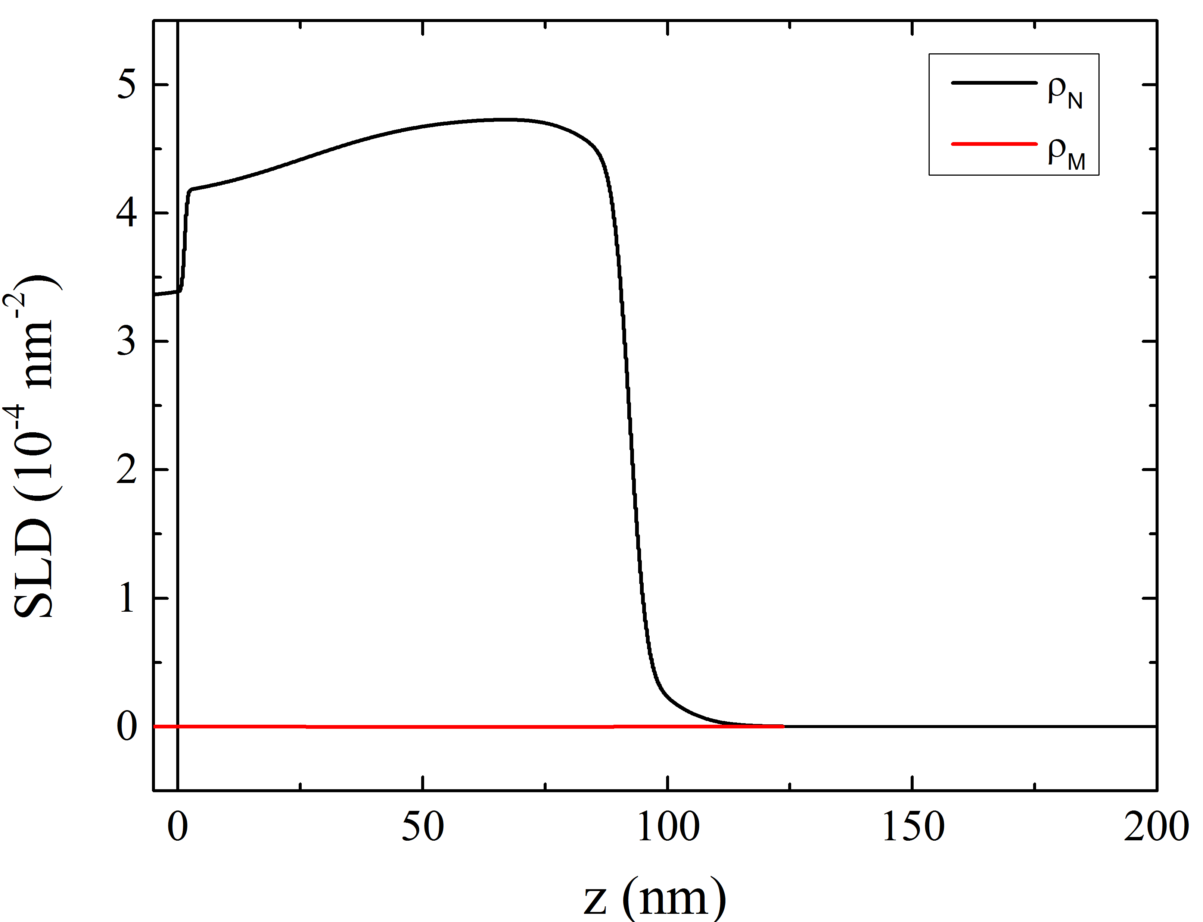
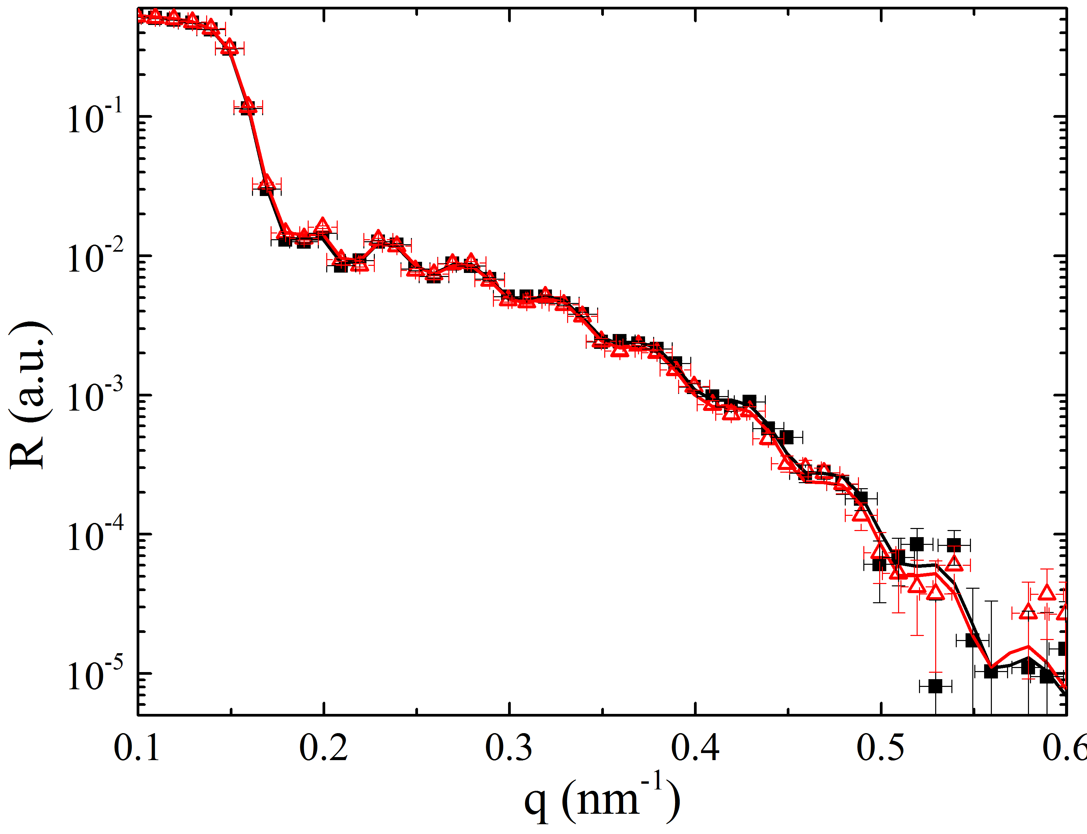
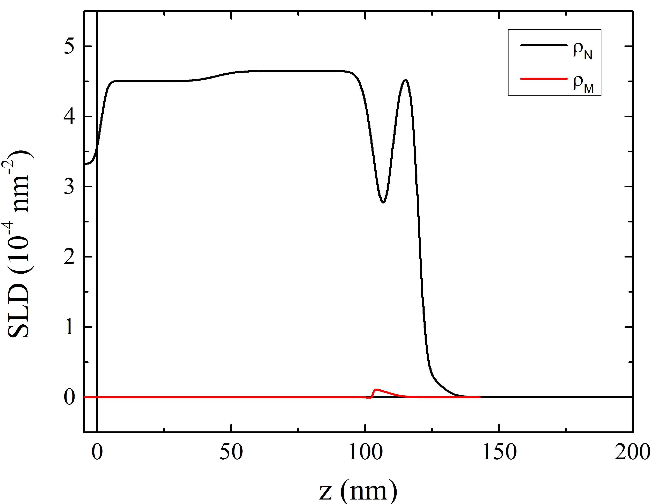
YBCO As Grown
YBCO/Gd(3 nm)

Slide 5
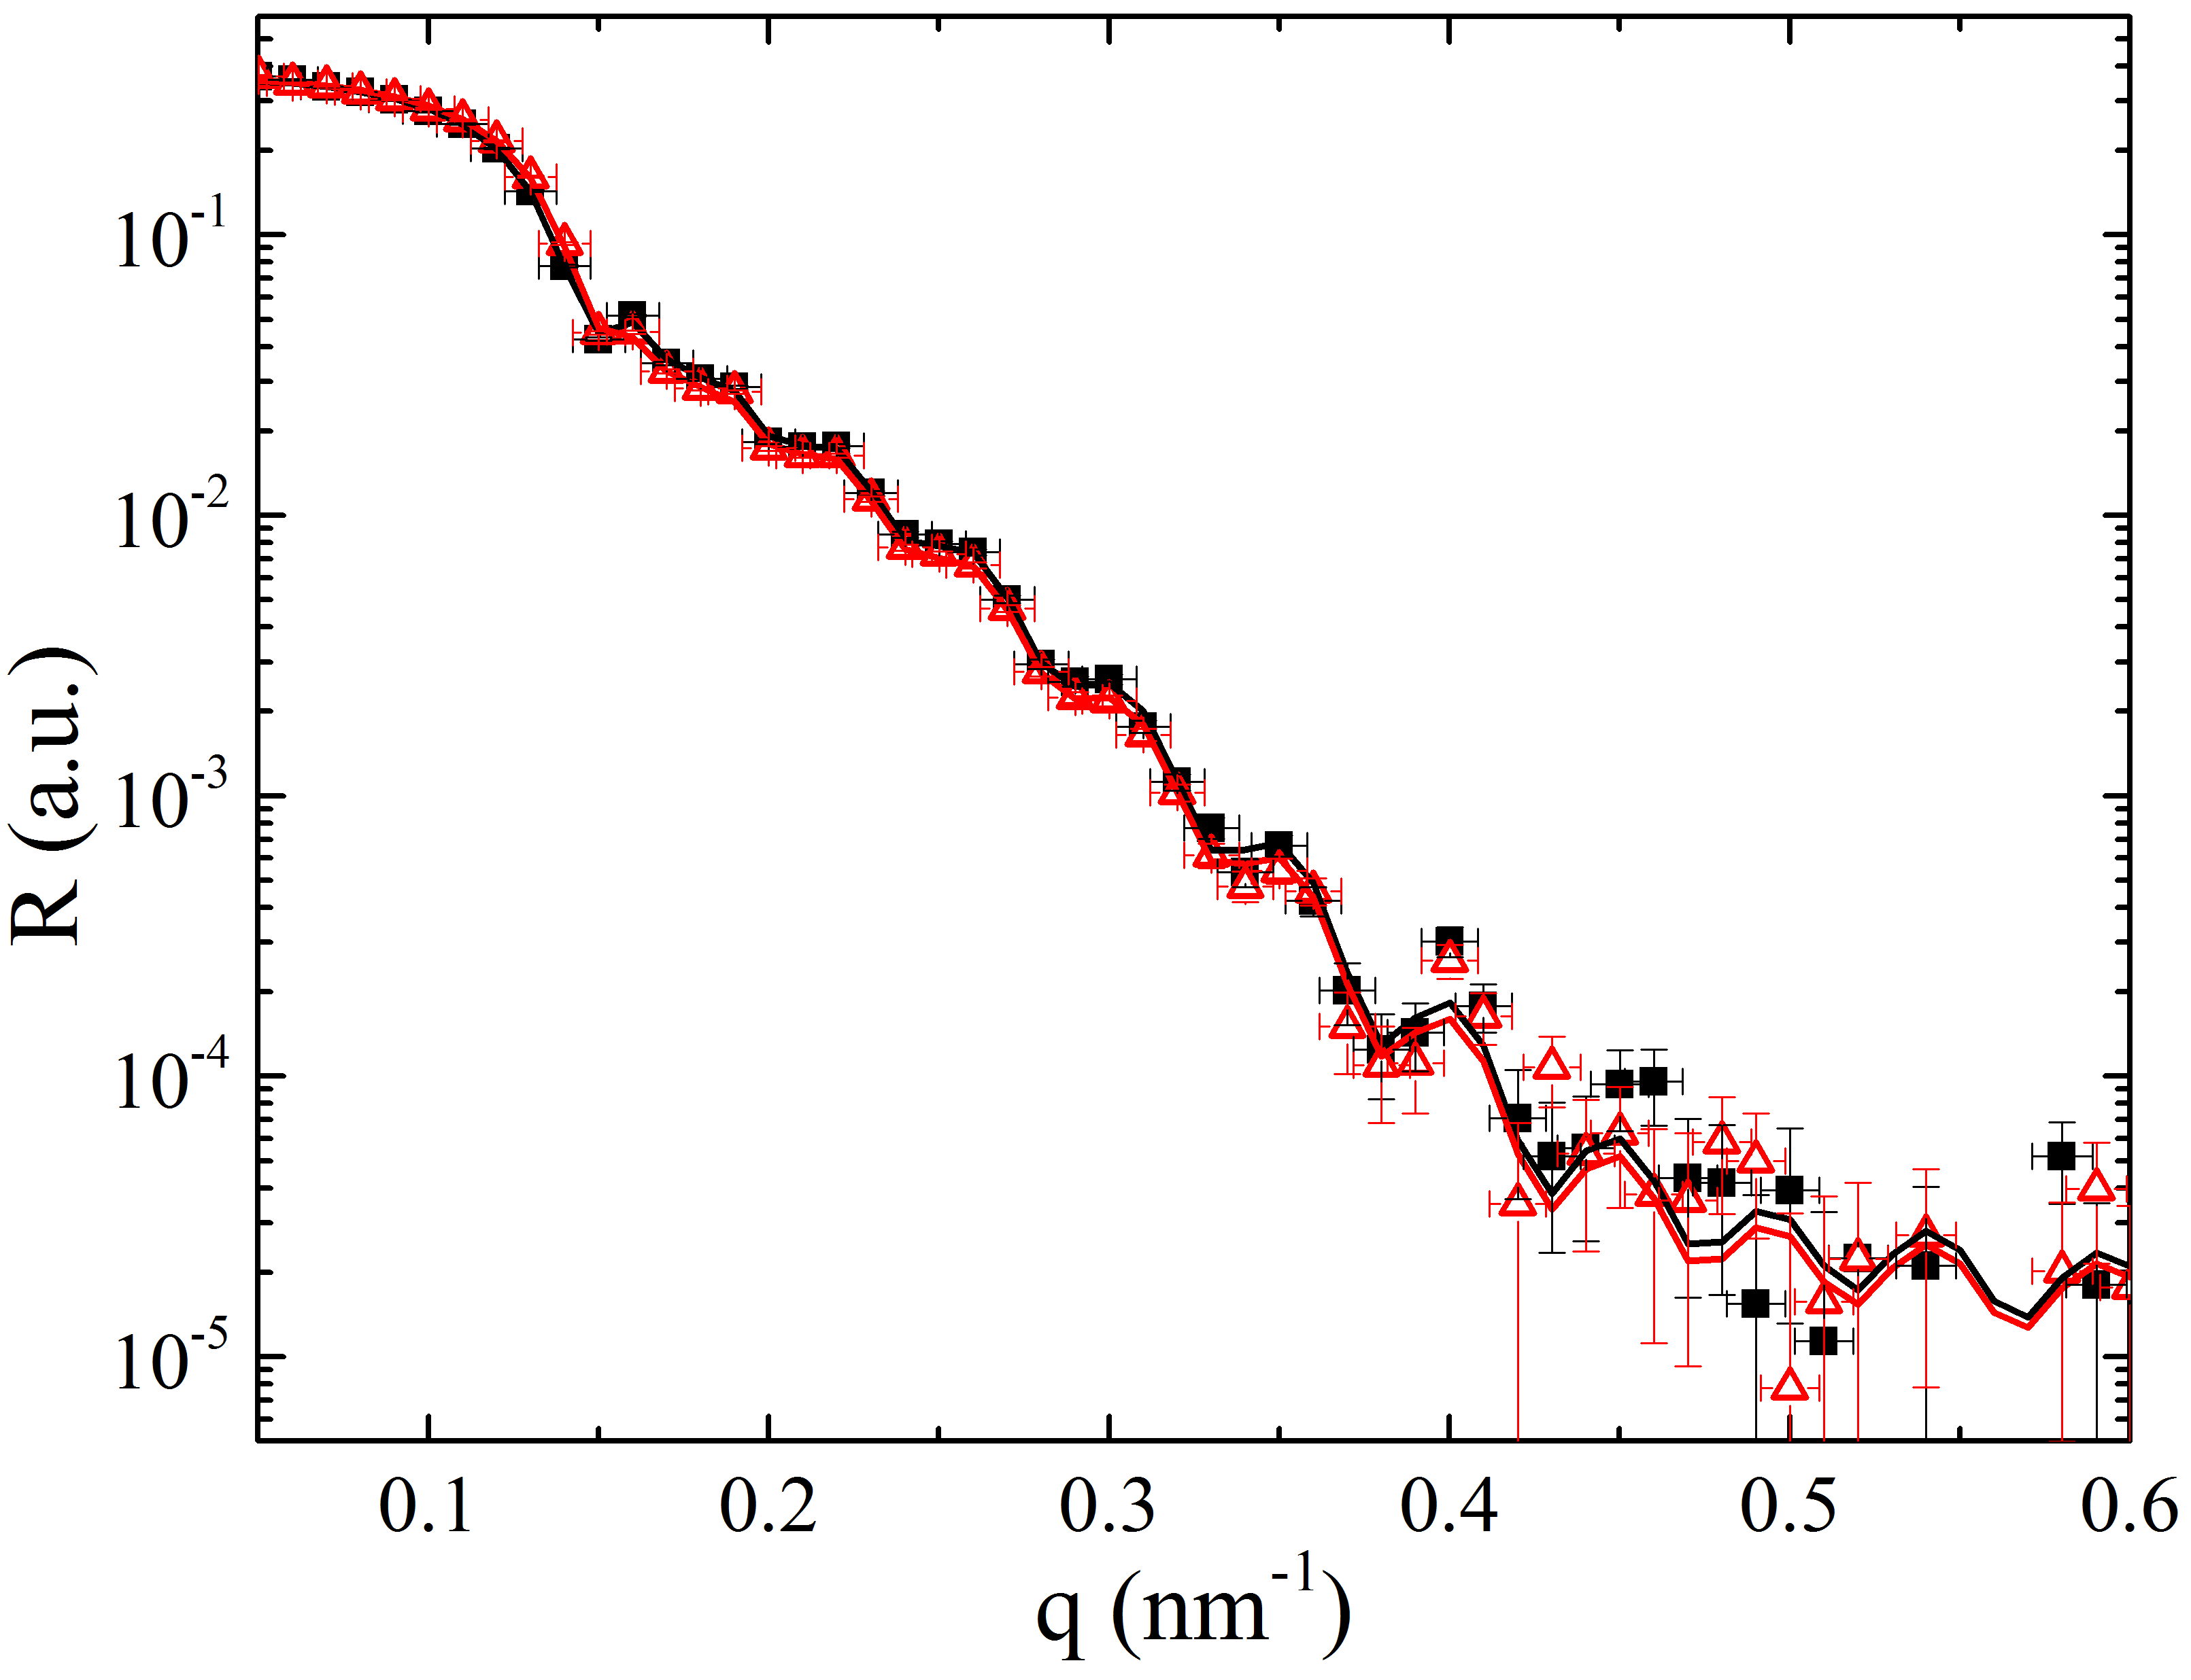
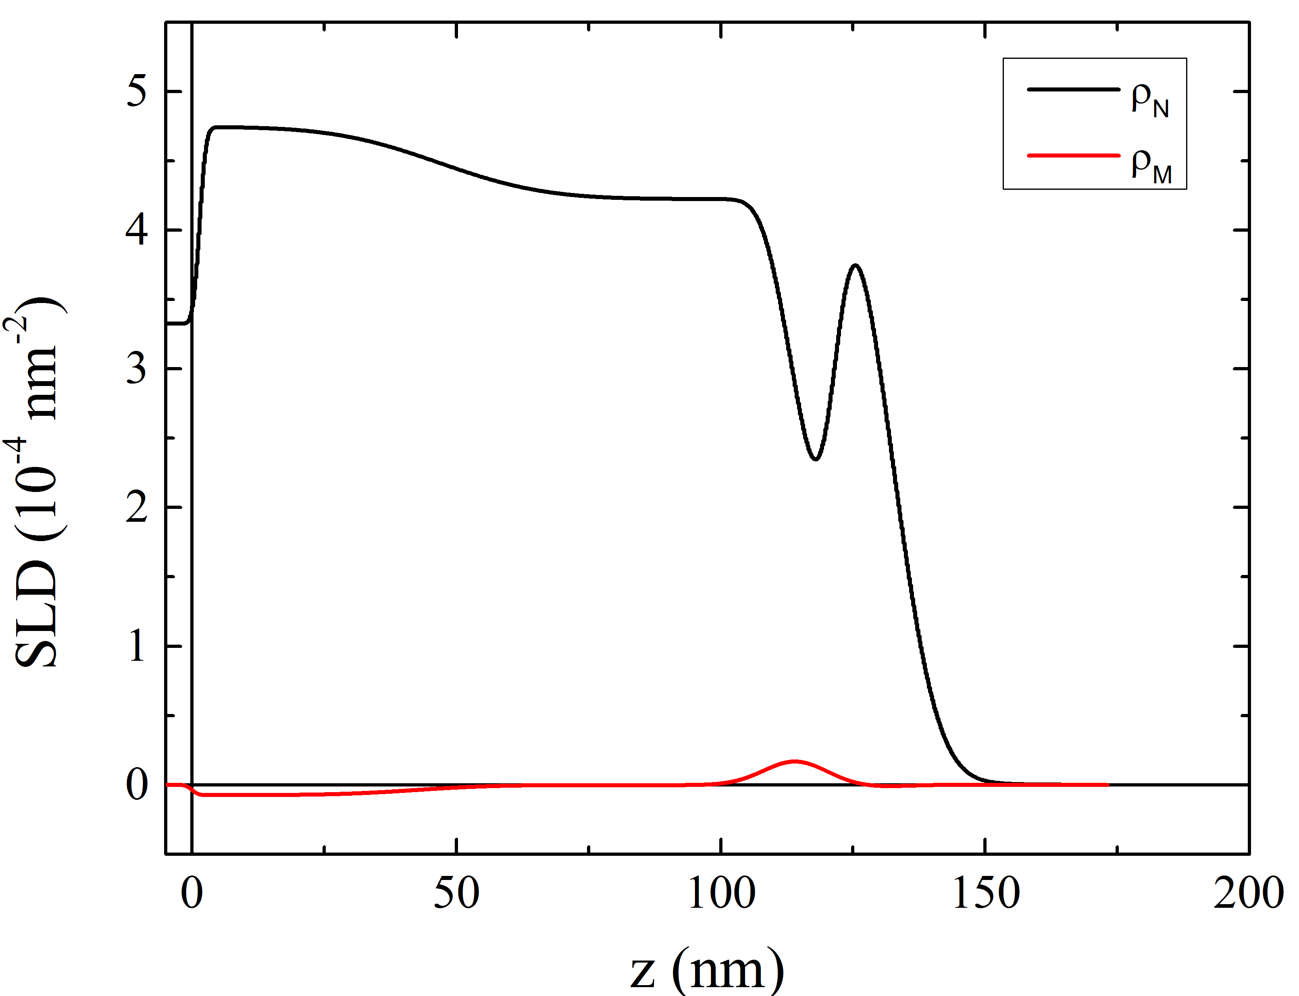
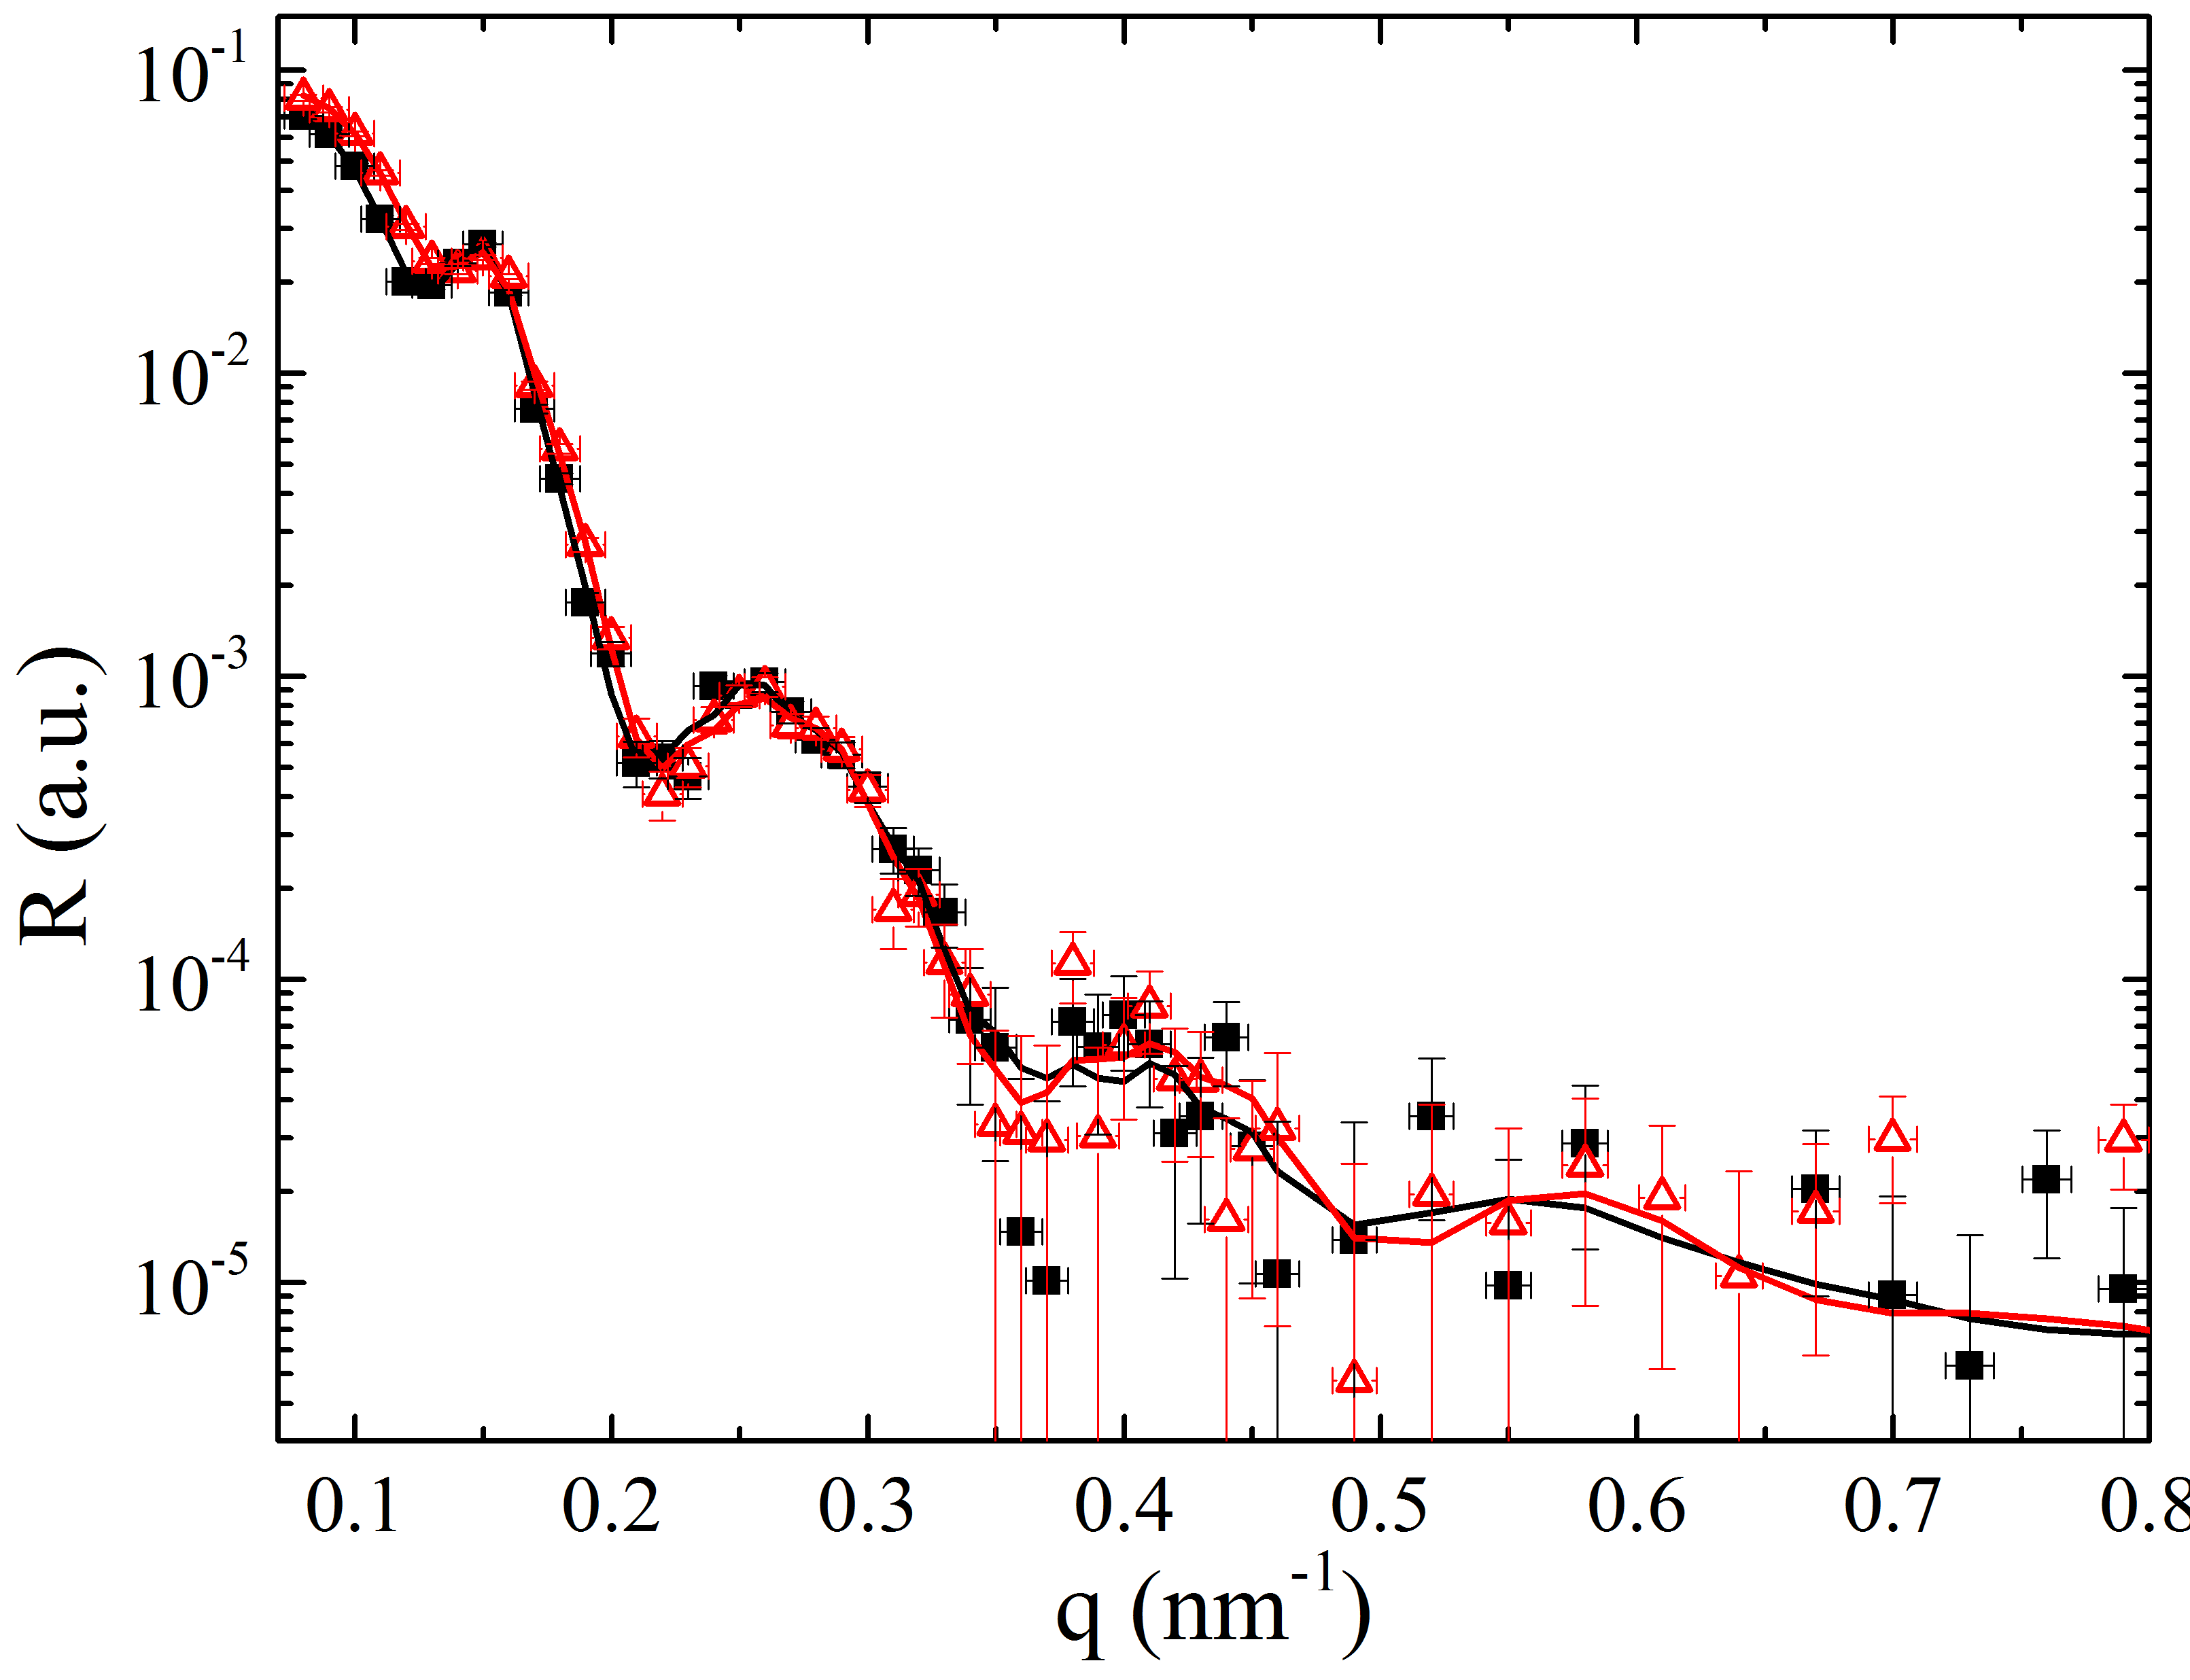
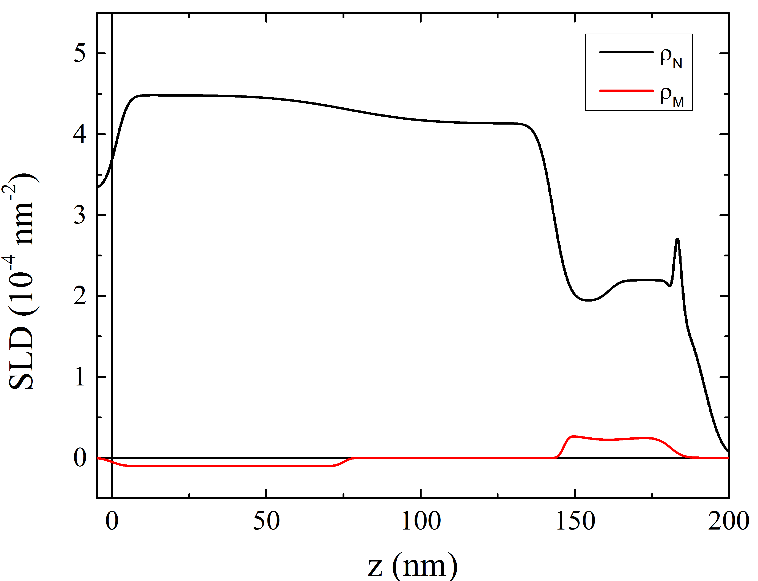
YBCO/Gd(7 nm)
YBCO/Gd(20 nm)

Slide 6
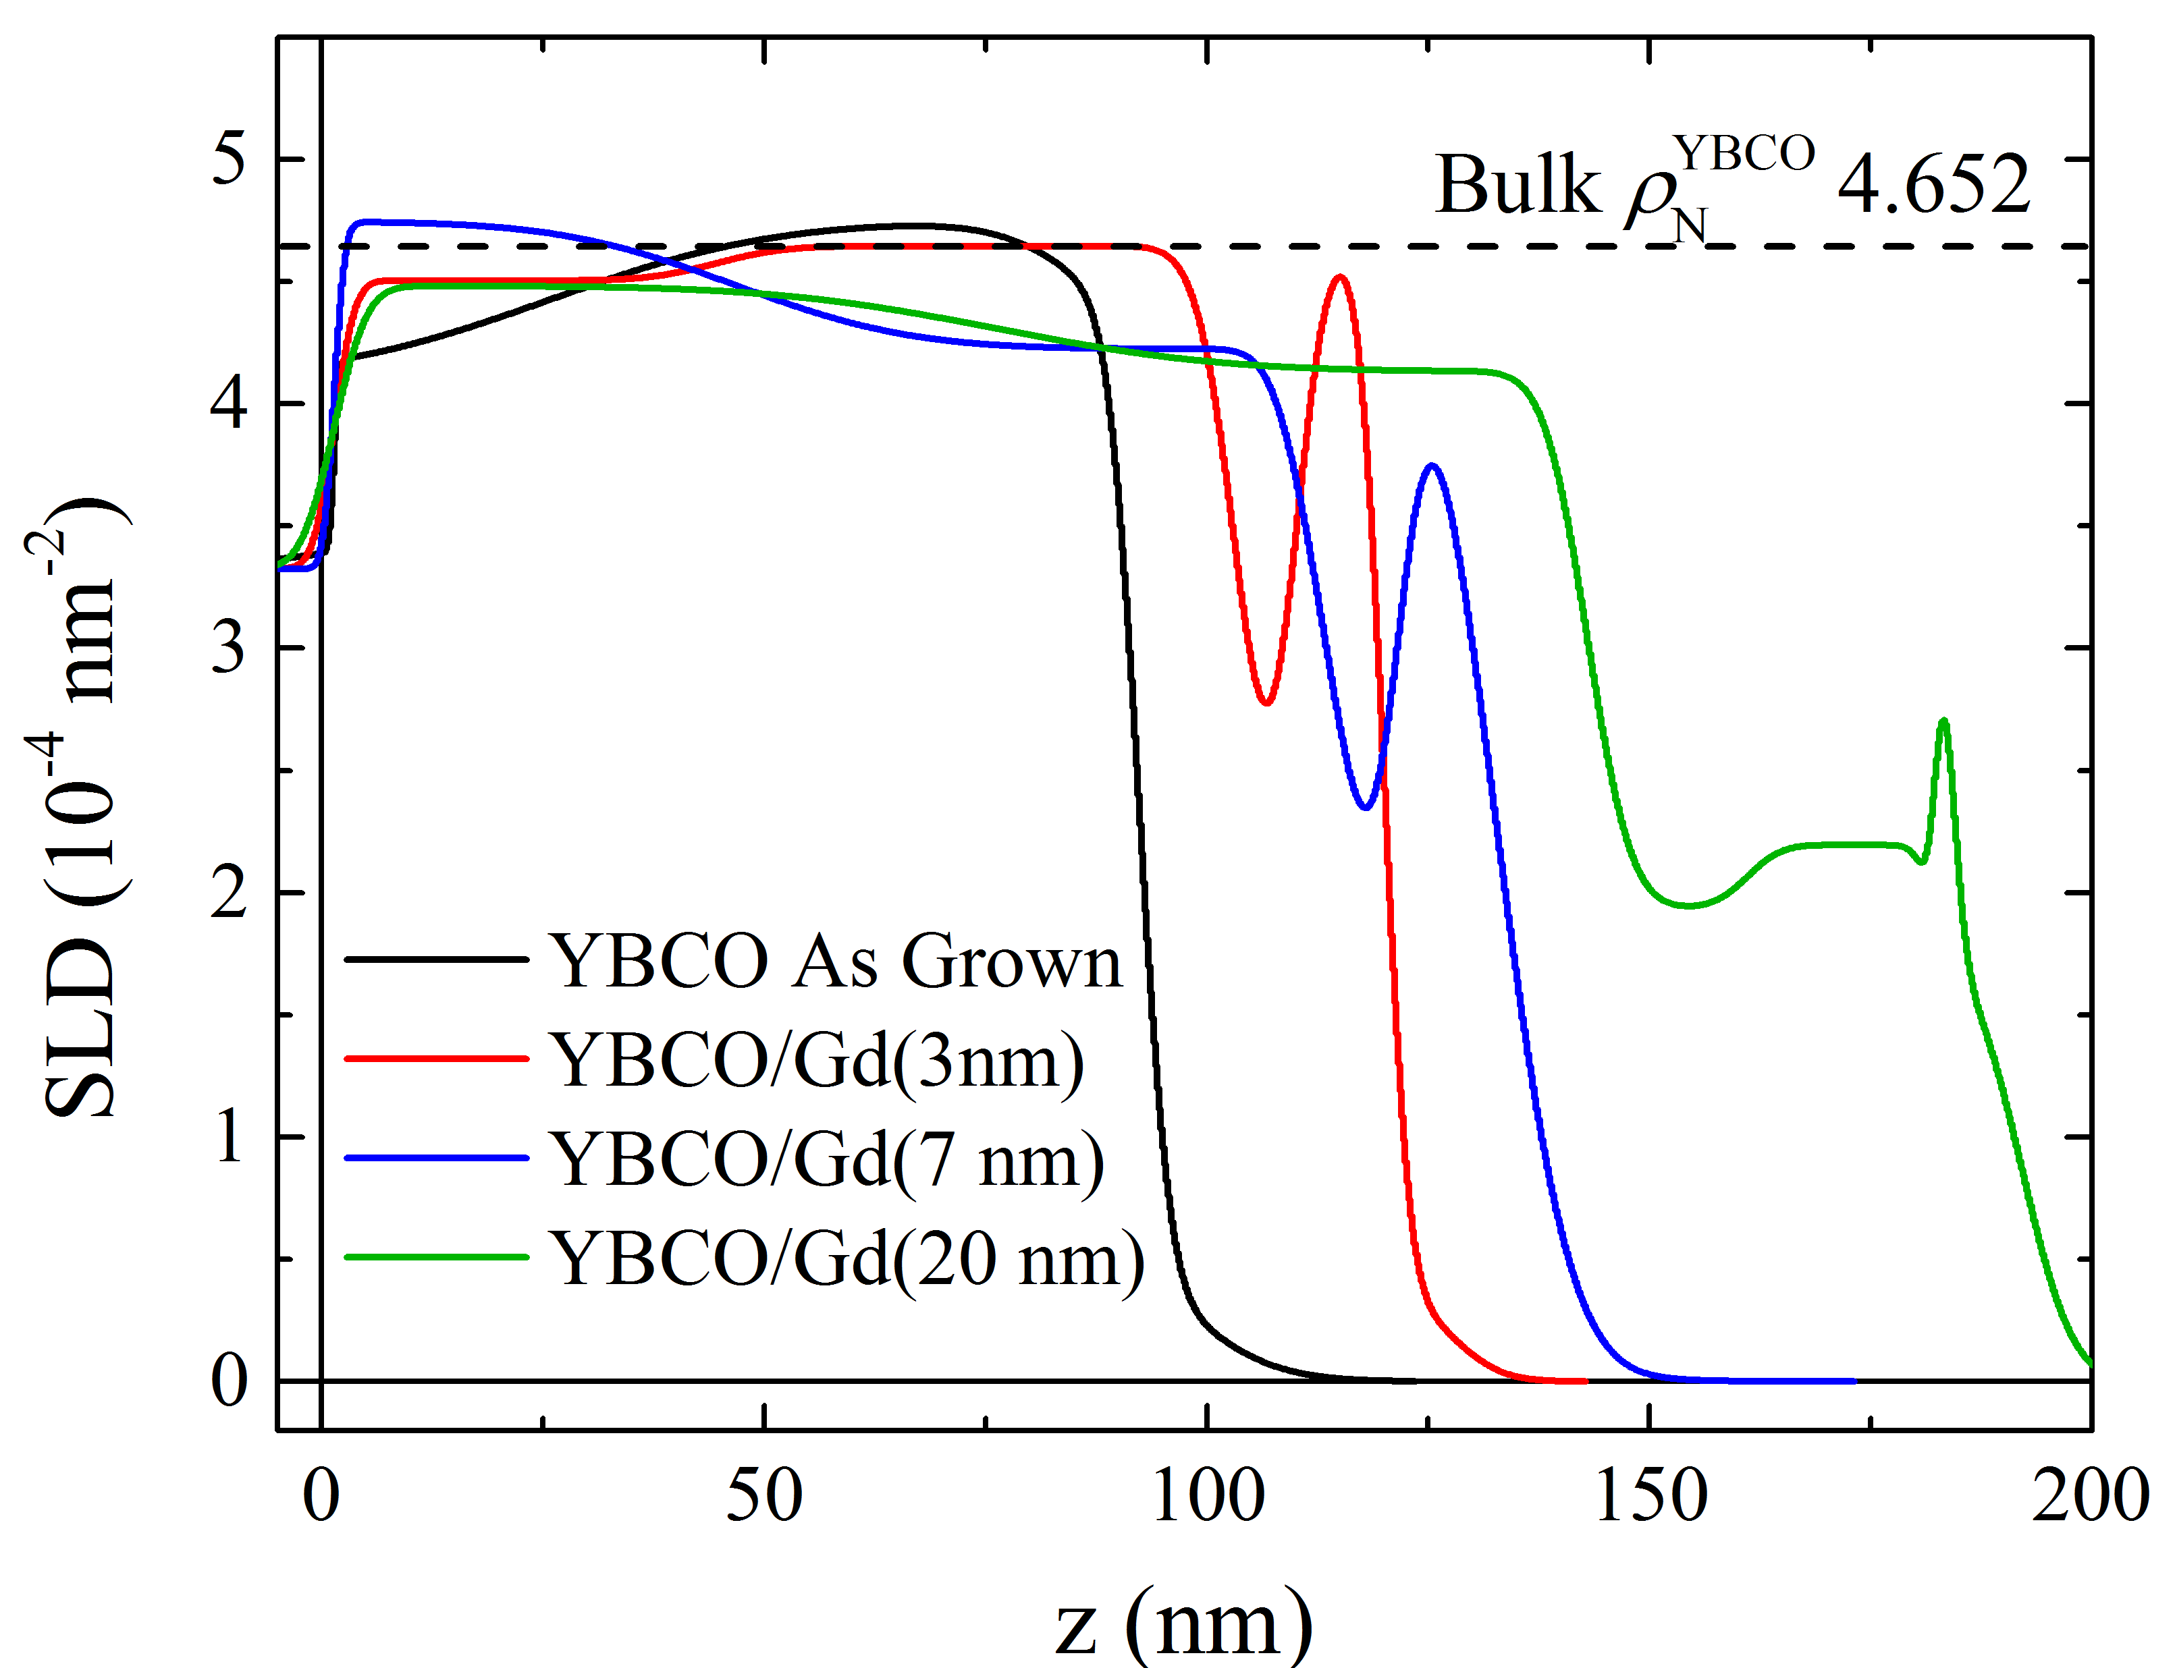

Slide 7
The story so far:
XAS shows that with increased Gd we develop an emergent Cu¹⁺ peak
There are stable, oxygen deficient phases of YBCO
YBa₂Cu₃O₇ has is a mixed valence (+2 and +3); YBa₂Cu₃O_{6.5} as Cu2+ valence; YBa₂Cu₃O₆ has a mixed (2+ and 1+)
Thus XAS implies we took out at-least 1 oxygen ion per unit cell (which is a lot)
XRD shows a shift in the peak initially, indicating simple lattice expansion. For YBCO/Gd(7nm and 20 nm) a new peak is emergent, indicating the likely formation of a new phase.

