Slide 1
GOAT Final Presentation
Peyton VanHook
Peyton White
Sean Hopkins

Slide 2
Introduction
GOAT
“Go On And Try”
Media Recommender
Movies
Books
Video Games
Purpose
Help users find media they may be interested in

Slide 3
Introduction - Recommendations
Multiple ways the user gets recommendations
Search
The user may search a media title and the GOAT will display similar media
Home Media
The user is shown multiple lists of media depending on their interests
Genre, keyword, etc.
Media Item
The user is given a descriptive view of the media
Also given a table of similar media like the Search
Given choice to add to save list or rate
Saving and rating will affect recommendations

Slide 4
Technology
Technology
Netbeans 12.0
JavaFX Maven
FXML SceneBuilder
Godaddy server
Mysql
PHPMyAdmin
CPanel file manager
Github

Slide 5
Software Demo

Slide 6
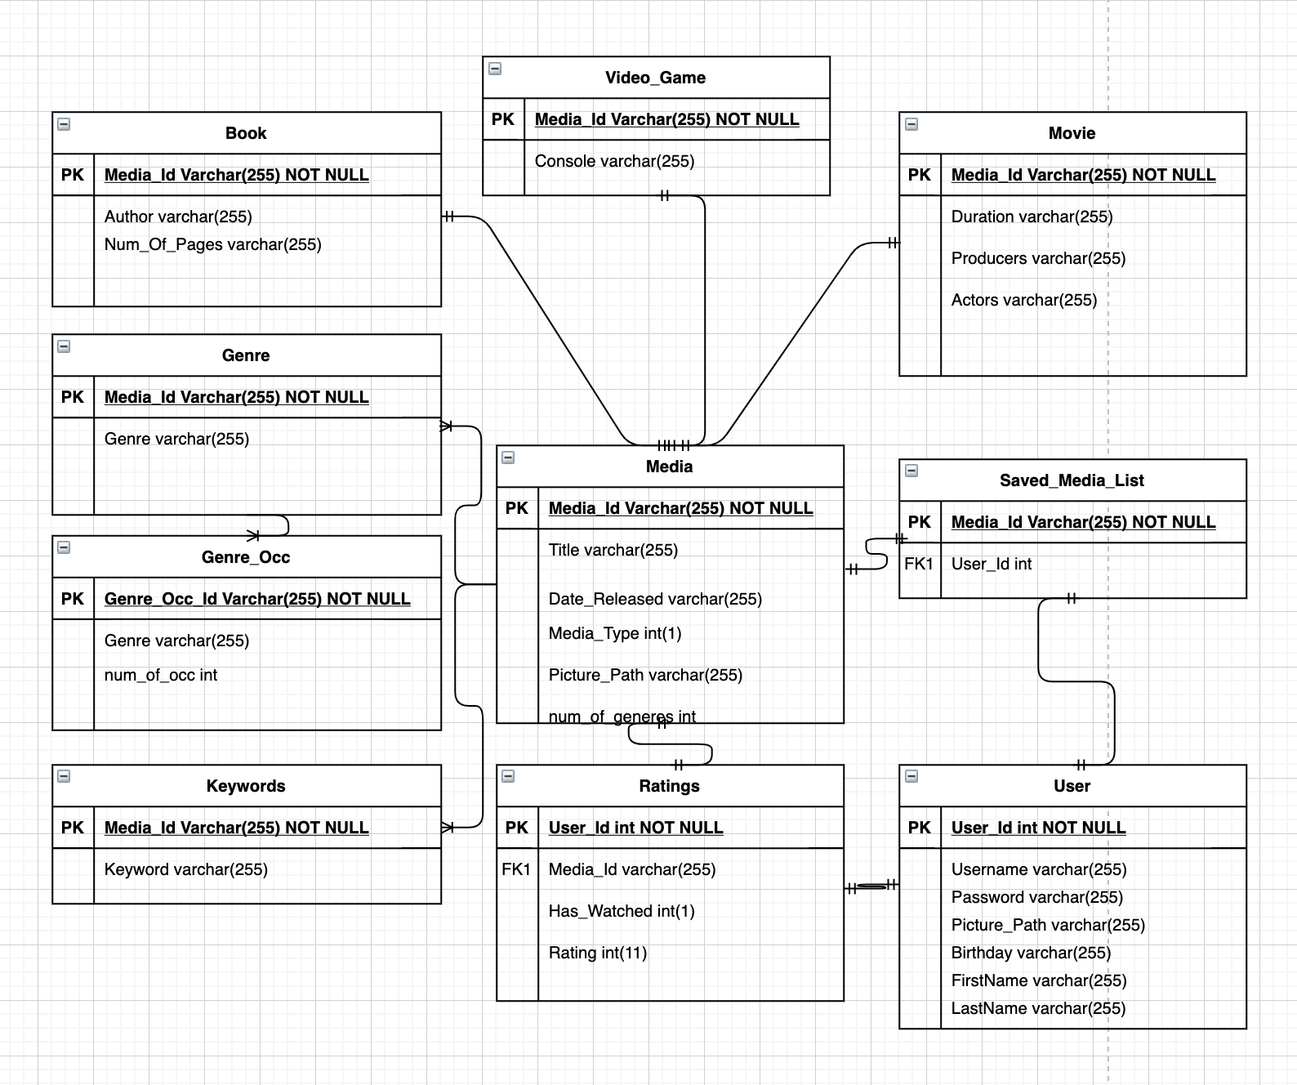
Design - Database

Slide 7
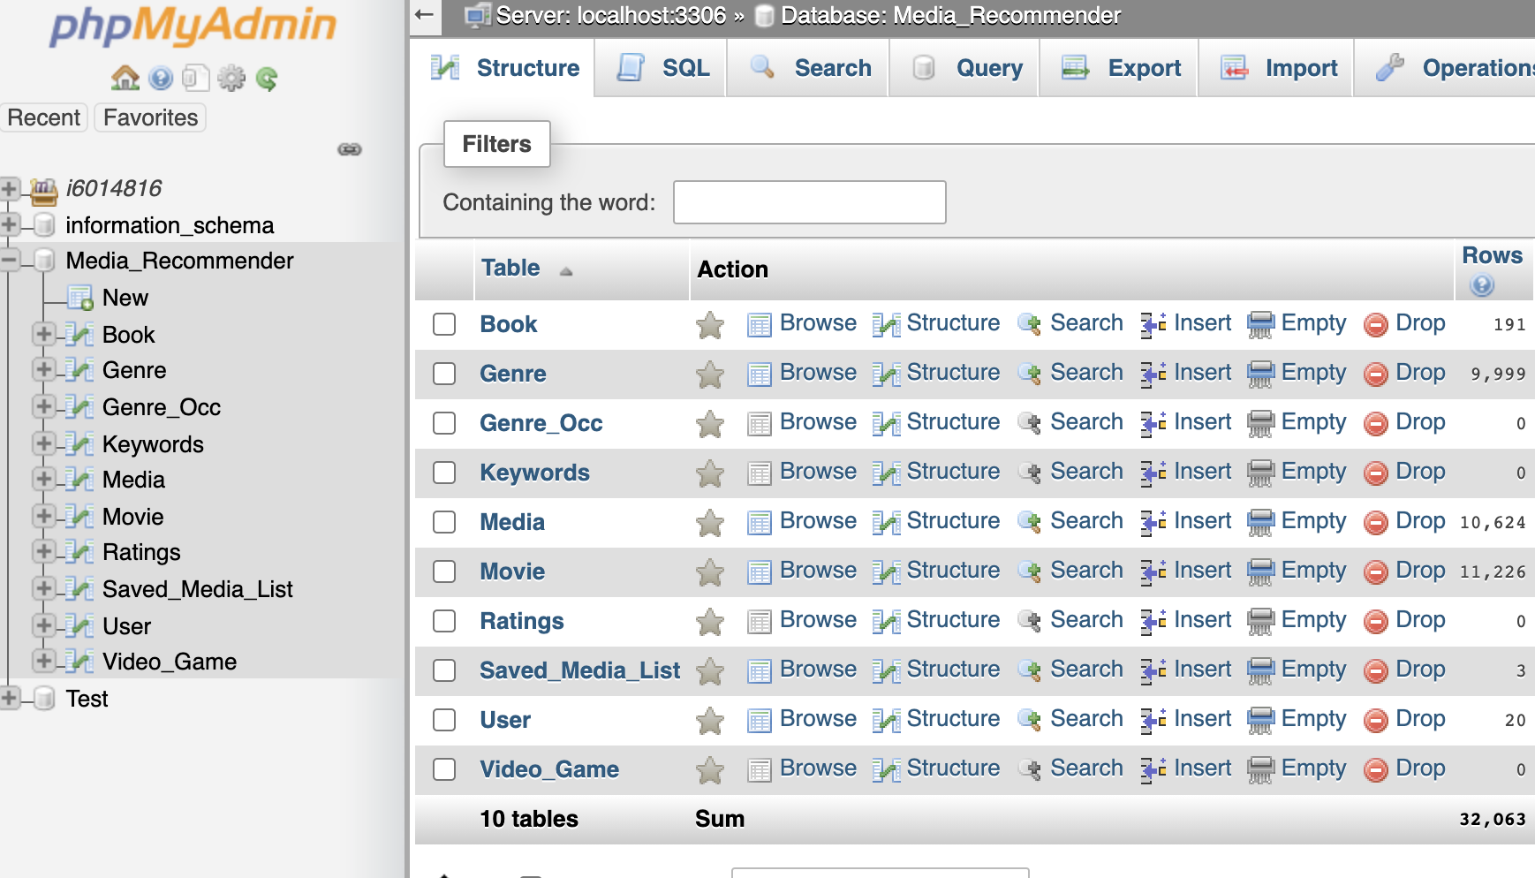
Design - Database

Slide 8
Design - PHP
What are they
All scripts are PHP files with SQL embedded
Purpose
Write to and from the database
Scripts
Have a URL
Do a specific thing
Get movies
Check login
Activated through post method
7 of them

Slide 9
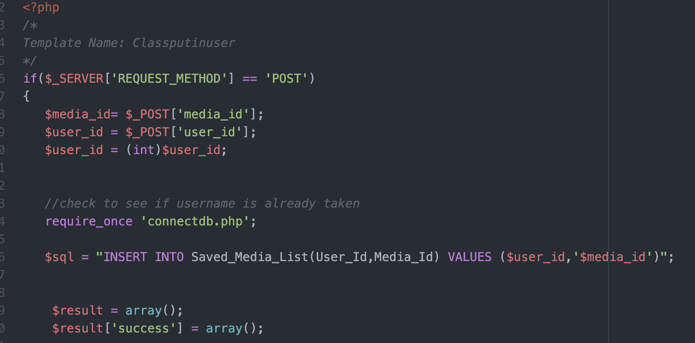
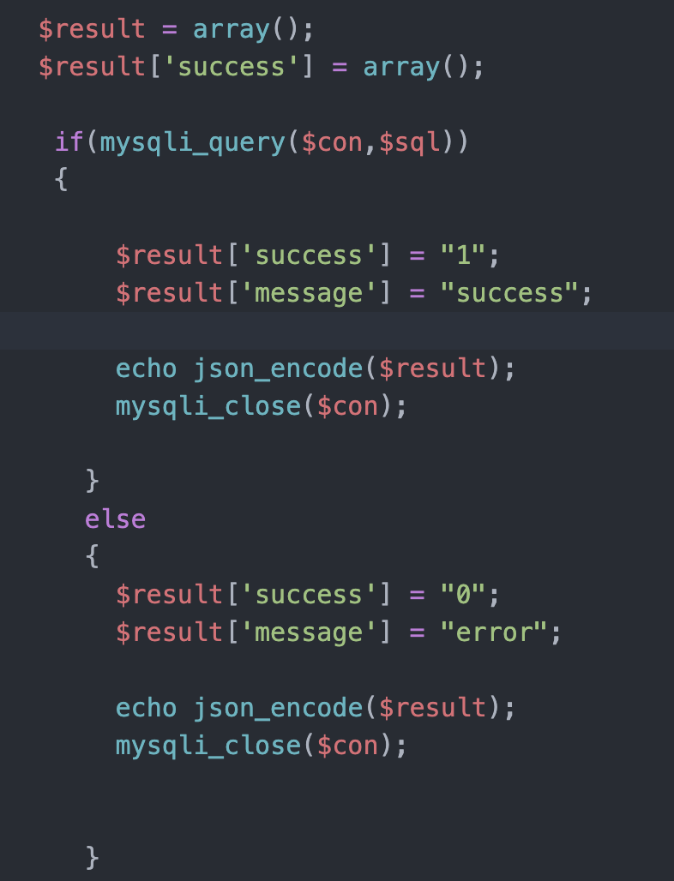
Design - PHP - saved_media.php

Slide 10
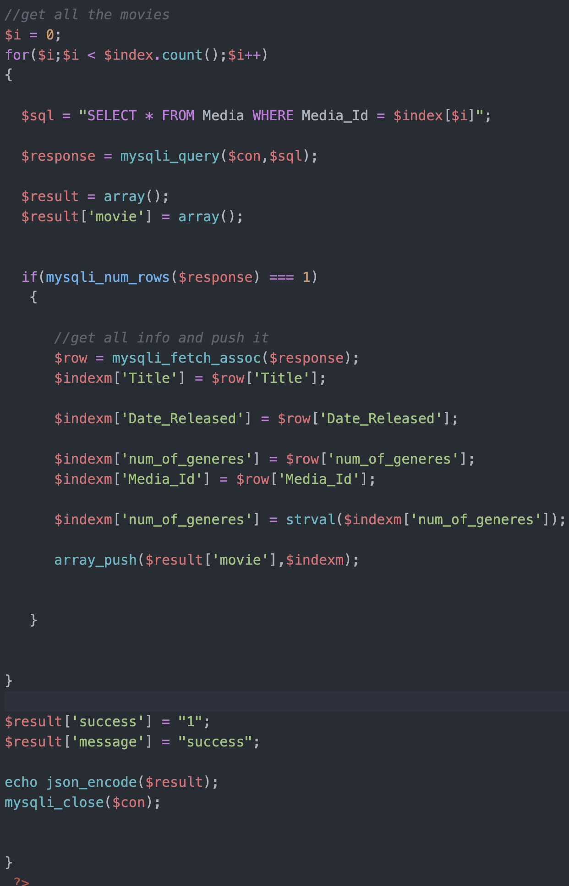
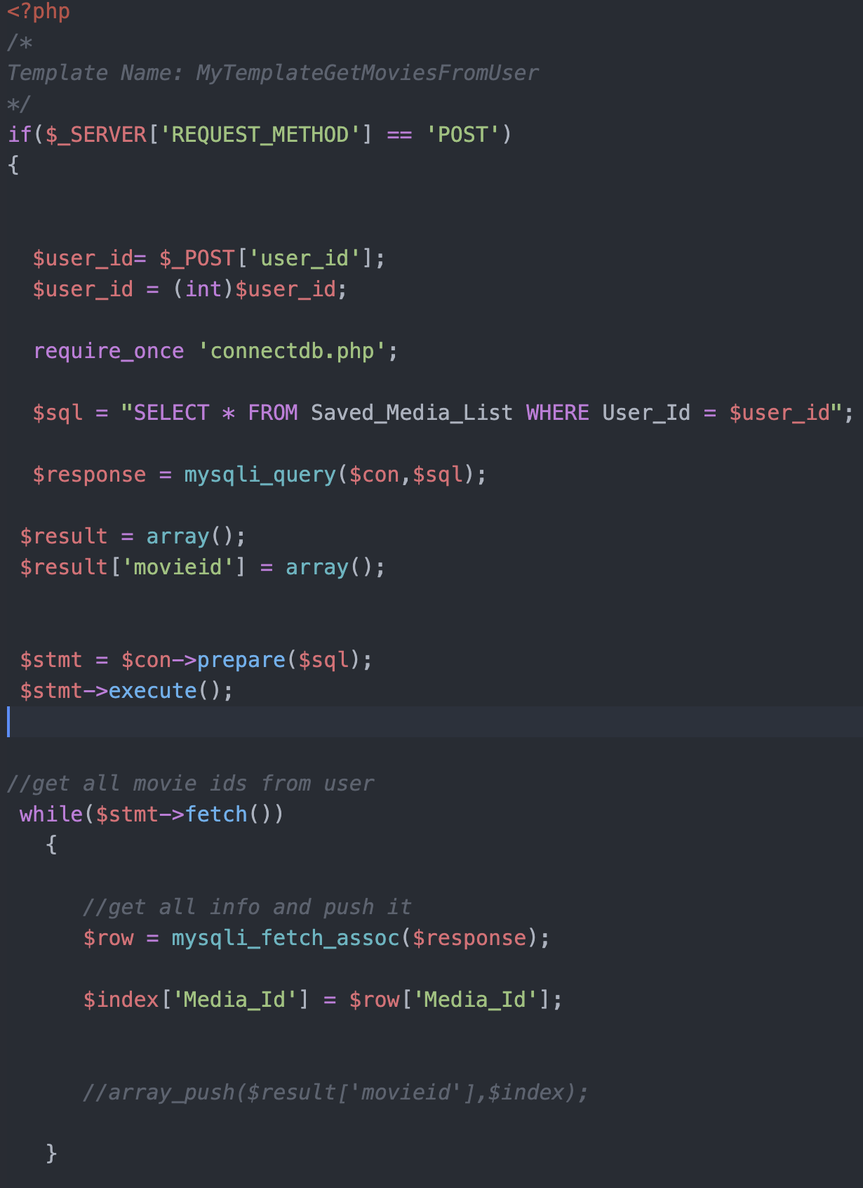
Design - PHP - saved_media.php

Slide 11
Data Merging
Sourcing data on fundamentally different kinds of media from different sources
PHP scripts read the data, parsed it, and combined it into our data schema.
5 Fundamental Components to the Parser:
Initializer
Scanner
Parser
Output
Deinitializer

Slide 12
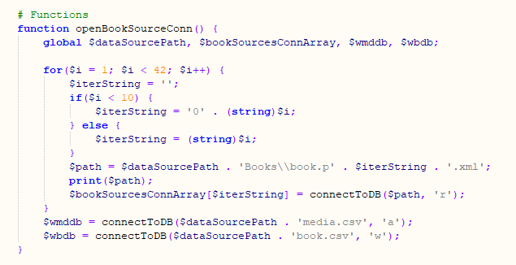
Data Merging: Initializer
Each data source script has an initializer function used to load the input and output file resources
Each is set up to be able to use multiple file sources, but only the books source actually does.

Slide 13
Data Merging: Scanner
Each data source has a scanner function that goes through each entry.
For the movie source, the scanner function also does the parsing, as minimal parsing is necessary.
The video game scanner leaves most of the parsing to an external function, but does check the returned data to make sure the entry is a game.
The book scanner has two functions, one to scan a single input file and another to run the individual scanner on each input files
The scanners all pass input data to the parser, merge the resulting data into the genre occurence array, and writes the parsed data to the output sheets.

Slide 14
Data Merging: Parser
For movie source data, no parsing is necessary beyond parsing the TSV data to an array.
For video games, some conversion is needed to copy data from JSON to PHP Array.
For books, significant parsing is necessary:
Utilizes simpleXML decoder.
Extracts information based on MARC21 data format.

Slide 15
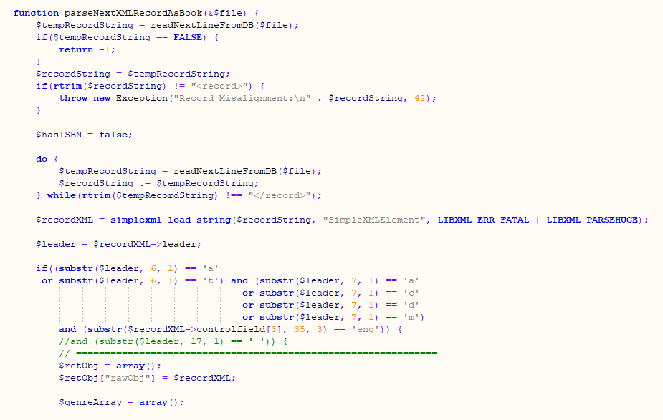
Data Merging: Book Parser

Slide 16
Data Merging: Output & Deinitializer
The output function is essentially the same for each data type, except where it varies to accommodate the unique data schema for each media-type specific data table.
The deinitializer function closes each file resource and sets the associated variable to NULL.

Slide 17
Bugs - The battle of lost data
How
Passing of windows
What
Mainly global variables
User data if bug not caught ‘
Main problem
Table views
Initialize function
Gets init before windows does
Can’t use global variables for functions
Solved
Using pop up windows instead of passing window

Slide 18
Bugs
Data merging performance issues
PHP timeout when running long import function moving exported CSV’s to webserver database.
Likely would be fixed if merging function itself was writing to the database, rather than using a middle function.

Slide 19
Future
Social features
Friends
Chat
Send Suggestions
Profile
Customizable profile
Photo
Background
Set media preferences
Recommendation Algorithm
Not finished due to lack of time
Finishing and Tuning is priority 1 for future work.

Slide 20
What we learned
Communication is key to a good team and building a great application .
Plan first - write later
It’s always important to scope the project down to a manageable size and, occasionally, cut out elements which are not strictly necessary.
Everything always takes longer than we think it will.

