Slide 1
G.O.A.T.
Project Requirements and Timeline

Slide 2
User Interface

Slide 3
User Profile
Login screen shown at startup
Registration Screen for new users
User profile screen includes:
User photo
Watch List
Watch History
Preferences Tester
Rating List

Slide 4
Home Screen
Main feature:
Search bar
To find recommended items based on media title.
Secondary features:
Saved List
Most Viewed Genres
Recommends media based on most watched genres.

Slide 5
Media Item Screen
Media title
Genre list
Media description
Ranking
1-5 stars
Cover photo
Keyword list
Recommended List
Similar to chosen media

Slide 6
Recommendation System

Slide 7
Recommendation System
Has two input functions:
ID - based
Takes a list of media ideas
Returns a different list of media IDs or similar value
Keyword - based
Takes a list of keywords
Returns a list of media IDs of similar value
Both will accept limit on number of results.

Slide 8
The Database

Slide 9
Database
User table
Media Table
Book Table
Movie Table
Video Game Table
Genre Table
Saved List Table
Rating Table
Keyword Table
Tables

Slide 10
Database, cont.
Build the Database
Update the Database Regularly
PHP Activations
Media Operations
Login & Registration

Slide 11
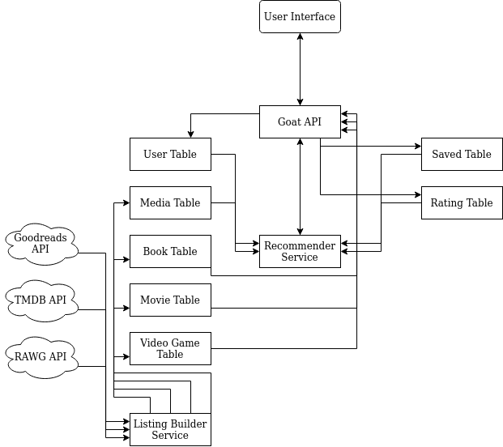
G.O.A.T. Design Overview

Slide 12
Timeline

Slide 13
Sept 13-19 | Database Building Decide Keyword and Genre Sets Organizing the Webserver Begin Login & Sign Up GUI
Sept 20-26 | Load converted dataset into database API Call research Finish Login & Sign Up and begin Profile Page Optimization on database calls
Sept 27-Oct 3 | Timed API requests for regular data updates Recommendation Algorithm Research Profile Lists GUI Building database calls for recommendation algorithm
Oct 4-10 | Implement Recommendation Algorithm Finish User Profile Screen Start building database API for front-end back-end communication.
Oct 11-17 | Build use-cases for Recommendation Algorithm like cold-case recommendation. Build API calls to facilitate info gathering for front-end Media Item Screen GUI

Slide 14
Oct 18-24 | Design loose-data scrapper to fill holes in initial dataset. Continue work on media item screen GUI
Oct 25-31 | Start processing through loose-data Determine need for graphical GUI elements to be designed, and begin designing those elements if necessary. Finishing media item screen and implementing API functions to GUI. Work on login security with PHP webserver.
Nov 1-7 | Continue processing on loose-data data sources. Start implementing any necessary GUI image elements. Finish media item screen and begin Home Screen GUI Finish PHP user security and continue work on server API.
Nov 8-14 | Implement search function on front-end and back-end. Continue work on data scrapping and GUI image design.
Nov 15-21 | Have fully completed database and all GUI image assets completed. Implement saved list and most viewed genres on the home screen. Make sure all API calls between server and GUI have been implemented.
Nov 22-28 | Final testing of application

