Slide 1



Java基础语法 ---- 鲁

Slide 2


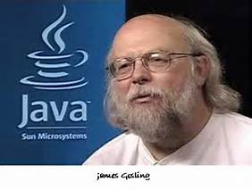
Java语言概述

Slide 3
JVM虚拟机及跨平台

Slide 4



Java流行的IDE

Slide 5
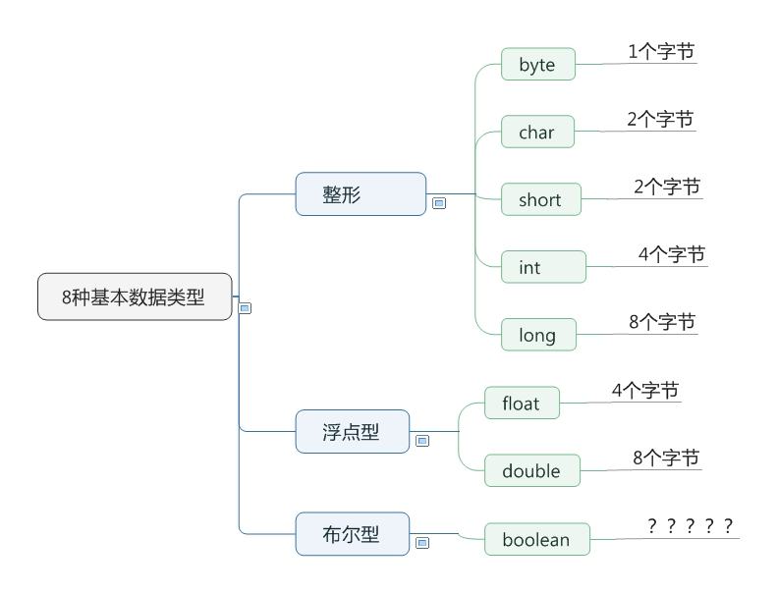
Java8种基本数据类型

Slide 6
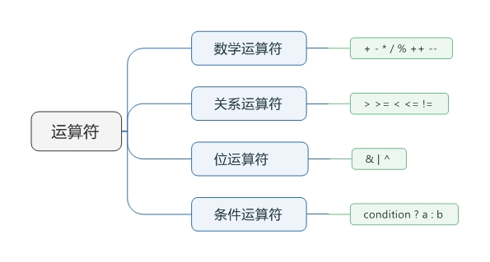
Java运算符
i++
++i
i = i + 1
三者有什么不同?

Slide 7
其他

Slide 8
回顾 & 实践
培训课程回顾
讨论
时间练习
知识点

Slide 9
后期巩固
Plan:
Environment setup
Implementation on 2 services
Delivery process training
Training and Knowledge transfer
Task assignment
Development guidance
Knowledge transfer
Task assignment
Development guidance
On-job Knowledge learning
Developing
Knowledge learning
Practice & Developing
Telephone
Email
Short –term return
Work together
Developed assets
Questions
Developed assets
Questions
Done List:
1. Setup the Dev environment;
2. Setup the Dev testing environment;
3. Working on initial assignment;

Slide 10
其他
Adapter
Bloomberg
Message Middleware
IBM MQ
Protocol
SWIFT
ActiveMQ
RabbitMQ
Hornetq
FIX
Data
SOAP/RPC
File
JMS
WCF
…
Calypso
IDFS
Broadridge
UULink
JSON
XML
Web Service
Message Routing
IBM Message Broker
Business Intelligence
jBMP
Service Composite
BEPL
Camel
Drools
EIP(camel)
Others
Security
Quartz
Cache
HA
Load Balance
…
BPNM
CEP
Synapse
Synapse
Notes:
The Society for Worldwide Interbank Financial Telecommunication (SWIFT) provides a network that enables financial institutions worldwide to send and receive information about financial transactions in a secure, standardized and reliable environment. SWIFT also sells software and services to financial institutions, much of it for use on the SWIFTNet Network, and ISO 9362. Business Identifier Codes (BICs) are popularly known as "SWIFT codes".
The Financial Information eXchange (FIX) protocol is an electronic communications protocol initiated in 1992 for international real-time exchange of information related to the securities transactions and markets. With trillions of dollars traded annually on the NASDAQ alone, financial service entities are investing heavily in optimizing electronic trading and employing direct market access (DMA) to increase their speed to financial markets. Managing the delivery of trading applications and keeping latency low increasingly requires an understanding of the FIX protocol.

Slide 11
提问环节

