Slide 1
Bike-sharing demand prediction using LSTM and attention-based LSTM
Pezhman lamei
Advanced Machine Learning
Fall 2022

Slide 2
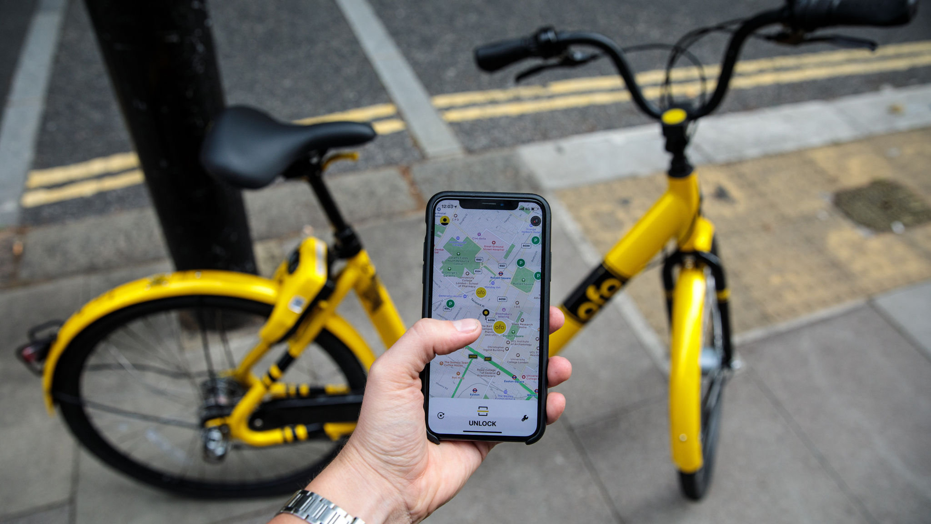
Bike-sharing
Since motor vehicles use is accounted for 40% of the greenhouse gas emissions in Europe and about 20% in the U.S., ride-sharing has been considered one of the main strategies for green behavior (Eren and Uz, 2020).
The global bike-sharing service market size was 1.5 billion U.S. dollars in 2018 (Choi and Choi, 2020).
An optimized bike-sharing system with optimal supply helps the whole city transportation system by linking bike-sharing users to it more efficiently (Yoon et al., 2012).

Slide 3

The problem
Many underlying factors—for example, time of the day, day of the week, events, weather, and correlation between stations — contribute to the demand for shared bikes.
Researchers have shown that the trip duration has significantly diminished compared to the past (Heydari et al., 2021).
Previous methodologies, including Autoregressive integrated moving average (ARIMA), RF, and other machine learning methods, have unsatisfactory results.

Slide 4
Literature review
Siami-Namini et al. (2018) concluded that LSTM model, which was trained on 70% of the data using MSE as loss function and ADAM as optimization functions improved the prediction performance by 85% compared to ARIMA model.
Using RNN, Pan et al. (2019) have found that this model outperforms the other deep learning approaches regarding RMSE.
Which one of the “LSTM” or “Attention-based model” is more efficient for bike-sharing demand prediction?

Slide 5
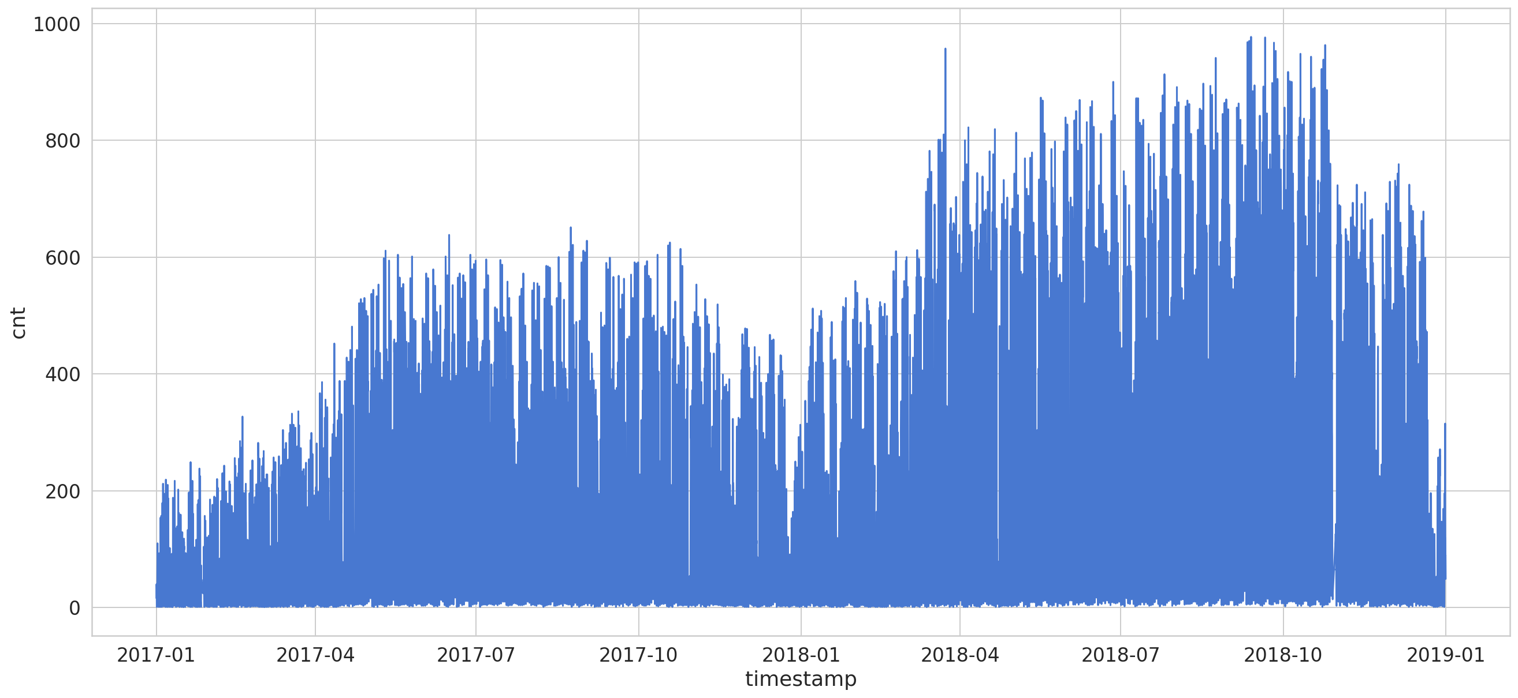
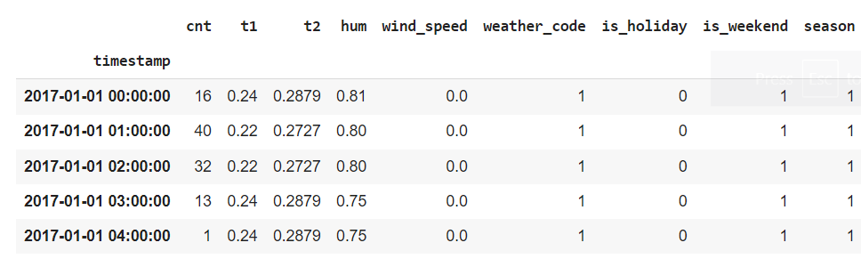
Data

Slide 6
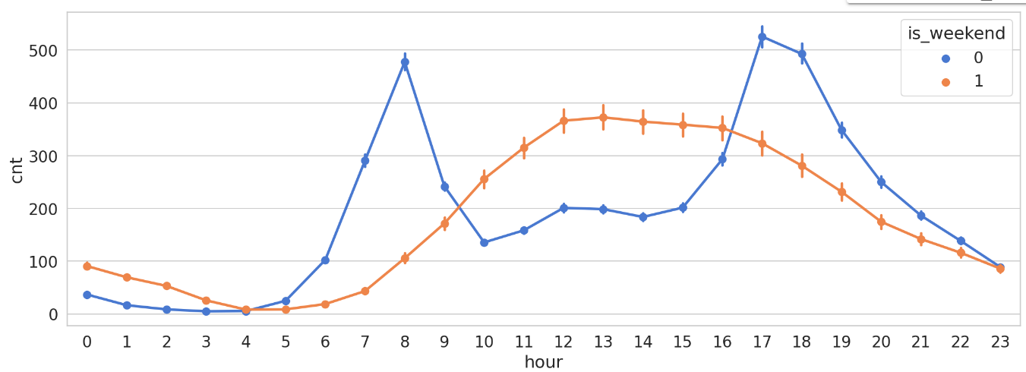
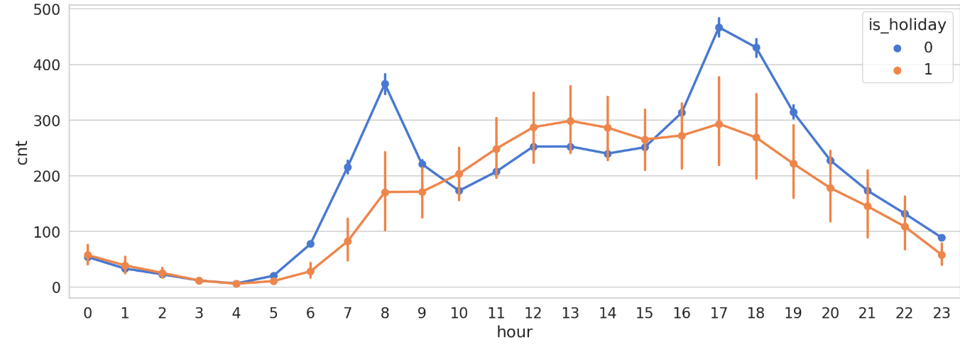
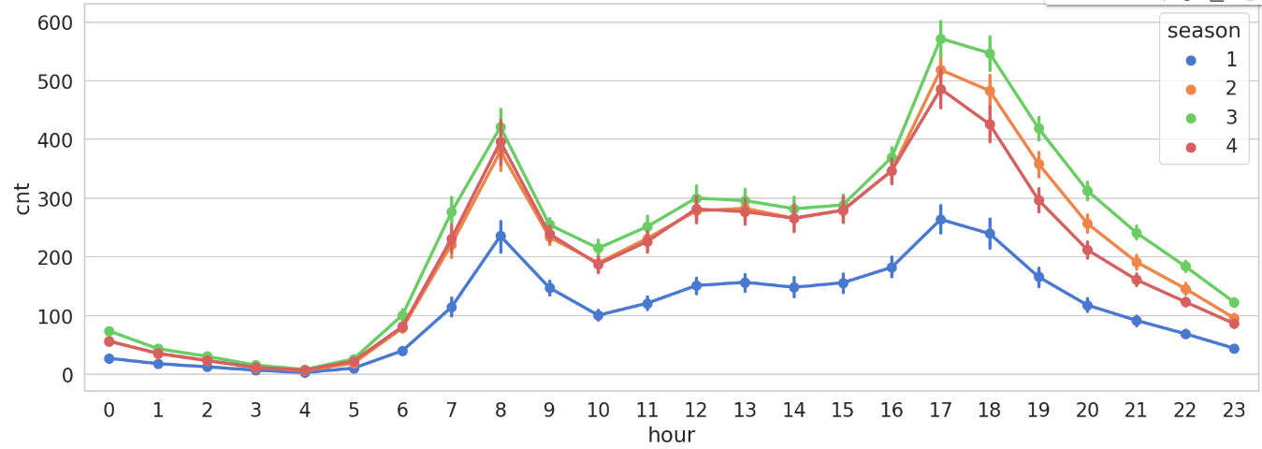
Affecting variables

Slide 7
Why LSTM model
The intrinsic recurrent networks suffer from weak memory, unable to take into account several elements of the past in predicting the future because of the vanishing gradient, which leads to numeric instability.
The training of a Recurrent Neural Network is hard to parallelize and is also computationally expensive.
LSTM bidirectional model helps the machine to earn which information is essential to keep or to forget, and add or remove.
Bidirectional takes input in forward and backward directions.

Slide 8
Adding attention network
Transformer Architectures
Seq2Se1 models: Encoder-Decoder model
Attention mechanism
The Encoder-Decoder model is the most common technique for problems where input sequences differ in length from output sequences.
Attention networks are an evolution of Encoder-decoder models. It assigns different importance to the different elements of the input sequence by different trainable weights and gives more attention to the more relevant inputs.

Slide 9
Attention-based model
model = Sequential([
LSTM(units=100,input_shape=(X_train.shape[1], X_train.shape[2]), return_sequences=True),
Dropout(0.2),
LSTM(units=100,return_sequences=True),
LSTM(units=50,return_sequences=True),
Dropout(0.2),
Attention(),
Dense(1, activation='linear')
])
model.compile(loss='mse', optimizer='adam')

Slide 10
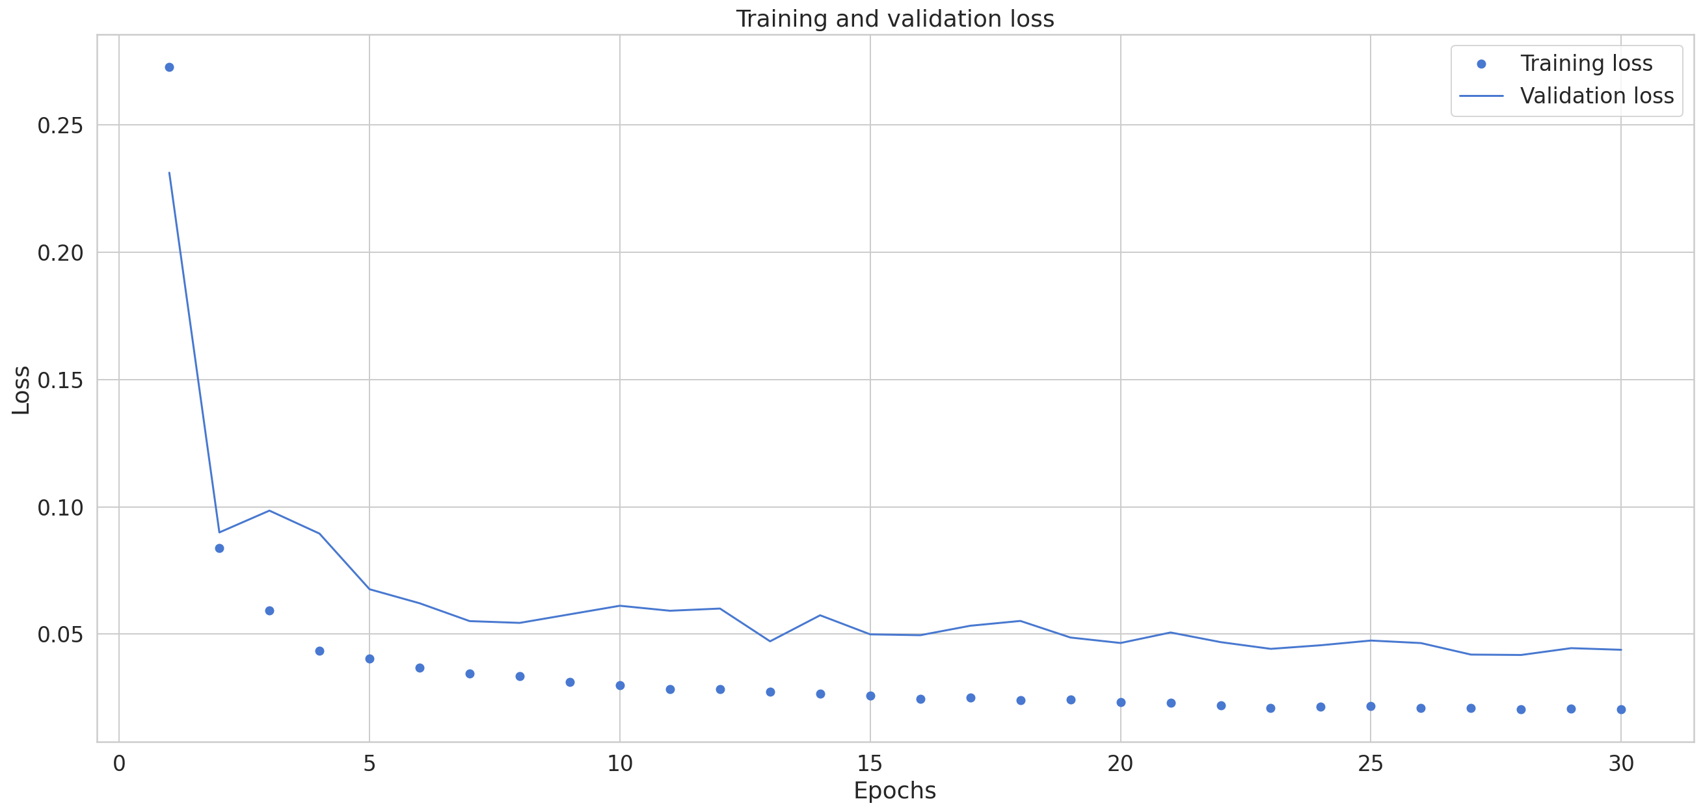
Results for LSTM
Train set MSE = 0.0606 Test set MSE = 0.041

Slide 11
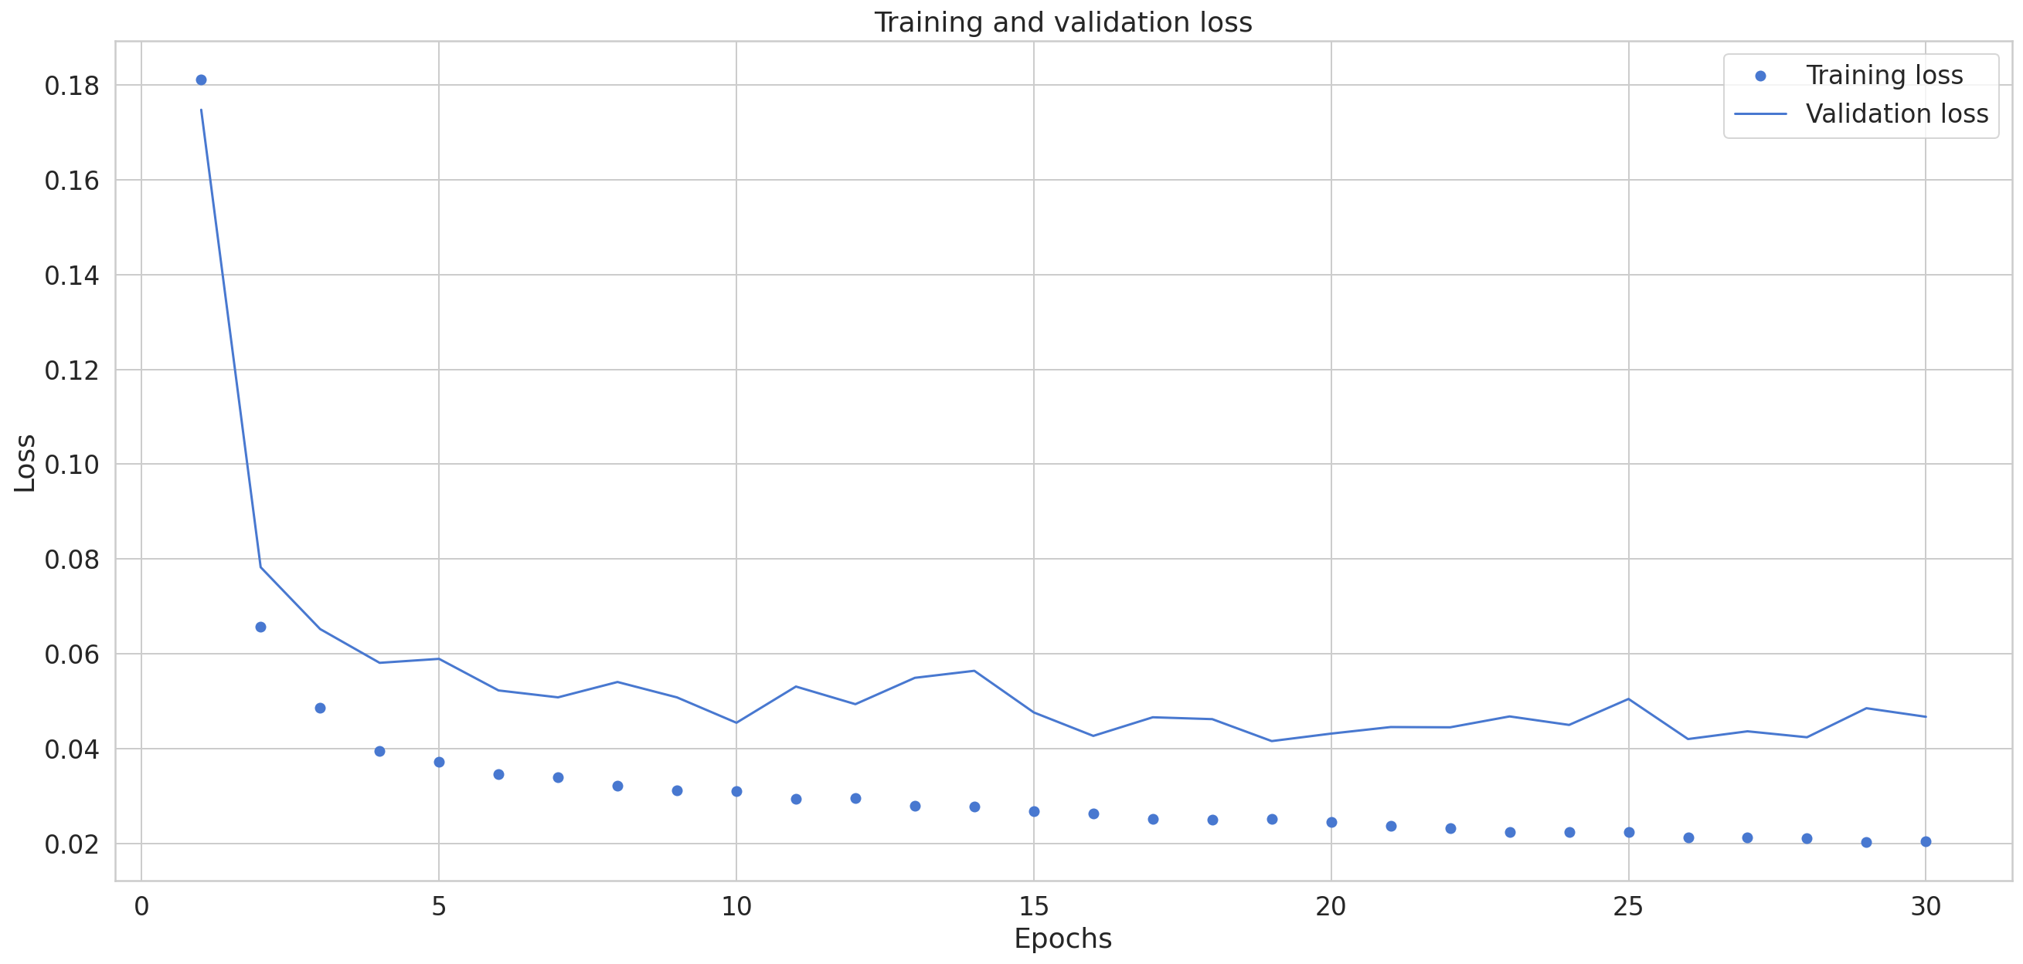
Results for Attention-based model
Train set MSE with attention = 0.05948
Test set MSE with attention = 0.036

Slide 12
Conclusion
Attention-based LSTM model outperforms the LSTM model.
Attention-based model with lower MSE and equal time for implementation is more efficient for bike-sharing demand forecasting.
Deciding to use which one of the time series forecasting models ( e.g., RNN, LSTM, Seq2Seq, Attention-based LSTM) depends on the complexity of the data structure.

Slide 13
Contribution
I added an attention network to an LSTM model to predict time series data. This is an improvement to the temperature forecasting model introduced in the textbook.
Reducing the ADAM learning rate to reach overfitted data.
Given the dynamic structure of demand, especially in bike-sharing and transportation behavior, this method would contribute to bike-sharing demand forecasting.

Slide 14


