Slide 1
Rakia-SingularityNET AI based semiconductor services
SingularityNET allows multiple AI computing agents to work as a whole to provide various services in a distributed and decentralized way.
For the first time, we have a financial substrate in the blockchain that lets us align diverse AI technologies and functions into a coherent financial and cognitive whole. The SingularityNET architecture incorporating block-chain smart-contracts and automatic payment will let diverse AIs integrate together into a single dynamic intelligence. AI agents incorporating the OpenCog AGI framework, Google Tensorflow and other powerful tools, interacting within the SingularityNET; will bootstrap the research and development of an AGI economy.

Slide 2
Singularitynet Architecture
The whitepaper provides a detailed vision for SingularityNET’s infrastructure.
The first layer is an open JSON/RPC protocol and its reference implementation for interoperability of the services. Second, a shared and extensible ontology for services description so transaction details can be negotiated between parties. Third, a reputation system to track the quality of services and incentivize better quality.
Finally, there will be financial layer for micro-payment transactions based on distributed ledger technology, so the parties can monetize high quality AI services in a frictionless manner.

Slide 3
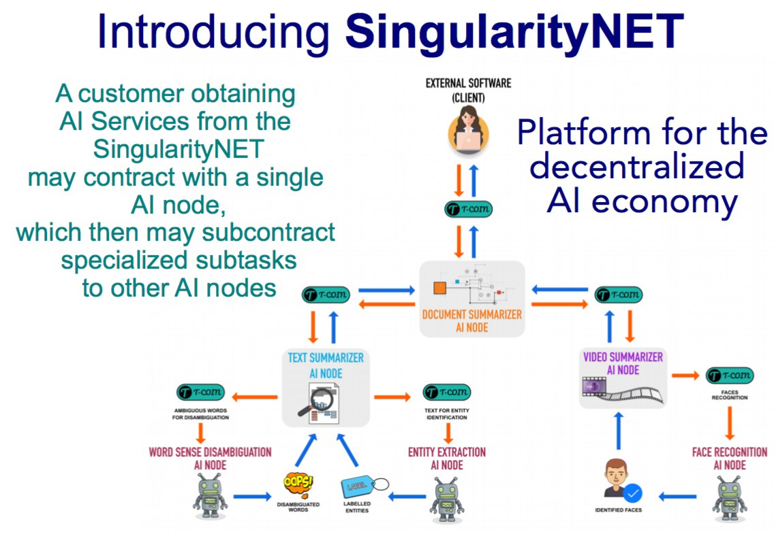

Slide 4
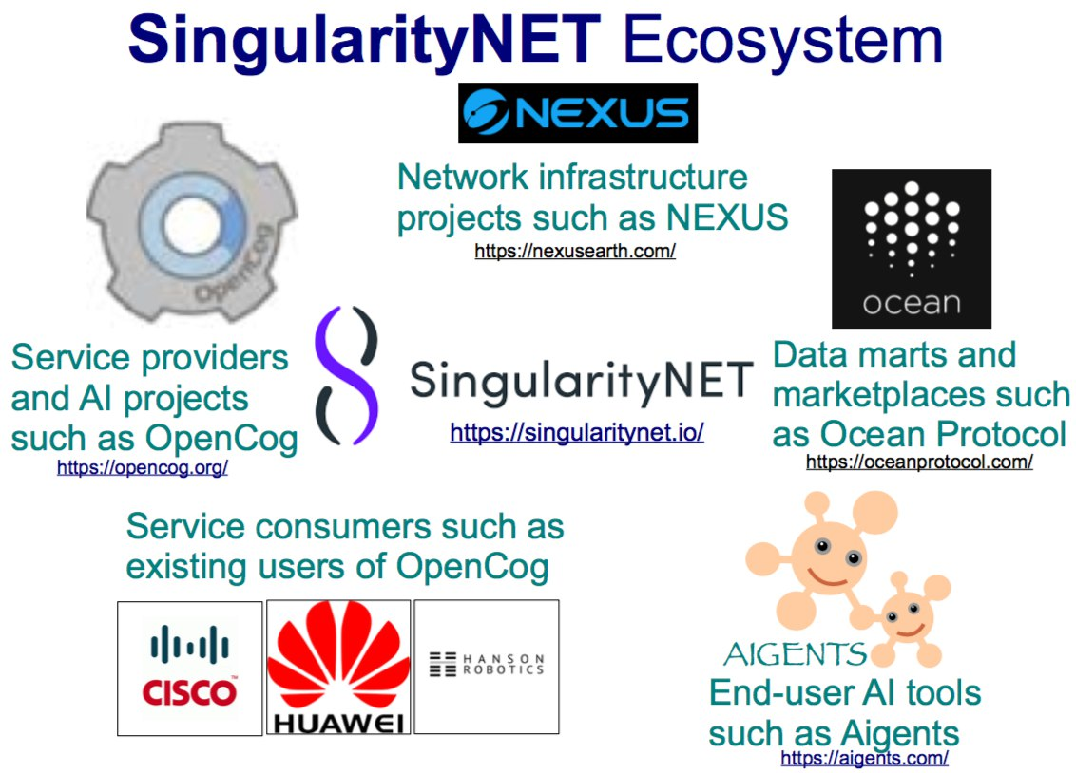

Slide 5
SingularityNET Ecosystem
AI emergence requires richness of environment. The importance of a rich environment is well-documented in developmental psychology. It is also known that many of the latest advances in machine learning are due to the huge volumes of diverse data collected for training.
To address this, SingularityNET has established several key partnerships with blockchain projects working towards creating open economies.
For example, our exclusive collaboration with Ocean Protocol will provide SingularityNET users access to decentralized data exchanges to train agents for any AI or ML application. We are also one of the earliest partners of the Nexus project, which is introducing a new generation of decentralized multi-layer Internet protocol.

Slide 6
Getting Started
These instructions will get you a copy of the project up and running on your local machine for development and testing purposes. See deployment for notes on how to deploy the project on a live system.
The agent server is responsible for communicating with AI Adapters which connect to individual AI systems and the rest of the network. You can run an Agent connected to the SingularityNET network as a server that runs stand-alone or as one that forwards requests for work to other servers running specialized AI services.

Slide 7
Prerequisites
SingularityNET runs on Mac OS X, or any Linux which has Python 3 installed and Docker or Docker for Mac installed. For Windows you'll also need Git Bash/MinGW or Ubuntu on Windows 10 WSL.
The core devs regularly develop on Mac OS X Sierra, Linux Mint Mate 18.2, and Linux Ubuntu 16.04 LTS among others.
Docker and Docker Compose are used heavily, so you must have a recent version of Docker installed to take advantage of most of the automation and to isolate yourself from the dependency hell which often results from installing software with complex dependencies directly onto your host development OS.
The current development demo runs from a dev docker container which can be launched from your favorite bash terminal using our helper tool shell script: tools.sh. ./tools.sh dev. This will bring up a set of docker containers and expose port 8000 to the local host machine. Visit the demo via: http://localhost:8000 in a modern browser.
Notes on running on Ubuntu under Windows Subsystem for Linux (WSL, Bash on Windows, etc) The trick to this is to install docker on Windows, then ensure the docker is in your path. In Ubuntu: Validate the docker path and add it to your ~/.bashrc file.
PATH="$PATH:/mnt/c/Program\ Files/Docker/Docker/resources/bin"

Slide 8
Adapter Examples
There are two kinds of Service Adapter examples in the project: real AI integration and template examples designed to teach concepts.
The directory singnet/agent/adapters contains working AI adapters that connect with AI services from OpenCog, TensorFlow, and Aigents, among others... Some knowledge of the underlying AI architectures and systems will be necessary to understand the code in these Service Adapters.
The directory singnet/agent/examples contains examples that are designed to show how to do something without necessarily implementing real AI so you can understand the mechanics without needing to understnd any particular AI sytems.

Slide 9
Running Tests
Tests are handled by PyTest via Tox, but we've made it very easy for you.
Just run: ./tools.sh agent-test

Slide 10
SingularityNET API
NetworkABC
The base class for block-chain networks. NetworkABC defines the protocol for managing the interactions of Agents, Ontology, ServiceDescriptors, as well as Agent discovery, and negotiation. Each block-chain implementation will require a separate NetworkABC subclass which implements the smart-contracts and communication protocols required to implement the Network ABC API.
NetworkABC subclasses must implement:
. join_network - creates a new agent on the block chain
leave_network - removes agent from the block chain
logon_network - opens a connection for an agent
logoff_network - closes the connection for an agent
get_network_status - get the agents status on the network
update_ontology - queries the block-chain and updates the ontology to current version
advertise_service - registers an agent's service offerings on the blockchain
remove_service_advertisement - removes an agents service offerings from the blockchain
find_service_providers - returns a list of external service provider agents

Slide 11
SingularityNET API
ServiceAdapterABC
This is the base class for all Service Adapters. Services can be AI services or other services of use by the network like file storage, backup, etc.
ServiceAdapterABC subclasses must implement:
perform - perform the service defined by the JobDescriptor
Additionally, ServiceAdapterABC subclasses may also implement:
init - perform service one-time initialization
start - connect with external network providers required to perform service
stop - disconnect in preparation for taking the service offline
can_perform - override to implement service specific logic
all_required_agents_can_perform - check if dependent agents can perform sub-services

Slide 12
