Slide 1
Space Simulator
Evan Cummings and Josh Bartz

Slide 2
Description
For our project idea, we would like to develop a 3D rendered engine via Python's interface to OpenGL. As it stands, we have a 3D particle simulation and an efficient way to calculate forces between particles and such. From this simulation, we would first like to create a space simulator complete with gravity between planets and other space bodies and thrusters on the spacecraft which create rotational and directional momentum. With the addition of a rear engine and front braking thrusters, this would effectively simulate a real space craft.

Slide 3
Usability Requirements
Game should be easily executable from a PC created within the last decade. To accomplish this, we have chosen to develop in Python.
For maximized performance (if many objects are desired), an NVIDIA graphics card is recommended (CUDA compatibility).

Slide 4
Functional Requirements – High Priority
Navigate easily between menus and the game screen
Configure the controls
Rotate the spacecraft 360 degrees
Change the speed of the spacecraft in all directions
Control the craft with a mouse and keyboard

Slide 5
Functional Requirements – Medium Priority
Avoid the gravitational pull of planets and asteroids
Control the craft with a joystick
Fly through a nebula and see color changes related to velocity
Have a map and a way to navigate
Know their distance from their selected destination

Slide 6
Functional Requirements – Low Priority
Dodge space debris
See on-screen vectors for moving objects
Fly through rings that guide the ship into orbit of a planet
Scale the game's complexity to increase the framerate of the game
Choose from several different spaceships with different attributes

Slide 7
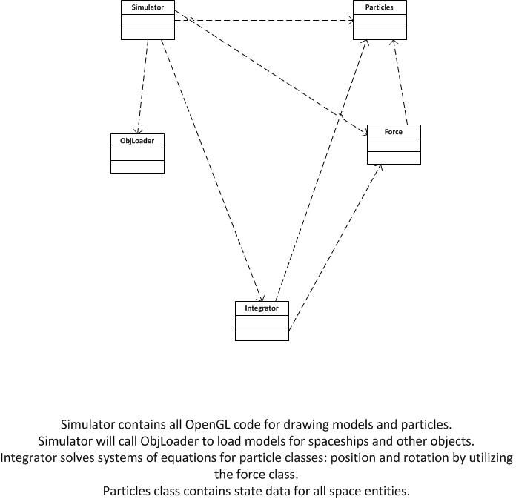
“UML”

Slide 8
Completed Goals
Finalized control scheme with basic movement
First playable game with physics and ability to move
Data structures for matrix calculations finalized

Slide 9
Timeline
CUDA implemented (no set date)
Basic playing field (a sun and a planet) - April 7
Graphical objects such as planets, asteroids, etc… - April 15
Planetary physics and interaction with objects (orbits, gravity, etc…) - May 1

Slide 10
Tools
Language: Python
Graphics: PyOpenGL (Python wrapper for OpenGL)
Graphics and controls: PyGame (Python wrapper for SDL)
Text Editors: VIM and Emacs
Model creation and editing: Blender
CUDA

Slide 11
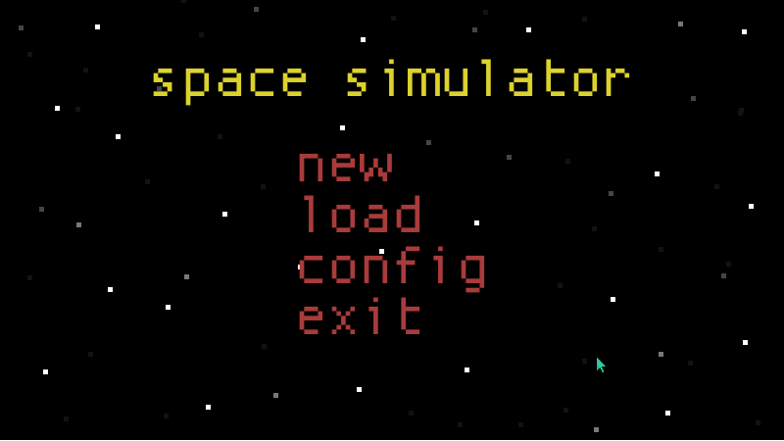
Start Menu

Slide 12
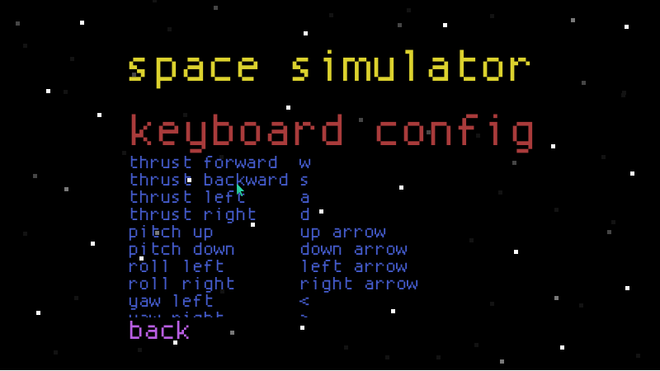
Config Controls

Slide 13
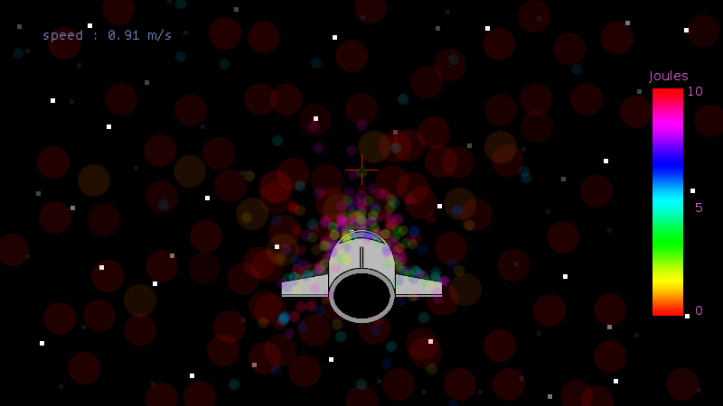
Nebula

Slide 14
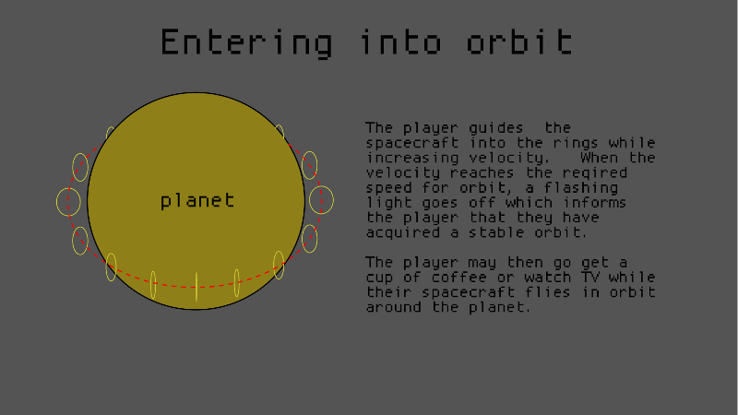
Entering Orbit

