Slide 1
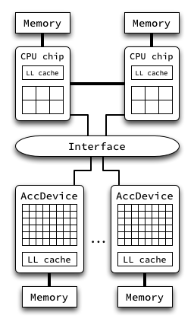
Heterogeneous Platforms
One or more interconnected computing nodes, allowing different CPU chips to work together.
Accelerator devices inside the computing nodes, working side by side with the CPU chip(s).
Distributed Memory architectures: data has to be explicitly transferred between distinct memory spaces.
 | 2006 | 2007 | 2008 | 2009 | 2010 | 2011 | 2012
Intel | Core up to 4 cores |  | Nehalem up to 10 cores |  |  | Sandy Bridge up to 8 cores
 |  |  | Larrabee (terminated in 2010) |  | Knights Ferry up to 50 cores | Knights Corner up to 60 cores
NVIDIA | G80 up to 128 GPU cores |  | GT200 up to 240 GPU cores | Fermi up to 512 GPU cores |  |  | Kepler GK110 up to 2,688 GPU cores
Example of a computing node architecture.
Experimental Setup
Linux CentOS 6.2 single node computer with:
Dual 8-core Intel Xeon (E5-2650, 2.00 GHz);
hardware support up to 32 simultaneous threads (with Intel HT);
64 GB shared RAM, NUMA (1333 MHz)
Intel C++ Compiler 12.0.0
Intel Math Kernel Library 11.0
Armadillo C++ Linear Algebra library 3.800.2
Methodology
Functional validation:
for small input data sets results were compared to Nag outputs;
for larger matrices, the relative error was monitored taking into account the condition of the problem;
Dimension of matrices: different large sizes; only the smaller fits the CPU LL cache; sizes range from 2000x2000 to 8192x8192;
Best size of blocks: experimentally tuned, 64x64;
Time measurements: the K best values, K=3, tolerance < 5%, minimum 10 runs, maximum 20 runs;

