Slide 1
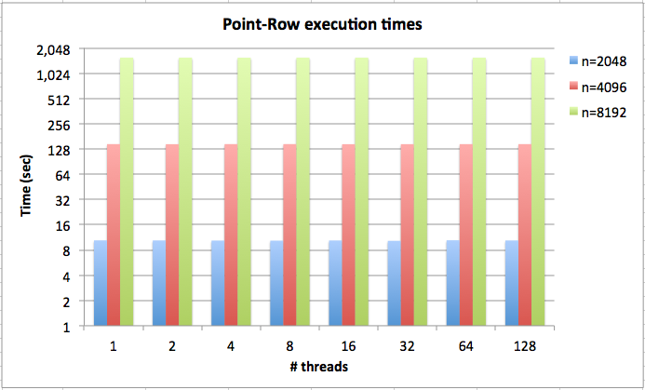
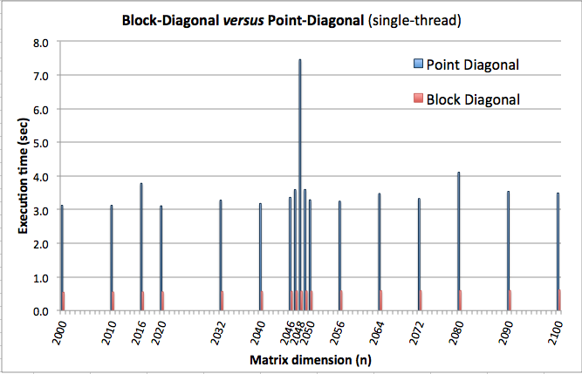
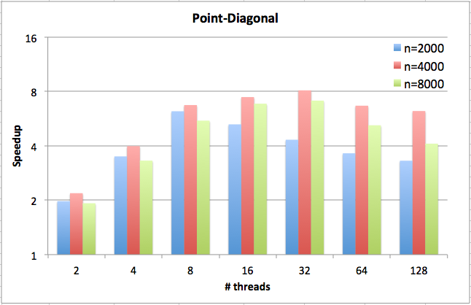
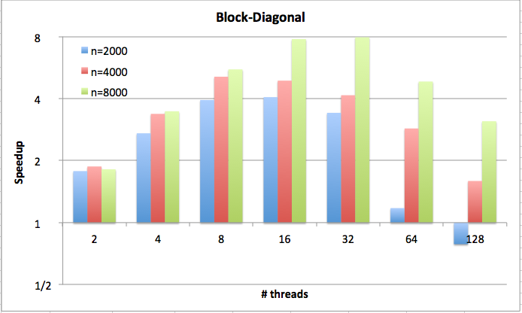
Performance Measurements
1. Point-row/column not suitable for multicore.
3. Block-diagonal faster and less sensitive to minor variations in matrix dimensions.
2. Single-threaded performance of point-diagonal similar to point-row, BUT point-diagonal scales well.
4. The block method also scales well.

Slide 2
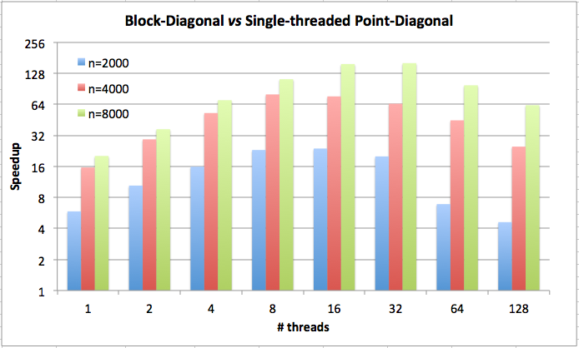
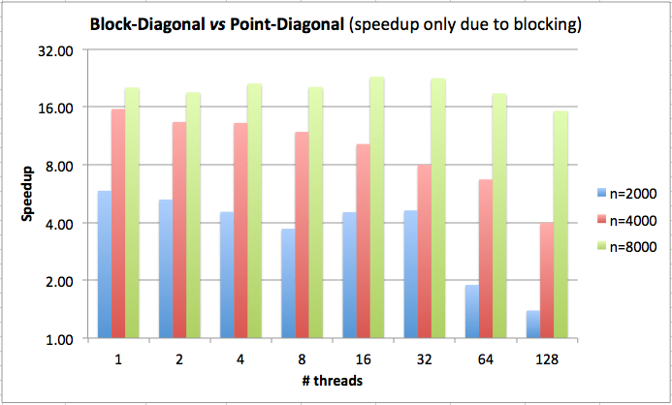
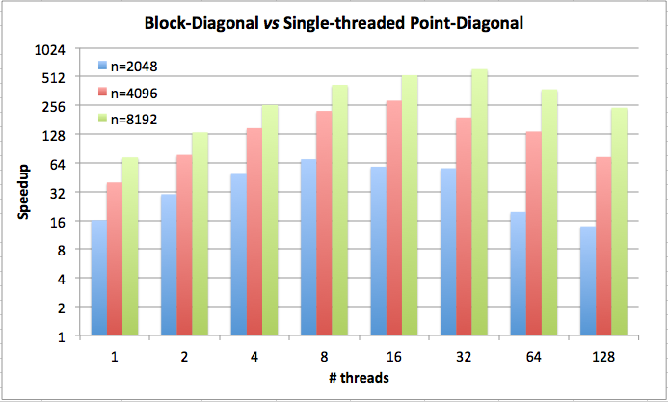
6. Blocking approach displays considerably speedup versus single-thread point-diagonal.
5. The multithreaded performance of the block method also considerably improved.
Note: These speed-ups are even higher for particular matrix sizes!
Next Steps
To build and evaluate Intel MIC and CUDA/GPU versions (Fermi and Kepler) to explore available parallelism in a single computing node.
To extend the methodology to the computation of p^{th}-roots of matrices, for large p.

