Slide 1
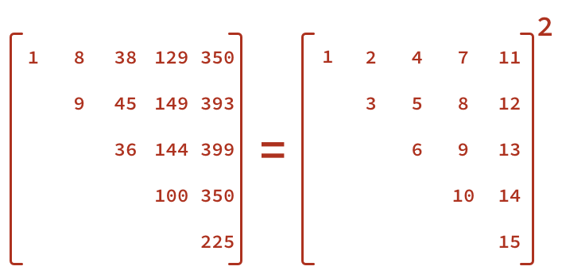
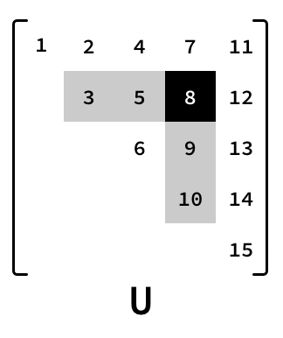
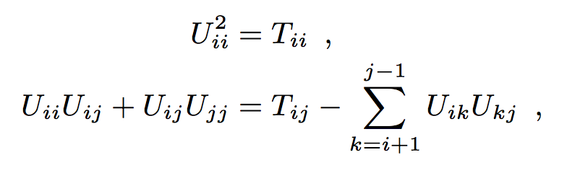
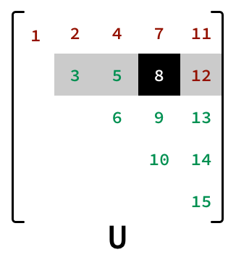
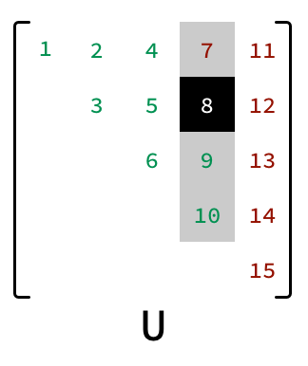
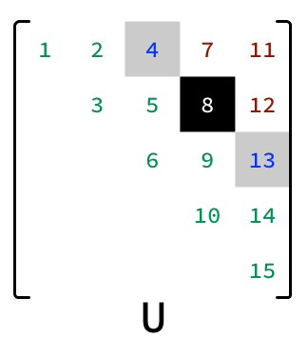

The problem to be solved: U=T^{1/2}
U is the principal square root ^{[1]}
T already upper triangular ^{[2]}
Parlett’s recurrence
U_{ij} can be a point (scalar) or a block ^{[3]}
U_{ij} dependencies: left and below
Possible approaches:
A super-diagonal at a time, towards top-right corner, no dependencies in a diagonal
A column at a time, left-right, bottom-up in a column
A row at a time, bottom-up, left-right in a row
being computed
U_{ij} point/block already computed | U_{ij} point/block not ready to be computed yet | U_{ij} point/block can be computed in parallel

