Slide 1
A
B
C
D
D
E
F
G
0
0
0
0
0
0
0
0
Privet
0
1
0
1
0
1
0
0
No Privet
1
0
0
1
1
0
0
0
0
0
0
0
1
0
0
0
A
B
C
D
E
F
G
0
0
0
0
0
0
0
0
1
0
1
1
0
0
1
0
0
1
0
0
0
0
0
0
1
0
0
0

Slide 2
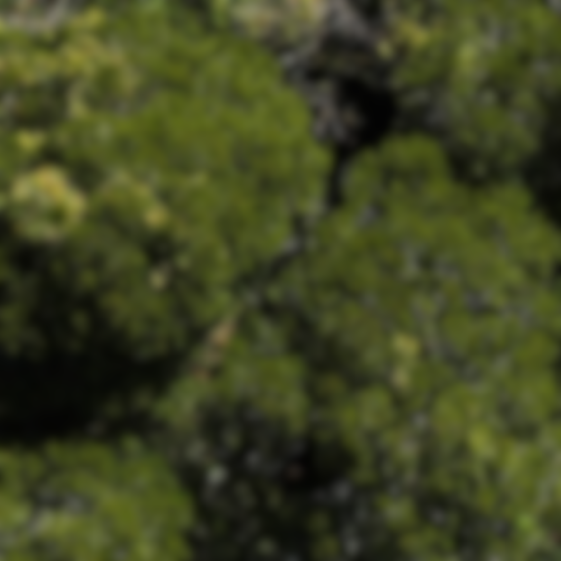
576
576
576
n
576
1
input image tile
output segmentation map
n
64
64
128
64
64
x
1
576²
576²
576²
576²
576²
576²
576²
64
128
128
256
128
128
288²
288²
288²
288²
288²
288²
128
256
256
512
256
256
144²
144²
144²
144²
144²
144²
256
512
512
1024
512
512
conv 3x3, ReLU, padding 1
skip connection (copy)
max pool 2x2
up-conv 2x2
conv 1x1
arg-max
72²
72²
72²
72²
72²
72²
36²
512
1024
1024
36²
36²

