Slide 1
Economics
Introduction

Slide 2
Ch.1 OUTLINE
1.0: Introduction and Syllabus
1.1: What Is Economics, and Why Is It Important?
1.2: Microeconomics and Macroeconomics
1.3: How Economists Use Theories and Models to Understand Economic Issues
1.4: How Economies Can Be Organized: An Overview of Economic Systems

Slide 3
General Information
Instructor: Paulo Fagandini
e-mail: paulo.fagandini@ext.universidadeeuropeia.pt
Official source of material: CANVAS
Official Reference:
📖 Shapiro, D.; MacDonald, D.; Greenlaw, S. A. (2022). Principles of Economics, 3e, OpenStax.
This book is free, and you can get it from https://www.openstax.org.
Exercises and slides will be based on that reference.

Slide 4
Assessment
There are two ways to pass the course:
Continuous assessment
Midterm, worth 50%, chapters 1,2,3,5,6,7,8,9,10,11 from main Book.
Midterm, worth 50%, chapters 19,21,22,23,24,25,26,27,28 from the main Book.
The grade in each midterm must be at least 8.00. Overall average must be 10 or more.
At least 70% of attendance.
Final Exam
A single Exam worth 100% covering all the semester.
Both assessments will consist of multiple-choice questions (qualitative and quantitative, plotting), and written questions (quantitative and can include qualitative parts as well).

Slide 5
1.1 What Is Economics, and Why Is It Important?
Economics is the study of how humans make decisions in the face of scarcity. These can be individual decisions, family decisions, business decisions or societal decisions.
Scarcity means that human wants for goods, services and resources exceed what is available.
The FRED website (https://openstax.org/l/FRED/) includes data on nearly 400,000 domestic and international economic and social variables over time, which will be used often in this course.

Slide 6

Economics in the Social Media Age
Economics is greatly impacted by how well information travels through society. Today, social media giants Twitter, Facebook, and Instagram are major forces on the information superhighway. (Credit: modification of "Social Media Mixed Icons - Banner" by Blogtrepreneur/Flickr, CC BY 2.0))

Slide 7
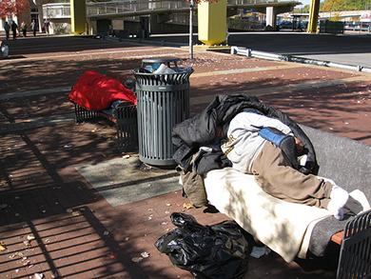
Scarcity
People experiencing homelessness are a stark reminder that scarcity of resources is real. (Credit: "Pittsburgh Homeless" by "daveyinn"/Flickr Creative Commons, CC BY 2.0)
Discussion Question: What are examples of critical goods and services?

Slide 8
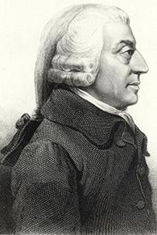
Comprehensive Study of Economics
Adam Smith introduced the idea of dividing labor into discrete tasks, in his famous 1776 book, titled The Wealth of Nations. (Credit: "Adam Smith" by Cadell and Davies (1811), John Horsburgh (1828), or R.C. Bell (1872)/Wikimedia Commons, Public Domain)

Slide 9
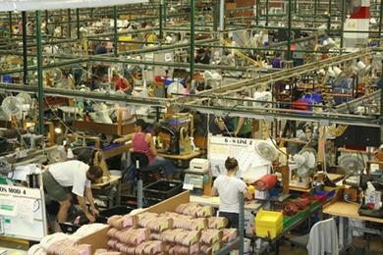
The Division of and Specialization of Labor
Division of labor - the way in which different workers divide required tasks to produce a good or service.
Workers on an assembly line are an example of the divisions of labor. (Credit: "Red Wing Shoe Factory Tour" by Nina Hale/Flickr Creative Commons, CC BY 2.0)

Slide 10
Why the Division of Labor Increases Production
Dividing and subdividing the tasks involved with producing a good or service, produces a greater quantity of output.
Specialization - when workers or firms focus on particular tasks for which they are well-suited within the overall production process.
Specialization allows businesses to take advantage of economies of scale, which means that for many goods, as the level of production increases, the average cost of producing each individual unit declines.

Slide 11
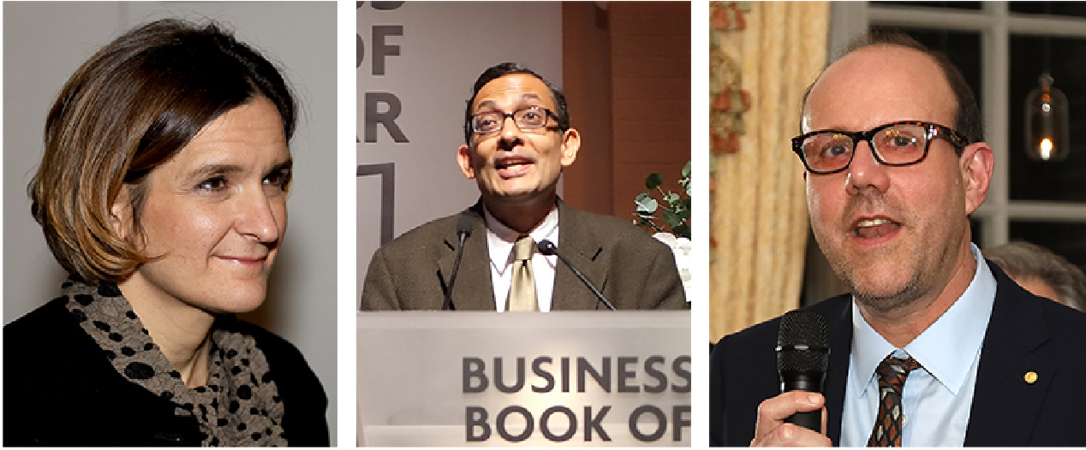
Why Study Economics?
Esther Duflo, Abhijit Banerjee (both from Massachusetts Institute of Technology), and Michael Kremer (University of Chicago) were awarded the Nobel Prize for groundbreaking work in which they established experimental methods to understand poverty and outcomes of initiatives to address it. (Credit: modification of work by U.S. Embassy Sweden/Wikimedia Commons, CC BY 2.0; Financial Times/Wikimedia Commons, CC BY 2.0; U.S. Embassy Sweden/Flickr Creative Commons, CC BY 2.0)

Slide 12
1.2 Microeconomics and Macroeconomics
Economics is concerned with the well-being of all people, including those with jobs and those without jobs, as well as those with high incomes and those with low incomes.
Microeconomics focuses on the actions of individual agents within the economy, like households, workers, and businesses.
Macroeconomics is the branch of economics that focuses on broad issues such as growth, unemployment, inflation, and trade balance.

Slide 13
Other Economic Terms
Monetary policy - policy that involves altering the level of interest rates, the availability of credit in the economy, and the extent of borrowing.
Determined by a nation’s central bank
Fiscal policy - economic policies that involve government spending and taxes.
Determined by a nation’s legislative body

Slide 14
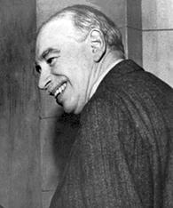
1.3 How Economists Use Theories and Models to Understand Economic Issues
One of the most influential economists in modern times was John Maynard Keynes. (Credit: “John Maynard Keynes” by IMF/Wikimedia Commons, Public Domain)
Keynes thought that economics teaches you how to think, not what to think.

Slide 15
Economic Theories and Models
A theory is a simplified representation of how two or more variables interact with each other.
A good theory is simple enough to understand, while complex enough to capture the key features of the object or situation you are studying.
Economists use models to test theories, but for this course we will use the terms model and theory interchangeably.

Slide 16
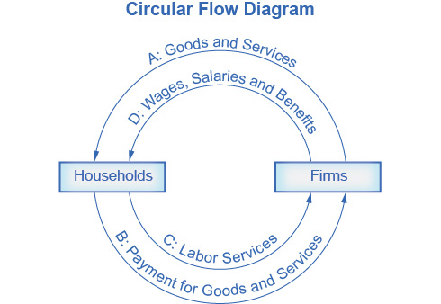
Circular Flow Diagram
The circular flow diagram shows how households and firms interact in the goods and services market, and in the labor market.
The direction of the arrows shows that in the goods and services market, households receive goods and services and pay firms for them.
In the labor market, households provide labor and receive payment from firms through wages, salaries, and benefits.

Slide 17
1.4 How Economies Can Be Organized: An Overview of Economic Systems
There are at least three ways that societies organize an economy:
1) Traditional economy - typically an agricultural economy where things are done the same as they have always been done.
Oldest economic system
Used in parts of Asia, Africa, and South America
Occupations tend to stay in the family
What you produce is what you consume
Little economic progress or development

Slide 18
An Overview of Economic Systems
2) Command economy - an economy where economic decisions are passed down from government authority and where the government owns the resources.
Government decides what goods and services will be produced and what prices it will charge for them.
The government decides what methods of production to use and sets wages for workers.
The government provides many necessities like healthcare and education for free.

Slide 19
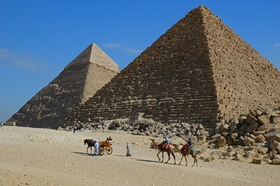
An Overview of Economic Systems
(Credit: "Pyramids at Giza" by Jay Bergesen/Flickr Creative Commons, CC BY 2.0)
Examples of command economy:
Ancient Egypt
Medieval manor life
Communism
Currently, Cuba and North Korea

Slide 20

An Overview of Economic Systems
3) Market economy - an economy where economic decisions are decentralized, private individuals own resources, and businesses supply goods and services based on demand.
Market - interaction between potential buyers and sellers; a combination of demand and supply.
Private enterprise - system where private individuals or groups of private individuals own and operate the means of production (resources and businesses).
Nothing says “market” more than The New York Stock Exchange. (Credit: work by Erik Drost/Flickr Creative Commons, CC BY 2.0)

Slide 21
Real World Economies
Most economies in the real world are mixed. They combine elements of command, traditional, and market systems.
The U.S. economy is positioned toward the market-oriented end of the spectrum.
Many countries in Europe and Latin America, while primarily market-oriented, have a greater degree of government involvement in economic decisions than the U.S. economy.
China and Russia, while they have moved more in the direction of having a market-oriented system, remain closer to the command economy end of the spectrum.

Slide 22
Regulations: The Rules of the Game
There is no such thing as an absolutely free market.
Regulations always define the “rules of the game” in the economy.
Economies that are primarily market-oriented have fewer regulations—ideally just enough to maintain an even playing field for participants.
Heavily regulated economies often have underground economies (or black markets), which are markets where the buyers and sellers make transactions without the government’s approval.

Slide 23
The Rise of Globalization
Globalization - the trend in which buying and selling in markets have increasingly crossed national borders.
Exports - the goods and services that a nation produces domestically and sells abroad.
Imports - the goods and services that are produced abroad and then sold domestically.
Gross domestic product (GDP) - measures the size of total production in an economy.

Slide 24
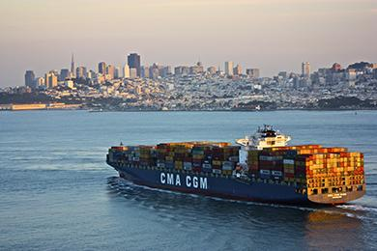
The Global Economy
Cargo ships are one mode of transportation for shipping goods in the global economy. (Credit: "Cargo Ship" by Raul Valdez/Flickr Creative Commons, CC BY 2.0)
Discussion question: What are examples of products and services in the modern economy? How has this contributed to globalization?

