Slide 1

Economics
CHOICE IN A WORLD OF SCARCITY

Slide 2
Ch.2 OUTLINE
2.1: How Individuals Make Choices Based on Their Budget Constraint
2.2: The Production Possibilities Frontier and Social Choices
2.3: Confronting Objections to the Economic Approach

Slide 3

Choices and Tradeoffs
(Credit: modification of "College of DuPage Commencement 2018 107" by COD Newsroom/Flickr, CC BY 2.0)
In general, the higher the degree, the higher the salary. So why aren’t more people pursuing higher degrees? The short answer: choices and tradeoffs.

Slide 4
2.1 How Individuals Make Choices Based on Their Budget Constraint
Budget constraint - all possible consumption combinations of goods that someone can afford, given the prices of goods, when all income is spent; the boundary of the opportunity set.
Opportunity set - all possible combinations of consumption that someone can afford given the prices of goods and the individual’s income (all income does not need to be spent).
Given the price of the two goods and a budget amount, a budget constraint can be illustrated graphically.
With a limited amount of income to spend on things, consumers must choose what they need and want.

Slide 5
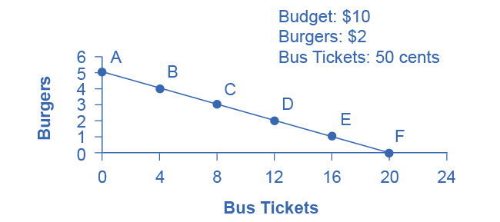
The Budget Constraint: Alphonso’s Consumption Choice
Each point on the budget constraint represents a combination of burgers and bus tickets whose total cost adds up to Alphonso’s budget of $10.
The slope of the budget constraint is determined by the relative price of burgers and bus tickets.
Giving up one burger means gaining four bus tickets.
The opportunity set - every point on (or inside) the constraint which shows a combination of burgers and bus tickets that Alphonso can afford.
Any point outside the constraint is not affordable, because it would cost more money than Alphonso has in his budget.

Slide 6
The Concept of Opportunity Cost
Opportunity cost indicates what people must give up to obtain what they desire.
The cost of one item is the lost opportunity to do or consume something else.
The opportunity cost is the value of the next best alternative.
A fundamental principle of economics is that every choice has an opportunity cost.
For Alphonso, the opportunity cost of a burger is the four bus tickets he would have to give up.

Slide 7
Identifying Opportunity Cost
In many cases, it is reasonable to refer to the opportunity cost as the price.
Example: If your cousin buys a new bicycle for $300, then $300 measures the amount of “other consumption” that he has forsaken.
Sometimes the price as measured in dollars may not accurately capture the true opportunity cost, such as when costs of time are involved.
Example: Attending college
The out-of-pocket costs of attending college include tuition, books, room and board, and other expenses.
Additionally, during the hours you are attending class and studying, it is impossible to work at a paying job.
So, college imposes both an out-of-pocket cost and an opportunity cost of lost earnings.

Slide 8
Opportunity Cost Examples
Discussion Question: What are the opportunity costs of...
Buying vs. leasing a car
Investing in different ways (i.e., savings accounts, certificates of deposit, mutual funds, stocks, etc.)
Going out to eat vs. preparing food at home
Walking or taking public transportation

Slide 9
Marginal Decision-Making and Diminishing Marginal Utility
Marginal analysis - examining the benefits and costs of choosing a little more or a little less of a good.
Utility - satisfaction, usefulness, or value one obtains from consuming goods and services.
Law of diminishing marginal utility - as a person receives more of a good, the additional (or marginal) utility from each additional unit of the good declines.
Example - the first slice of pizza eaten brings more satisfaction than the sixth.

Slide 10
Sunk Costs
Sunk costs - costs that were incurred in the past and cannot be recovered.
For people and firms alike, dealing with sunk costs can be frustrating.
Example - A firm finds it hard to give up on a new product that is doing poorly because much money was spent in creating and launching the product.
The lesson of sunk costs is to ignore the past errors and make decisions based on what will happen in the future.

Slide 11
2.2 The Production Possibilities Frontier and Social Choices
Production possibilities frontier (PPF) - a diagram that shows the productively efficient combinations of two products that an economy can produce given the resources it has available.
The slope of the production possibilities frontier shows the opportunity cost.

Slide 12
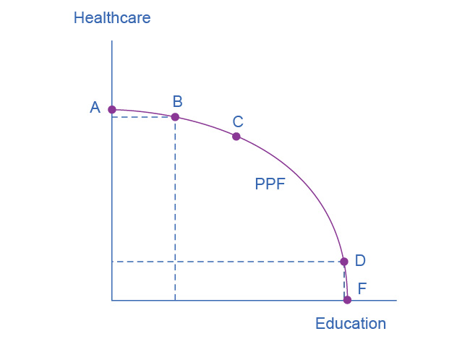
Healthcare vs. Education Production Possibilities Frontier
This production possibilities frontier shows a tradeoff between devoting social resources to healthcare and devoting them to education.
At A all resources go to healthcare and at B, most go to healthcare.
At D most resources go to education, and at F, all go to education.

Slide 13
Healthcare vs. Education Production Possibilities Frontier
A society could choose to produce any combination of healthcare and education on the production possibilities frontier.
It does not have enough resources to produce outside the PPF.
Because the PPF is downward sloping from left to right, the only way society can obtain more education is by giving up some healthcare.

Slide 14
The Shape of the PPF and the Law of Diminishing Returns
Law of diminishing returns - as additional increments of resources to producing a good or service are added, the marginal benefit from those additional increments will decline.
The law of diminishing marginal utility is a more specific case of the law of diminishing returns.

Slide 15
Healthcare vs. Education Production Possibilities Frontier, Continued
The curvature of the PPF shows that as we add more resources to education, moving from left to right along the horizontal axis, the original gains are fairly large, but gradually diminish.
By contrast, as we add more resources to healthcare, moving from bottom to top on the vertical axis, the original gains are fairly large, but again gradually diminish.

Slide 16
Differences - Budget Constraint and PPF
Two major differences between a budget constraint and a PPF:
1) The budget constraint is a straight line.
Slope is given by the relative prices of the two goods, which are fixed, so slope doesn't change.
PPF has a curved shape because of the law of diminishing returns, so slope is different at various points on the PPF.
2) The absence of specific numbers on the axes of the PPF.
The exact amount of resources an imaginary economy has is not known.

Slide 17
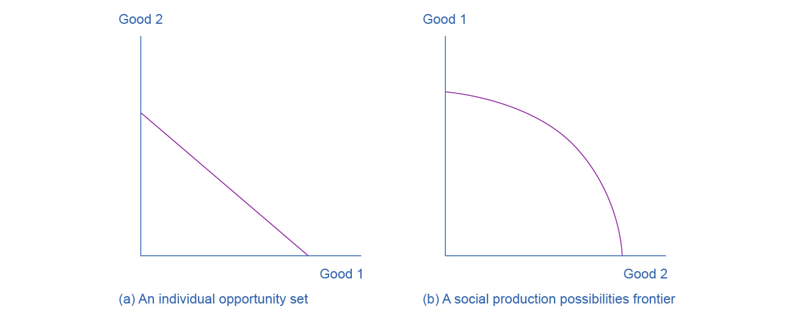
Similarities - Budget Constraint and PPF
Both the budget constraint and the social production possibilities frontier (PPF) show the constraints under which individual consumers and society as a whole operate.
Both diagrams show the tradeoff in choosing more of one good at the cost of less of the other.

Slide 18
Productive Efficiency and Allocative Efficiency
Productive efficiency - when it is impossible to produce more of one good (or service) without decreasing the quantity produced of another good (or service)
Any choice inside the PPF is productively inefficient because it is possible to produce more of one good, the other good, or some combination of both goods.
Allocative efficiency - when the mix of goods produced represents the mix that society most desires

Slide 19
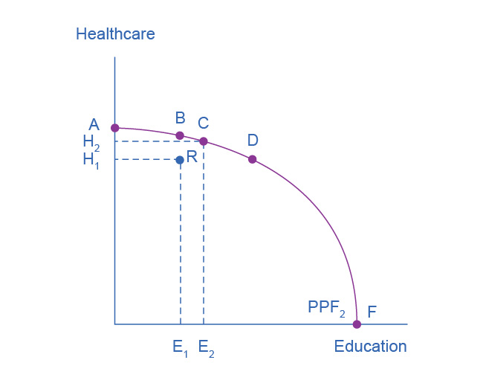
Healthcare vs. Education Production Possibilities Frontier, Continued
Productive efficiency -
All choices along a given PPF like B, C, and D display productive efficiency.
R does not, because it is inside the PPF curve, and thus not all resources are being used.

Slide 20
The PPF and Comparative Advantage
How much of a good a country decides to produce depends on how expensive it is to produce it versus buying it from a different country.
Countries tend to have different opportunity costs of producing a specific good, either because of different climates, geography, technology, or skills.
Comparative advantage - when a country can produce a good at a lower opportunity cost than another country.

Slide 21
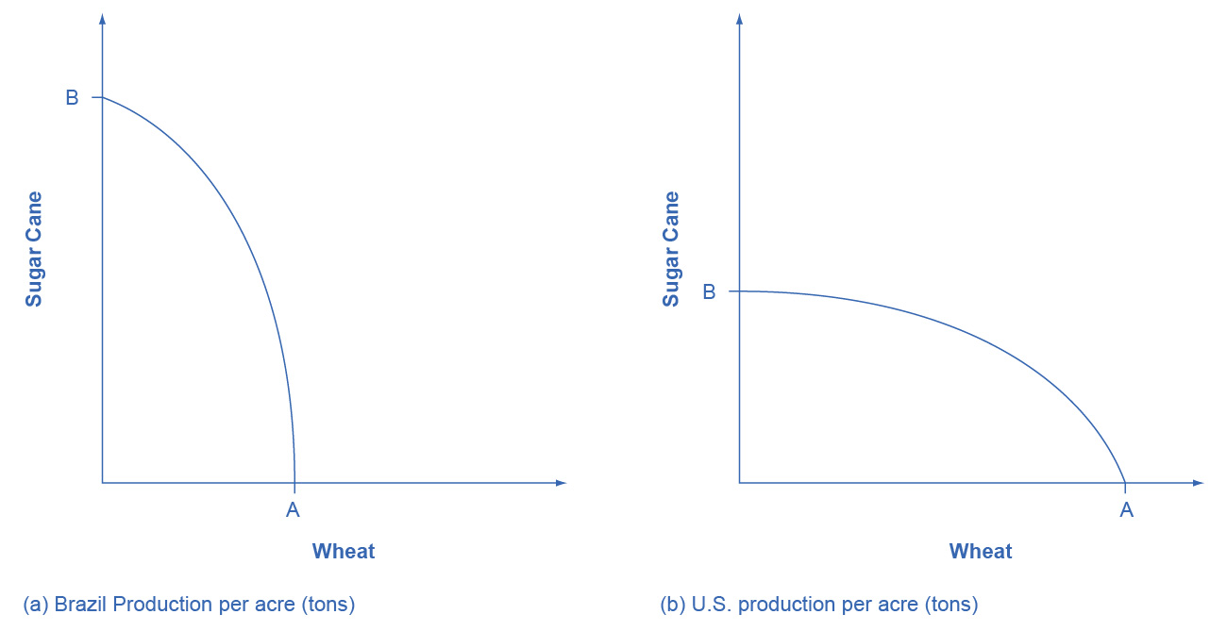
The PPF and Comparative Advantage
The U.S. PPF is flatter than the Brazil PPF implying that the opportunity cost of wheat in terms of sugar cane is lower in the U.S. than in Brazil.
Conversely, the opportunity cost of sugar cane is lower in Brazil.
The U.S. has comparative advantage in wheat and Brazil has comparative advantage in sugar cane.

Slide 22
2.3 Confronting Objections to the Economic Approach
Objections in understanding the economic approach to decision-making:
1) People, firms, and society do not act in a way that fits the economic way of thinking.
However, it is reasonable, as a first approximation, to analyze them with the tools of economic analysis.
Will be addressed in a later chapter on consumer choices.

Slide 23
Confronting Objections to the Economic Approach
Objections in understanding the economic approach to decision-making:
2) People, firms, and society should not act this way.
The economics approach:
Portrays people as self-interested, but economics is not a form of moral instruction.
Seeks to describe economic behavior as it actually exists.
Uses, positive statements, which describe the world as it is. These are factual.
Tries to avoid normative statements, which describe how the world should be. These statements are subjective questions of opinion.

Slide 24
Confronting Objections to the Economic Approach
Invisible hand - concept that individuals' self-interested behavior can lead to positive social outcomes
Identified in Adam Smith’s The Wealth of Nations.
Consumers will encourage businesses to offer goods and services that meet their needs.
It is possible that broader social good can emerge from selfish individual actions.
Self-interest in economics does not not imply self-interest in all aspects of life.

