Slide 1

Economics
DEMAND AND SUPPLY

Slide 2
Ch.3 OUTLINE
3.1: Demand, Supply, and Equilibrium in Markets for Goods and Services
3.2: Shifts in Demand and Supply for Goods and Services
3.3: Changes in Equilibrium Price and Quantity: The Four-Step Process
3.4: Price Ceilings and Price Floors
3.5: Demand, Supply, and Efficiency

Slide 3

Why Does It Cost More?
Organic vegetables and fruits that are grown and sold within a specific geographical region should, in theory, cost less than conventional produce because the transportation costs are less. That is not, however, usually the case. This is caused by demand and supply.
(Credit: modification of "Old Farmers' Market" by NatalieMaynor/Flickr, CC BY 2.0)

Slide 4
3.1 Demand, Supply, and Equilibrium in Markets for Goods and Services
Demand - the amount of some good or service consumers are willing and able to purchase at each price.
Price - what a buyer pays for a unit of the specific good or service.
Quantity demanded - the total number of units of a good or service consumers are willing to purchase at a given price
Law of demand - keeping all other variables that affect demand constant,
if price goes , then quantity demanded goes
if price goes , then quantity demanded goes

Slide 5
Demand Schedule & Curve
Demand schedule - a table that shows a range of prices for a certain good or service and the quantity demanded at each price.
Demand curve - a graphic representation of the relationship between price and quantity demanded of a certain good or service, with quantity on the horizontal axis and the price on the vertical axis.

Slide 6
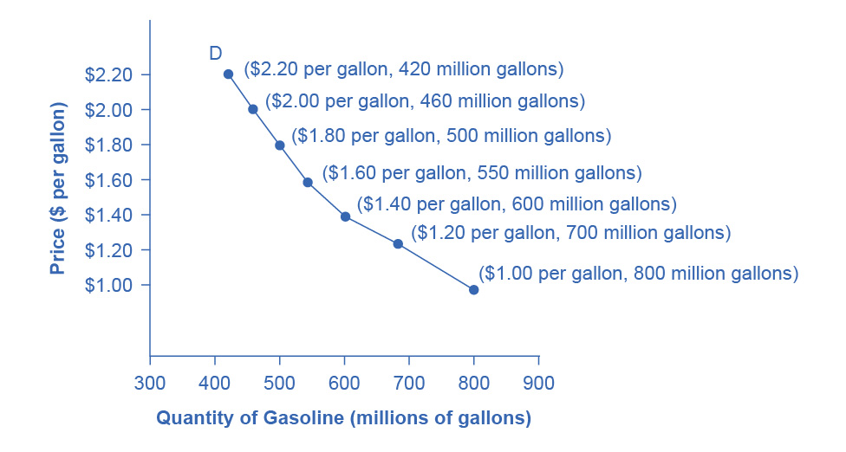
Graphing the Demand
The points of a demand schedule are graphed, and the line connecting them is the demand curve (D).
The downward slope of the demand curve again illustrates the law of demand - the inverse relationship between prices and quantity demanded.

Slide 7
Supply of Goods and Services
Supply - the amount of some good or service a producer is willing to supply at each price.
Quantity supplied - the total number of units of a good or service producers are willing to sell at a given price.
Law of supply - assuming all other variables that affect supply are held constant,
if price goes , then quantity supplied goes
if price goes , then quantity supplied goes

Slide 8
Supply Schedule & Curve
Supply schedule - a table that shows the quantity supplied at a range of different prices.
Supply curve - a graphic illustration of the relationship between price, shown on the vertical axis, and quantity, shown on the horizontal axis.

Slide 9
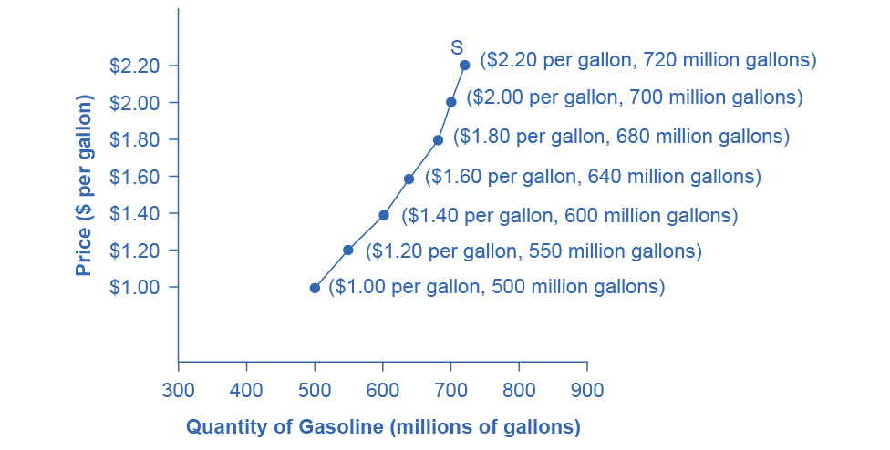
Graphing the Supply
The supply curve (S) is created by graphing the points from a supply schedule and then connecting them.
The upward slope of the supply curve illustrates the law of supply - that a higher price leads to a higher quantity supplied, and vice versa.

Slide 10
Equilibrium - Where Demand and Supply Intersect
Equilibrium - the combination of price and quantity where there is no economic pressure from surpluses or shortages that would cause price or quantity to change
quantity demanded = quantity supplied
Equilibrium price - the price where quantity demanded is equal to quantity supplied
Equilibrium quantity - the quantity at which quantity demanded and quantity supplied are equal for a certain price level.
Surplus or excess supply - at the existing price, quantity supplied exceeds the quantity demanded.
Shortage or excess demand - at the existing price, the quantity demanded exceeds the quantity supplied.

Slide 11
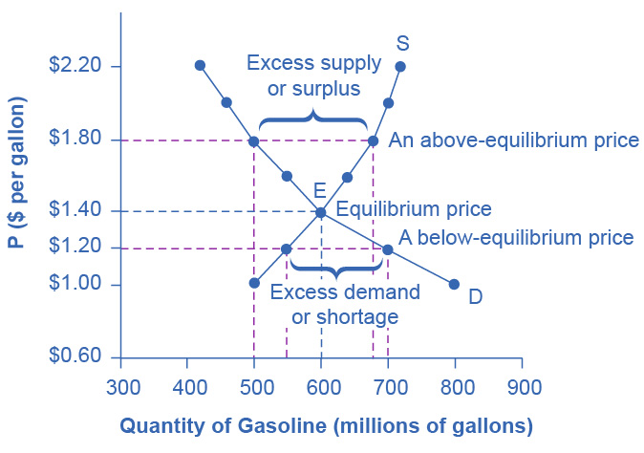
Equilibrium - Where Demand and Supply Intersect
The demand curve (D) and the supply curve (S) intersect at the equilibrium point E.
The equilibrium price is the only price where,
quantity demanded = quantity supplied
At a price above equilibrium, quantity supplied > quantity demanded, so there is excess supply.
At a price below equilibrium, quantity demanded > quantity supplied, so there is excess demand.

Slide 12
3.2 Shifts in Demand and Supply for Goods and Services
Ceteris paribus - Latin phrase meaning “other things being equal”
Any given demand or supply curve is based on the ceteris paribus assumption that all else is held equal.

Slide 13
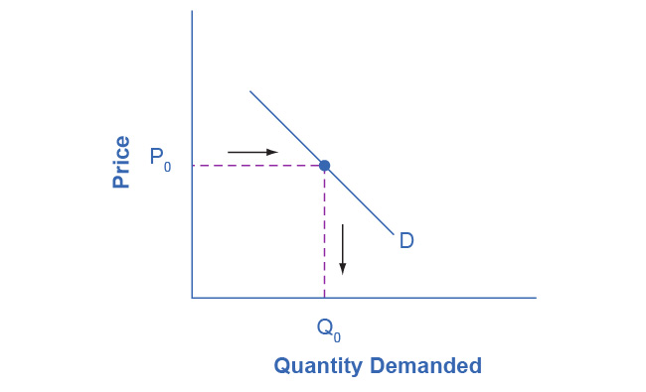
Demand Curve
The demand curve can be used to identify how much consumers would buy at any given price.

Slide 14
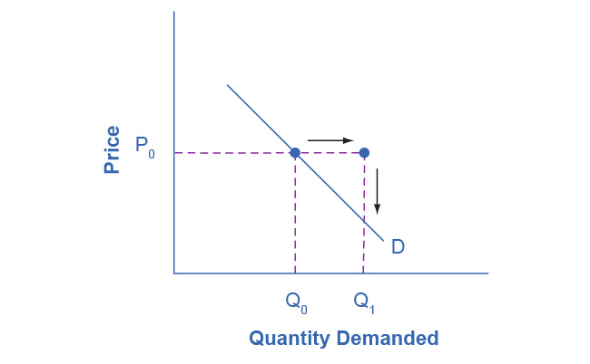
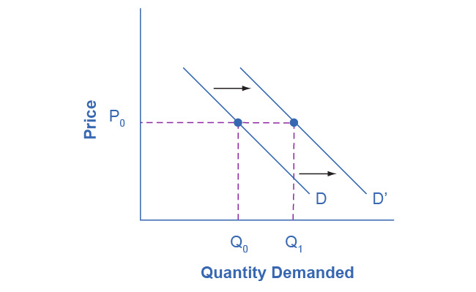
Shifting the Demand Curve
Figure A
Figure B
If income increases:
Consumers will purchase larger quantities, pushing demand to the right (figure A).
Thus, causing the demand curve to shift right (figure B).

Slide 15
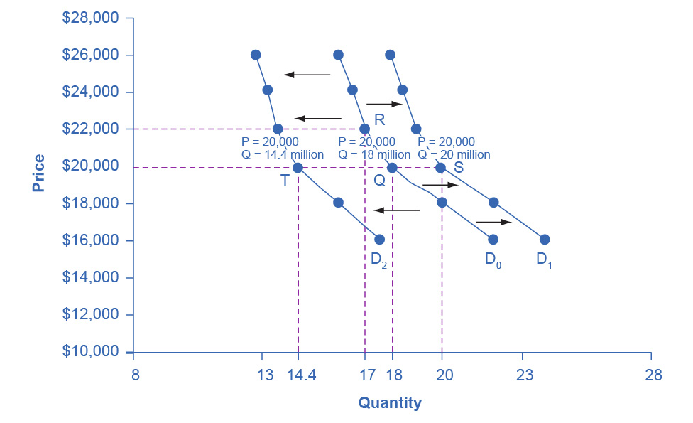
Shifting the Demand Curve
Increased demand means that at every given price, the quantity demanded is higher, so that the demand curve shifts to the right from D₀ to D₁.
Decreased demand means that at every given price, the quantity demanded is lower, so that the demand curve shifts to the left from D₀ to D₂.

Slide 16
What Factors Affect Demand?
A shift in demand happens when a change in some economic factor (other than price) causes a different quantity to be demanded at every price.
Factors that affect demand:
Income
Changing tastes or preferences
Changes in the composition of the population
Price of substitute or complement changes
Changes in expectations about future

Slide 17
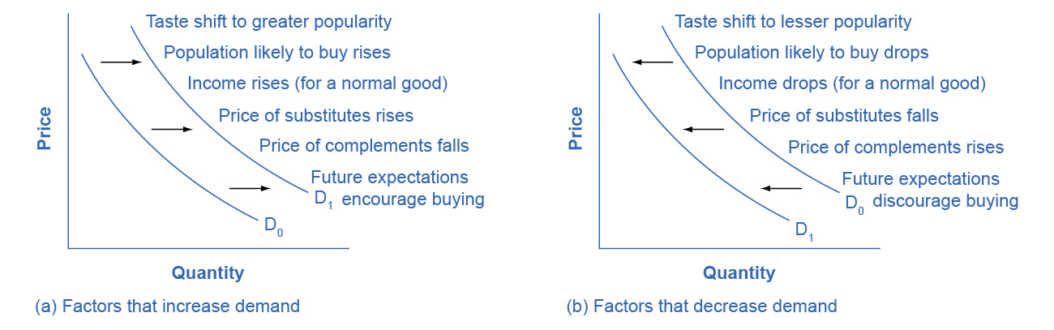
How Factors Affect Demand
(a) A list of factors that can cause an increase in demand from D₀ to D₁.
(b) The same factors, if their direction is reversed, can cause a decrease in demand from D₀ to D₁.

Slide 18
Types of Goods & Services
Normal good - A product whose demand rises when income rises, and vice versa.
Inferior good - A product whose demand falls when income rises, rises, and vice versa.
Substitute - a good or service that we can use in place of another good or service.
Complements - goods or services that are often used together so that consumption of one good tends to enhance consumption of the other.

Slide 19
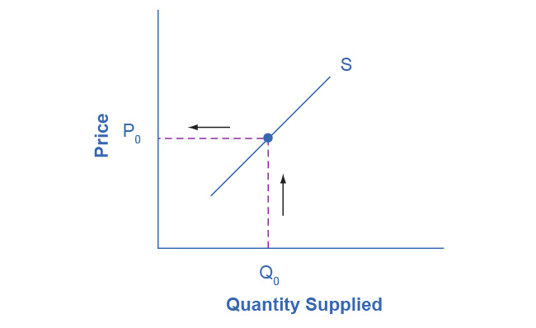
Supply Curve
The supply curve can be used to show the minimum price a firm will accept to produce a given quantity of output.

Slide 20
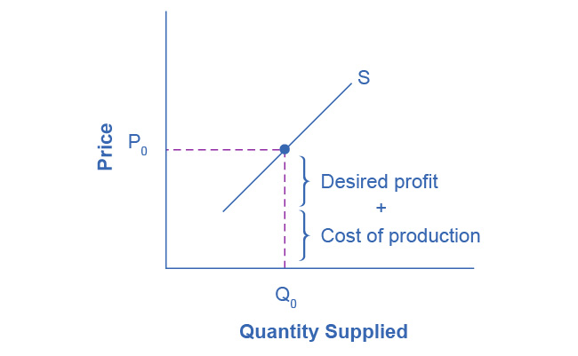
Supply Price
The cost of production and the desired profit equal the price a firm will set for a product.

Slide 21
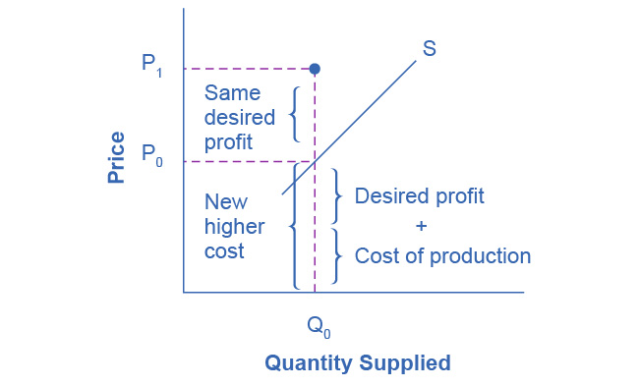
Changing the Price
Because the cost of production and the desired profit equal the price a firm will set for a product,
If the cost of production , the price for the product will also need to .

Slide 22
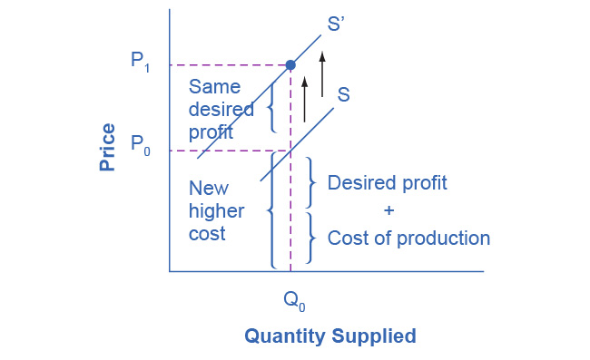
Shifting the Supply Curve
When the cost of production increases, the supply curve shifts up to a new price level.

Slide 23
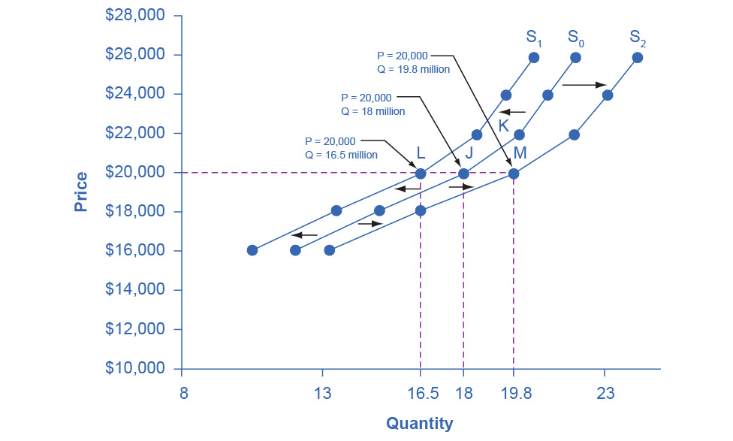
Shifting the Supply Curve
Decreased supply means that at every given price, the quantity supplied is lower, so that the supply curve shifts to the left, from S₀ to S₁.
Increased supply means that at every given price, the quantity supplied is higher, so that the supply curve shifts to the right, from S₀ to S₂.

Slide 24
What Factors Affect Supply?
Shift in supply - when a change in some economic factor (other than price) causes a different quantity to be supplied at every price.
Inputs or factors of production - the combination of labor, materials, and machinery that is used to produce goods and services.
Factors that affect supply:
Natural conditions
Input prices
Technology
Government policies

Slide 25
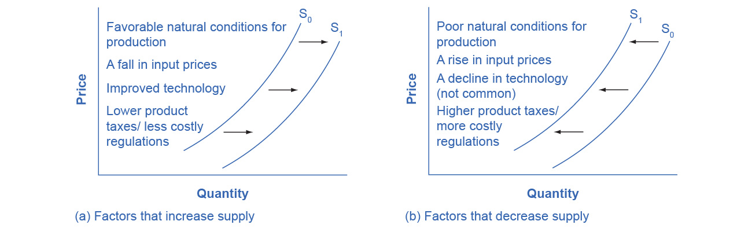
How Factors Affect Supply
(a) A list of factors that can cause an increase in supply from S₀ to S₁.
(b) The same factors, if their direction is reversed, can cause a decrease in supply from S₀ to S₁.

Slide 26
3.3 Changes in Equilibrium Price and Quantity: The Four-Step Process
Four-step process to determining how an economic event affects equilibrium price and quantity:
Step 1. Draw a demand and supply model before the economic change took place.
Step 2. Decide whether the economic change affects demand or supply.
Step 3. Decide whether the effect causes a curve shift to the right or to the left, and sketch the new curve on the diagram.
Step 4. Identify the new equilibrium and then compare to the original.

Slide 27
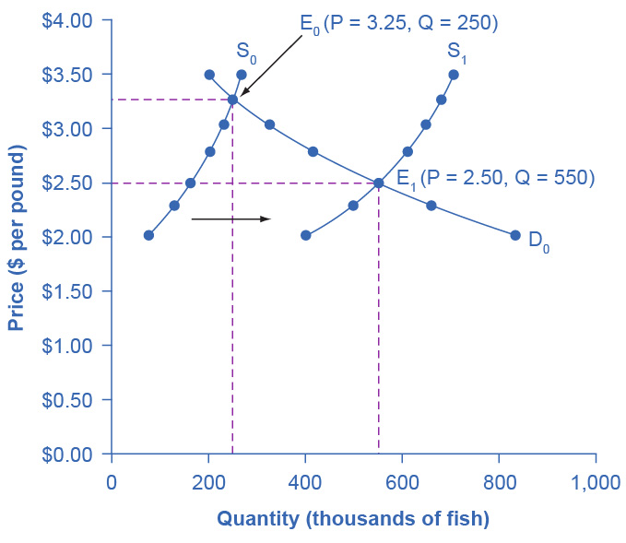
Example: Shift in Supply
Discussion Question: Using the 4-step approach, how did excellent weather conditions during the summer affect the quantity and price of salmon?

Slide 28
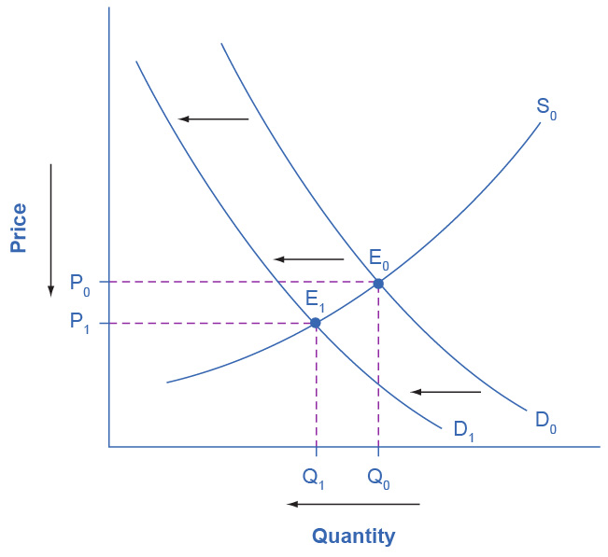
Example: Shift in Demand
Discussion Question: From 2004 to 2012, the share of Americans who reported obtaining their news from digital sources increased from 24% to 39%. Using the 4-step approach, how has this affected the consumption of traditional sources, such as print news media, and radio and television news?

Slide 29
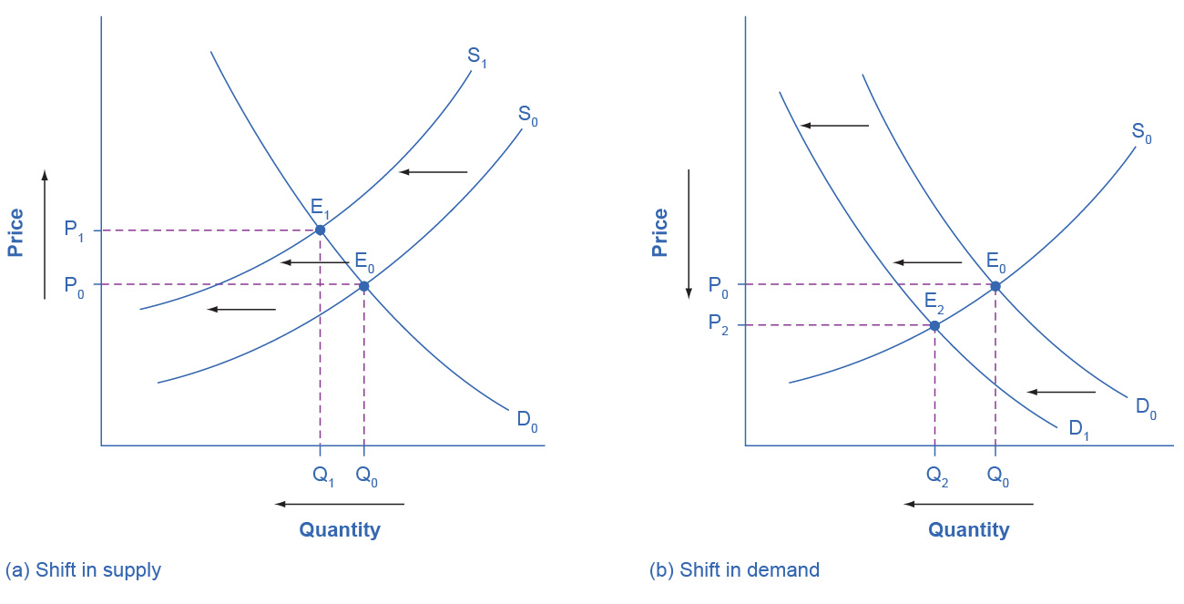
A Combined Example
Discussion Question: Using the 4-step approach, what does an increase in labor compensation, as well as an increase in digital communication suggest about the continued viability of the Postal Service?
(a) Higher labor compensation causes a leftward shift in the supply curve, a decrease in the equilibrium quantity, and an increase in the equilibrium price.
(b) A change in tastes away from Postal Services causes a leftward shift in the demand curve, a decrease in the equilibrium quantity, and a decrease in the equilibrium price.

Slide 30
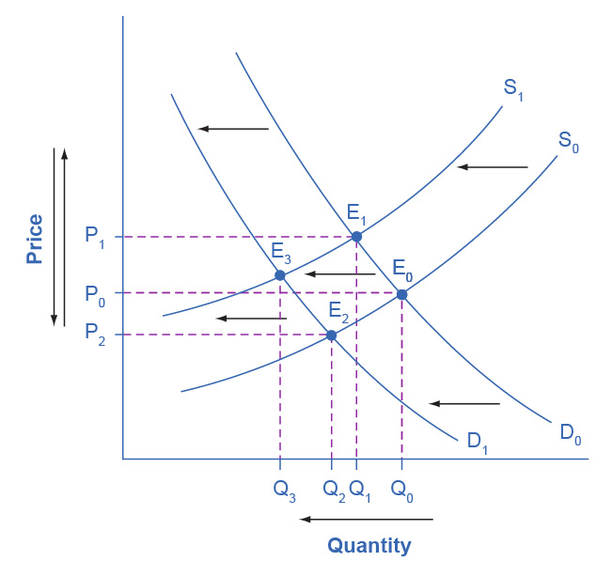
A Combined Example
Superimposing the previous two diagrams one on top of the other, we see that supply and demand shifts cause changes in equilibrium price and quantity.

Slide 31
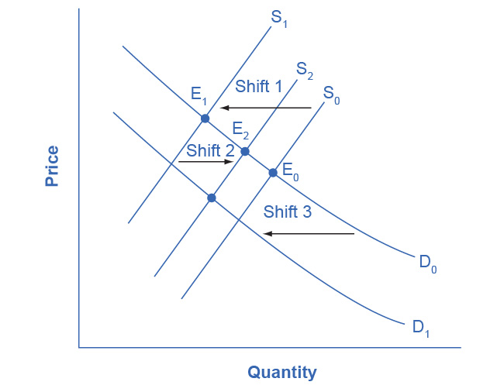
Movements vs. Shifts
Movements are different than shifts.
A shift in one curve never causes a shift in the other curve. Rather, a shift in one curve causes a movement along the second curve.

Slide 32
3.4 Price Ceilings and Price Floors
Price controls - laws that governments enact to regulate prices.
Price ceiling -
keeps a price from rising above a certain level
a legal maximum price that one pays for some good or service
Price floor -
keeps a price from falling below a given level.
is the lowest price that one can legally pay for some good or service.

Slide 33
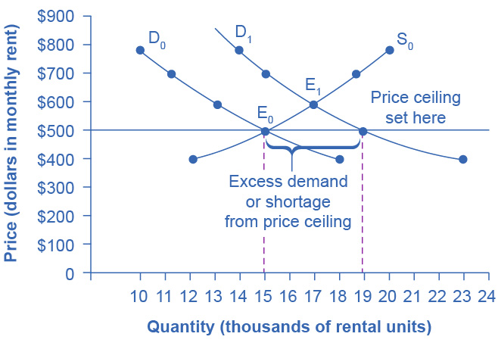
A Price Ceiling Example - Rent Control
The original intersection of demand and supply occurs at E₀.
If demand shifts from D₀ to D₁, the new equilibrium would be at E₁ - unless a price ceiling prevents the price from rising.
If the price is not permitted to rise, the quantity supplied remains at 15,000. However, after the change in demand, the quantity demanded rises to 19,000, resulting in a shortage.

Slide 34
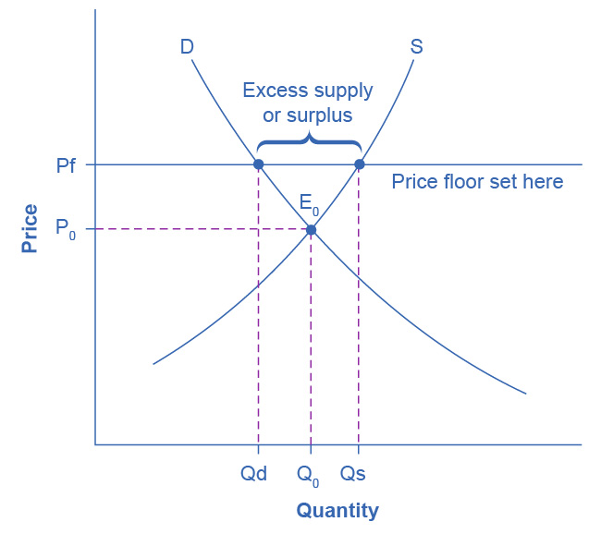
A Price Floor Example - European Wheat Prices
The intersection of demand (D) and supply (S) would be at the equilibrium point E₀.
However, a price floor set at Pf holds the price above E₀ and prevents it from falling.
The result of the price floor is that the quantity supplied Q_{s} exceeds the quantity demanded Q_{d}. There is excess supply, also called a surplus.

Slide 35
3.5 Demand, Supply, and Efficiency
Consumer surplus -
the amount that individuals would have been willing to pay minus the amount that they actually paid.
the area above the market price and below the demand curve.
Producer surplus -
the price the producer actually received minus the price the producer would have been willing to accept.
the area between the market price and the segment of the supply curve below the equilibrium.
Social surplus/economic surplus/total surplus =
consumer surplus + producer surplus
Deadweight loss - the loss in social surplus that occurs when a market produces an inefficient quantity

Slide 36
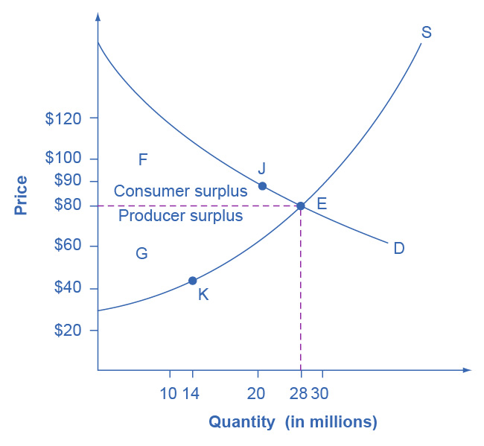
Consumer and Producer Surplus
The somewhat triangular area labeled by F shows the area of consumer surplus, which shows that the equilibrium price in the market was less than what many of the consumers were willing to pay.
The somewhat triangular area labeled by G shows the area of producer surplus, which shows that the equilibrium price received in the market was greater than what many of the producers were willing to accept for their products.

Slide 37
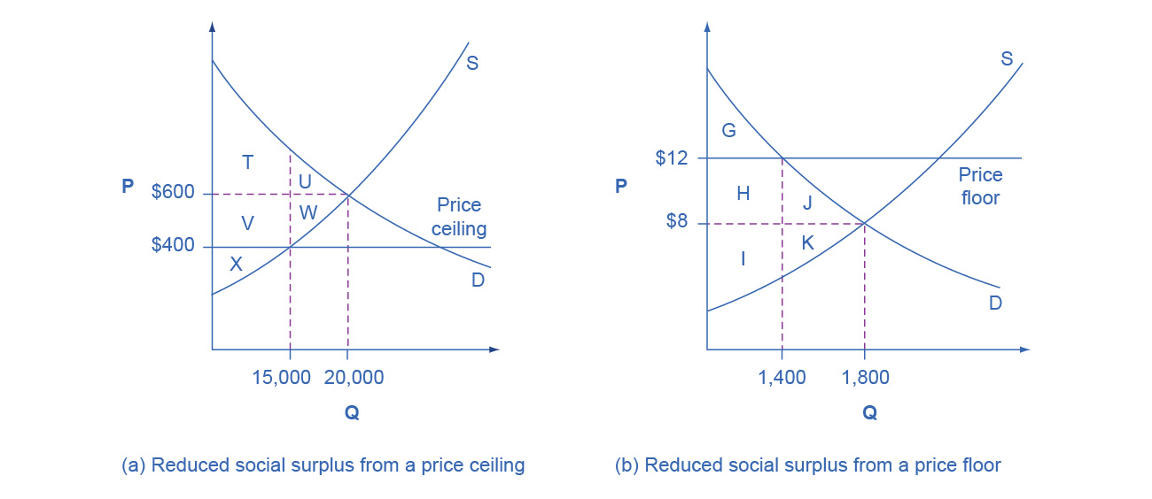
Efficiency and Price Floors and Ceilings
(a) The original equilibrium price is $600 with a quantity of 20,000. Consumer surplus is T + U, and producer surplus is V + W + X. A price ceiling is imposed at $400, so firms in the market now produce only a quantity of 15,000. As a result, the new consumer surplus is T + V, while the new producer surplus is X.
(b) The original equilibrium is $8 at a quantity of 1,800. Consumer surplus is G + H + J, and producer surplus is I + K. A price floor is imposed at $12, which means that quantity demanded falls to 1,400. As a result, the new consumer surplus is G, and the new producer surplus is H + I.

