Slide 1

Economics
CONSUMER CHOICES

Slide 2
Ch.6 OUTLINE
6.1: Consumption Choices
6.2: How Changes in Income and Prices Affect Consumption Choices
6.3: Behavioral Economics: An Alternative Framework for Consumer Choice

Slide 3

Investment Choices
Higher education is generally viewed as a good investment, if one can afford it. Is spending on education only considered beneficial during the good times, since incomes decrease during recessions?
(Credit: modification of “Commencement” by roanokecollege/Flickr, CC BY 2.0)

Slide 4
6.1 Consumption Choices
Budget constraint - shows the possible combinations of two goods that are affordable given a consumer’s limited income.
Total utility - satisfaction derived from consumer choices.

Slide 5
Consumption Choices
Marginal utility - the additional utility provided by one additional unit of consumption.
Diminishing marginal utility - the common pattern that each marginal unit of a good consumed provides less of an addition to utility than the previous unit

Slide 6
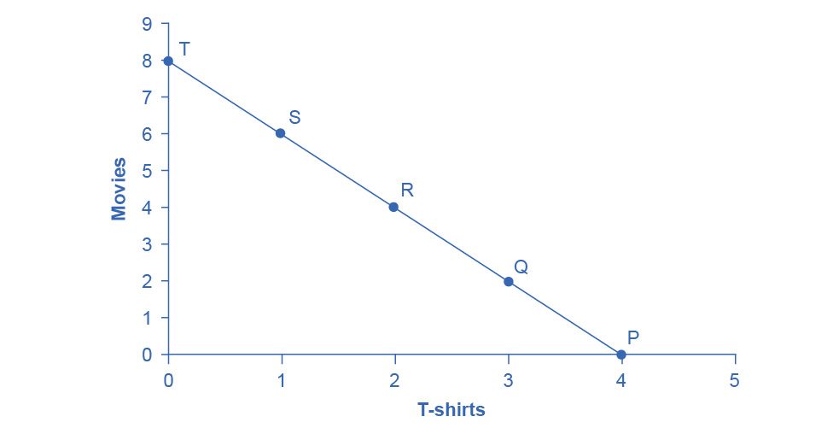
A Choice between Consumption Goods
José has an income of $56.
Movies cost $7 and T-shirts cost $14.
The points on the budget constraint line show the combinations of movies and T-shirts that are affordable.

Slide 7
A Rule for Maximizing Utility
Marginal utility per dollar - the additional satisfaction gained from purchasing a good given the price of the product.
If you always choose the item with the greatest marginal utility per dollar spent, when the budget is exhausted, the utility maximizing choice should occur where the marginal utility per dollar spent is the same for both goods.

Slide 8
6.2 How Changes in Income and Prices Affect Consumption Choices
Income, prices, and preferences affect consumer choices.
Utility and marginal utility can also be used to analyze how consumer choices change when the budget constraint shifts in response to changes in income or price.

Slide 9
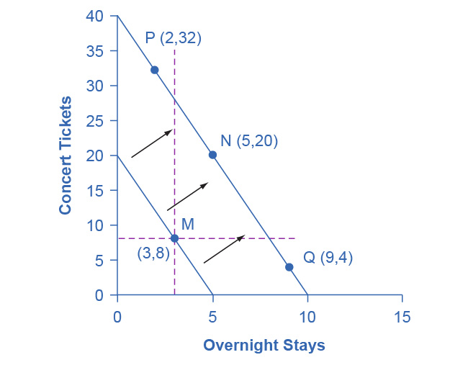
Example - Concert Tickets vs. Overnight Getaway when Income Increases
The utility-maximizing choice on the original budget constraint is M.
The dashed horizontal and vertical lines extending through point M allow you to see whether the quantity consumed of goods on the new budget constraint is higher or lower than on the original budget constraint.

Slide 10
Example - Concert Tickets vs. Overnight Getaway when Income Increases, Cont.
On the new budget constraint, a choice like N will be made if both goods are normal goods.
If overnight stays is an inferior good, a choice like P will be made.
If concert tickets are an inferior good, a choice like Q will be made.

Slide 11
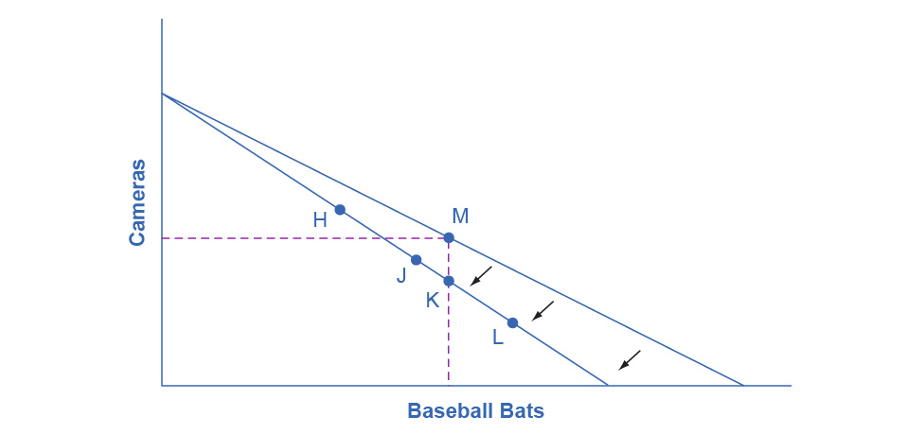
Example - How a Change in Price Affects Consumption Choices
The original utility-maximizing choice is M.
When the price of bats rises, the budget constraint rotates inward.
The dashed lines make it possible to see whether the new consumption choice involves less of both goods, or less of one good and more of the other.

Slide 12
Example - How a Change in Price Affects Consumption Choices, Continued
The new possible choices would be fewer baseball bats and more cameras, like point H, or less of both goods, as at point J.
Choice K would mean that the higher price of bats led to exactly the same quantity of bat consumption, but fewer cameras.
Possibly, but unlikely, would be choice L since it would mean a higher price for bats lead to a greater consumption of bats.

Slide 13
Response to Higher Prices
The typical response to higher prices is that a person chooses to consume less of the product with the higher price.
This occurs for two reasons:
Substitution effect - when a price changes, consumers have an incentive to consume less of the good with a relatively higher price and more of the good with a relatively lower price; always happens simultaneously with an income effect
Income effect - a higher price means that the buying power of income has been reduced, even though actual income has not changed; always happens simultaneously with a substitution effect

Slide 14
The Foundations of Demand Curves
Changes in the price of a good lead the budget constraint to rotate.
A rotation in the budget constraint means that when individuals are seeking their highest utility, the quantity that is demanded of that good will change.
In this way, the logical foundations of demand curves (a connection between prices and quantity demanded) are based on the underlying idea of individuals seeking utility.

Slide 15
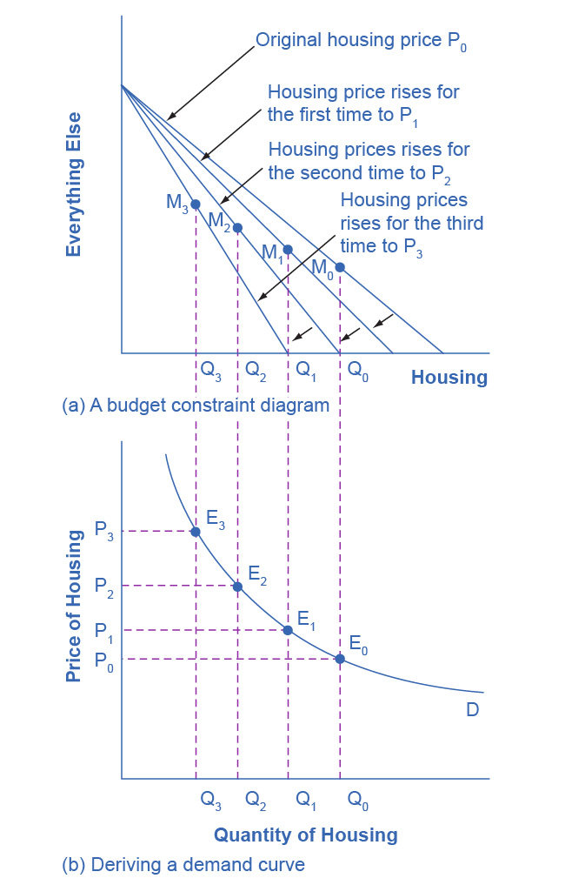
The Foundations of a Demand Curve: An Example of Housing
In (a) as the price increases from P₀ to P₁ to P₂ to P₃, the budget constraint on the upper part of the diagram rotates inward.
The utility-maximizing choice changes from M₀ to M₁ to M₂ to M₃.
As a result, the quantity demanded of housing shifts from Q₀ to Q₁ to Q₂ to Q₃, ceteris paribus.
The demand curve (b) graphs each combination of the price of housing and the quantity of housing demanded, ceteris paribus.
The quantities of housing are the same at the points on both (a) and (b).
Thus, the original price of housing (P₀) and the original quantity of housing (Q₀) appear on the demand curve as point E₀.
The higher price of housing (P₁) and the corresponding lower quantity demanded of housing (Q₁) appear on the demand curve as point E₁.

Slide 16
6.3 Behavioral Economics: An Alternative Framework for Consumer Choice
The traditional economic models assume rationality.
People take all available information and make consistent and informed decisions that are in their best interest.
Assumes human beings have complete self control.
Fungible - units of a good are capable of mutual substitution with each other and carry equal value to the individual.

Slide 17
Behavioral Economics
Behavioral economics takes into account people’s state of mind.
Seeks to enrich our understanding of decision-making by integrating the insights of psychology into economics.
Investigates how given dollar amounts can mean different things to individuals depending on the situation.
This can lead to decisions that appear outwardly inconsistent, or irrational, to the outside observer.

Slide 18
Is Education Worth It?
Discussion Question: Why spend the money to go to college during a recession?
If you are unemployed (or underemployed, working fewer hours than you would like), the opportunity cost of your time is low.
If you are unemployed, you don’t have to give up work hours and income by going to college.
Do you think the data supports the idea that more education means less unemployment ?

Slide 19
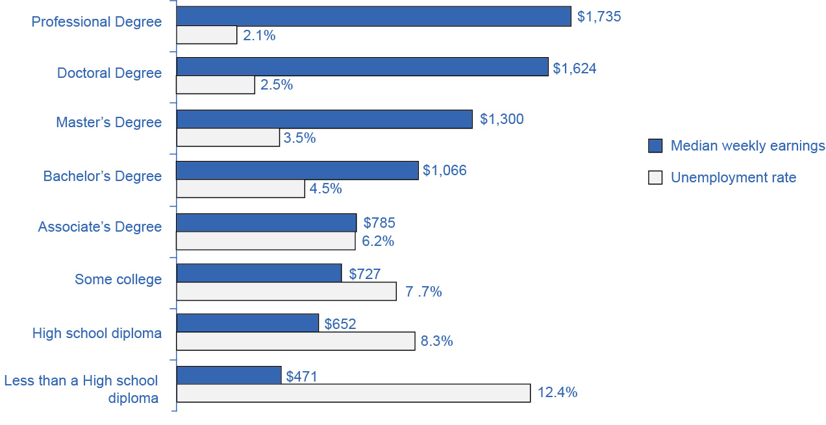
The Impact of Education on Earnings and Unemployment Rates, 2012
There is a positive correlation between earnings and education.
Those with the highest degrees in 2012 had substantially lower unemployment rates
Those with the least formal education had the highest unemployment rates.
The national median average weekly income was $815, and the nation unemployment average in 2012 was 6.8%. (Source: Bureau of Labor Statistics, May 22, 2013)

