Slide 1

Economics
PRODUCTION, COSTS, AND INDUSTRY STRUCTURE

Slide 2
Ch.7 OUTLINE
7.1: Explicit and Implicit Costs, and Accounting and Economic Profit
7.2: Production in the Short Run
7.3: Costs in the Short Run
7.4: Production in the Long Run
7.5: Costs in the Long Run

Slide 3

Amazon - Example of Economies of Scale
Amazon is an American international electronic commerce company that sells books, among many other things, shipping them directly to the consumer. Until recently there were no brick and mortar Amazon stores.
A major reason for the giant retailer’s success is its production model and cost structure, which has enabled Amazon to undercut the competitors' prices even when factoring in the cost of shipping.
(Credit: modification of “Amazon Prime Delivery Van (50072389511)” by Tony Webster/Wikimedia Commons, CC BY 2.0)

Slide 4
Theory of the Firm
Firm (or producer or business) - an organization that combines inputs of labor, capital, land, and raw or finished component materials to produce outputs.
Private enterprise - the ownership of businesses by private individuals
Production - the process of combining inputs to produce outputs, ideally of a value greater than the value of the inputs.

Slide 5
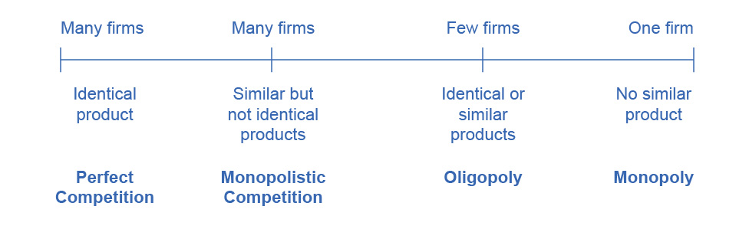
The Spectrum of Competition
Firms face different competitive situations.
At one extreme—perfect competition—many firms are all trying to sell identical products.
At the other extreme—monopoly—only one firm is selling the product, and this firm faces no competition.
Monopolistic competition is a situation with many firms selling similar, but not identical products.
Oligopoly is a situation with few firms that sell identical or similar products.

Slide 6
7.1 Explicit and Implicit Costs, and Accounting and Economic Profit
Profit = Total Revenue – Total Cost
Revenue - the income a firm generates from selling its products.
Total Revenue = Price × Quantity Sold
Explicit costs - out-of-pocket costs; actual payments.
Wages, rent, etc.
Implicit costs - the opportunity cost of using resources that the firm already owns.
Depreciation of goods, materials, and equipment

Slide 7
Types of Profit
Accounting profit - the difference between dollars brought in and dollars paid out.
Accounting Profit = Total Revenue – Explicit Costs
Economic profit - includes both explicit and implicit costs.
Economic Profit = Total Revenue – Total Costs
Total Costs = Explicit Costs + Implicit Costs

Slide 8

7.2 Production in the Short Run
The production process for pizza includes inputs such as ingredients, the efforts of the pizza maker, and tools and materials for cooking and serving. (Credit: “Grilled gluten-free BBQ chicken pizza” by Keith McDuffee/Flickr, CC BY 2.0)

Slide 9
Production
Categories of factors of production (inputs) - resources that firms use to produce their products,:
Natural Resources (Land and Raw Materials)
Labor
Capital
Technology
Entrepreneurship
Production function - mathematical equation that tells how much output (Q) a firm can produce with given amounts of the inputs.
Q = f [NR,L, K,t, E]

Slide 10
Inputs
Fixed inputs (K) - factors of production that can’t be easily increased or decreased in a short period of time
Variable inputs (L) - factors of production that a firm can easily increase or decrease in a short period of time
Short-hand form for the production function:
Q = f [L, K]

Slide 11
Short and Long Run Production
Short run - period of time during which at least some factors of production are fixed.
Long run - period of time during which all factors are variable.

Slide 12

Example - Production in Short Run
Production in the short run may be explored through the example of lumberjacks using a two-person saw.
Q = TP = f [L, K], or just
Q = TP = f [L]
Output (Q) is also called Total Product (TP).
Since K is fixed in the short run, the amount of output (trees cut down per day) depends only on the amount of labor employed (number of lumberjacks working).

Slide 13
Marginal Product
Marginal product (MP) - the additional output of one more worker.
Law of Diminishing Marginal Productivity - general rule that as a firm employs more labor, eventually the amount of additional output produced declines.

Slide 14
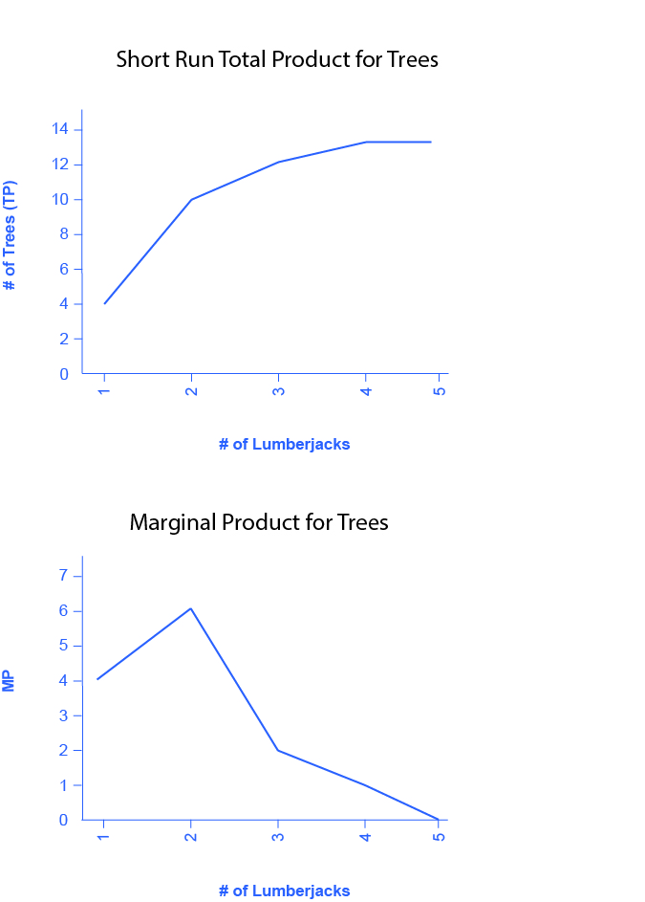
Short Run Production Function for Trees
The top graph shows the short run total product for trees.
As the number of lumberjacks increase, the output also increases, until 5 lumberjacks are reached.
The bottom graph shows that as workers are added, the MP increases at first, but sooner or later additional workers will have decreasing marginal product.

Slide 15
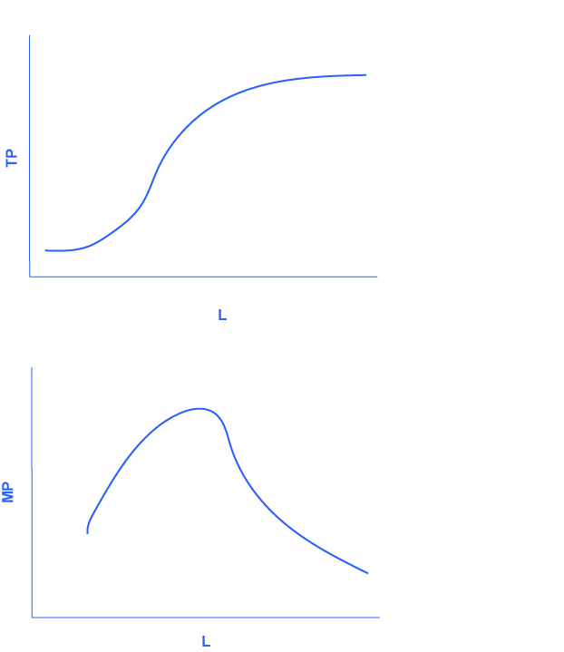
General Case of Total Product and Marginal Product Curves
General case of total product curve.
General case of marginal product curve.

Slide 16
7.3 Costs in the Short Run
Factor payments - what the firm pays for the use of the factors of production (aka costs, from the firm’s perspective).
Raw materials prices
Rent
Wages and salaries
Interest and dividends
Profit
Variable costs - costs of the variable inputs, like labor.
Fixed costs - costs of the fixed inputs, like rent.
Expenditure that a firm must make before production starts
Do not change in the short run
Do not change regardless of the level of production.
Total cost - the sum of fixed and variable costs of production

Slide 17
Costs
Average total cost (ATC) - total cost divided by the quantity of output produced.
ATC = TC
Q
Marginal cost (MC) - the additional cost of producing one more unit of output.
MC = ΔTC
ΔQ
Average variable cost - variable cost divided by quantity of output.

Slide 18
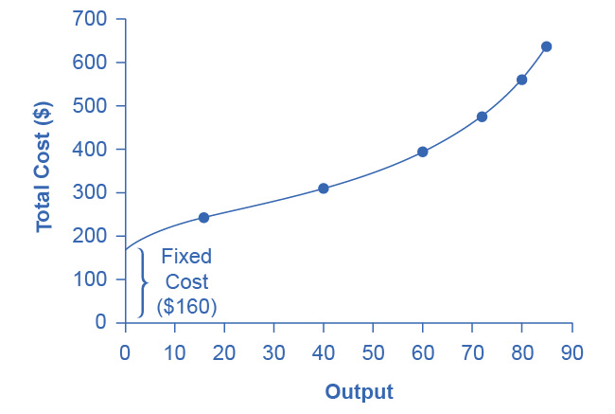
How Output Affects Total Costs
At zero production, the fixed costs of $160 are still present.
As production increases, variable costs are added to fixed costs, and the total cost is the sum of the two.

Slide 19
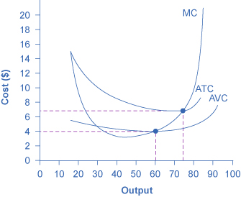
Cost Curves
Average total cost (ATC)
Typically U-shaped
Average variable cost (AVC)
Lies below the average total cost curve and
Typically U-shaped or upward-sloping.
Marginal cost (MC)
Generally upward-sloping

Slide 20
Average Profit
Average Profit or profit margin = price – average cost
If the market price > average cost, then average profit will be positive.
If price is < average cost, then profits will be negative.

Slide 21
7.4 Production in the Long Run
In the long run, all factors (including capital) are variable.
Production function is Q = f [L, K]
Because all factors are variable, the long run production function shows the most efficient way of producing any level of output.

Slide 22
7.5 Costs in the Long Run
The long run is the period of time when all costs are variable.
Production technologies - alternative methods of combining inputs to produce output
Economies of scale - the situation where, as the quantity of output goes up, the cost per unit goes down.

Slide 23
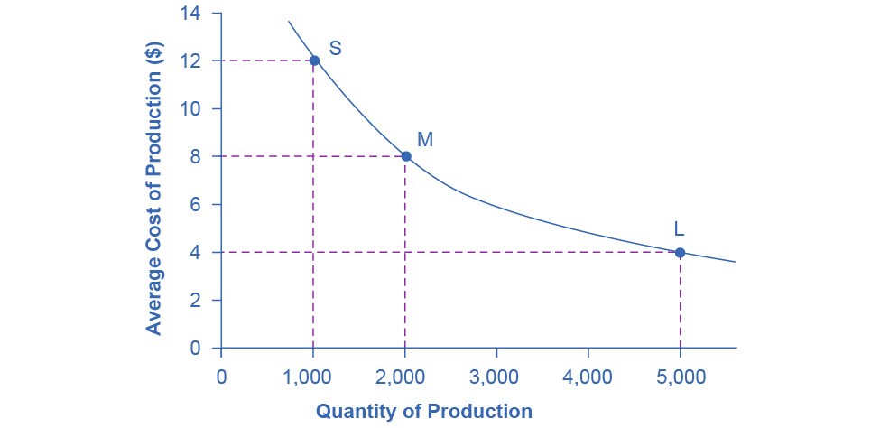
Economies of Scale
A small factory like S produces 1,000 alarm clocks at an average cost of $12 per clock.
A medium factory like M produces 2,000 alarm clocks at a cost of $8 per clock.
A large factory like L produces 5,000 alarm clocks at a cost of $4 per clock.
Economies of scale exist because the larger scale of production leads to lower average costs.

Slide 24
Shapes of Long-Run Average Cost Curves
Long-run average cost (LRAC) curve - shows the lowest possible average cost of production, allowing all the inputs to production to vary so that the firm is choosing its production technology.
Short-run average cost (SRAC) curves - the average total cost curve in the short term; shows the total of the average fixed costs and the average variable costs.

Slide 25
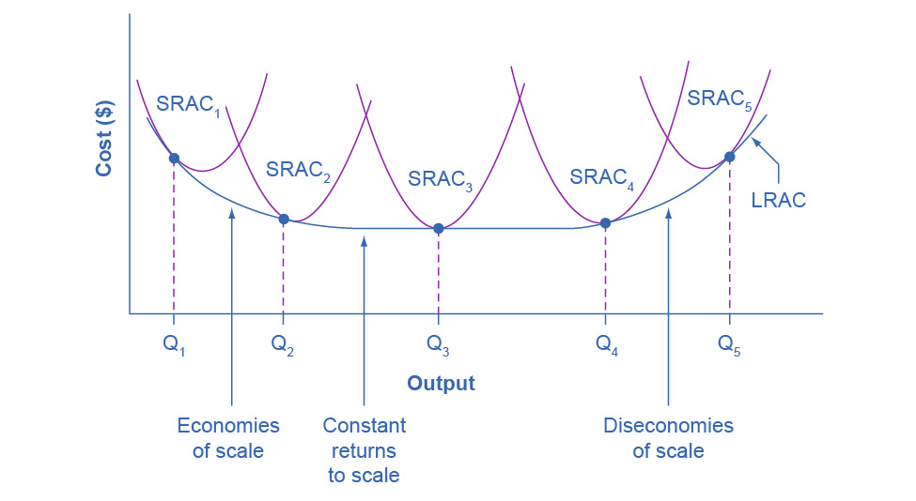
From Short-Run Average Cost Curves to Long-Run Average Cost Curves
The five different short-run average cost (SRAC) curves each represents a different level of fixed costs, from the low level of fixed costs at SRAC₁ to the high level of fixed costs at SRAC₅.
Other SRAC curves, not in the diagram, lie between the ones that are here.
The long-run average cost (LRAC) curve shows the lowest cost for producing each quantity of output when fixed costs can vary, and so it is formed by the bottom edge of the family of SRAC curves.
If a firm wished to produce quantity Q₃, it would choose the fixed costs associated with SRAC₃.

Slide 26
Ranges on the Long-Run Average Cost Curve
Constant returns to scale - when expanding all inputs proportionately does not change the average cost of production.
Diseconomies of scale - the long-run average cost of producing each individual unit increases as total output increases.
A firm or a factory can grow so large that it becomes very difficult to manage or run efficiently.

Slide 27
The Size and Number of Firms in an Industry
The shape of the long-run average cost curve has implications for:
how many firms will compete in an industry
whether the firms in an industry have many different sizes
or if they will tend to be the same size.

Slide 28
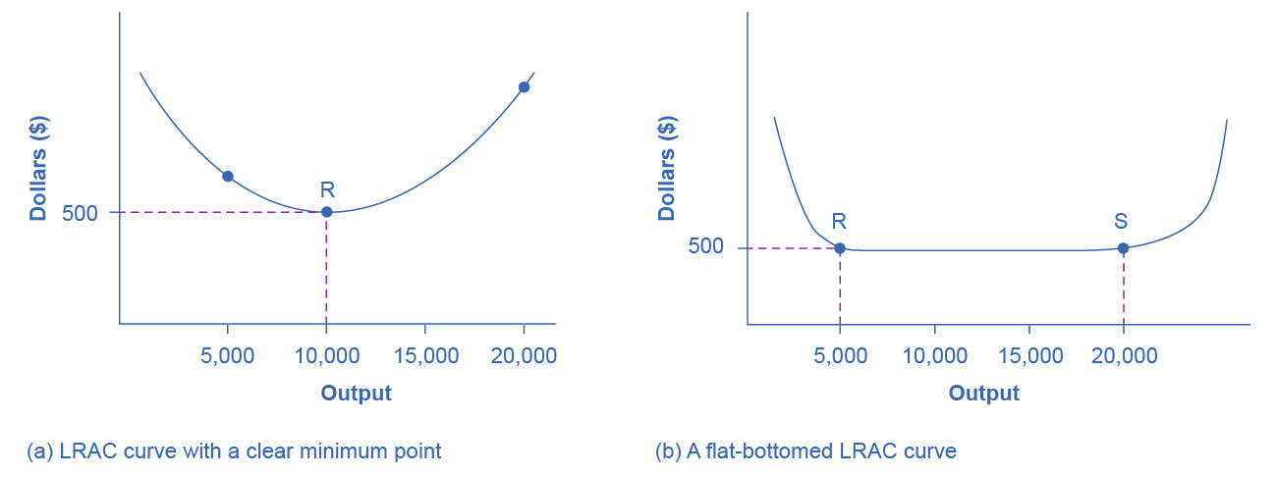
The LRAC Curve and the Size and Number of Firms
For graph (a):
Low-cost firms will produce at output level R.
When the LRAC curve has a clear minimum point, then any firm producing a different quantity will have higher costs.
In this case, a firm producing at a quantity of 10,000 will produce at a lower average cost than a firm producing 5,000 or 20,000 units.

Slide 29
The LRAC Curve and the Size and Number of Firms, Continued
For graph (b):
Low-cost firms will produce between output levels R and S.
When the LRAC curve has a flat bottom, then firms producing at any quantity along this flat bottom can compete.
In this case, any firm producing a quantity between 5,000 and 20,000 can compete effectively,
Firms producing less than 5,000 or more than 20,000 would face higher average costs and be unable to compete.

