Slide 1

Economics
PERFECT COMPETITION

Slide 2
Ch.8 OUTLINE
8.1: Perfect Competition and Why It Matters
8.2: How Perfectly Competitive Firms Make Output Decisions
8.3: Entry and Exit Decisions in the Long Run
8.4: Efficiency in Perfectly Competitive Markets

Slide 3

Competition in Farming
Depending upon the competition and prices offered, a wheat farmer may choose to grow a different crop.
(Credit: modification “Agronomist & Farmer Inspecting Weeds” by United Soybean Board/Flickr, CC BY 2.0)

Slide 4
8.1 Perfect Competition and Why It Matters
Market structure - the conditions in an industry, such as number of sellers, how easy or difficult it is for a new firm to enter, and the type of products that are sold.
Perfect competition - each firm faces many competitors that sell identical products.
4 criteria:
many firms produce identical products,
many buyers and many sellers are available,
sellers and buyers have all relevant information to make rational decisions,
firms can enter and leave the market without any restrictions.
Price taker - a firm in a perfectly competitive market that must take the prevailing market price as given.

Slide 5
8.2 How Perfectly Competitive Firms Make Output Decisions
A perfectly competitive firm has only one major decision to make - what quantity to produce?
A perfectly competitive firm must accept the price for its output as determined by the product’s market demand and supply.
The maximum profit will occur at the quantity where the difference between total revenue and total cost is largest.

Slide 6
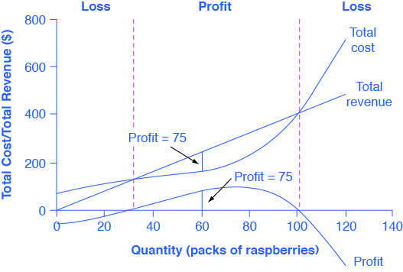
Total Cost and Total Revenue at a Raspberry Farm
Total revenue for a perfectly competitive firm is a straight line sloping up; the slope is equal to the price of the good.
Total cost also slopes up, but with some curvature.
At higher levels of output, total cost begins to slope upward more steeply because of diminishing marginal returns.
The maximum profit will occur at the quantity where the difference between total revenue and total cost is largest.

Slide 7
Comparing Marginal Revenue and Marginal Costs
Marginal revenue (MR) - the additional revenue gained from selling one more unit.
Marginal cost (MC) - the cost per additional unit sold.
The profit-maximizing choice for a perfectly competitive firm will occur at the level of output where MR = MC.

Slide 8
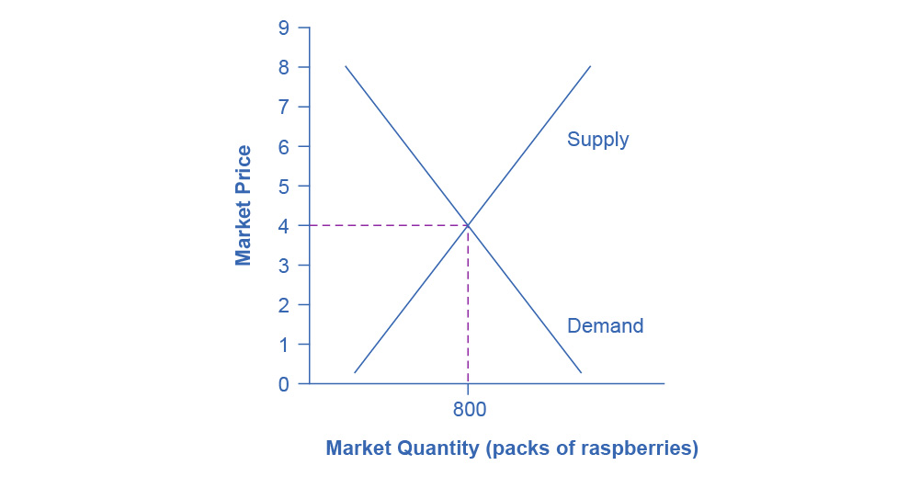
Marginal Revenues and Marginal Costs at the Raspberry Farm: Raspberry Market
The equilibrium price of raspberries is determined through the interaction of market supply and market demand at $4.00.
If there are 10 farms in the market, the equilibrium quantity is 80 × 10 = 800.

Slide 9
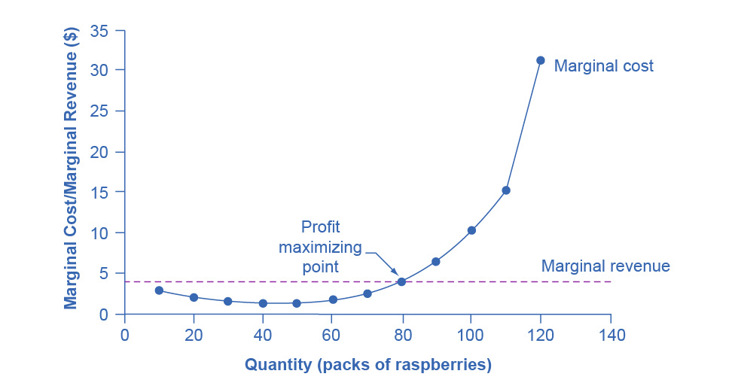
Marginal Revenues and Marginal Costs at the Raspberry Farm: Individual Farmer
For a perfectly competitive firm, the marginal revenue curve is a horizontal line because it’s equal to the price of the good ($4), determined by the market.
The marginal cost curve is sometimes initially downward-sloping, if there is a region of increasing marginal returns at low levels of output.
It is eventually upward-sloping at higher levels of output as diminishing marginal returns kick in.

Slide 10
Profits and Losses with the Average Cost Curve
Does maximizing profit (producing where MR = MC) imply an actual economic profit?
The answer depends on the relationship between price and average total cost, which is the average profit or profit margin.

Slide 11
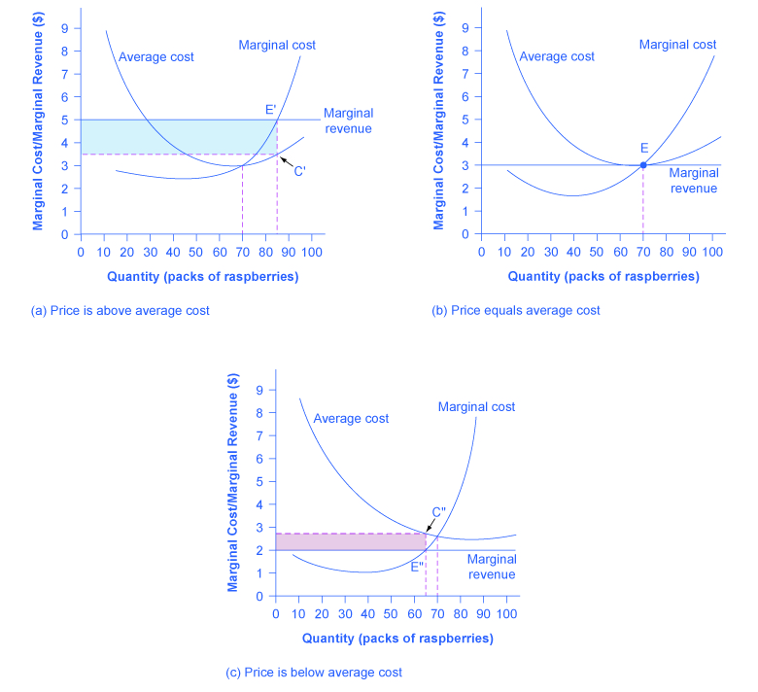
Price and Average Cost at the Raspberry Farm
In (a), price intersects MC above the AC curve.
Since price > AC, the firm is making a profit.
In (b), price intersects MC at the minimum point of the AC curve.
Since price = AC, the firm is breaking even.
In (c), price intersects MC below the AC curve.
Since price < average cost, the firm is making a loss.

Slide 12
The Shutdown Point
Discussion Question: Why can a firm not avoid losses by shutting down and not producing at all?
Shutdown point - the intersection of the average variable cost curve and the marginal cost curve. If:
price < minimum AVC, then the firm shuts down
price > minimum AVC, then the firm stays in business

Slide 13
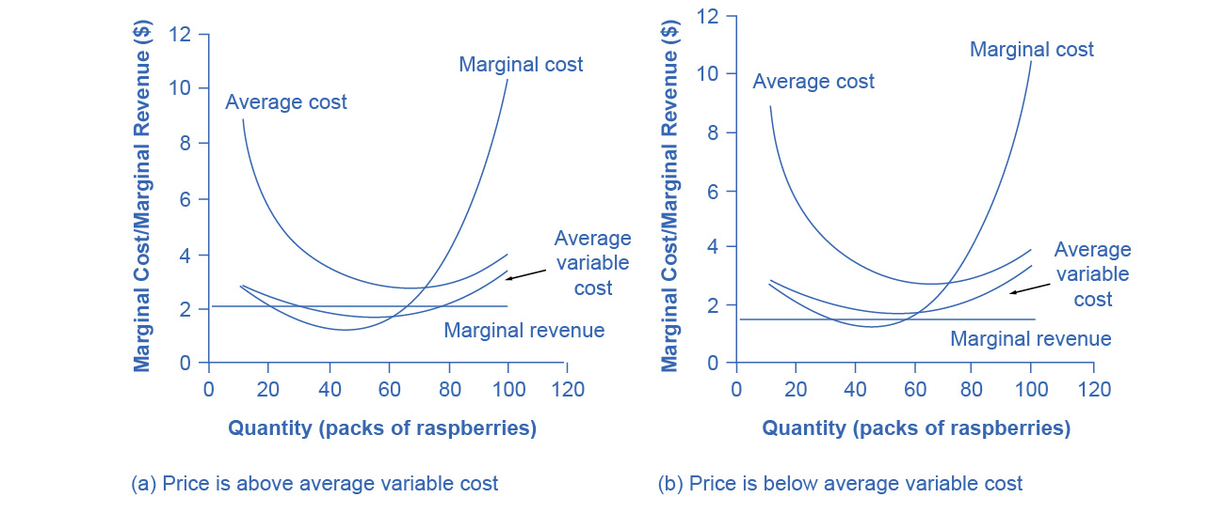
The Shutdown Point for the Raspberry Farm
In (a), the farm produces at a level of 65. It is making losses, but price > AVC, so it continues to operate.
In (b), the farm produces at a level of 60. This price < AVC for this level of output.
If the farmer cannot pay workers (the variable costs), then it has to shut down.

Slide 14
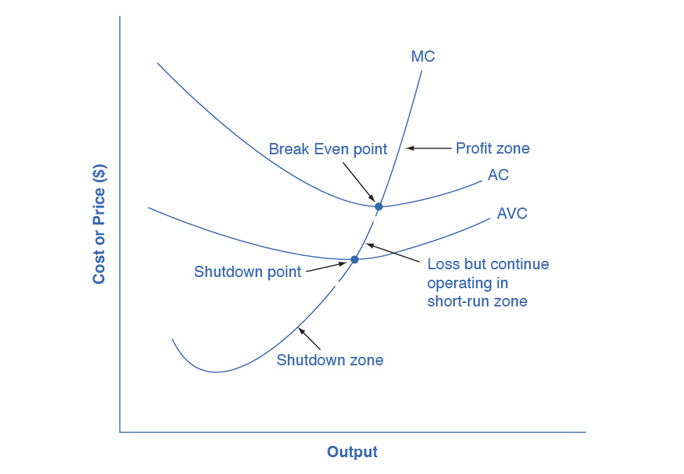
Short-Run Outcomes for Perfectly Competitive Firms
We can divide the MC curve into 3 zones, based on where it is crossed by the AC and AVC curves.
We call the point where MC crosses AC the break even point.
If the firm is operating where price > break even point, then price > AC and the firm is earning profits.
If the price = break even point, then the firm is making zero profits.
Break even point - level of output where the MC intersects the AC curve at the minimum point of AC; if the price is at this point, the firm is earning zero economic profits.

Slide 15
Short-Run Outcomes for Perfectly Competitive Firms
If shutdown point < price < break even point,
the firm is making losses
but will continue to operate in the short run,
since it is covering its variable costs, and more if price is above the shutdown-point price.
If price < shutdown point, then the firm will shut down immediately, since it is not even covering its variable costs.

Slide 16
8.3 Entry and Exit Decisions in the Long Run
Entry - when new firms enter the industry in response to increased industry profits.
Exit - the long-run process of reducing production in response to a sustained pattern of losses.
Long-run equilibrium - where all firms earn zero economic profits producing the output level where P = MR = MC and P = AC.

Slide 17
The Long-Run Adjustment and Industry Types
Constant-cost industry - as demand increases, the cost of production for firms stays the same.
Increasing-cost industry - as demand increases, the cost of production for firms increases.
Decreasing-cost industry - as demand increases the costs of production for the firms decreases

Slide 18
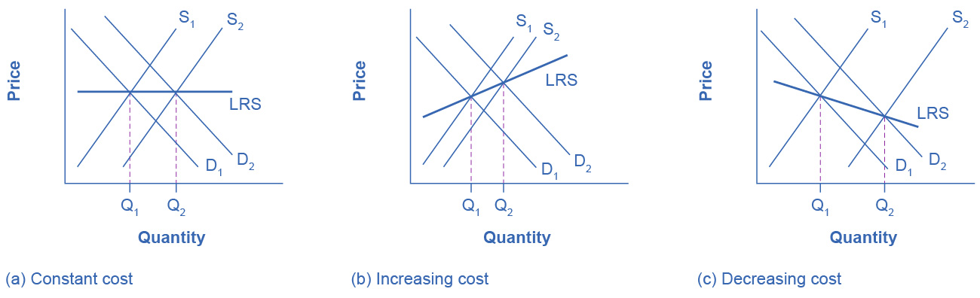
Adjustment Process in a Constant-Cost Industry
In (a), demand increased and supply met it.
Notice that the supply increase is equal to the demand increase.
The result is that the equilibrium price stays the same as quantity sold increases.

Slide 19
Adjustment Process in a Constant-Cost Industry
In (b), notice that sellers were not able to increase supply as much as demand.
Some inputs were scarce, or wages were rising.
The equilibrium price rises.
In (c), sellers easily increased supply in response to the demand increase.
Here, new technology or economies of scale caused the large increase in supply, The equilibrium price declines.

Slide 20
8.4 Efficiency in Perfectly Competitive Markets
When profit-maximizing firms in perfectly competitive markets combine with utility-maximizing consumers, the resulting quantities of outputs of goods and services demonstrate both productive and allocative efficiency.
Productive efficiency means producing without waste, so that the choice is on the PPF.
In the long run in a perfectly competitive market, the price in the market is equal to the minimum of the long-run average cost curve.
In other words, firms produce and sell goods at the lowest possible average cost.

Slide 21
Perfectly Competitive Market and Allocative Efficiency
Allocative efficiency means that among the points on the production possibility frontier, the chosen point is socially preferred.
In a perfectly competitive market, P = MC of production.
When perfectly competitive firms follow the rule that profits are maximized by producing at the quantity where P = MC, they are ensuring that the social benefits they receive from producing a good are in line with the social costs of production.

Slide 22
Compare Perfect Competition to Real-World Markets
Perfect competition is a hypothetical benchmark.
Real-world markets include many issues that are assumed away in the model of perfect competition.
Such as:
Pollution,
Inventions of new technology
Poverty (some people are unable to pay for basic necessities)
Government programs
Discrimination in labor markets
Buyers and sellers with imperfect and unclear information.

