Slide 1

Economics
MONOPOLY

Slide 2
Ch.9 OUTLINE
9.1: How Monopolies Form: Barriers to Entry
9.2: How a Profit-Maximizing Monopoly Chooses Output and Price

Slide 3
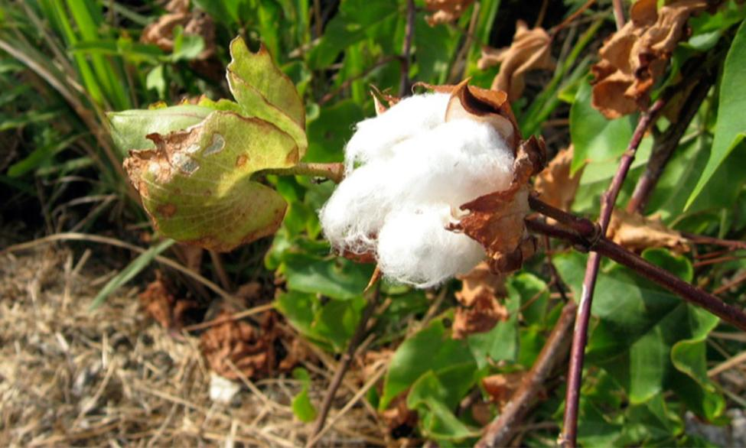
Political Power from a Cotton Monopoly
In the year 1860, the United States, specifically the Southern states, had a near monopoly in the cotton supplied to Great Britain.
These states attempted to leverage this economic power into political power—trying to sway Great Britain to formally recognize the Confederate States of America.
(Credit: modification of "cotton!" by ashley/Flickr, CC BY 2.0)

Slide 4
9.1 How Monopolies Form: Barriers to Entry
Monopoly - one firm produces all of the output in a market
Barriers to entry - are the legal, technological, or market forces that discourage or prevent potential competitors from entering a market.
Natural monopoly - where the barriers to entry are something other than legal prohibition.
Legal monopoly - laws prohibit (or severely limit) competition.

Slide 5
Natural Monopoly
Natural monopolies can arise:
in industries where the marginal cost of adding an additional customer is very low, once the fixed costs of the overall system are in place.
in smaller local markets for products that are difficult to transport.
when a company has control of a scarce physical resource.
Discussion Question: What are some examples of natural monopolies?

Slide 6
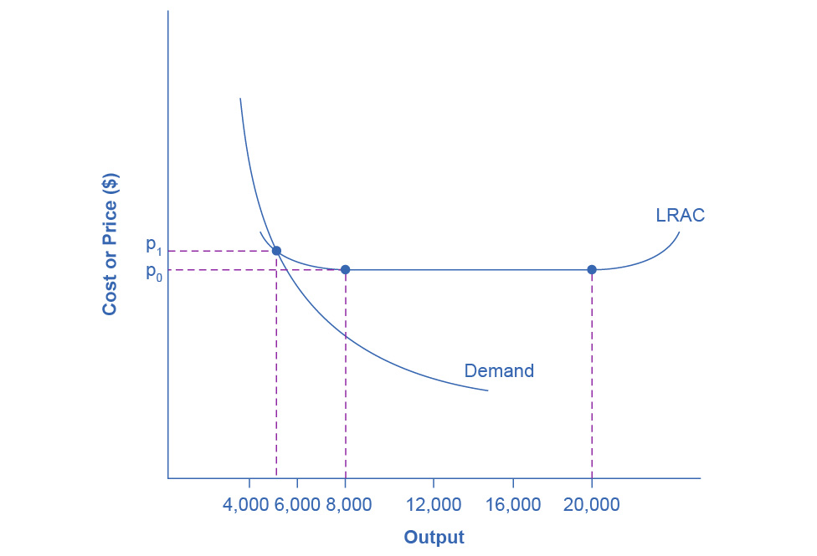
Economies of Scale and Natural Monopoly
In this market, the demand curve intersects the long-run average cost (LRAC) curve at its downward-sloping part.
A natural monopoly occurs when the quantity demanded is less than the minimum quantity it takes to be at the bottom of the long-run average cost curve.

Slide 7
Legal Monopoly
The government creates barriers to entry by prohibiting or limiting competition.
Examples of legal monopolies:
U.S. Postal Service
Utilities - electric, water, garbage, etc.

Slide 8
Promoting Innovation
Patent - gives the inventor the exclusive legal right to make, use, or sell the invention for a limited time.
Trademark - an identifying symbol or name for a particular good.
Copyright - a form of legal protection to prevent copying, for commercial purposes, original works of authorship, including books and music.
Trade secrets - methods of production kept secret by the producing firm

Slide 9
Promoting Innovation
Intellectual property - the body of law including patents, trademarks, copyrights, and trade secret law that protect the right of inventors to produce and sell their inventions.
Implies ownership over an idea, concept, or image, not a physical piece of property.
Deregulation - removing government controls over setting prices and quantities in certain industries.

Slide 10
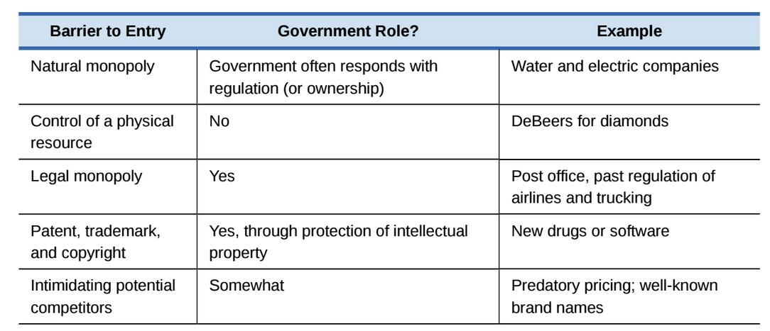
Summing Up Barriers to Entry

Slide 11
Intimidating Potential Competition
Predatory pricing - a firm uses the threat of sharp price cuts to discourage competition.
A violation of U.S. antitrust law, but it is difficult to prove.

Slide 12
9.2 How a Profit-Maximizing Monopoly Chooses Output and Price
A monopolist can charge any price for its product, but the demand for the firm’s product constrains the price.
Because the monopolist is the only firm in the market, its demand curve is the same as the market demand curve.

Slide 13
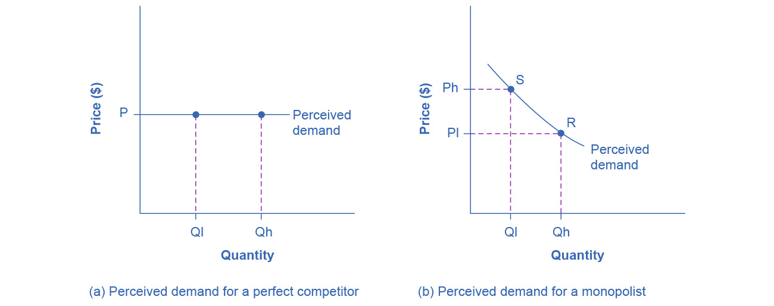
The Perceived Demand Curve for a Perfect Competitor and a Monopolist
In graph (a), a perfectly competitive firm’s demand curve is flat.
The flat shape means that the firm can sell either a low quantity (Ql) or a high quantity (Qh) at exactly the same price (P).

Slide 14
The Perceived Demand Curve for a Perfect Competitor and a Monopolist, Continued
A monopolist’s demand curve is the same as the market demand curve, which for most goods is downward-sloping.
So, if the monopolist chooses a high level of output (Qh), it can charge only a relatively low price (Pl);
Conversely, if the monopolist chooses a low level of output (Ql), it can then charge a higher price (Ph).
The challenge for the monopolist is to choose the combination of price and quantity that maximizes profits.

Slide 15
Total Cost and Total Revenue for a Monopolist
Total costs rise as output increases.
The highest profit will occur at the quantity where total revenue is the farthest above total cost.

Slide 16
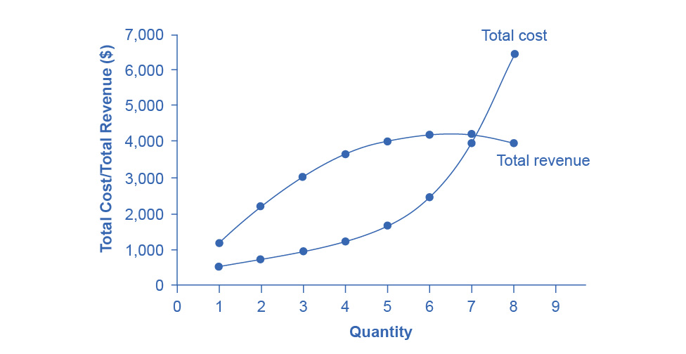
Total Revenue and Total Cost for the HealthPill Monopoly
Total revenue for the monopoly firm called HealthPill first rises, then falls.
Low levels of output bring in relatively little total revenue, because the quantity is low.
High levels of output bring in relatively less revenue, because the high quantity pushes down the market price.
The total cost curve is upward-sloping.

Slide 17
Total Revenue and Total Cost for the HealthPill Monopoly, Continued
Profits will be highest at the quantity of output where total revenue is most above total cost.
The profit-maximizing level of output is not the same as the revenue-maximizing level of output, which should make sense, because profits take costs into account and revenues do not.

Slide 18
Marginal Revenue and Marginal Cost for a Monopolist
In the real world, a monopolist often does not have enough information to analyze its entire total revenues or total costs curves.
The firm does not know exactly what would happen if it were to alter production dramatically.
However, a monopolist often has fairly reliable information about how changing output by small or moderate amounts will affect its marginal revenues and marginal costs.
Marginal profit - profit of one more unit of output, computed as marginal revenue minus marginal cost.

Slide 19
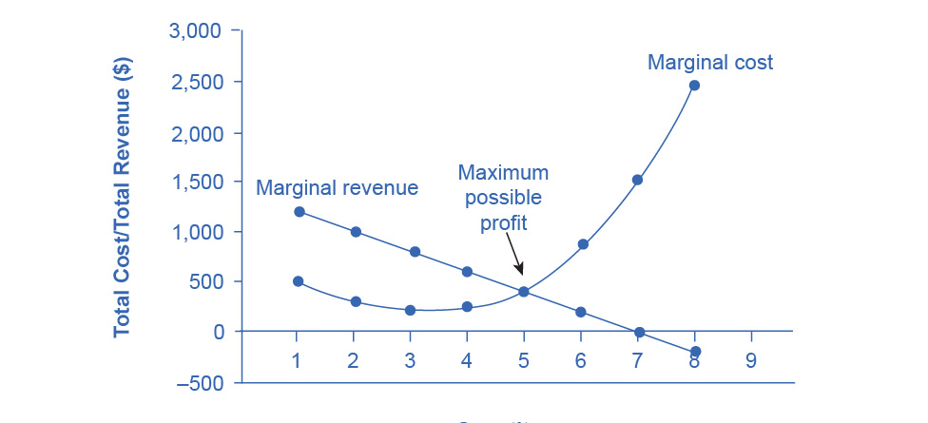
Marginal Revenue and Marginal Cost for the HealthPill Monopoly
For a monopoly like HealthPill, marginal revenue decreases as it sells additional units of output.
The marginal cost curve is upward-sloping.
The profit-maximizing choice for the monopoly will be to produce at the quantity where MR = MC.

Slide 20
Marginal Revenue and Marginal Cost for the HealthPill Monopoly, Continued
If the monopoly produces a lower quantity, then MR > MC at those levels of output, and the firm can make higher profits by expanding output.
If the firm produces at a greater quantity, then MC > MR, and the firm can make higher profits by reducing its quantity of output.

Slide 21
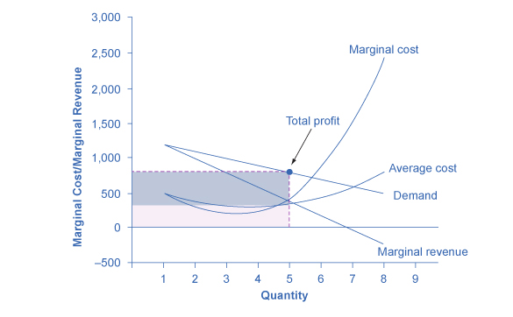
Illustrating Profits at the HealthPill Monopoly
Using the same MR and MC curves, the AC curve and the demand curve are added.
The HealthPill firm first chooses the quantity where MR = MC of 5.
The monopolist then decides what price to charge by looking at the demand curve it faces.
The large box, with quantity on the horizontal axis and demand (which shows the price) on the vertical axis, shows total revenue for the firm.

Slide 22
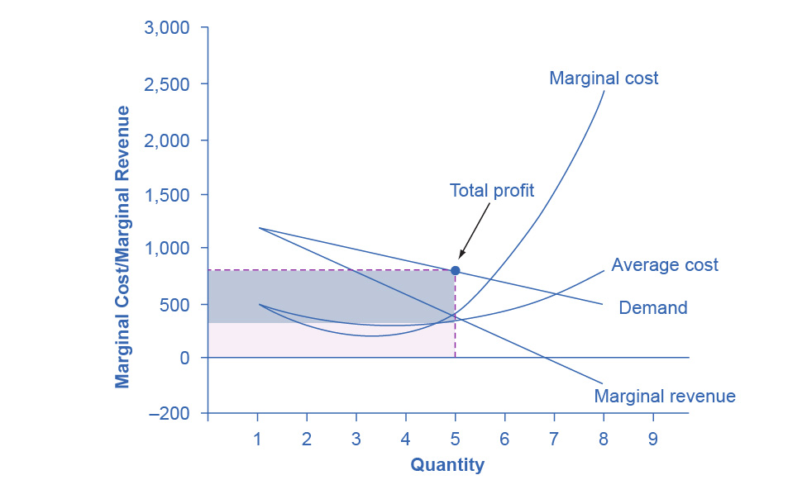
Illustrating Profits at the HealthPill Monopoly, Continued
The lighter-shaded box, which is quantity on the horizontal axis and average cost of production on the vertical axis shows the firm's total costs.
The large total revenue box minus the smaller total cost box leaves the darkly shaded box that shows total profits.
Since the price charged is above average cost, the firm is earning positive profits.

Slide 23
How a Profit-Maximizing Monopoly Decides Price
Step 1: The Monopolist Determines Its Profit-Maximizing Level of Output
Step 2: The Monopolist Decides What Price to Charge
Step 3: Calculate Total Revenue, Total Cost, and Profit

Slide 24
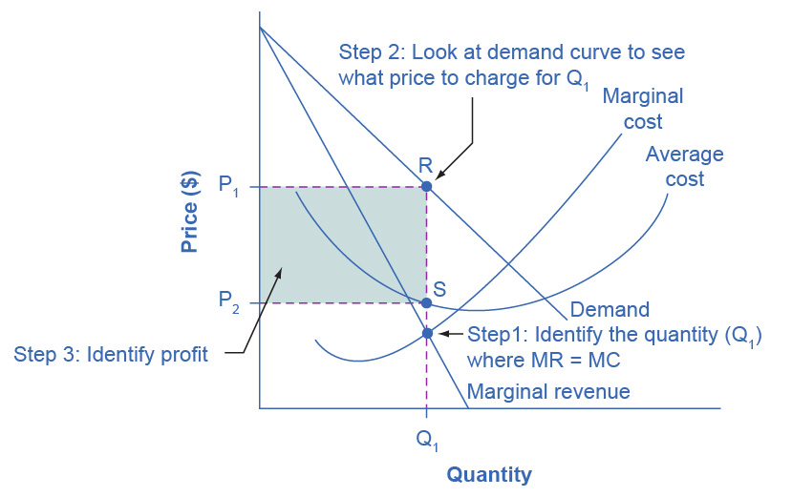
How a Profit-Maximizing Monopoly Decides Price
Step 1, the monopoly chooses the profit-maximizing level of output Q₁, by choosing the quantity where MR = MC.
Step 2, the monopoly decides how much to charge for output level Q₁ by drawing a line straight up from Q₁ to point R on its perceived demand curve.
Thus, the monopoly will charge a price (P₁).

Slide 25
How a Profit-Maximizing Monopoly Decides Price, Continued
Step 3, the monopoly identifies its profit.
Total revenue will be Q₁ multiplied by P₁.
Total cost will be Q₁ multiplied by the average cost of producing Q₁, which point S shows on the average cost curve to be P₂.
Profits will be the total revenue rectangle - total cost rectangle, which the shaded zone in the figure shows.

Slide 26
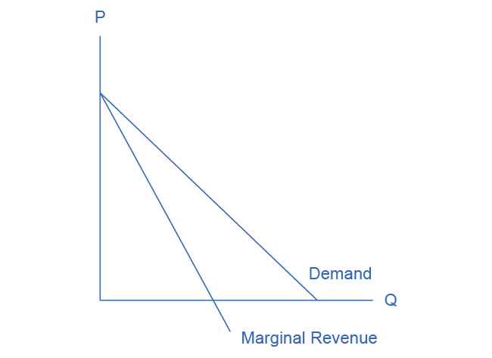
The Monopolist’s Marginal Revenue Curve versus Demand Curve
Because the market demand curve is conditional, the marginal revenue curve for a monopolist lies beneath the demand curve.

Slide 27
The Inefficiency of Monopoly
Allocative efficiency - producing the optimal quantity of some output; the quantity where the marginal benefit to society of one more unit just equals the marginal cost.

