Slide 1

Economics
MONOPOLISTIC COMPETITION AND OLIGOPOLY

Slide 2
Ch.10 OUTLINE
10.1: Monopolistic Competition
10.2: Oligopoly

Slide 3
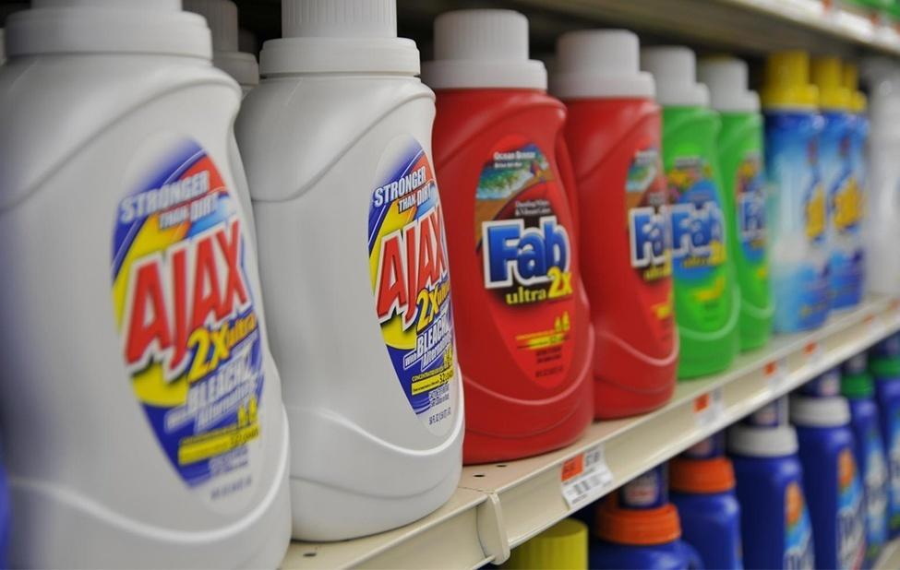
Competing Brands?
The laundry detergent market is one that is characterized neither as perfect competition nor monopoly.
(Credit: modification of “DSC_7174” by Pixel Drip/Flickr Creative Commons, CC BY 2.0)

Slide 4
10.1 Monopolistic Competition
Imperfectly competitive - firms and organizations that fall between the extremes of monopoly and perfect competition.
Monopolistic competition - many firms competing to sell similar but differentiated products.
Oligopoly - when a few large firms have all or most of the sales in an industry.

Slide 5
Differentiated Products
Differentiated product - a product that consumers perceive as distinctive in some way.
Ways for a product to be differentiated:
physical aspects
location from which it sells
intangible aspects
perceptions

Slide 6
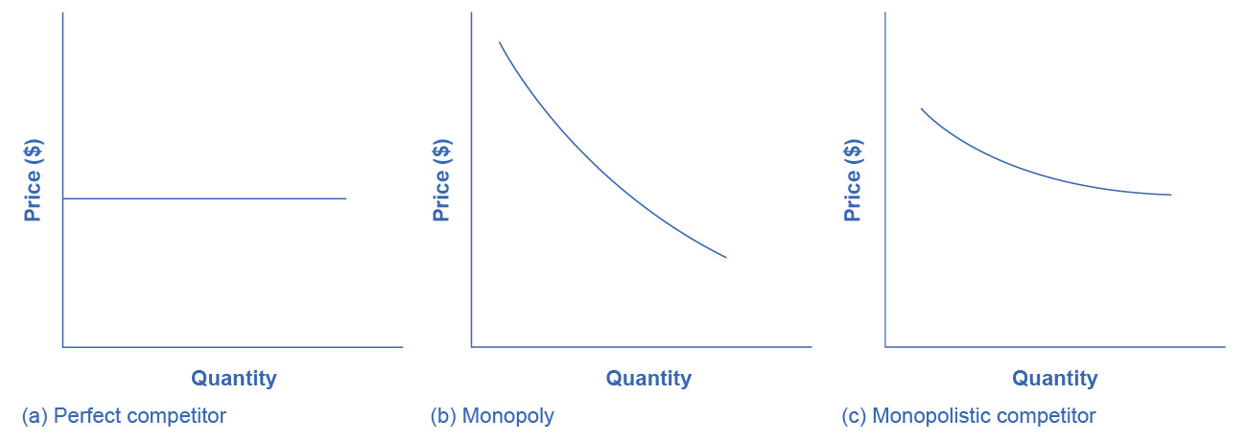
Perceived Demand for Firms in Different Competitive Settings
The demand curve faced by a perfectly competitive firm is perfectly elastic.
It can sell all the output it wishes at the prevailing market price.
(a)

Slide 7
Perceived Demand for Firms in Different Competitive Settings
The demand curve faced by a monopoly is the market demand.
It can sell more output only by decreasing the price it charges.
(b)

Slide 8
Perceived Demand for Firms in Different Competitive Settings
(c)
The demand curve faced by a monopolistically competitive firm falls in between.

Slide 9
How a Monopolistic Competitor Chooses Price and Quantity
The monopolistically competitive firm decides on its profit-maximizing quantity and price in much the same way as a monopolist.
A monopolistic competitor, like a monopolist, faces a downward-sloping demand curve,
It will choose some combination of price and quantity along its perceived demand curve.

Slide 10
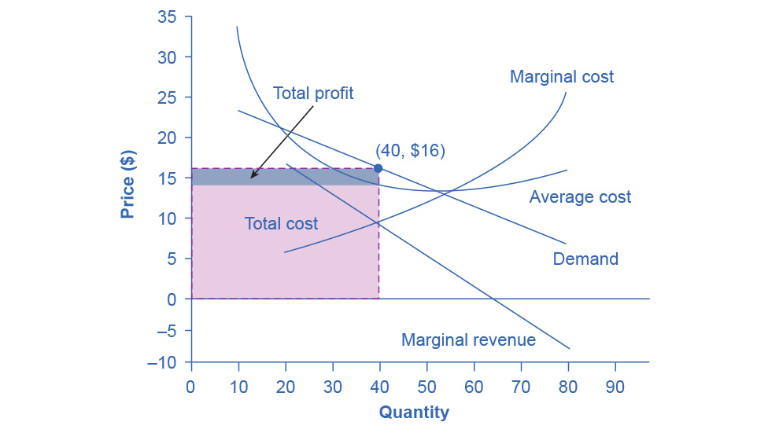
Example: How a Monopolistic Competitor Chooses its Profit Maximizing Output and Price
To maximize profits, a firm would choose a quantity, Q, where MR = MC.
Here it would choose a quantity of 40 and a price of $16.

Slide 11
Monopolistic Competitors and Entry
If one monopolistic competitor earns positive economic profits, other firms will be tempted to enter the market.
The entry of other firms into the same general market shifts the demand curve that a monopolistically competitive firm faces.

Slide 12
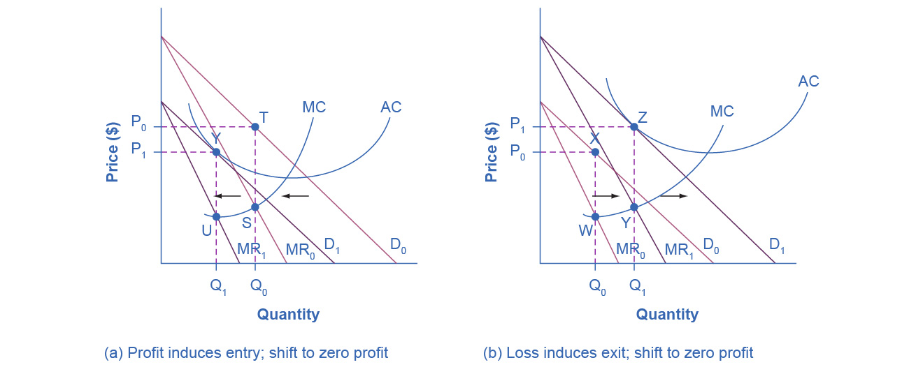
Monopolistic Competition, Entry, and Exit
At P₀ and Q₀, the monopolistically competitive firm shown in this figure is making a positive economic profit.
This is clear because if you follow the dotted line above Q₀, you can see that price > AC.
Positive economic profits attract competing firms to the industry, driving the original firm’s demand down to D₁.
At the new equilibrium quantity (P₁, Q₁), the original firm is earning zero economic profits, and entry into the industry ceases.

Slide 13
Monopolistic Competition, Entry, and Exit, Continued
In (b) the opposite occurs.
At P₀ and Q₀, the firm is losing money.
If you follow the dotted line above Q₀, you can see that AC > price.
Losses induce firms to leave the industry.
When they do, demand for the original firm rises to D₁, where once again the firm is earning zero economic profit.

Slide 14
Monopolistic Competition and Efficiency
The long-term result of entry and exit in a perfectly competitive market:
Firms sell at the price level determined by the lowest point on the AC curve.
Displays productive efficiency: goods are produced at the lowest possible average cost.
In monopolistic competition, the end result of entry and exit:
Firms end up with a price that lies on the downward-sloping portion of the AC curve, not at the very bottom of the AC curve.
Thus, monopolistic competition will not be productively efficient.

Slide 15
10.2 Oligopoly
Oligopoly - when a small number of large firms have all or most of the sales in an industry.
If oligopolists compete hard, they act similarly to perfect competitors, driving down costs and leading to zero profits for all.
If oligopolists collude with each other, they may act like a monopoly, and succeed in pushing up prices and earning consistently high levels of profit.
Discussion Question: What are examples of oligopolies?

Slide 16
Collusion and Cartels
Collusion - when firms act together to reduce output and keep prices high. They do this by:
holding down industry output,
charging a higher price,
and dividing the profit among themselves.
Cartel - a group of firms that have a formal agreement to collude to produce the monopoly output and sell at the monopoly price.

Slide 17
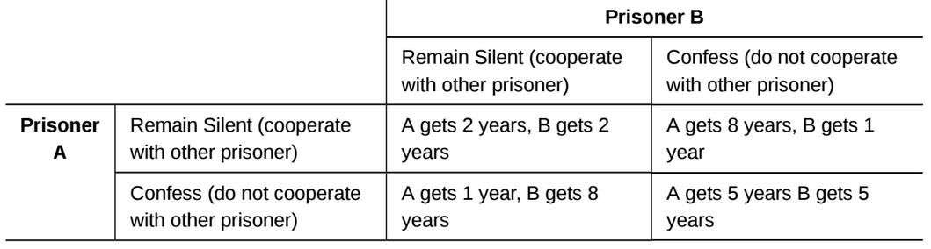
The Prisoner’s Dilemma
Game theory - a branch of mathematics that analyzes situations in which players must make decisions and then receive payoffs based on what other players decide to do.
Prisoner’s dilemma - a scenario in which the gains from cooperation are larger than the rewards from pursuing self-interest.

Slide 18
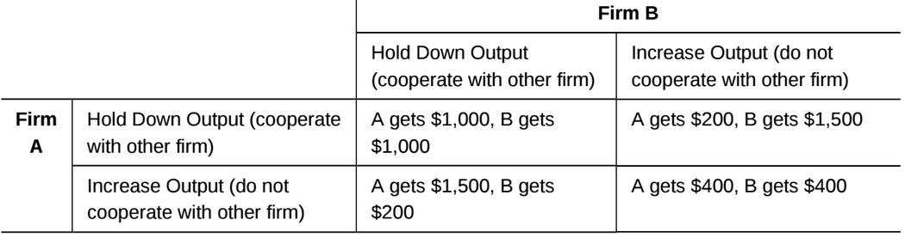
The Oligopoly Version of the Prisoner’s Dilemma
Duopoly - an oligopoly with only two firms.

Slide 19
How to Enforce Cooperation
The way out of a prisoner’s dilemma is to find a way to penalize those who do not cooperate.
Oligopolists may choose to act in a way that generates pressure on each firm to stick to its agreed quantity of output.
Kinked demand curve - a perceived demand curve that arises when competing oligopoly firms commit to match price cuts, but not price increases

Slide 20
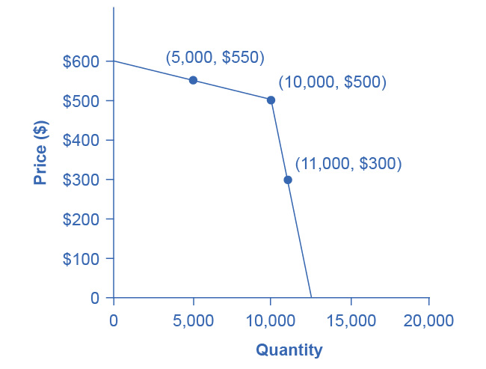
A Kinked Demand Curve
A member firm in an oligopoly cartel is supposed to produce a quantity of 10,000 and sell at a price of $500.
The other members of the cartel can encourage this firm to honor its commitments by acting so that the firm faces a kinked demand curve.

Slide 21
A Kinked Demand Curve, Continued
If the member firm expands output to 11,000, the price per unit falls dramatically, to $300.
Because other firms also cut prices immediately.
If the firm raises its price to $550, its sales decline sharply to 5,000.
Because other firms will not raise prices also.
Thus, the members of a cartel can discipline each other to stick to the pre-agreed levels of quantity and price through a strategy of matching all price cuts but not matching any price increases.

