Slide 1

Economics
MONOPOLY AND ANTITRUST POLICY

Slide 2
Ch.11 OUTLINE
11.1: Corporate Mergers
11.2: Regulating Anticompetitive Behavior
11.3: Regulating Natural Monopolies
11.4: The Great Deregulation Experiment

Slide 3
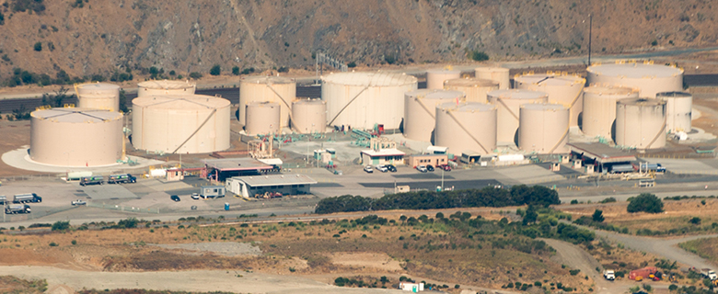
Oligopoly versus Competitors in the Marketplace
Large corporations, such as the natural gas producer Kinder Morgan, can bring economies of scale to the marketplace.
Will that benefit consumers, or is more competition better? (Credit: modification of “Aerial view of Kinder Morgan Brisbane Terminal” by Chiara Coetzee/Flickr Creative Commons, Public Domain)

Slide 4
11.1 Corporate Mergers
Merger - when two formerly separate firms combine to become a single firm.
Acquisition - when one firm purchases another.

Slide 5
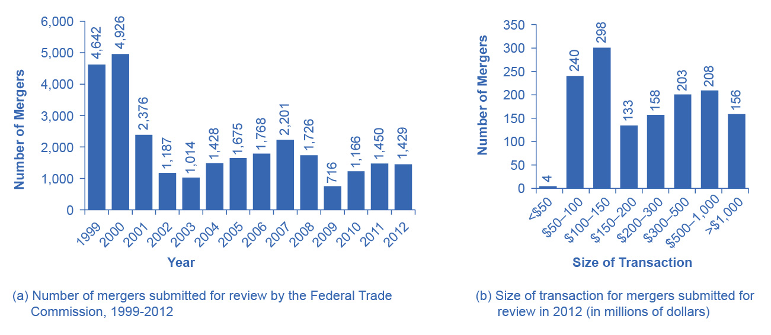
Number and Size of Mergers
The number of mergers in 1999 and 2000 were relatively high compared to the annual numbers seen from 2001–2012.
While 2001 and 2007 saw a high number of mergers, these were still only about half the number of mergers in 1999 and 2000.
In 2012, the greatest number of mergers submitted for review was for transactions between $100 and $150 million.
(a)
(b)

Slide 6
Regulations for Approving Mergers
Antitrust laws - laws that give government the power to block certain mergers, and even in some cases to break up large firms into smaller ones.
Historical antitrust laws:
Sherman Antitrust Act
Clayton Antitrust Act
Celler-Kefauver Act

Slide 7
Measuring Degree of Monopoly Power - Old Way
Regulators have tried to measure the degree of monopoly power in an industry.
(Four-Firm) Concentration ratio - an earlier tool which measures what share of the total sales in the industry are accounted for by the largest firms, typically the top four to eight firms.
Market share - each firm’s proportion of total sales in that market.

Slide 8
The Herfindahl-Hirshman Index
The Herfindahl-Hirshman Index (HHI) - approach to measuring market concentration by adding the square of the market share of each firm in the industry.

Slide 9
Defining A Market in Current Times
Now, defining a market is often difficult and controversial.
In recent decades, there have been two important shifts affecting how markets are defined:
technology
globalization

Slide 10
Measuring Degree of Monopoly Power - New Way
The new approach to antitrust regulation involves detailed analysis of specific markets and companies, instead of defining a market and counting up total sales. It is done by:
estimating the demand curves and supply curves the firms proposing a merger face.
building a statistical model that estimates the likely outcome for consumers if the two firms are allowed to merge.

Slide 11
11.2 Regulating Anticompetitive Behavior
Under U.S. antitrust laws, monopoly itself is not illegal.
But, U.S. antitrust laws include rules against some restrictive practices.
Restrictive practices - practices that do not involve outright agreements to raise prices or to reduce the quantity produced, but that might have the effect of reducing competition.

Slide 12
Types of Restrictive Practices
Types of restrictive practices:
Minimum resale price maintenance agreement - requires a dealer who buys from a manufacturer to sell for at least a certain minimum price.
Exclusive dealing - an agreement that a dealer will sell only products from one manufacturer.
Tying sales - a situation where a customer is allowed to buy one product only if the customer also buys another product.
Bundling - a situation in which multiple products are sold as one.

Slide 13
11.3 Regulating Natural Monopolies
Most true monopolies today in the U.S. are regulated, natural monopolies.
Natural monopoly arises when average costs are declining over the range of production that satisfies market demand.
Typically happens when fixed costs are large relative to variable costs.

Slide 14
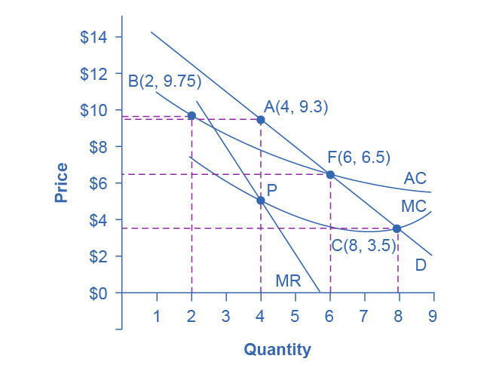
Regulatory Choices in Dealing with Natural Monopoly
A natural monopoly will maximize profits by producing at the quantity where MR = MC, and by then looking to the market demand curve to see what price to charge for this quantity.
This monopoly will produce at point A, with a quantity of 4 and a price of 9.3.

Slide 15
Regulatory Choices in Dealing with Natural Monopoly
If antitrust regulators split this company exactly in half, then each half would produce at point B, with average costs of 9.75 and output of 2.
The regulators might require the firm to produce where MC = D at point C.
However, if the firm is required to produce at a quantity of 8 and sell at a price of 3.5, the firm will incur losses.
The most likely choice is point F, where the firm is required to produce a quantity of 6 and charge a price of 6.5.

Slide 16
Cost-Plus versus Price Cap Regulation
Cost-plus regulation - when regulators permit a regulated firm to cover its costs and to make a normal level of profit.
Price cap regulation - when the regulator sets a price that a firm cannot exceed over the next few years.

Slide 17
11.4 The Great Deregulation Experiment
Deregulation - removing government controls over prices and quantities.
Regulatory capture - when the supposedly regulated firms end up playing a large role in setting the regulations that they will follow and as a result, they “capture” the people usually through the promise of a job in that “regulated” industry once their term in government has ended.

Slide 18
The Effects of Deregulation
Sarbanes-Oxley Act - designed to increase confidence in financial information provided by public corporations to protect investors from accounting fraud.
Dodd-Frank Act - “To promote the financial stability of the United States by improving accountability and transparency in the financial system, to end “too big to fail,” to protect the American taxpayer by ending bailouts, [and] to protect consumers from abusive financial services practices…”

Slide 19
Airline Deregulation
1926 - 1st U.S. government regulation of airline industry, giving airlines permission to fly certain routes based on mail delivery needs.
1934 - Antitrust authorities charged the Postmaster General with colluding with the major airlines to monopolize the nation’s airways.
1938 - U.S. government created the Civil Aeronautics Board (CAB) to regulate airfares and routes instead.
1978 - Airline Deregulation Act took the government out of the business of determining airfares and schedules.
Following 30 years: greater competition from deregulation, reduced airfares, increased efficiency, offered more service, increased jobs.
Discussion questions: Since deregulation, how has a string of mergers raised concerns over how competition might be compromised? Has it affected the consumer product and demand for it?

