Slide 1

Economics
THE INTERNATIONAL TRADE AND CAPITAL FLOWS

Slide 2
Ch.23 OUTLINE
23.1: Measuring Trade Balances
23.2: Trade Balances in Historical and International Context
23.3: Trade Balances and Flows of Financial Capital
23.4: The National Saving and Investment Identity
23.5: The Pros and Cons of Trade Deficits and Surpluses
23.6: The Difference between Level of Trade and the Trade Balance

Slide 3
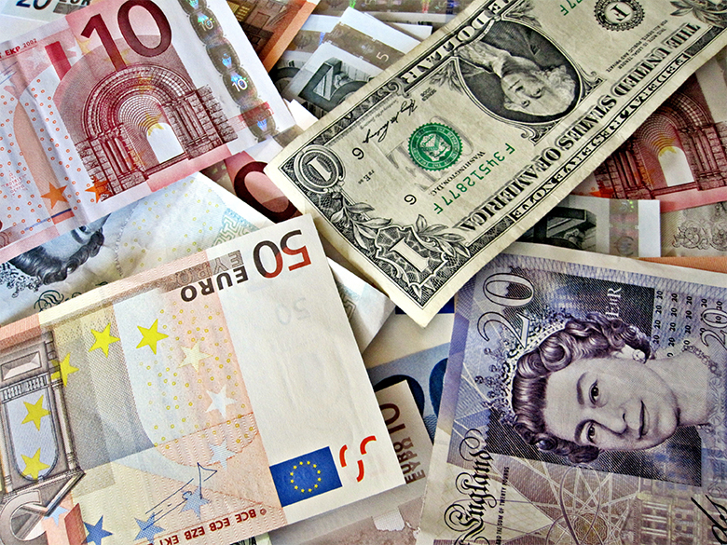
A World of Money
We are all part of the global financial system, which includes many different currencies. (Credit: modification of "Money from around the world" by Images Money/Flickr, CC BY 2.0)

Slide 4
23.1 Measuring Trade Balances
Balance of trade (or trade balance) - the gap, if any, between a nation’s exports and imports.
In high-income economies, including the U.S., goods comprise less than half of a country’s total production, while services comprise more than half.

Slide 5
Merchandise Trade Balance vs. Current Account Balance
Merchandise trade balance - the balance of trade looking only at goods.
Current account balance - a broad measure of the balance of trade that includes trade in goods and services, as well as international flows of income and foreign aid.
Unilateral transfers - payments that government, private charities, or individuals make in which they send money abroad without receiving any direct good or service.

Slide 6
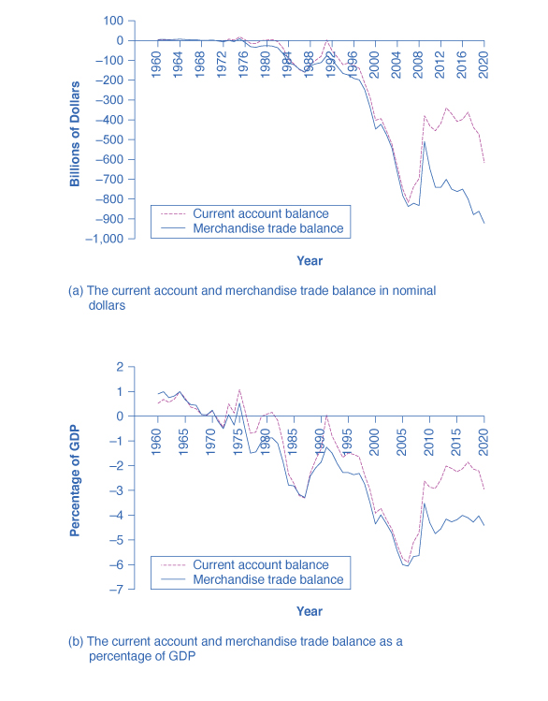
23.2 Trade Balances in Historical and International Context
Graph (a), shows the current account balance and the merchandise trade balance in billions of dollars from 1960 to 2020.
If the lines are above zero dollars, the United States was running a positive trade balance and current account balance.
If the lines fall below zero dollars, the United States is running a trade deficit and a deficit in its current account balance.

Slide 7
23.2 Trade Balances in Historical and International Context, Continued
Graph (b) shows the same items - trade balance and current account balance - in relationship to the size of the U.S. economy, or GDP, from 1960 to 2020.

Slide 8
A Measure of an Economy's Globalization
Exports of goods and services as a percentage of GDP - the dollar value of exports divided by the dollar value of a country’s GDP.

Slide 9
23.3 Trade Balances and Flows of Financial Capital
Financial capital - the international flows of money that facilitates trade and investment.
The connection between trade balances and international flows of financial capital is so close that economists sometimes describe the balance of trade as the balance of payments.
Each category of the current account balance involves a corresponding flow of payments between a given country and the rest of the world economy.

Slide 10
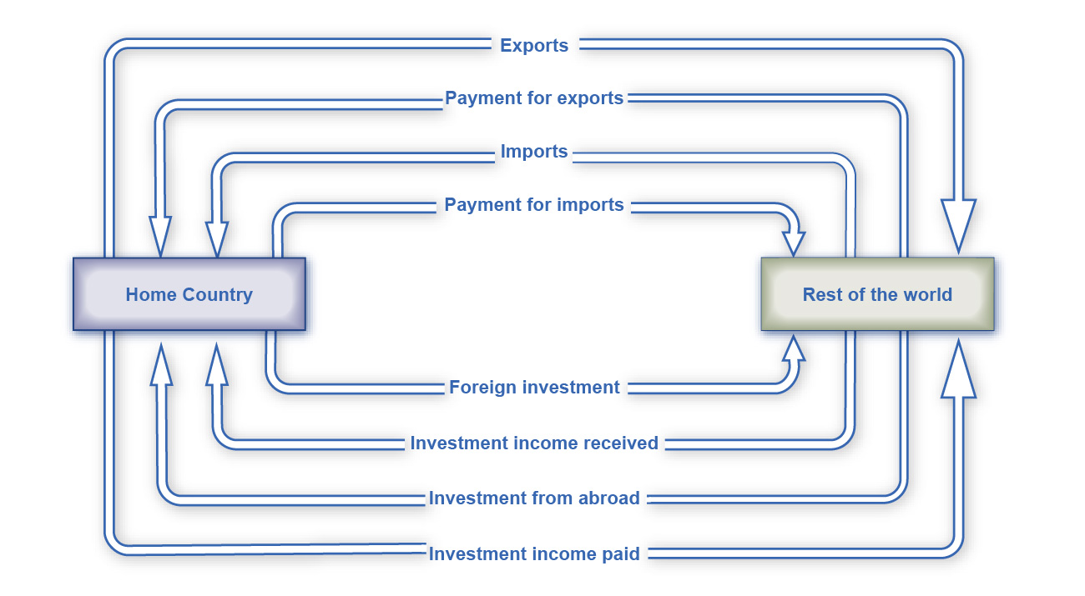
Flow of Investment Goods and Capital
Each element of the current account balance involves a flow of financial payments between countries.
The top line shows exports of goods and services leaving the home country.
The second line shows the money that the home country receives for those exports.
The third line shows imports that the home country receives.
The fourth line shows the payments that the home country sent abroad in exchange for these imports.

Slide 11
The Balance of Trade as the Balance of Payments
A current account deficit means that the country is a net borrower from abroad.
Conversely, a positive current account balance means a country is a net lender to the rest of the world.
An inflow and outflow of foreign capital does not necessarily refer to a debt that governments owe to other governments (although government debt may be part of the picture).
These international flows of financial capital refer to all of the ways in which private investors in one country may invest in another country.
Buying real estate
Buying companies
Financial investments like stocks and bonds

Slide 12
23.4 The National Saving and Investment Identity
National saving and investment identity - the total of private savings and public savings (a government budget surplus).
Supply of financial capital = Demand for financial capital
S + (M – X) = I + (G – T)
S = saving by individuals and firms
(M – X) = imports (M) - exports (E) = trade deficit
I = private sector investment
G = government spending
T = taxes collected

Slide 13
The National Saving and Investment Identity, Continued
Supply of financial capital = Demand for financial capital
S + (M – X) = I + (G – T)
G = government spending
T = taxes collected
If G > T, then the government would be a demander of financial capital.
If T > G, then the government would contribute as a supplier of financial capital.

Slide 14
Domestic Saving and Investment Determine the Trade Balance
The connection of domestic saving and investment to the trade balance explains why economists view the balance of trade as a fundamentally macroeconomic phenomenon.
In the case of a trade deficit, the national saving and investment identity can be rewritten as:
Trade deficit = Domestic investment – Private domestic saving – Government (or public) savings
(M – X) = I – S – (T – G)
The only way that domestic investment can exceed domestic saving is if capital is flowing into a country from abroad.

Slide 15
Domestic Saving and Investment Determine the Trade Balance, Continued
In the case of a trade surplus, the national saving and investment identity can be rewritten as:
Trade surplus = Private domestic saving + Public saving – Domestic investment
(X – M) = S + (T – G) – I
Domestic savings (both private and public) is higher than domestic investment.
That extra financial capital will be invested abroad.

Slide 16
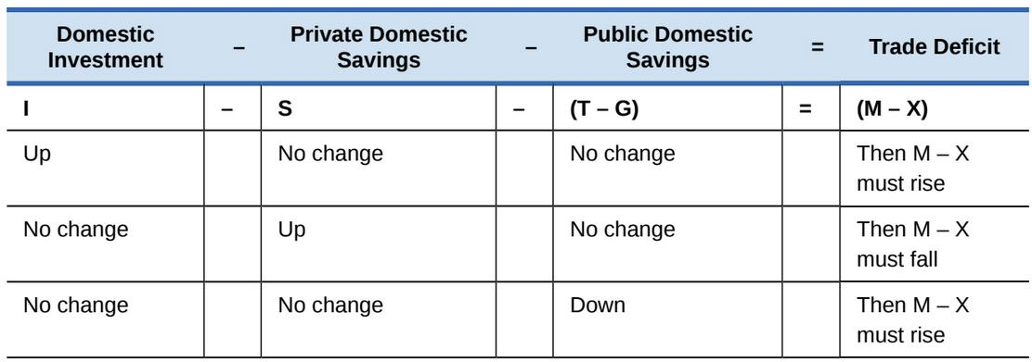
Exploring Trade Balances One Factor at a Time
The national saving and investment identity also provides a framework for thinking about what will cause trade deficits to rise or fall.
Domestic investment – Private domestic savings – Public domestic savings = Trade deficit
I – S – (T – G) = (M – X)

Slide 17
Short-Term Movements in the Business Cycle and the Trade Balance
In the short run, whether an economy is in a recession or on the upswing can affect trade imbalances.
A recession tends to make a trade deficit smaller, or a trade surplus larger.
While a period of strong economic growth tends to make a trade deficit larger, or a trade surplus smaller.
However, these are not hard-and-fast rules.

Slide 18
23.5 The Pros and Cons of Trade Deficits and Surpluses
For countries, there is no economic merit in a policy of abstaining from participation in financial capital markets.
It can make economic sense for a national economy to borrow from abroad, as long as it wisely invests the money in ways that will tend to raise the nation’s economic growth over time.
Examples: U.S. in mid-1800s and South Korea in 1970s.
A borrower nation can find itself in trouble if it does not invest the incoming funds from abroad in a way that leads to increased productivity.
Examples: Mexico, Brazil, and some African nations in the 1970s and 1980s.

Slide 19
23.6 The Difference between Level of Trade and the Trade Balance
A country’s level of trade tells how much of its production it exports.
Separate term than the balance of trade.
Measured as the percent of exports out of GDP.
Three factors strongly influence a nation’s level of trade:
the size of its economy,
its geographic location,
its history of trade.
Discussion Question: Do you think the following countries have a low or high level of trade?
Sweden
United States
Japan

Slide 20
Final Thoughts about Trade Balances
Trade deficits can be a good or a bad sign for an economy, and trade surpluses can be a good or a bad sign also.
Even a trade balance of zero - which just means that a nation is neither a net borrower nor lender in the international economy - can be either a good or bad sign.
The fundamental economic question is not whether a nation’s economy is borrowing or lending at all, but whether the particular borrowing or lending in the particular economic conditions of that country makes sense.

